Slide 1
Pollution
POLLUTION AND THEIR TYPES

Slide 2
What is pollution ?
Pollution is the introduction of substances or energy (such as light or heat) into the natural environment in amounts or concentrations that can be harmful for humans, animals, and plants.
Pollution can reduce the health of ecosystems by harming or even causing death to the living things that call those ecosystems home. The negative effects of pollution can range in severity depending on what the pollutant is, the characteristics of the pollutant, and where the pollutant is located.

Slide 3
What are some different types of pollution?
Water, air, and land pollution are three major categories of pollution. Sometimes pollution is easy to detect and is obvious to see, like an oil spill from a ship in the ocean. However, pollution can also be hard to see, like in the case of many types of air pollution. Specific pollutants can also contaminate more than one system at a time. For example, spilled chemicals may contaminate soil at the spill site (land pollution), and rain water may carry the chemicals and some of the contaminated soil into waterways (water pollution).

Slide 4
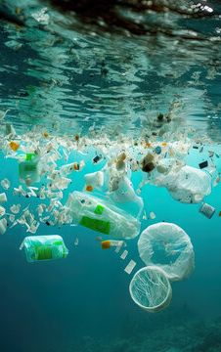
WHAT IS WATER POLLUTION ?
Water pollution is the release of substances into bodies of water that makes water unsafe for human use and disrupts aquatic ecosystems. Water pollution can be caused by a plethora of different contaminants, including toxic waste, petroleum, and disease-causing microorganisms.

Slide 5
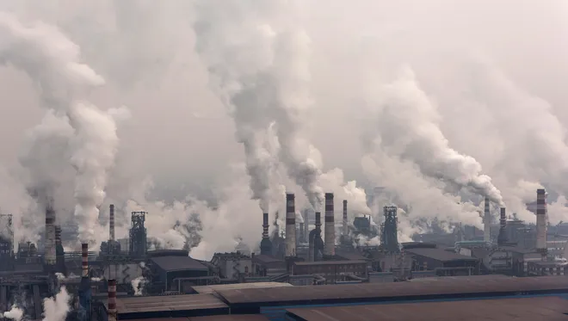
WHAT IS AIR POLLUTION ?
Air pollution is contamination of the indoor or outdoor environment by any chemical, physical or biological agent that modifies the natural characteristics of the atmosphere. Household combustion devices, motor vehicles, industrial facilities and forest fires are common sources of air pollution.

Slide 6
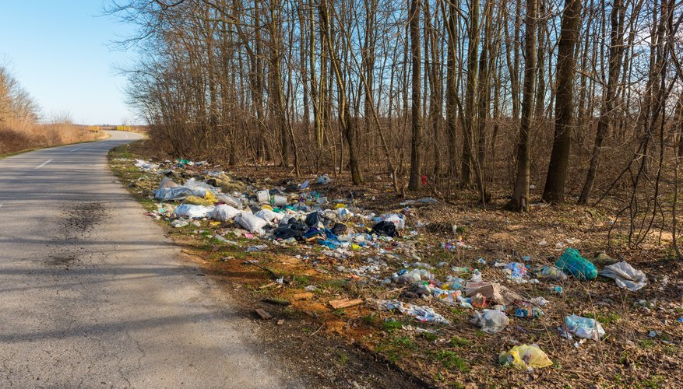
WHAT IS LAND POLLUTION ?
land pollution, the deposition of solid or liquid waste materials on land or underground in a manner that can contaminate the soil and groundwater, threaten public health, and cause unsightly conditions and nuisances.

