Slide 1
Real Estate Price Prediction
A Final Year Major Project Presentation
on
SUPERVISOR
Er. Ishwar Dhungana
Presented By:
Pravat Yadav - 17
Sanoj Raj Shrestha – 23
Shivani Karna - 24
Shreedhar Nyaupane - 25
Date:2078/08/20

Slide 2
Overview
Introduction
Objectives
Scope
Use Case Diagram
Methodology
Work completed
Work remaining
Some Visualizations
Challenges
Limitation
Reference

Slide 3
Introduction
A lot of time and research is necessary before buying a property like a permanent home. It is a huge investment and people want the best product for the best price.
This project aims to provide an objective price of a house provided parameters like the area of the land, number of rooms, room size, address of the house, etc.

Slide 4
Objectives
Develop a model which predicts the price of a residential house based on parameters like area, location, no. of rooms etc..
Deploy the model on a website.

Slide 5
Scope
Buyers can use the insights and predictions form the project as a reference when buying homes.
Sellers can use the model to determine the price of their house.

Slide 6
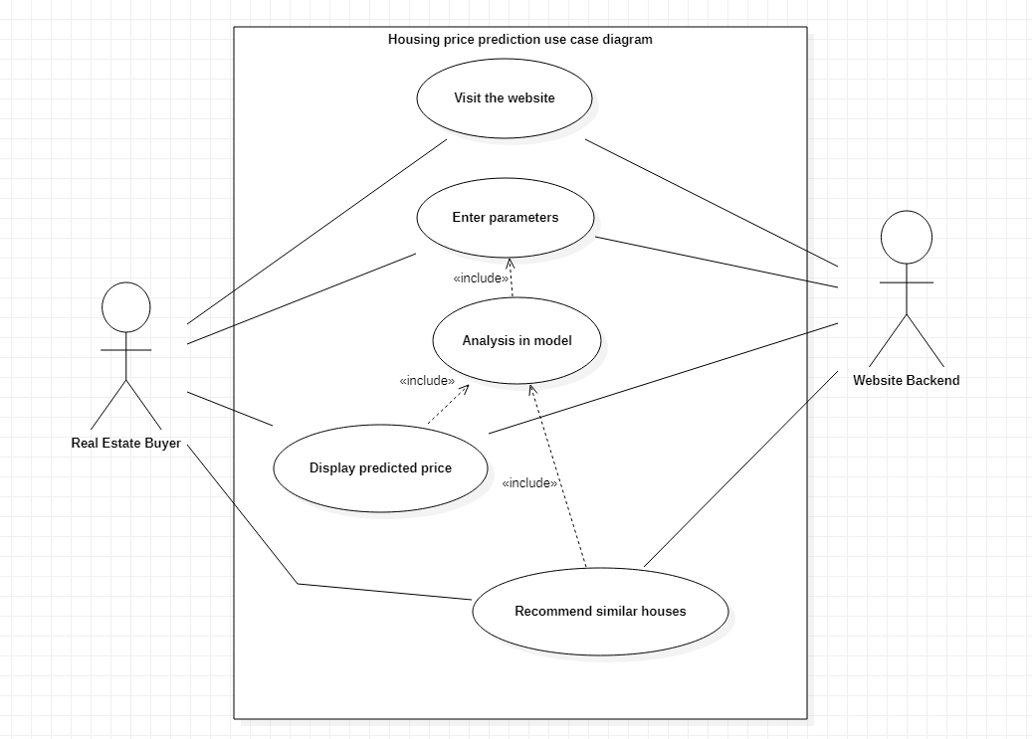
Use case

Slide 7
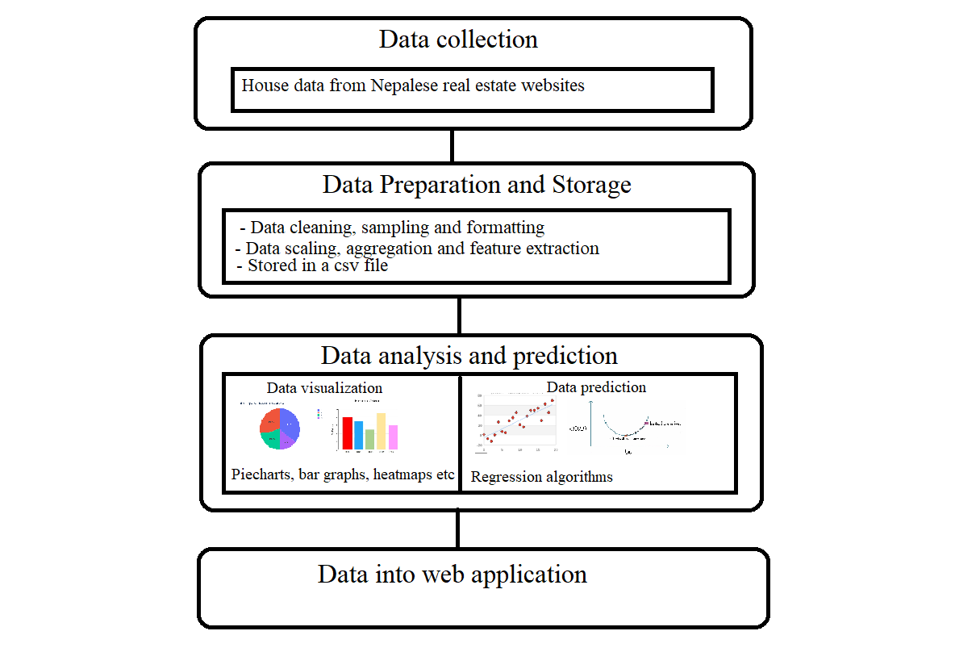
Methodology

Slide 8
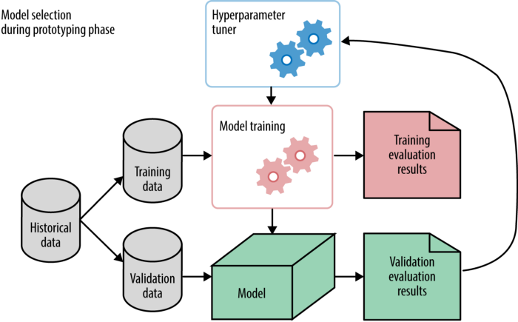
Data modelling

Slide 9
Work completed
Researched various Real Estate websites in Nepal .
Studied the tools required to scrape data which are Python, BS4 and Selenium.
Fetched data from three websites which are 99aana,1Ropani, Basobass using python and stored them in a csv file.
Learned about tools required to clean the data like Numpy, Pandas, Matplotlib etc.
Cleaned data from 99aana.

Slide 10
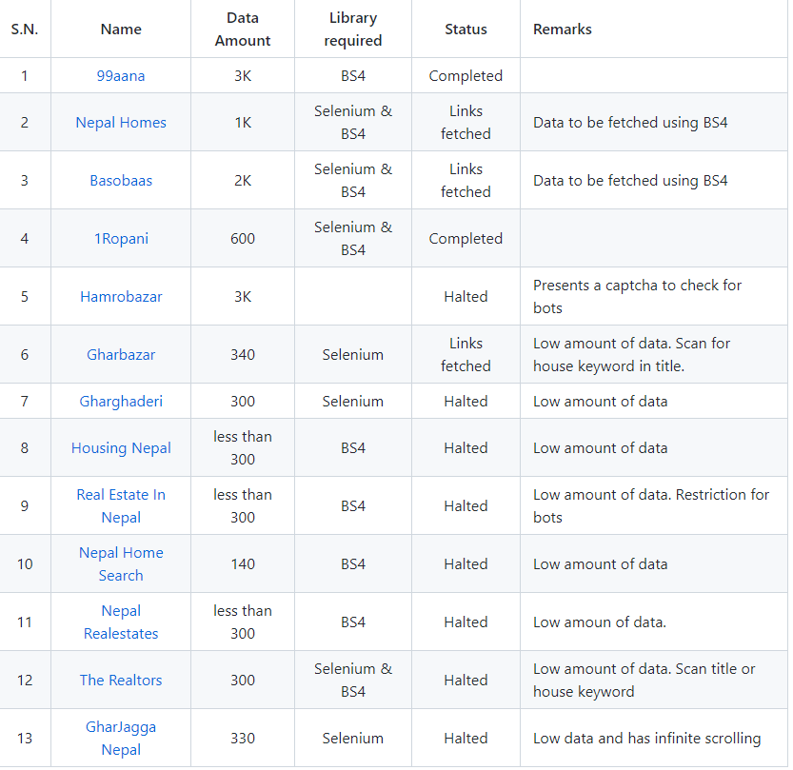

Slide 11
Work Remaining
Clean data from 1Ropani and Basobass.
Apply a proper regression algorithm for price prediction.
Deploy the model to a website.

Slide 12
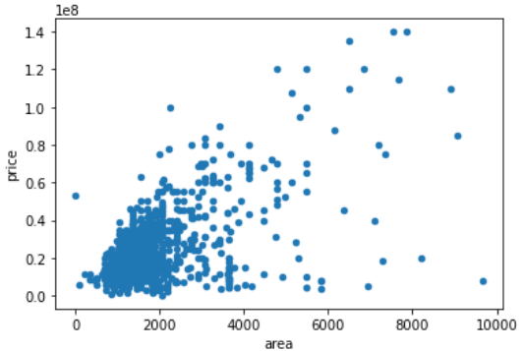
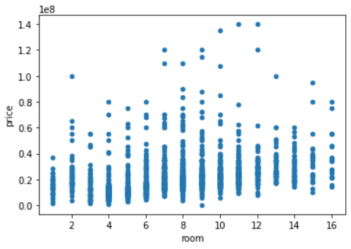
Some Visualizations

Slide 13
Challenges
Inconsistent data
Incomplete data
Too few parameters

Slide 14
References
1. C. R. Madhuri, G. Anuradha and M. V. Pujitha, "House Price Prediction Using Regression Techniques: A Comparative Study," 2019 International Conference on Smart Structures and Systems (ICSSS), 2019, pp. 1-5, doi: 10.1109/ICSSS.2019.8882834.
2. D. Banerjee and S. Dutta, "Predicting the housing price direction using machine learning techniques," 2017 IEEE International Conference on Power, Control, Signals and Instrumentation Engineering (ICPCSI), 2017, pp. 2998-3000, doi: 10.1109/ICPCSI.2017.8392275.
3. A. Varma, A. Sharma, S. Doshi and R. Nair, "House Price Prediction Using Machine Learning and Neural Networks," 2018 Second International Conference on Inventive Communication and Computational Technologies (ICICCT), 2018, pp. 1936-1939, doi: 10.1109/ICICCT.2018.8473231

Slide 15
THANK YOU!

