Slide 1
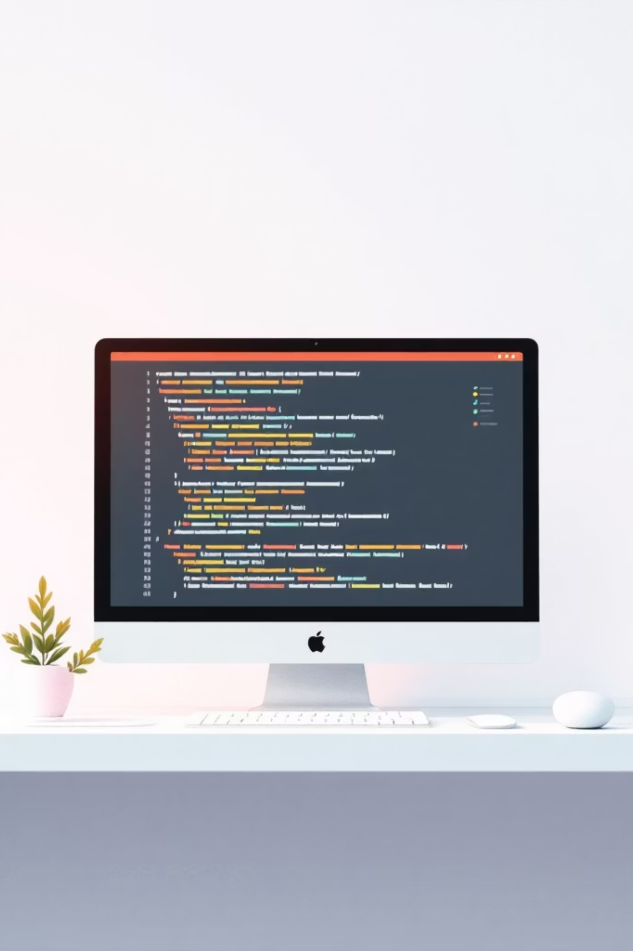



The Software Testing Life Cycle (STLC)
Manila Aryal
CSIT 5TH SEMESTER

Slide 2




Introduction: The Foundation of Quality Software
What is Software Testing?
The systematic process of evaluating software to identify defects and ensure it meets specified requirements before deployment.
Why is Testing Crucial?
Catches bugs early, saves costs, enhances user satisfaction, prevents reputational damage, and ensures secure, reliable performance.

Slide 3



Understanding the STLC: A Structured Approach
What is the Software Testing Life Cycle?
Purpose of STLC
Provides a clear framework for quality assurance
Detects defects early, reducing rework costs
Ensures all requirements are met
Delivers high-quality, defect-free products
A systematic process that outlines the sequence of activities performed during software testing. It ensures that testing is conducted methodically, from initial requirements to final closure.

Slide 4

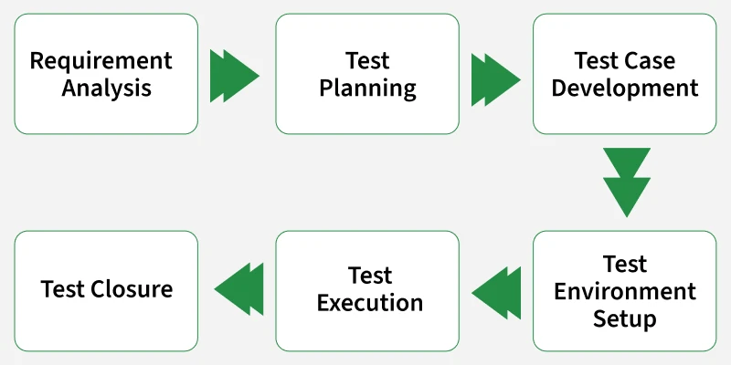






The Six Phases of STLC
Requirement Analysis
Test Planning
Test Case Development
Test Environment Setup
Test Execution
Test Cycle Closure

Slide 5


Phase 1 & 2: Laying the Groundwork
Requirement Analysis
Understanding and analysing software requirements (functional and non-functional). Identifying testable requirements, ambiguities, and potential risks. Clarifying doubts with stakeholders to ensure shared understanding.
1
Test Planning
Defining the overall testing strategy, scope, and approach. Identifying necessary resources, tools, and effort estimation. Establishing entry and exit criteria for each phase. Creating a detailed Test Plan document.
2

Slide 6


Phase 3 & 4: Preparing for Action
Test Case Development
Test Environment Setup
Designing detailed, step-by-step test cases based on analysed requirements
Creating test scripts and preparing necessary test data
Ensuring coverage of all identified requirements and scenarios
Configuring hardware, software, and network configurations required for testing
Ensuring the test environment accurately mimics production
Verifying tools and utilities are installed and functional

Slide 7




Phase 5: The Core of Testing
Test Execution
Result Comparison
Running prepared test cases systematically and identifying, documenting, and tracking defects found during execution.
Comparing actual results with expected results to identify discrepancies and ensure functionality meets specifications.
Testing Types
Performing various types of testing including functional, regression, performance, security, and usability testing.

Slide 8


Phase 6: Wrapping Up and Learning
Test Cycle Closure
01
Finalise Activities
Complete all testing activities for the current cycle
02
Analyse Results
Review test results and defect reports thoroughly
03
Document Learnings
Capture key metrics and recommendations for future cycles
04
Prepare Report
Create Test Closure Report for stakeholders

Slide 9
Testing Mechanisms Used in STLC
Manual Testing
Automation Testing
Black Box Testing
White Box Testing
Grey Box Testing

Slide 10

The Importance of a Structured STLC
Cost-Effectiveness
Improved Quality
Early defect detection in planning can cost as little as $100 to fix, compared to $10,000+ in production—a 100x difference in repair costs.
A systematic approach minimises the risk of missed defects, leading to more reliable, robust software that users can trust.
Efficiency
Predictability
Clear phases and deliverables streamline the testing process, reducing wasted effort and accelerating time-to-market.
Provides a measurable and repeatable workflow, allowing for better project management and resource allocation.

Slide 11

Conclusion
The Software Testing Life Cycle is not just a process; it’s commitment to quality.
By adhering to its structured phases, teams can proactively identify and resolve issues, ensuring the delivery of robust, user-friendly software.
A well-executed STLC transforms testing from a reactive task into a strategic asset, building confidence in every release and delivering value to end-users consistently.

Slide 12
THANK YOU!!!

