Slide 1
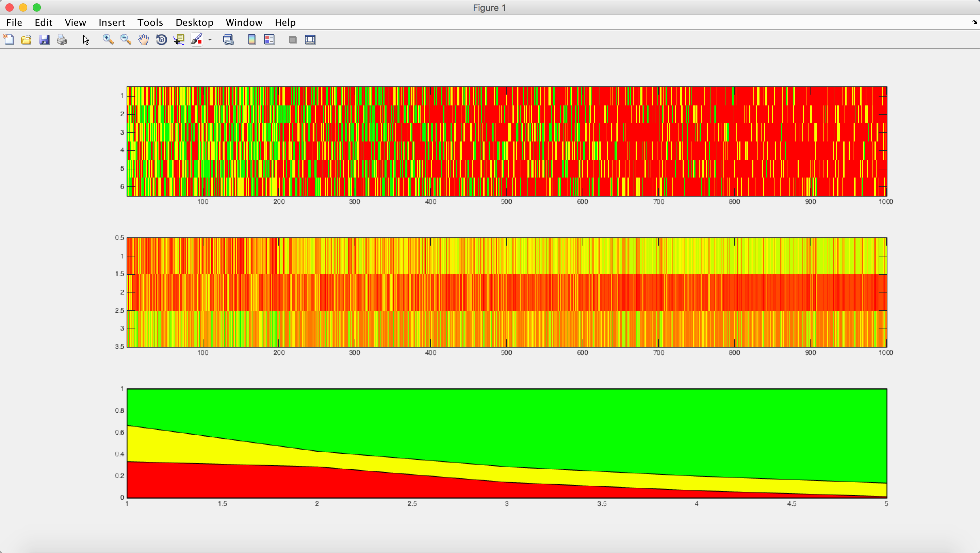
Exp1:
5 aspect follow the same trend
Trend is distribution of positive rating becoming less along with time

