Slide 1



Kathmandu University
FEATURES
CODE SEGMENTS
CODE FLOW
QUERIES
CONCLUSION
CONTD...
OBJECTIVE
INTRODUCTION
HISTORY
Presenter’s : Group D
Shishir Kafle
Harichandra Khatri
Saloon Gautam
Sanskar Karki

Slide 2

TELEPHONE DIRECTORY
It's a list of subscribers along with their contact information.
CODE SEGMENTS
INTRODUCTION
CODE FLOW
QUERIES
CONCLUSION
CONTD...
OBJECTIVE
FEATURES
Numbers can be easily access when needed.
HISTORY
We need not to recall the numbers.

Slide 3
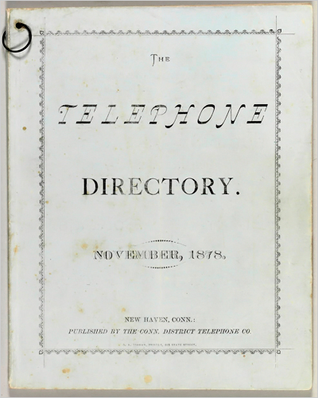

In February of 1878, it was discovered for the first time.
It was made up of single cardboard piece.
CODE SEGMENTS
INTRODUCTION
CODE FLOW
QUERIES
CONCLUSION
CONTD...
OBJECTIVE
FEATURES
It featured 50 phone numbers for people, corporations, and other offices.
HISTORY

Slide 4

To store contact details in a database.
To maintain track of contact information in a systematic way.
CODE SEGMENTS
INTRODUCTION
CODE FLOW
QUERIES
CONCLUSION
CONTD...
FEATURES
OBJECTIVE
HISTORY
Sorting a list of people's data in various ways.
Allowing users to search the database for contact information.

Slide 5

Append
Display
Delete
Save
Sort
Search
CODE SEGMENTS
INTRODUCTION
CODE FLOW
QUERIES
CONCLUSION
CONTD...
FEATURES
OBJECTIVE
HISTORY

Slide 6

IMPORTANT CODE SEGMENTS
APPEND function()
SEARCH function()
DELETE function()
SORT function()
CODE FLOW
CODE SEGMENTS
INTRODUCTION
QUERIES
CONCLUSION
CONTD...
FEATURES
OBJECTIVE
HISTORY

Slide 7


Main.c
phonebook.h
login.h
Records.txt
User_Input.txt
CODE SEGMENTS
INTRODUCTION
QUERIES
CODE FLOW
CONCLUSION
CONTD...
FEATURES
OBJECTIVE
HISTORY

Slide 8
Login.h
A new user is added to the phone directory, and an existing user logs in.
Phonebook.h
The database modification is tracked.
CODE SEGMENTS
INTRODUCTION
QUERIES
CODE FLOW
CONCLUSION
CONTD...
FEATURES
OBJECTIVE
HISTORY

Slide 9
Telephone Directory makes it easy for users to keep track of their contacts by allowing them to add, delete, and sort them, as well as update them if they make a mistake when listing them. All of the information is saved in a Database. More capabilities, such as the option to add multiple contacts of a same individual, could be added in the future.
CONCLUSION
INTRODUCTION
CODE SEGMENTS
QUERIES
CODE FLOW
CONTD...
FEATURES
OBJECTIVE
HISTORY

Slide 10

CODE SEGMENTS
INTRODUCTION
CODE FLOW
QUERIES
CONCLUSION
CONTD...
FEATURES
OBJECTIVE
HISTORY
ANY QUERIES

