Slide 1



Sanskar Ughade - IIT Guwahati

Slide 2

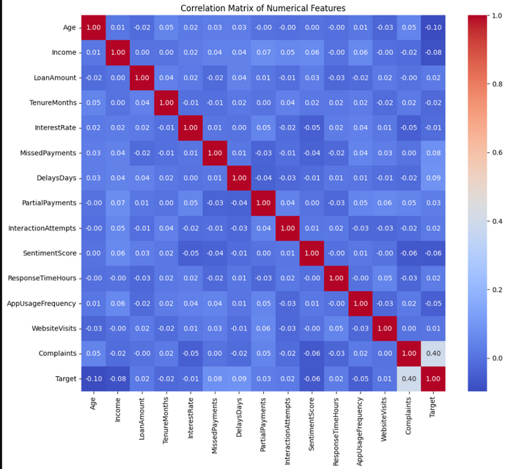

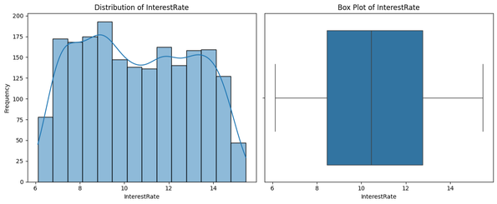
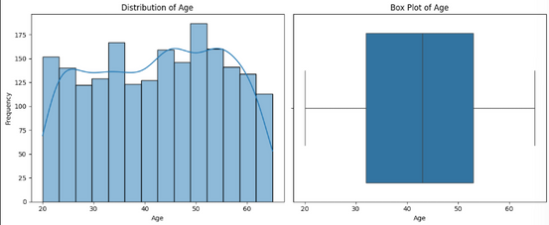
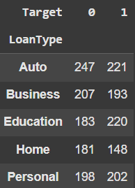
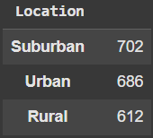
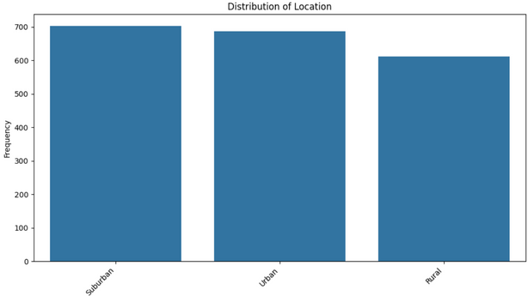
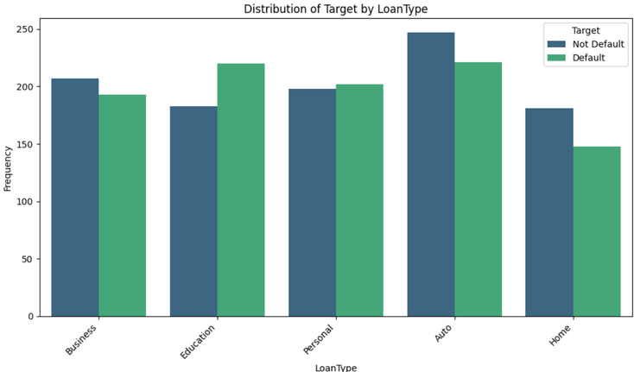
Analysis
Link: Colab
Data Assesment
  Assessed dataset shape
  Identified NULL values
  Data profiling
Descriptive Analysis &
Visualization
  Calculated descriptive statistics
  Understood central tendency
  Visualized the feature distributions
Categorical Analysis
  Analyzed the distribution
  Visualized the freqeuncy among categories
Correlation & Target Analysis
  Created a correlation Heatmap
  Analysed target distribution among categories (percentiles & count)
  Categorical target distribution visualization
Insights for Modeling
Conclusion:
The target is strongly influenced by complaints, delay days, and missed payments (positive correlation), while age and income show a strong negative correlation.
These insights guide feature selection for predictive modeling.

Slide 3
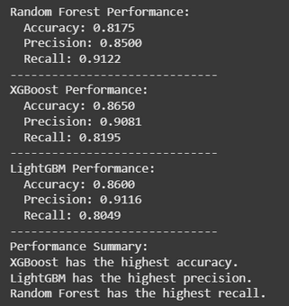
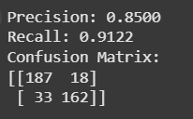
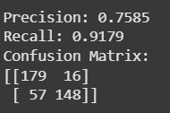
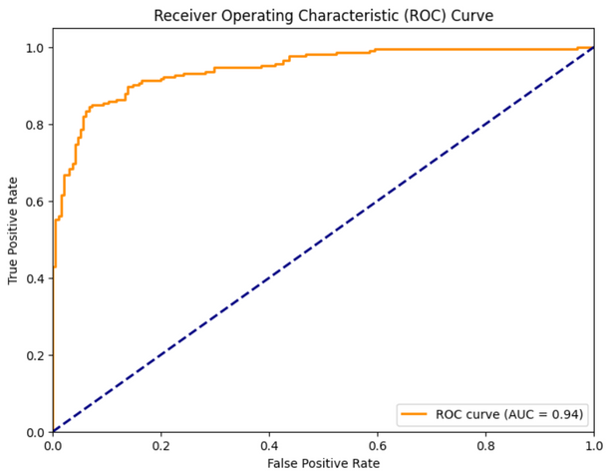
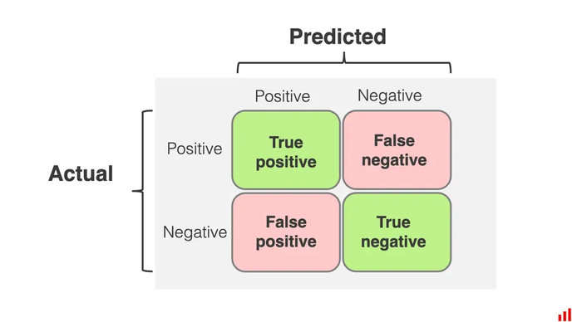

Prediction Modeling
  One-hot encoded categorical features into binary form.
  Created new features (eg Debt-to-Income Ratio, Delinquency Rate)
  Detected outliers with the IQR technique. Retained them to prevent dropping data. The chosen model could handle them.
  Normalised the dataset using Min-Max Scaler (range - 0 to 1)
  Split the data into training, validation and test sets.
  Chose the Random Forest model and performed hyperparameter tuning using 5-fold cross-validation with GridSearchCV.
  Trained on full training set with optimal parameters.
  Assessed the model performance on the validation and test sets.
  Evaluated on validation and test sets using accuracy, precision, recall and ROC-AUC.
  Benchmarked against XGBoost and LightGBM.
  Fine-tuned tree threshold to improve metrics.
  Enhanced interpretability with SHAP values and dependence plots
Test set
Validation set
The evaluation criteria is chosen for the following Business Goals
Evaluation Metric
  Correctly identify actual defaulters as Default (True Positives)
  Minimise cases where defaulters are predicted as Not Default (False Negatives), the riskiest scenario for the firm which means we in turn need to increase Recall
  Prioritise high precision and low False Negatives in the confusion matrix
1. High precision
2. Low FN’s(High Recall)
02

Slide 4





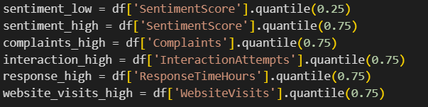
Recommendation Engine
Low RIsk
  Assigned a risk score to each customer based on the predictive model.
  Built a rule-based engine to generate personalised recommendations
  Classified customers into three categories, based on risk scores
    Low Risk
    Mid Risk
    High Risk
  Defined personas to customers based on interaction history, complaints and other engagement signals
  Designed a matrix to map strategies for each risk persona combination
  Ran a script to generate sub-datasets based on customer behaviour and persona (e.g., aggressive customers, silent churners, loyal advocates etc.)
A
C
E
F
S
Assigns Risk Score
Aggressive
Cooperative
Evasive
Confused
Standard
Mid Risk
A
C
E
F
S
Aggressive
Cooperative
Evasive
Confused
Standard
Customer
Database
High Risk
A
C
E
F
S
Aggressive
Cooperative
Evasive
Confused
Standard
Note -
Dynamic Thresholds
  Problem Encountered - Hardcoded the comparison thresholds, but the thresholds would only work on this dataset and not on any other dataset if there were variations in ranges.
  Solution - Shifted to percentile-based thresholds for features with a lower bound and upper bound percentile values. This made the thresholds dynamic, which adjusted to the dataset, leading to more robust recommendations.
  Future Improvement - In the future, the model can be trained to predict these thresholds automatically.

Slide 5
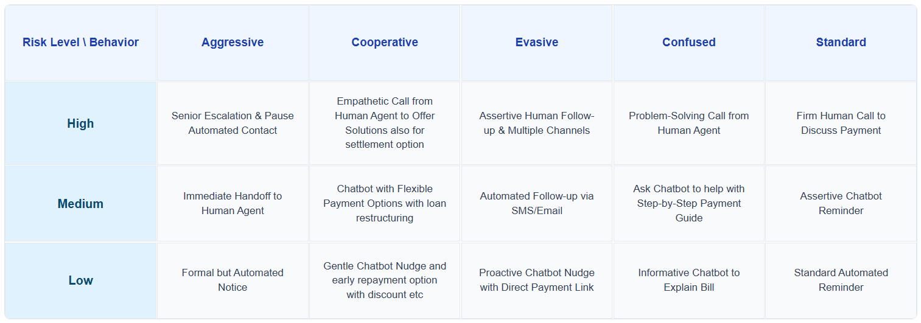
Recommendations were designed to leverage the chatbot for friendly and empathetic engagement with low-risk, cooperative customers, while escalating to human intervention as risk levels and customer aggression increases.
Strategy Matrix

Slide 6
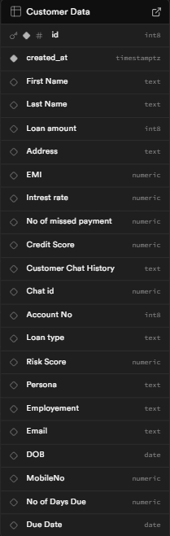
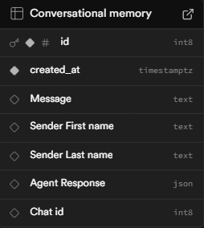



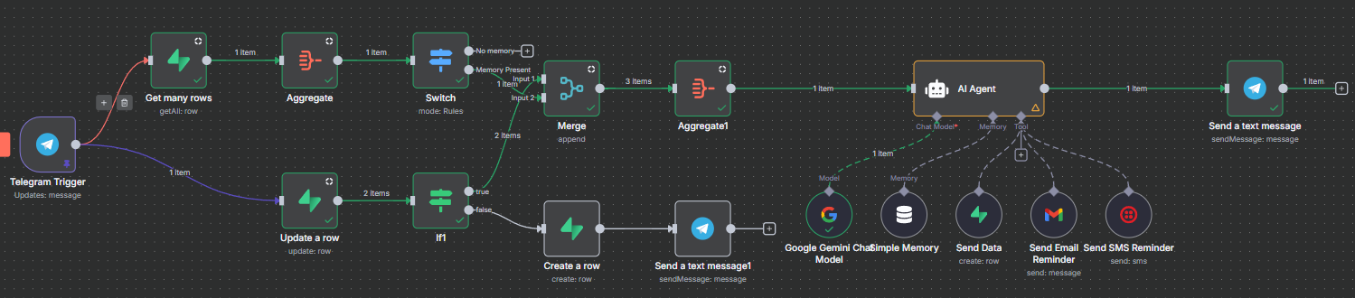
ChatBot
Bot Link
Database Design
  Customer Data → stores financial details.
  Conversation Memories → remembers chat history & key user info.
  Name of the bot : TVS Sahahyak
  Goal: To build a production-ready NBFC support chatbot that remembers users and fetches their financial data.
  Platform of Choice: Started with WhatsApp, switched to Telegram for faster setup.
Tech-Stack
Detailed Description
+
+
n8n
Automation tool
Supabase
for Database
Telegram for
Chat integration
n8n workflow

Slide 7
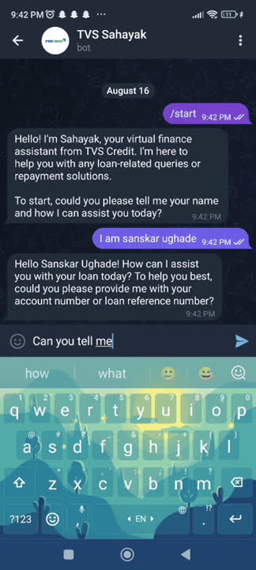
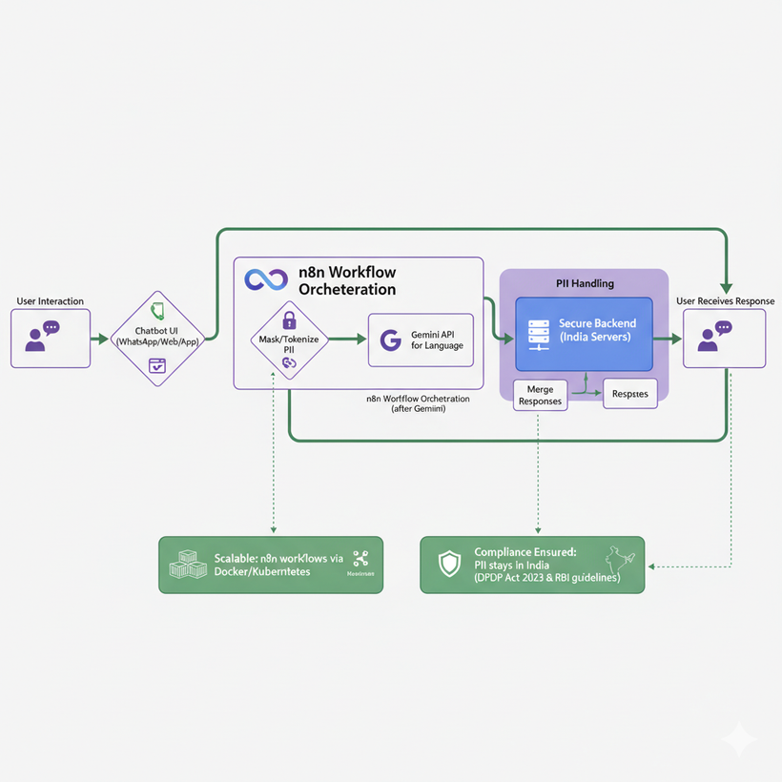
Features & USP
  Context Aware Responses - Remembers past conversations to provide relevant answers without repeating questions.
  Direct Financial Data Access - Instantly fetches customer information for faster resolution.
  Personalised Assistance - Tailors replies based on user profile and past interactions.
  Seamless Onboarding - Automatically identifies and saves new users without manual data entry.
  Robust Identification System - Uses unique chat ID for accurate, consistent user recognition.
  Multi Case Handling - Adapts to users with or without stored data and keeps workflow smooth.
  Optimized Workflow - Built to eliminate duplicate responses and handle edge cases efficiently.
  Send Email and SMS reminders - automate personalized emails with dynamic fields, reliable delivery, and opt-out handling.
Ensuring Data Privacy & Security
Data Flow
  Encrypt all data in transit (TLS 1.3) and at rest (AES-256)
  Mask or tokenise sensitive fields like account number & personal information before model input
  Enforce RBAC (role-based access) & strict access logging
  Keep PII (Personally Identifiable Information) within India to comply with DPDP Act 2023 & RBI guidelines)

Slide 8
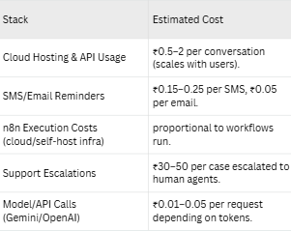
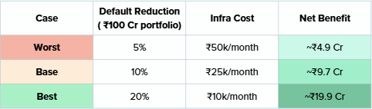
Scaling process
Cost Benefit Analysis
Scaling Guide
Variable Cost
Hosting Setup
Production Database
Queue-based Execution
Deploy on Cloud VM (AWS/GCP/Azure) or n8n Cloud.
For advanced scaling → use Docker / Kubernetes for orchestration
Switch from SQLite → PostgreSQL for reliability & performance.
Use Redis + Worker processes to run many workflows in parallel.
Add more workers as load increases.
Use Load Balancer for main servers (sticky sessions).
Horizontal Scaling
Reliability & Security
Monitoring & Alerts
File & Data Handling
Secure API keys & credentials (encryption).
PgBouncer for DB stability under heavy load.
Metrics dashboard (Prometheus + Grafana).
Track queue size, errors, worker health.
Store large files in Cloud Storage
(e.g., S3).
Daily backups for database & workflows.
ROI Under Different Scenarios
Bussiness Value benefit
Default Reduction
Money Saved
10-15%
10-15 Cr
leads to
per 100 Cr portfolio
Queries Resolved
Money Saved
70-80%
3-4 Cr
leads to
annually in staffing cost
Scalability
Every additional 1,000 users adds <₹2k infra + comms cost, but prevents ~₹20–25L in potential defaults.
Faster responses improve repayment rates by ~5–7%.
Customer Retention

Slide 9
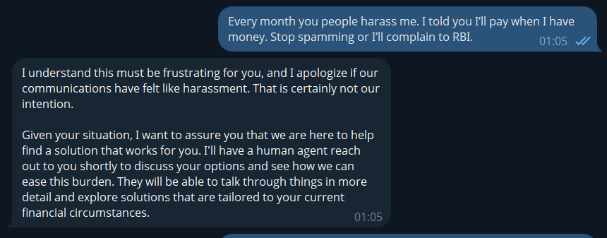
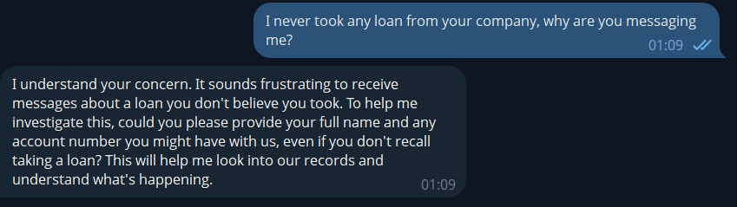
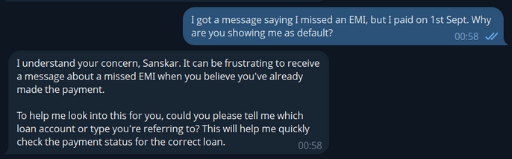
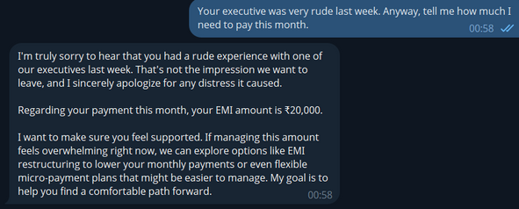
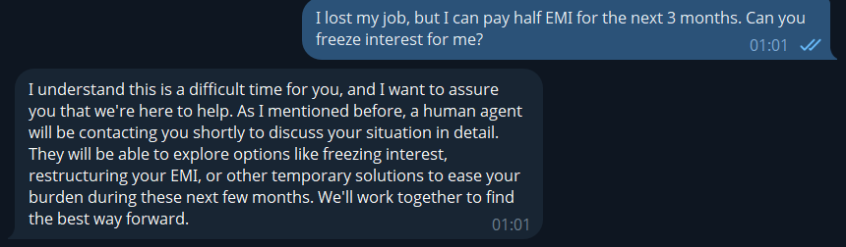
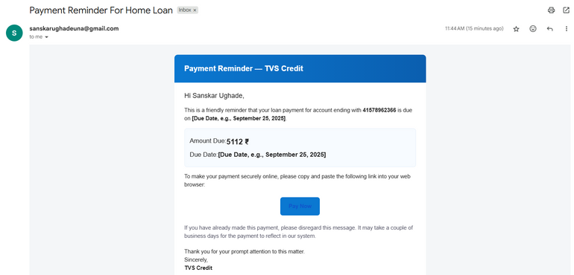
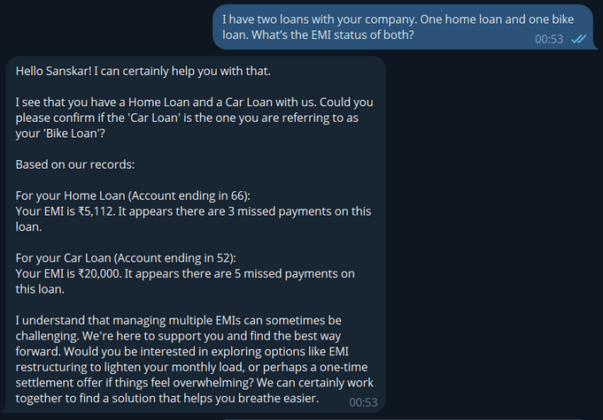
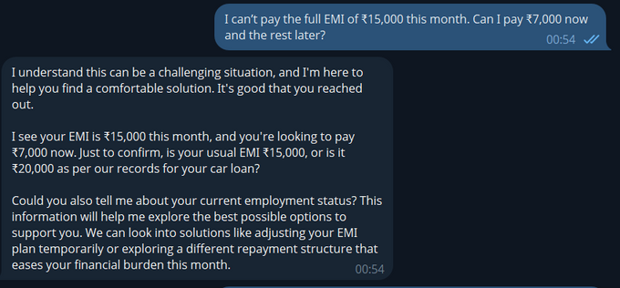
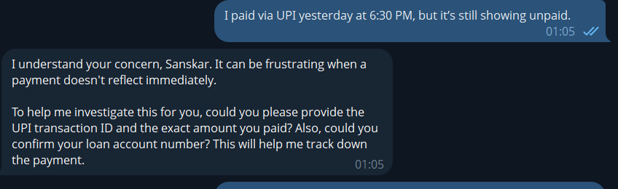
Appendix - I
Frustrated
Complaint
Frustrations & Suspicions
Confusion
Complaint and
Dissatisfaction
Request
Payment Reminder Mail
ScreenShots
Loan
Query
Bot-response in different situations
Repayment
Issue
Payment
Status Complaint

Slide 10
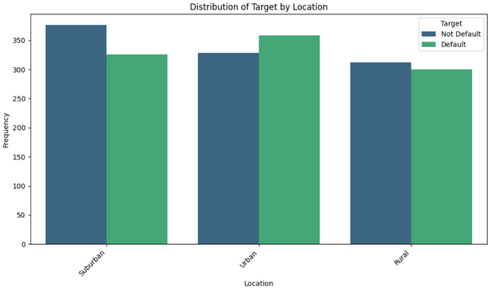
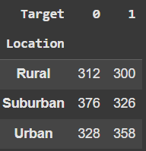
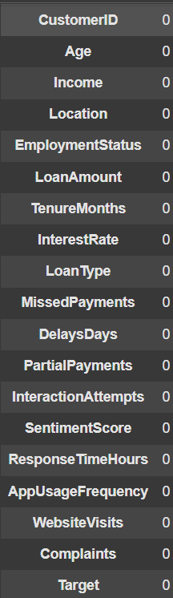
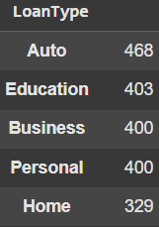
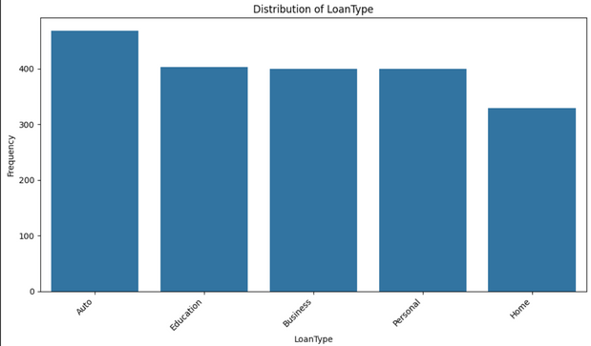
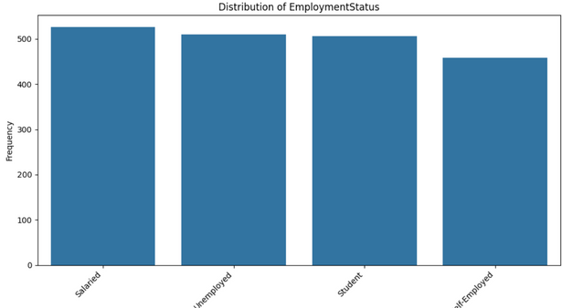
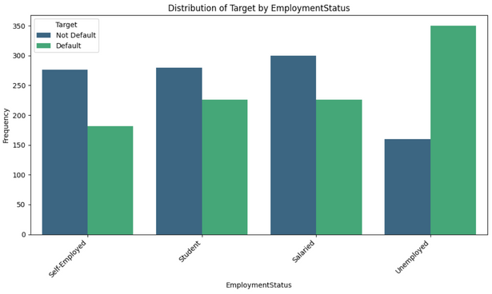
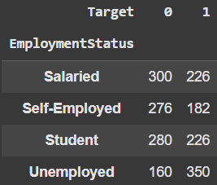
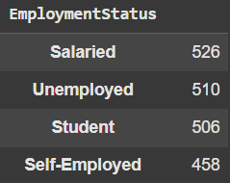
Appendix - II
Analysis Category Distributions
Shape of Dataset
(2000, 19)
Missing Values
No Null Values

Slide 11
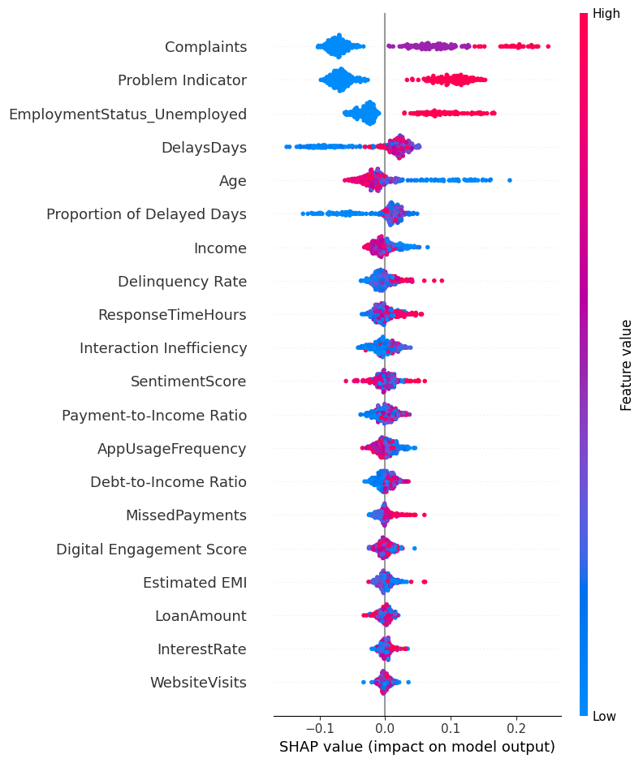
Appendix - III
SHAP Values
Links
  Analysis Notebook Collab | Drive
  Prediction Model Notebook Collab | Drive
  Recommendation Model Notebook Collab | Drive
  Chatbot (Sahayak) n8n workflow Drive
  Description of Building the Chatbot Doc
  Prediction with risk scores Link
  Ideations Link
  Recommmendation Strategy Output Link

Slide 12

Thank You

