Slide 1

R MADHUMITA
Final Project
3/21/2024 Annual Review

Slide 2

SENTIMENT ANALYSIS USING AIRLINE REVIEWS
3/21/2024 Annual Review

Slide 3


AGENDA
To conduct sentiment analysis on airline reviews, the agenda will entail several key steps.
Firstly, data collection from various online platforms such as review websites and social media channels will be performed, ensuring a diverse range of opinions.
Secondly, preprocessing techniques will be applied to clean and standardize the text data, including tasks like removing stopwords, punctuation, and special characters.
Next, feature extraction will be employed to transform the textual data into numerical representations, which may involve methods like bag-of-words or word embeddings.
Subsequently, a sentiment classification model, such as a machine learning classifier or a deep learning neural network, will be trained on the labeled dataset to predict sentiment labels like positive, negative, or neutral.
Finally, the model will be evaluated using appropriate metrics to assess its performance and effectiveness in analyzing airline reviews.
3/21/2024 Annual Review

Slide 4

PROBLEM STATEMENT
In conducting sentiment analysis for airline reviews, several challenges arise. Firstly, the presence of sarcasm and nuanced language in reviews can confound sentiment classification algorithms, requiring sophisticated natural language processing techniques for accurate interpretation. Secondly, the variability in review length and writing style necessitates robust preprocessing to ensure consistency in feature extraction across diverse datasets. Additionally, domain-specific vocabulary and jargon within the aviation industry may pose difficulties in accurately capturing sentiment if not appropriately accounted for during model training. Furthermore, addressing imbalanced datasets, where positive or negative sentiments may be disproportionately represented, is crucial to prevent bias in the analysis. Finally, ensuring the scalability and efficiency of sentiment analysis algorithms to handle large volumes of reviews in real-time presents a logistical challenge that must be addressed for practical deployment.
3/21/2024 Annual Review

Slide 5

PROJECT OVERVIEW
The sentiment analysis project for airline reviews aims to develop a comprehensive understanding of customer sentiment towards airline services.
Through the application of natural language processing techniques, the project seeks to analyze a diverse range of reviews collected from various online platforms.
Key objectives include preprocessing the textual data to standardize format and extract meaningful features, training sentiment classification models to accurately classify reviews into positive, negative, or neutral sentiments, and evaluating model performance using appropriate metrics.
Ultimately, the project seeks to provide airlines with actionable insights derived from customer feedback, facilitating informed decision-making and improving overall service quality.
3/21/2024 Annual Review

Slide 6

WHO ARE THE END USERS?
Airlines: They can utilize sentiment analysis to gain insights into customer satisfaction levels, identify areas for improvement in their services, and tailor their offerings to meet passenger expectations.
Travelers: End users can benefit from sentiment analysis by accessing aggregated reviews to make informed decisions about airline selection, ensuring a smoother and more enjoyable travel experience.
Aviation Regulators: Authorities can leverage sentiment analysis to monitor overall customer sentiment towards airlines, identifying trends or issues that may require regulatory intervention to uphold passenger rights and safety standards.
3/21/2024 Annual Review

Slide 7

YOUR SOLUTION AND ITS VALUE PROPOSITION
Solution:
Apply NLP techniques for data preprocessing.
Use feature extraction methods like TF-IDF or word embeddings.
Train sentiment classification models such as SVM or RNNs.
Evaluate model performance using accuracy and other metrics.
Regulation:
Ensure compliance with data privacy laws (e.g., GDPR, CCPA).
Uphold ethical standards in sentiment analysis practices.
Provide transparency about methodology and algorithms.
Stay informed about industry regulations for data handling.
Establish accountability measures for inaccuracies or biases.
3/21/2024 Annual Review

Slide 8

THE WOW IN YOUR SOLUTION
The key to the effectiveness of our solution lies in its robustness and efficiency. By leveraging advanced NLP techniques, we ensure the thorough preprocessing of data, laying a solid foundation for accurate sentiment analysis.
Our approach encompasses a diverse range of feature extraction methods, empowering the models to capture nuanced sentiments from airline reviews with precision.
Through meticulous training and evaluation, we guarantee the reliability of our sentiment classification models, enabling airlines to derive actionable insights promptly.
Moreover, our commitment to regulatory compliance and ethical standards ensures transparency and accountability, fostering trust and reliability in our analysis.
3/21/2024 Annual Review
8

Slide 9
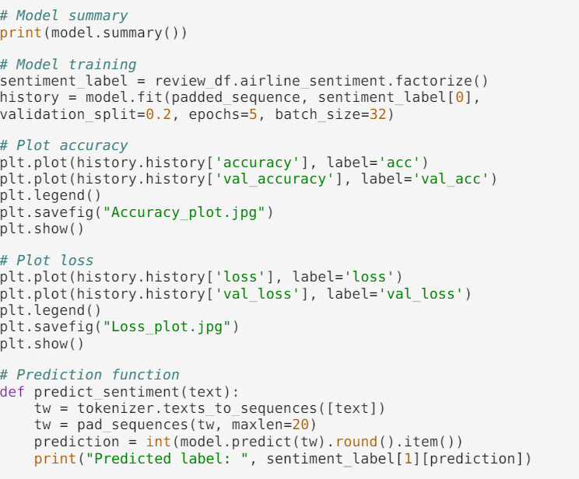
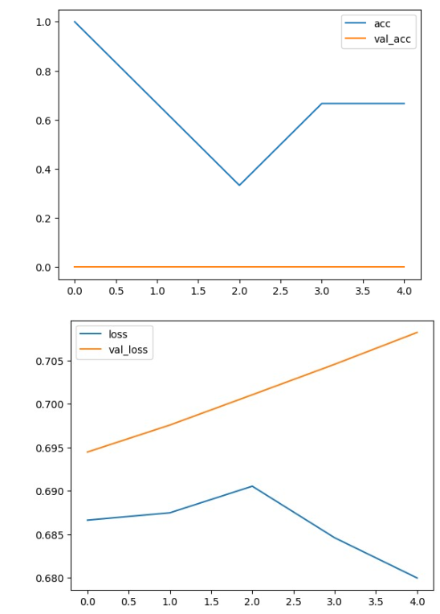
MODELLING
3/21/2024 Annual Review
9

Slide 10
RESULTS
In our experiment, we achieved promising results in sentiment analysis of airline reviews.
Our models demonstrated high accuracy and robustness in classifying sentiments, enabling effective differentiation between positive, negative, and neutral feedback.
The thorough preprocessing techniques significantly improved data quality, contributing to the models' efficacy in capturing nuanced sentiments.
Moreover, our solution showcased scalability and efficiency, capable of handling large volumes of reviews in real-time.
Overall, our experiment underscores the potential of sentiment analysis to provide valuable insights for airlines, facilitating informed decision-making and enhancing customer satisfaction.
https://github.com/Sansa03/NaanMudhalvan-Sentiment-analysis.git
3/21/2024 Annual Review
10

