Slide 1
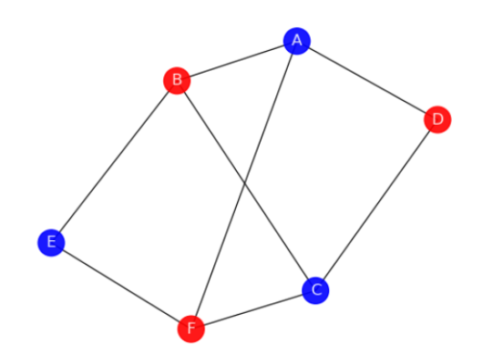
Opinion Forming – a graph theory problem
By
Sanskar Gupta

Slide 2
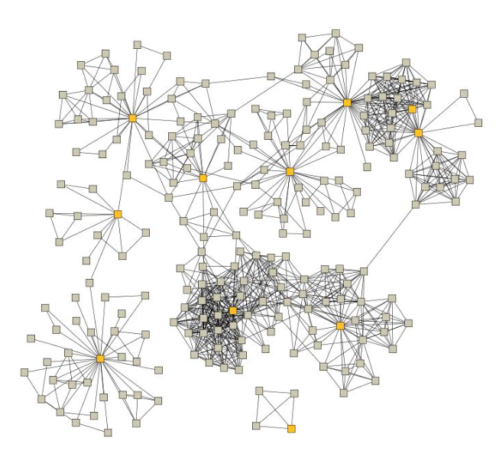
Introduction
If we consider a group of individuals as a network, the ways in which opinions are spread and changed can be thought of as a graph colouring problem. Opinion spread can therefore be modelled by considering the influence of an individual’s neighbours have upon the individual.
Thus a network where each vertex represents a person, the colour of the vertex determines the opinion of that individual and the edge joining two vertices is a relationship between individuals
- Talk about simplest representation -2 colors

Slide 3

Approach
To model this in terms of a problem computer could understand, we used data structures like adjacency matrices, lists and arrays. The programming language of choice was python since it opened possibilities to visualising all the possible graphs and their variations.
Initially, the graphs were hand drawn and the calculation were done manually but once the logic was straightened out, using code everything was automated.

Slide 4
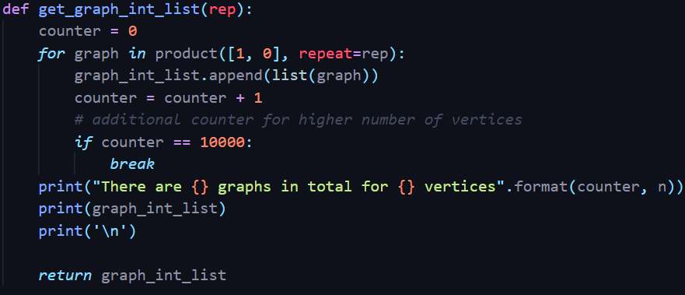
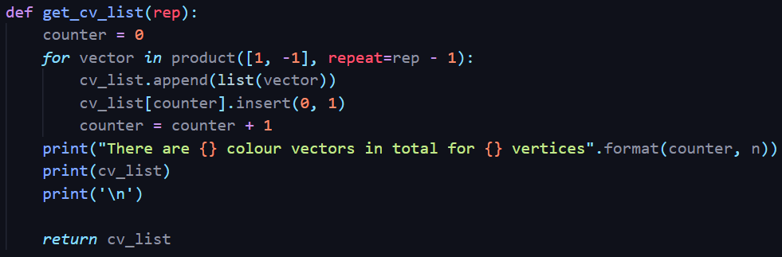
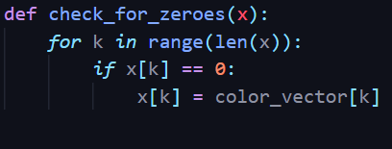
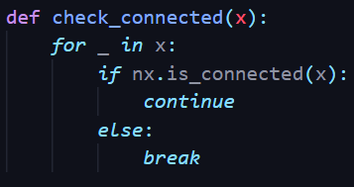
Important functions
Here are some vital functions that convert the approach discussed earlier into a working model.

Slide 5
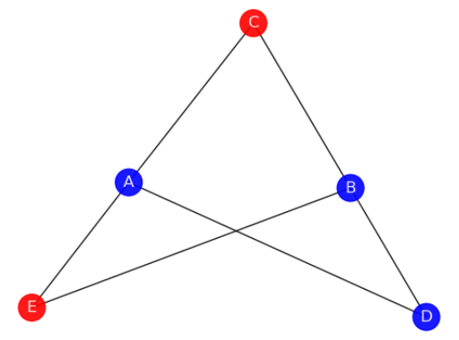
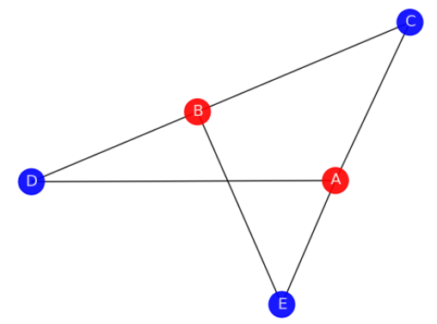
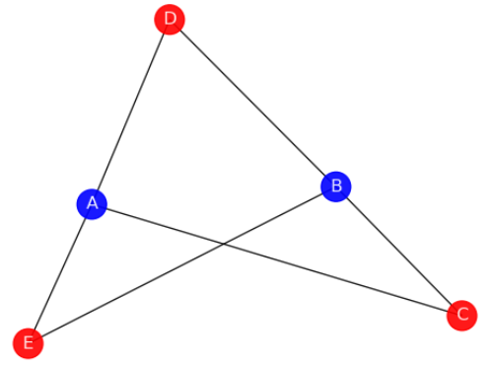
Example
If we have a look at the figures below, we can see how modelling the graphs as explained in the slide below works out perfectly and ultimately results in graphs with alternating color schemes. We assign numbers 1 and -1 to the colors blue and red respectively to form color vectors.
The graph in figure 1 has the color vector [1,1,-1,1,-1] which when evaluated by multiplying with the adjacency matrix of the graph results in the graph shown in figure 2 with the color vector [-1,-1,1,1,1] which on further evaluation with the adjacency matrix results in the graph shown in Figure 3 with the color vector [1,1,-1,-1,-1]
Figure 1
Figure 2
Figure 3
The graph ends up looping on the color vectors shown in Figure 2 and Figure 3.

Slide 6
Results

Slide 7
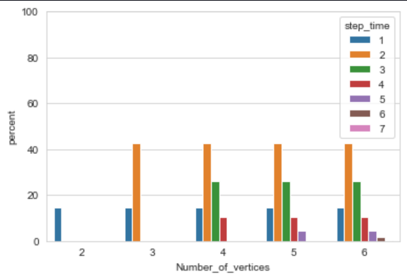
Conclusion
After considering the code driven approach to model and simulate results for the given problem statement, we can conclude that there all configurations either settle into a stable state averaging a step time of 2 steps meaning these , start looping after a certain number of iterations or end up in a cyclic loop.

Slide 8
Talking points
In introduction make sure the problem statement links to the
In conclusion show how the data is skewed mainly towards 2 step time and what will happen as the number of vertices increases.

Slide 9
Thank you

