Slide 1
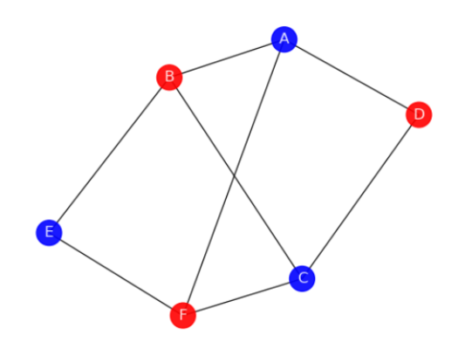
Opinion Forming – a graph theory problem
By
Sanskar Gupta

Slide 2
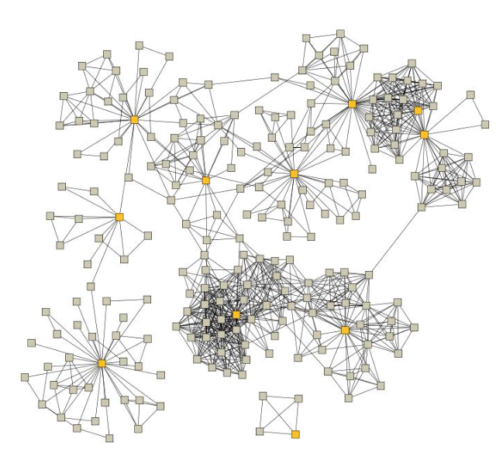
Introduction
If we consider a group of individuals as a network, the ways in which opinions are spread and changed can be thought of as a graph colouring problem. Opinion spread can therefore be modelled by considering the influence of an individual’s neighbours have upon the individual.
Thus a network where each vertex represents a person, the colour of the vertex determines the opinion of that individual and the edge joining two vertices is a relationship between individuals
- Talk about simplest representation -2 colors

Slide 3
Approach
To model this in terms of a problem computer could understand, we used data structures like adjacency matrices, lists and arrays. The programming language of choice was python since it opened possibilities to visualising all the

Slide 4
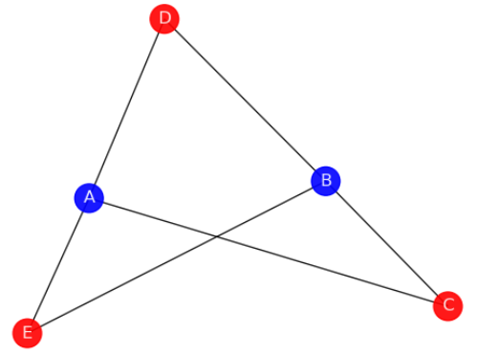
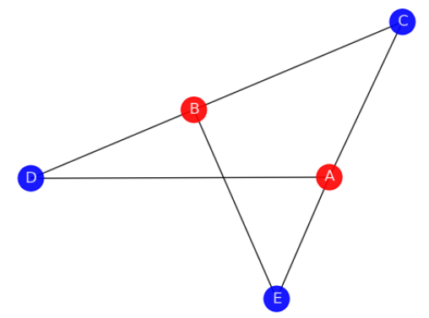
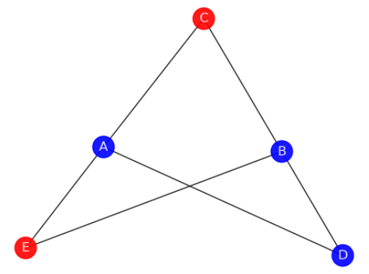
Example

Slide 5
Results

Slide 6
Conclusion

Slide 7
Thank you

