Slide 1
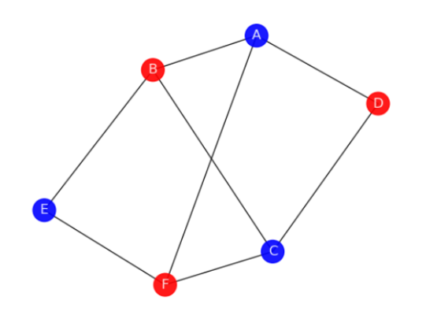
Opinion Forming – a graph theory problem
By
Sanskar Gupta

Slide 2
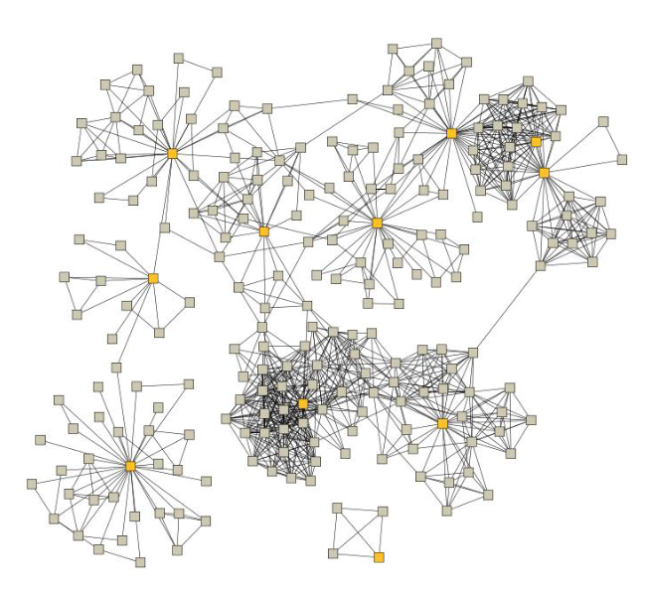
Introduction
If we consider a group of individuals as a network, the ways in which opinions are spread and changed can be thought of as a graph colouring problem. Opinion spread can therefore be modelled by considering the influence of an individual’s neighbours have upon the individual.
Thus opinion forming can be modelled using a network where each vertex represents a person, the colour of the vertex determines the opinion of that individual and the edge joining two vertices is a relationship between individuals.
- Talk about simplest representation -2 colors

Slide 3

Approach
To model this in terms of a problem computer could understand, we used data structures like adjacency matrices, lists and arrays. The programming language of choice was python since it opened possibilities to visualising all the possible graphs and their variations
Initially, the graphs were hand drawn and the calculation were done manually but once the logic was worked out, using various functions everything was automated. The python file produces various insights on this problem just by taking the number of vertices for the graph as an input.

Slide 4
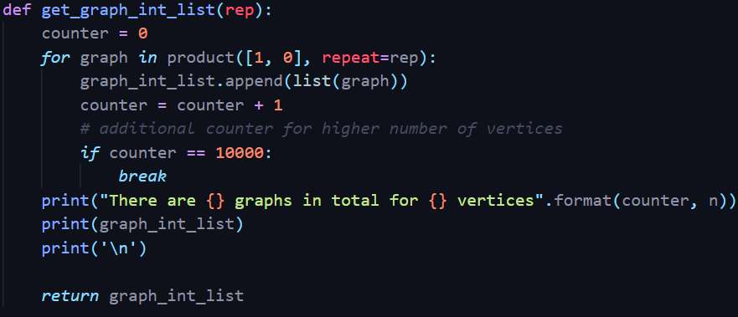
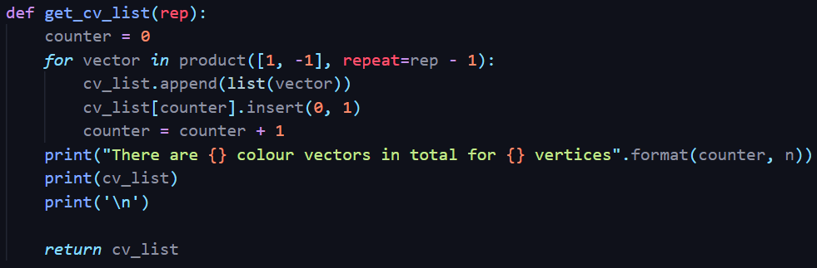
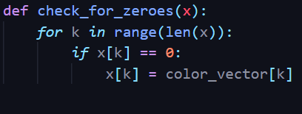
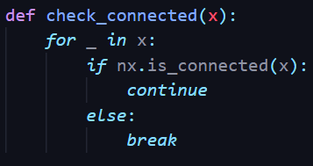
Important functions
Here are some vital functions that convert the approach discussed earlier into a working model.

Slide 5
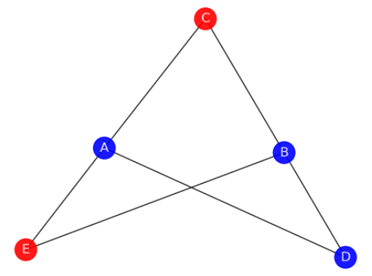
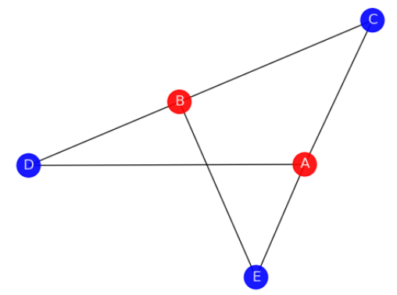
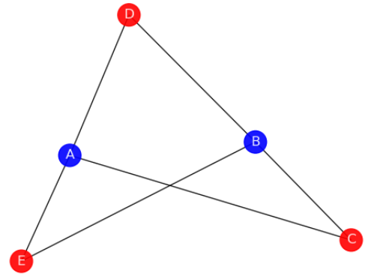
Example
If we have a look at the figures below, we can see how modelling the graphs as explained in the slide below works out perfectly and ultimately results in graphs with alternating color schemes. We assign numbers 1 and -1 to the colors blue and red respectively to form color vectors.
The graph in figure 1 has the color vector [1,1,-1,1,-1] which when evaluated by multiplying with the adjacency matrix of the graph results in the graph shown in figure 2 with the color vector [-1,-1,1,1,1] which on further evaluation with the adjacency matrix results in the graph shown in Figure 3 with the color vector [1,1,-1,-1,-1]
Figure 1
Figure 2
Figure 3
The graph ends up looping on the color vectors shown in Figure 2 and Figure 3.

Slide 6
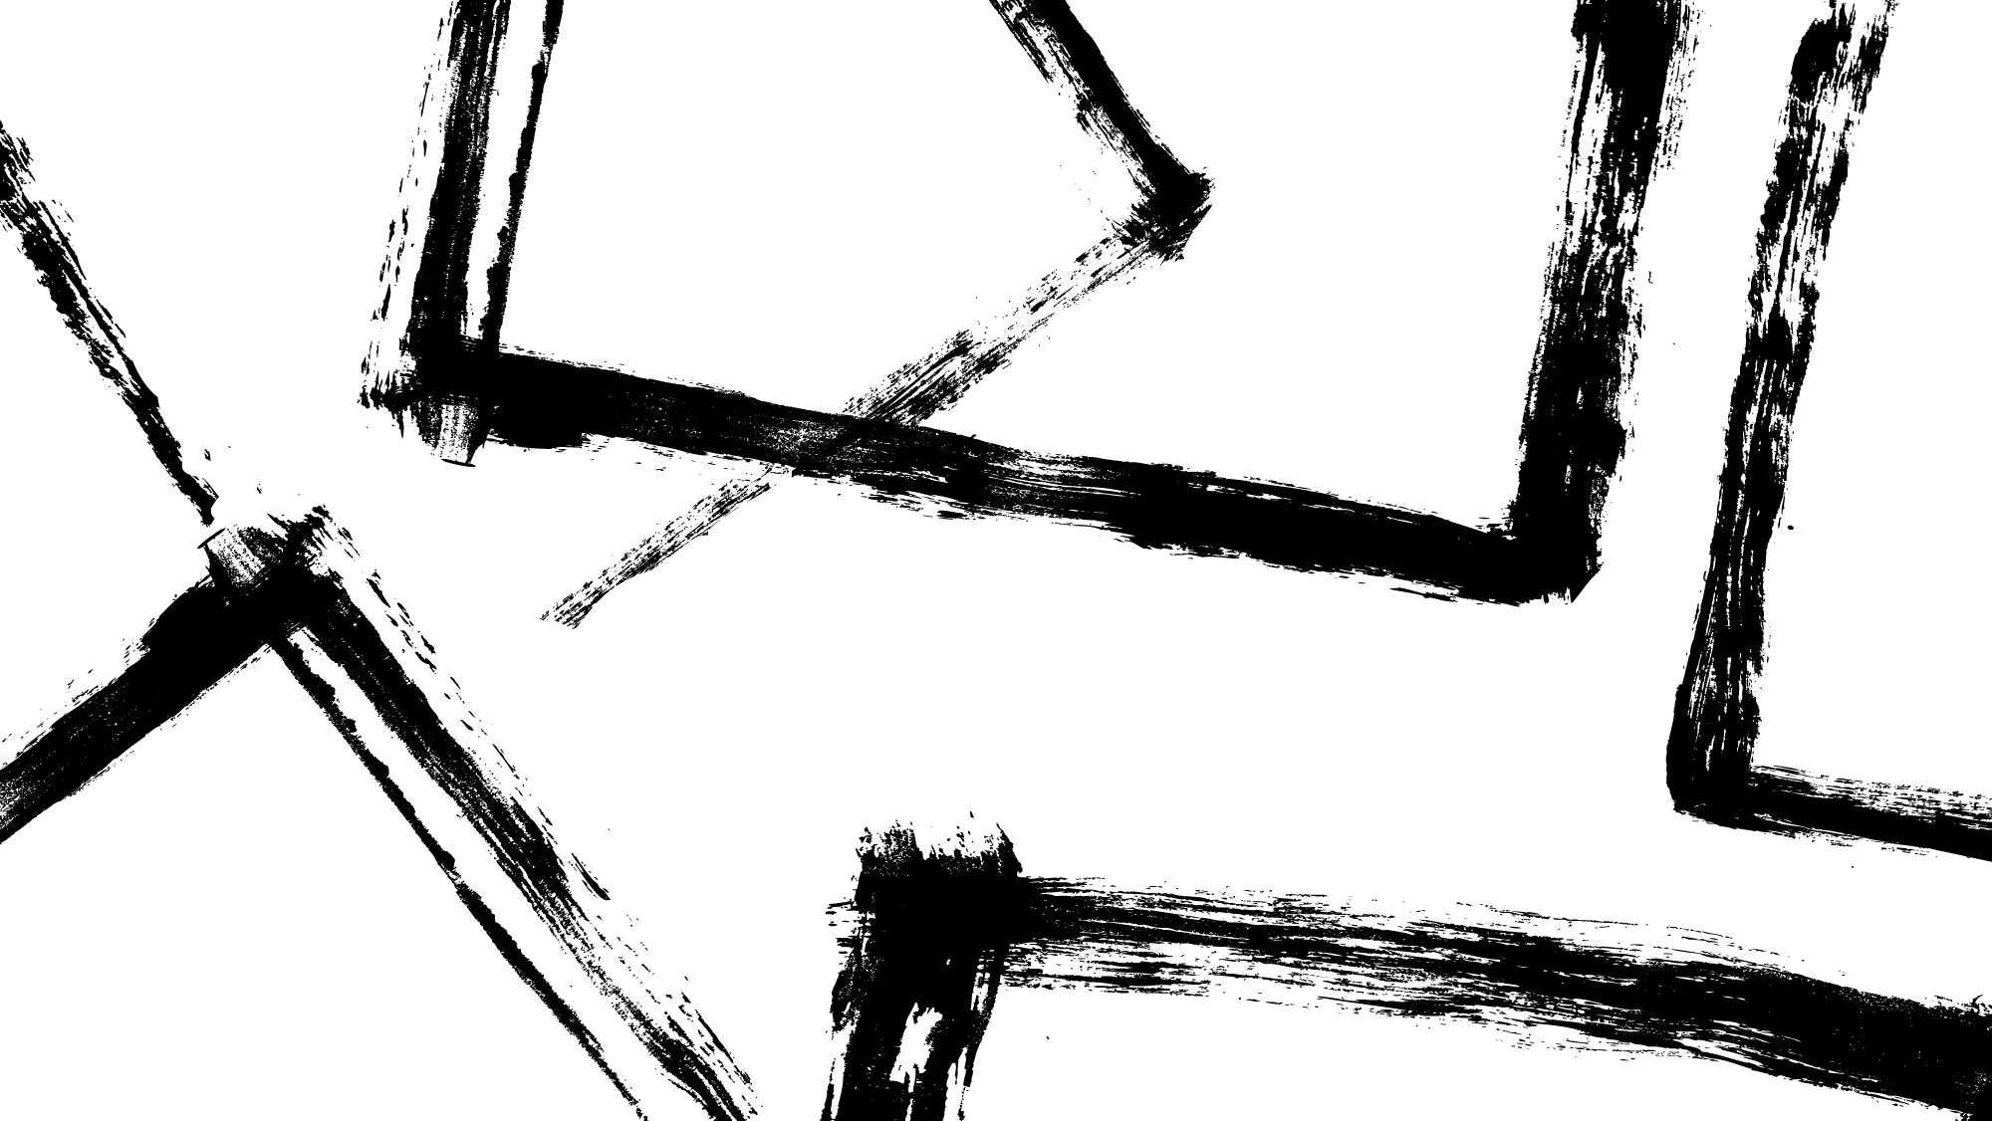
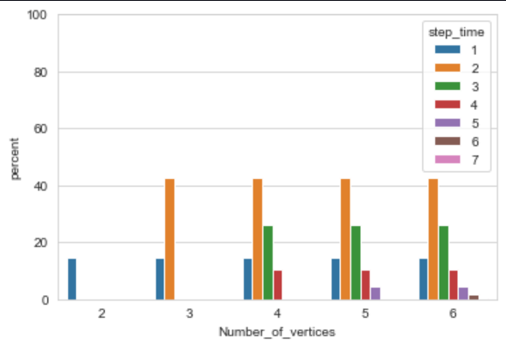
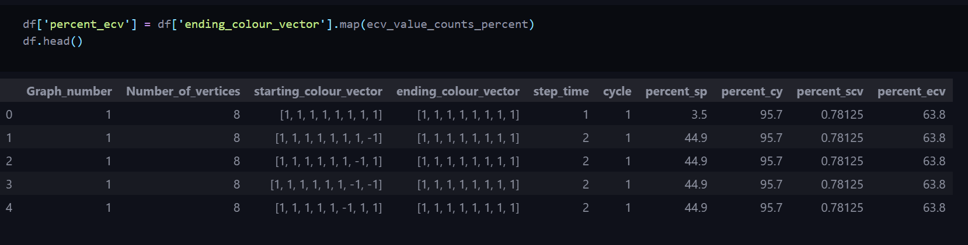
Conclusion
The dataset for all the vertices is positive skewed in terms of step time suggesting that the configurations settle into a stable state very quickly averaging a step time of 2 for almost all values of n ranging from 2-6.
The most common ending colour vector turns out to be [1,1,1,1,1,1,1,1] i.e., 63.8 percent of graphs end with this colour vector as its colour scheme suggesting that the graph turns into state where all the vertices are coloured the same by the time the program ends.
If we were to find a step time greater than 2, we could potentially find graphs going from an orientation such that it starts with 1 colour as a majority and ends up as another colour being the majority.
The value of positive skew is directly proportional to the number of vertices.

Slide 7
Thank you

