Slide 1

Smart Ambulance and Traffic Analyzer System
NAME | ROLL NO | Email-id
Sanskar Hood | 04 | hoodsr@rknec.edu
Payal Yedke | 15 | yedkeps@rknec.edu
DEPARTMENT OF ELECTRONICS ENGINEERING
SHRI RAMDEOBABA COLLEGE OF ENGINEERING AND MANAGEMENT, NAGPUR

Slide 2
OUTLINE
INTRODUCTION
LITERATURE REVIEW
METHODOLOGY
WORKING PRINCIPLE
SOFTWARES
BLOCK SCHEMATIC
RESULTS
CONCLUSION
FUTURES SCOPES
REFRENCES
DEPARTMENT OF ELECTRONICS ENGINEERING
SHRI RAMDEOBABA COLLEGE OF ENGINEERING AND MANAGEMENT, NAGPUR

Slide 3
INTRODUCTION
In today's bustling urban landscapes, navigating through congested traffic poses a significant challenge for emergency responders, especially ambulances rushing to save lives.
The Smart Ambulance and Traffic Signal Analyzer System introduces a novel solution aimed at revolutionizing emergency response systems. .
By harnessing the power of advanced object detection and intelligent traffic analysis, it stands poised to revolutionize the way we approach emergency situations in urban settings.
Through its implementation, we pave the way for safer, more efficient emergency response systems, ultimately saving lives when every second counts.
DEPARTMENT OF ELECTRONICS ENGINEERING
SHRI RAMDEOBABA COLLEGE OF ENGINEERING AND MANAGEMENT, NAGPUR

Slide 4
What is the need of this System ?
Efficient emergency response: Improve the efficiency of emergency response systems by reducing ambulance navigation times through congested traffic.
Enhanced safety: Minimize delays in reaching emergency situations, potentially saving lives by enabling faster access to medical care.
Traffic management: Assist in better traffic management by prioritizing ambulance routes, reducing congestion, and improving overall road safety.
Resource optimization: Optimize the utilization of emergency resources by ensuring timely dispatch and arrival of ambulances to critical locations.
Mitigation of delays: Address the challenges posed by traffic congestion and urban infrastructure to mitigate delays in emergency medical services.
DEPARTMENT OF ELECTRONICS ENGINEERING
SHRI RAMDEOBABA COLLEGE OF ENGINEERING AND MANAGEMENT, NAGPUR

Slide 5
Motivation behind the system?
To serve as a system in order to save human life in emergency system there is lack of services
Encountered various instances where due to traffic patient losses his/her life
At some signals the timer is still on even there is no traffic engagement and eventually everyone is wasting their time.
Also can adjust signals according to squares and different locations in concern with their respective traffic
No need of new implementation , can be done by using change in pre existing system
DEPARTMENT OF ELECTRONICS ENGINEERING
SHRI RAMDEOBABA COLLEGE OF ENGINEERING AND MANAGEMENT, NAGPUR

Slide 6
How can be it implemented ?
Data collection
Data augmentation
Model training
Deployment of basic model
Integration of basic model with advanced model
DEPARTMENT OF ELECTRONICS ENGINEERING
SHRI RAMDEOBABA COLLEGE OF ENGINEERING AND MANAGEMENT, NAGPUR

Slide 7
STEP1: DATA COLLECTION
Data Collection is an important step in order to create a custom model for ambulance detection
Data is collected from trusted sources and internet
Such images are selected which have distinct identification of ambulance
Ambulance with different angles and lighting are selected
To create a standard model it is suggested to have at least 1000 images .
These images must be resized and made be of same size

Slide 8
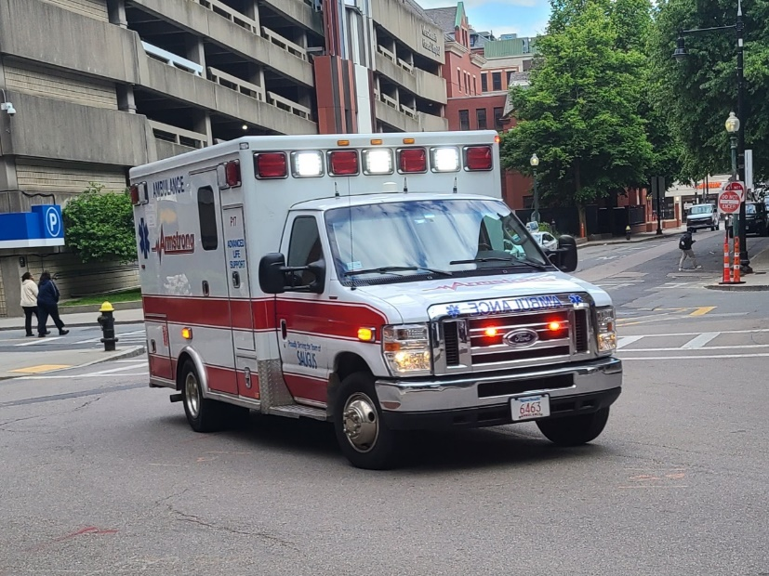
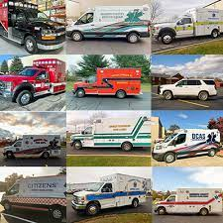
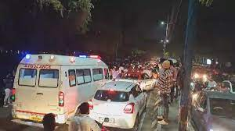
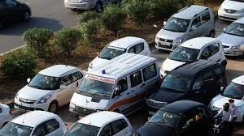
BASICS OF DATA COLLECTION
A front view
Available dimensions
Appearance at night
Amongst various other classes

Slide 9
STEP 2: DATA AUGUMETATION
Data augumentaion includes specification of only ambulance from all images .
We need to create a specific directory named as test/ which has 3 subfolder namely train,valid,test.
Each folder has 2 subfolder named image and co-ordinates
The bounding boxes created store co-ordinates of location of ambulance .
For each image we have its own co-ordinate location and its class
Each image has a similar class since we are only identifying ambulance

Slide 10
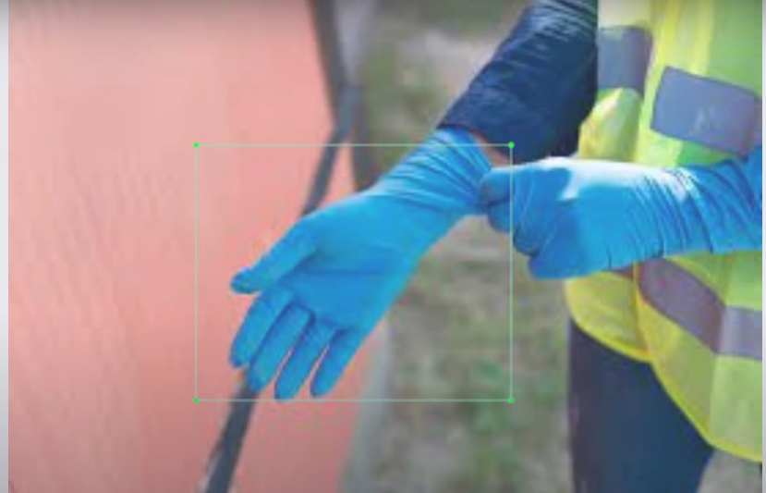
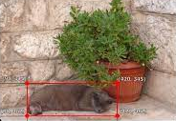
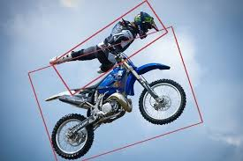
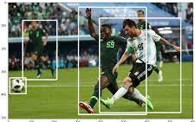
Data augmentation techniques

Slide 11
STEP3: MODEL IMPLEMENTATION
Now since we have collected the images and dataset and augumented them we just now need to implement them and train model
This is done by using google collabrative sheets .
We need to install ultralytnics model for further working of the dataset
Now we need to implement certain instructions they are as follows
From google.colab import drive
Drive.mount(‘path to folder’)
Yolo task=detect mode=train model=yolov8s.pt data=data.yml epoxh=25 imgsz=224 plots=True
By this method we can train our model on custom dataset and now we have a system that can detect ambulannce

Slide 12
STEP4:DEVELOPMENT OF BASIC MODEL
A basic model is developed which handles traffic on daily basics and just adjusts the signal timings according to the traffic present
At various instances there are chances of a signal running and no involvement of traffic in that area, means time is wasted by that signal
Now this time is managed and added to such direction where traffic is high and is provided with inadequate time.
This is done by predefined YOLOv8 model which detects car ,trucks , motorbikes and other vehicles
The basic idea is counting vehicles and comparing them and adding left time with the signal with more no of vehicles

Slide 13
STEP5:INTEGRATION OF BASIC AND trained MODEL
On final note we will integrate the basic model and trained model to create a advanced model
This model on regular mode will analyze traffic and adjust timings and make signals
As soon as a ambulance is detected it would turn that signal to green would allow smmoth flow of ambulance
This will help in adding more value to human life and can be easily implemented via integration with current systems

Slide 14
Working Principle
A basic model which will count vehicles on each side and if a signal is encountered with no traffic engagement the remaining time of that signal will be transferred to signal with most number of vehicles
While the basic model is running as soon as an ambulance is encountered all signal except the one which includes the ambulance are stopped and the ambulance is passed
Further the basic model starts running itself unless another ambulance is detected.
The ensures smooth flow of ambulance in even intense traffic and congested situations.
DEPARTMENT OF ELECTRONICS ENGINEERING
SHRI RAMDEOBABA COLLEGE OF ENGINEERING AND MANAGEMENT, NAGPUR

Slide 15




SOFTWARES AND PLATFORMS
TENSORFLOW
GOOGLE COLABORATORY
OPENCV
PYTHON

Slide 16
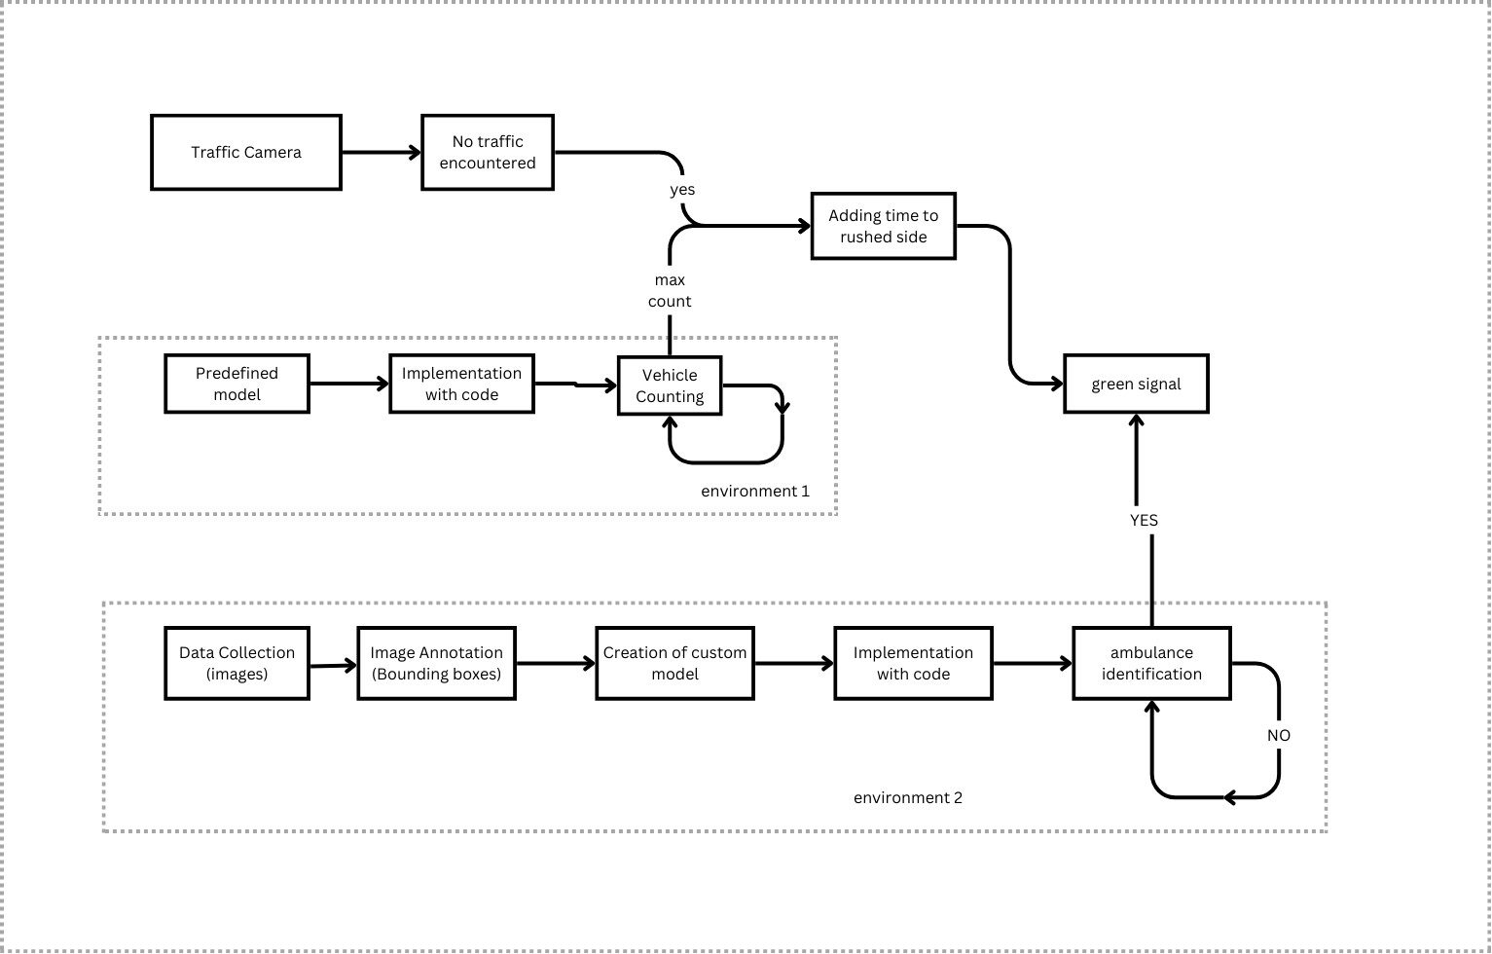
FLOWCHART

Slide 17
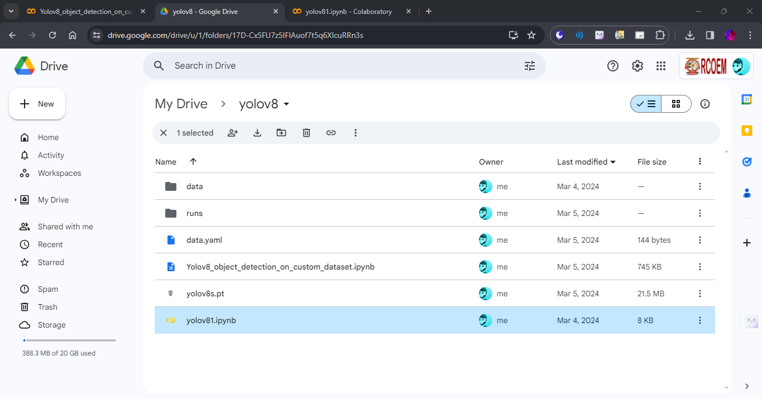
outcomes
Files obtained on model training
We obtain multiple files on model training including performance matrix, testing images and model after training[10][6]
DEPARTMENT OF ELECTRONICS ENGINEERING
SHRI RAMDEOBABA COLLEGE OF ENGINEERING AND MANAGEMENT, NAGPUR

Slide 18
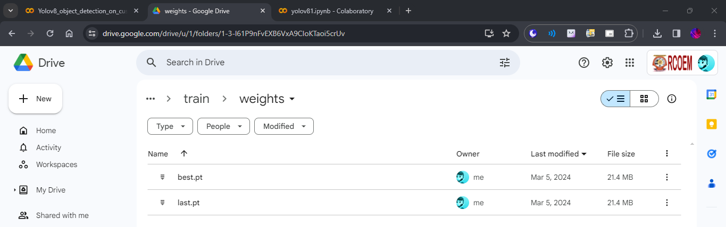
Model obtained as “best.pt” and “last.pt”
These models are obtained after implementation the best.pt contains the best trained model where as
last.pt contains the most least trained for the best and worst performance comparison of the model
in scenarios [10]

Slide 19
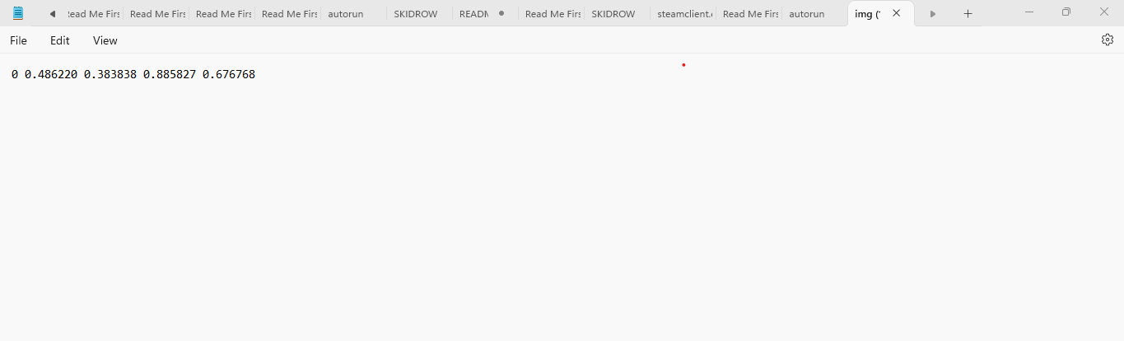
Co-ordinates of target saved on notepad
We also obtain a notepad file containing co-ordinates
of the ambulance at each frame[10][6]

Slide 20
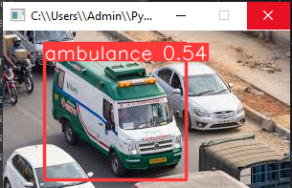
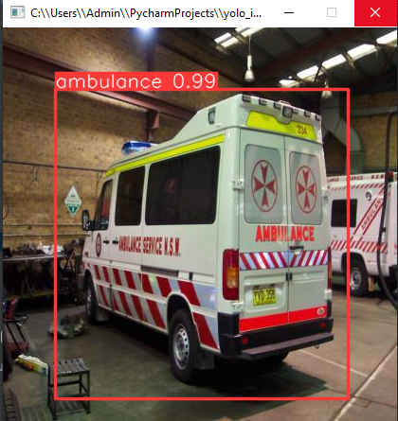
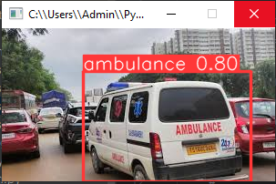

Slide 21
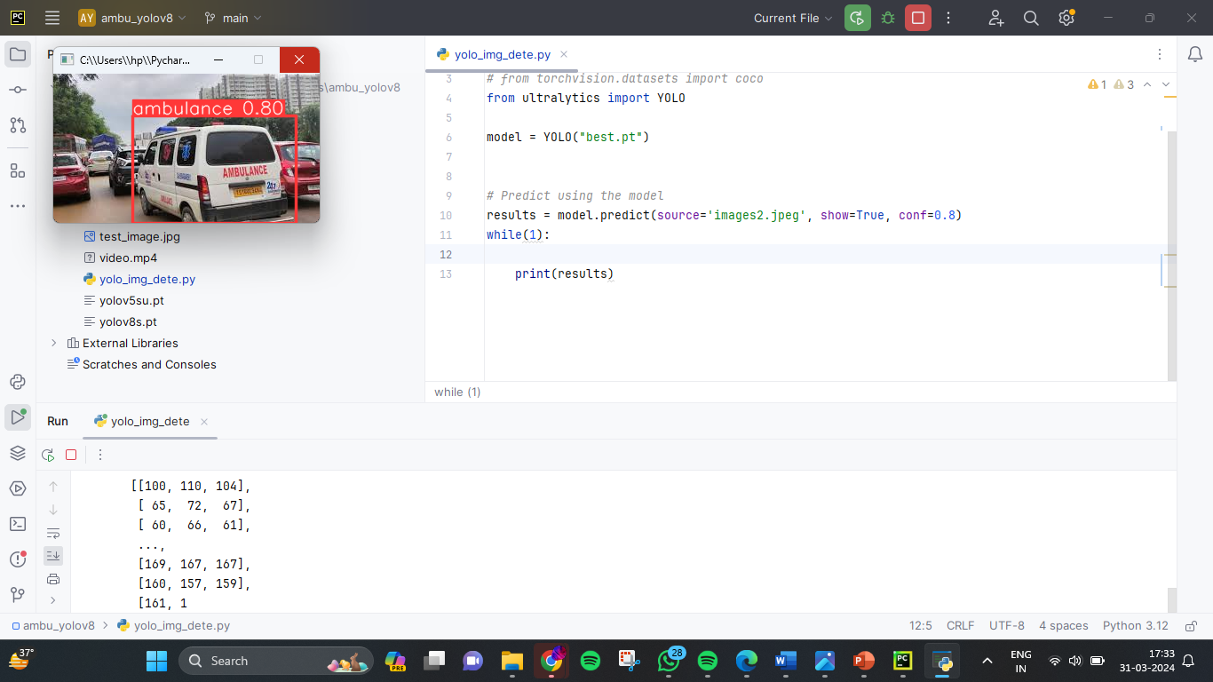
Code implementation on PyCharm
The code is implemented on PyCharm and the results are
Displayed including the co-ordinates of the ambulance
Also, multiple targets that is ambulance can be identified
at each frame[5]

Slide 22
Conclusion
The Smart Ambulance and Traffic Signal Analyzer System is a promising initiative aimed at enhancing emergency response systems by integrating cutting-edge technologies.
By leveraging the YOLOv8 model for object detection, the system enables efficient identification of ambulances amidst congested traffic, thereby expediting their navigation during emergencies.
Through the integration of real-time traffic signal analysis, the system optimizes ambulance routes, minimizing response times and potentially saving lives.
The project underscores the critical importance of innovation in addressing challenges within emergency services, ultimately leading to more effective and timely emergency response

Slide 23
Future Scopes
Enhanced Object Detection: Continuously refining and updating the object detection algorithms to improve accuracy, particularly in challenging scenarios such as low visibility or occluded environments.
Integration of Predictive Analytics: Incorporating predictive analytics capabilities to anticipate traffic patterns and optimize ambulance routes proactively, further reducing response times.
Implementation of Autonomous Driving: Exploring the potential for implementing autonomous driving technologies to further optimize ambulance navigation and reduce reliance on human drivers.
Scalability and Deployment: Ensuring scalability and ease of deployment across different urban environments, taking into account variations in traffic conditions and infrastructure.

Slide 24
References:
Python Software Foundation. (2020). Python Programming Language [Software]. Available at: https://www.python.org/.
Google. (Year). Google Colab [Software].
Available at: https://colab.research.google.com/
Tzutalin. . LabelImg [Software].
Available at: https://github.com/tzutalin/labelImg
Ultralytics,USA -yolovs.n detection, segmentation, classification, tracking https://github.com/ultralytics
DSwithBappy - How to Train for Object Detection on a Custom Dataset
https://youtu.be/iy34dSwfEsY?si=7mOJzEg5zFQNQVKg

Slide 25
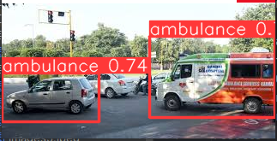
Challenges
Misinterpretation of objects: The only challenge we have amongst us is misinterpretation of objects . Due to loose training it identifies objects which are not even the target class. However by adjusting confidence scores we can manage this problem but by more rigorous training we can avoid such challenges

