Slide 1
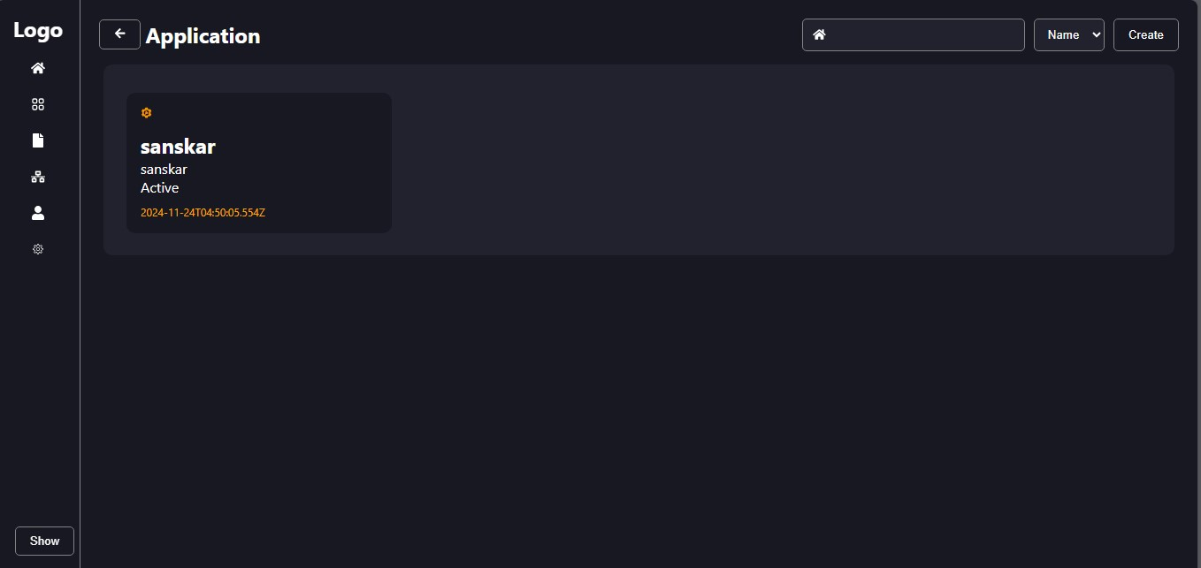
Welcome
Project Presntation
Project Title: Database and API’s Handler
By
Sanskar Vinod Bandgar
( FE / 601 )

Slide 2

Problem Statement
Every Website needs image and database but any database not provide both of service at a time.
Objectivies
To provide th file storage and database to website from one platform.

Slide 3
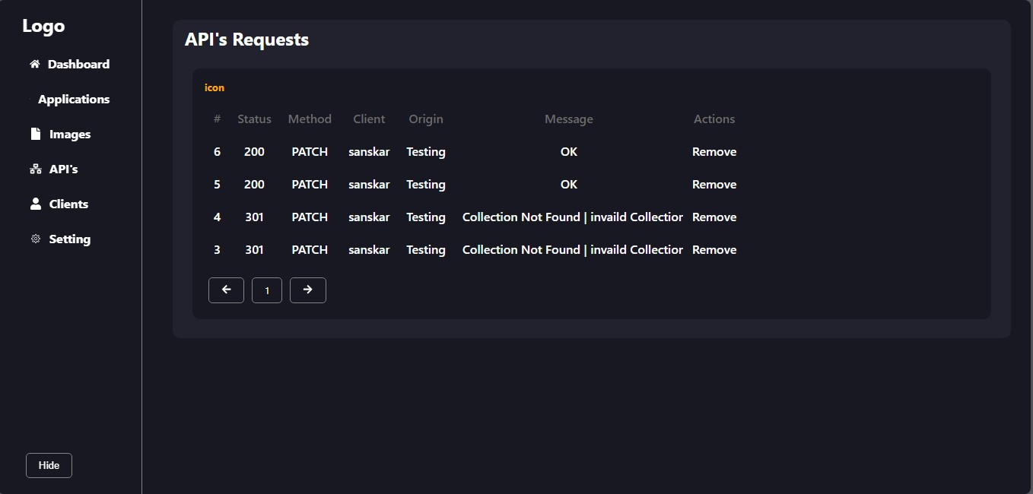
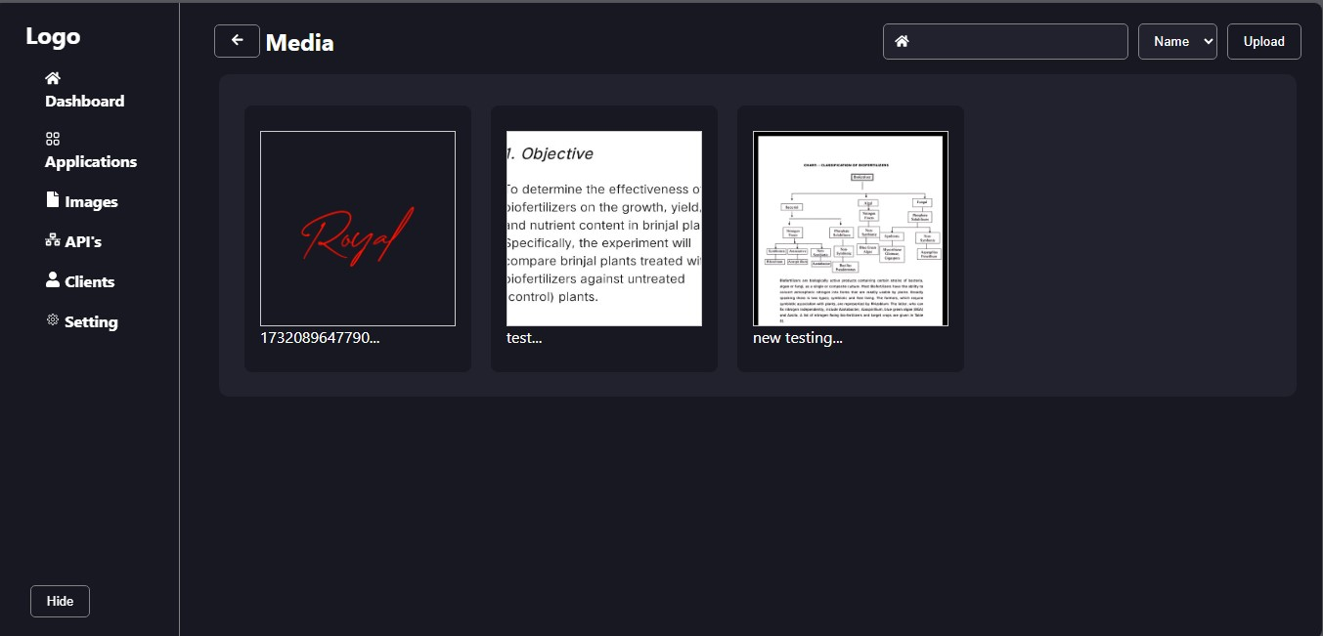
Data View
Intergrated File Storage
Data Contening in 2 view mode as table or simple formate and JSON formate (Javascript object Notation)
It’s Provide normal Database as well as intergrated File storage which supported to Image,PDF, Objects, Document and PPT’s

Slide 4
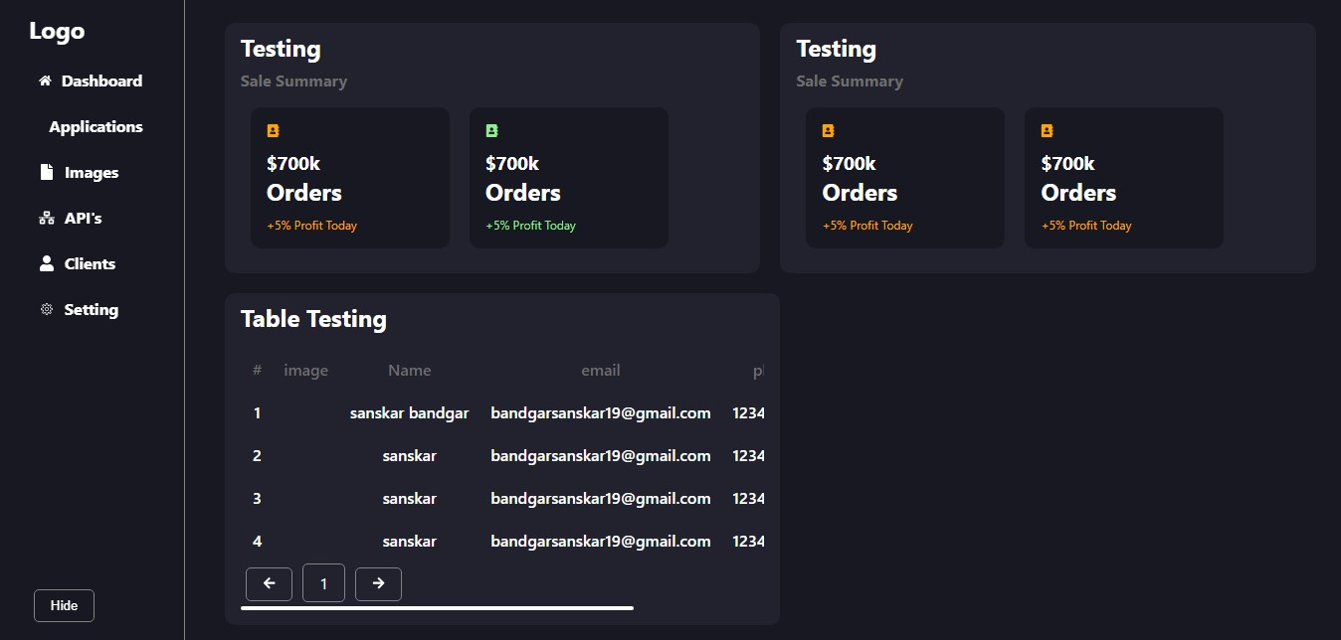
Security
Dashboard
As for security its Save all API request data at server database with Fetcher data and which its fetch and Write at database
You can make charts, graphs, and pictures from your information. As per Client Customizations that is it’s open soucre

Slide 5
Used Technology and tools
Framework : Next js 13.5
Design : CSS3
Icons : React Icons
Lanuage : Javascript / CSS3
Hosting : Self / Paid Hosting
Capacity : Depending on plan and Hosting
Next js Is easy to use and its provide or
Use For Frontend as well as Backend
Working software and website.
Why Next js

Slide 6
Special Feature
Open Source
Easy to Use
It is open source which is any one can be use.
Integreate in other application is very easy.
Technology’s
Hosting
We Can use only Next.js technology to create it
It need to Self Hosting or Paid Hosting Provider

Slide 7
Where Use it
Whats next !
For Freelancer
For Self
They can create small database server for there clients
Create Own database server for there multiples app and websites
AI
External Database
In this database Intergreate AI for doing all works
It can connected to external Database like mongoDB and cloudinary

Slide 8
Thank You

