Slide 1
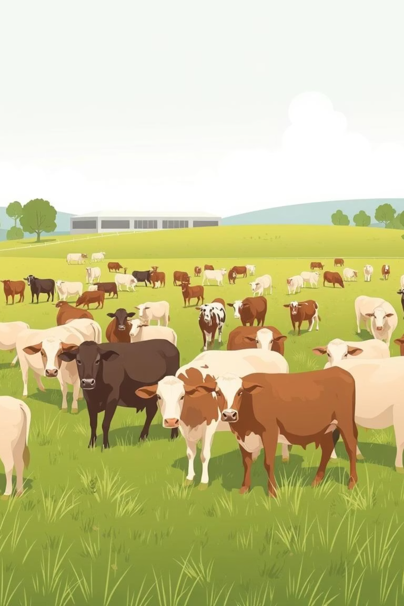
Image based Breed Recognition for Cattle and Buffaloes of India

Slide 2
Problem Statement
Cattle farming plays a vital role in global agriculture and the economy, but one of its persistent challenges is the accurate and efficient classification of cattle breeds. Cattle breed identification is a critical task in livestock management, breeding programs, and disease prevention. However, traditional methods rely heavily on visual inspection, which is subjective, slow, and often inaccurate.
This creates inconsistencies in breed classification, leading to challenges in ensuring proper vaccination, maintaining genetic diversity, and optimizing farm productivity. Moreover, variations in cattle appearance across regions, poor-quality datasets, and the absence of standardized classification methods further complicate the process. The lack of a reliable and efficient system for cattle breed classification continues to hinder effective livestock management and agricultural decision-making.

Slide 3
Aim/Objective
The objective of this study is to systematically evaluate and compare various machine learning frameworks and algorithms for cattle breed classification using image datasets. This work is undertaken to address the limitations of traditional visual inspection methods, which are subjective, inconsistent, and time-consuming.
By benchmarking models such as ResNet, CNN, SVM, Random Forest, KNN, PCA, and PyTorch-based architectures against key performance metrics (accuracy, precision, recall, F1-score, ROC, learning curves, and confusion matrices), the study seeks to identify the most effective and reliable methods for breed identification. The purpose of this evaluation is to provide clear, evidence-based insights that can guide livestock researchers, farmers, and industry stakeholders in adopting accurate and efficient breed classification systems, ultimately improving cattle management, breeding practices, disease prevention, and agricultural decision-making.

Slide 4





Methodology: Data Collection & Annotation
Raw collected data; in the form of images
Merge & Tag metadata (location, age, lightning)
Labeling (breed tags, bounding boxes)
Quality Control, Deduplication & Sampling

Slide 5
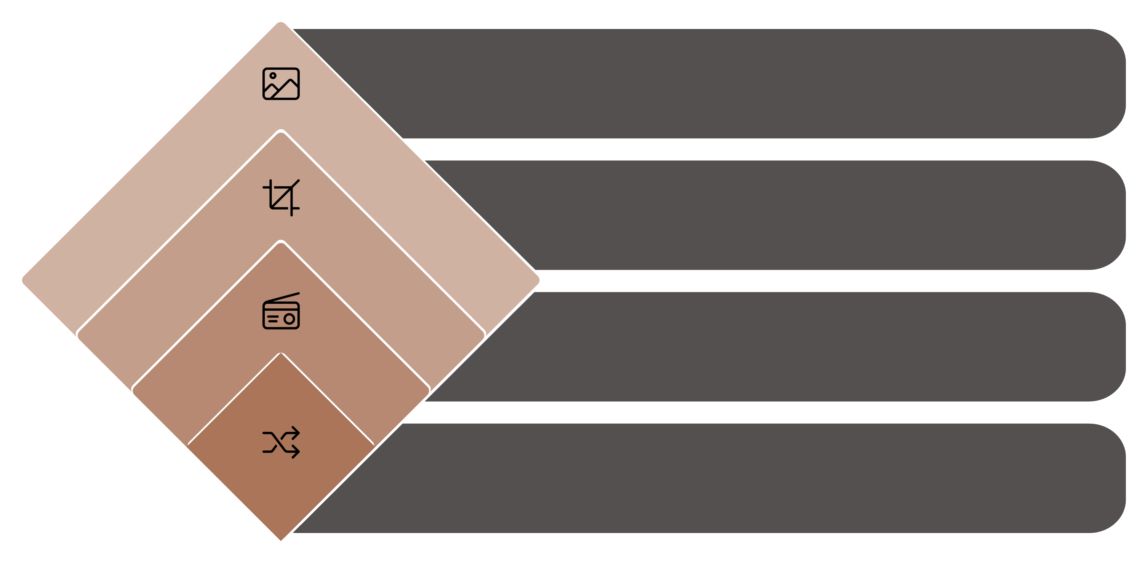




Methodology: Pre-processing & Augmentation
Raw Image
Original Input
Standardize
Resize, center crop, RGB
Normalize
Per-channel mean/std
Augment
Flips, rotation, brightness, blur, random crop, colot jitter

Slide 6
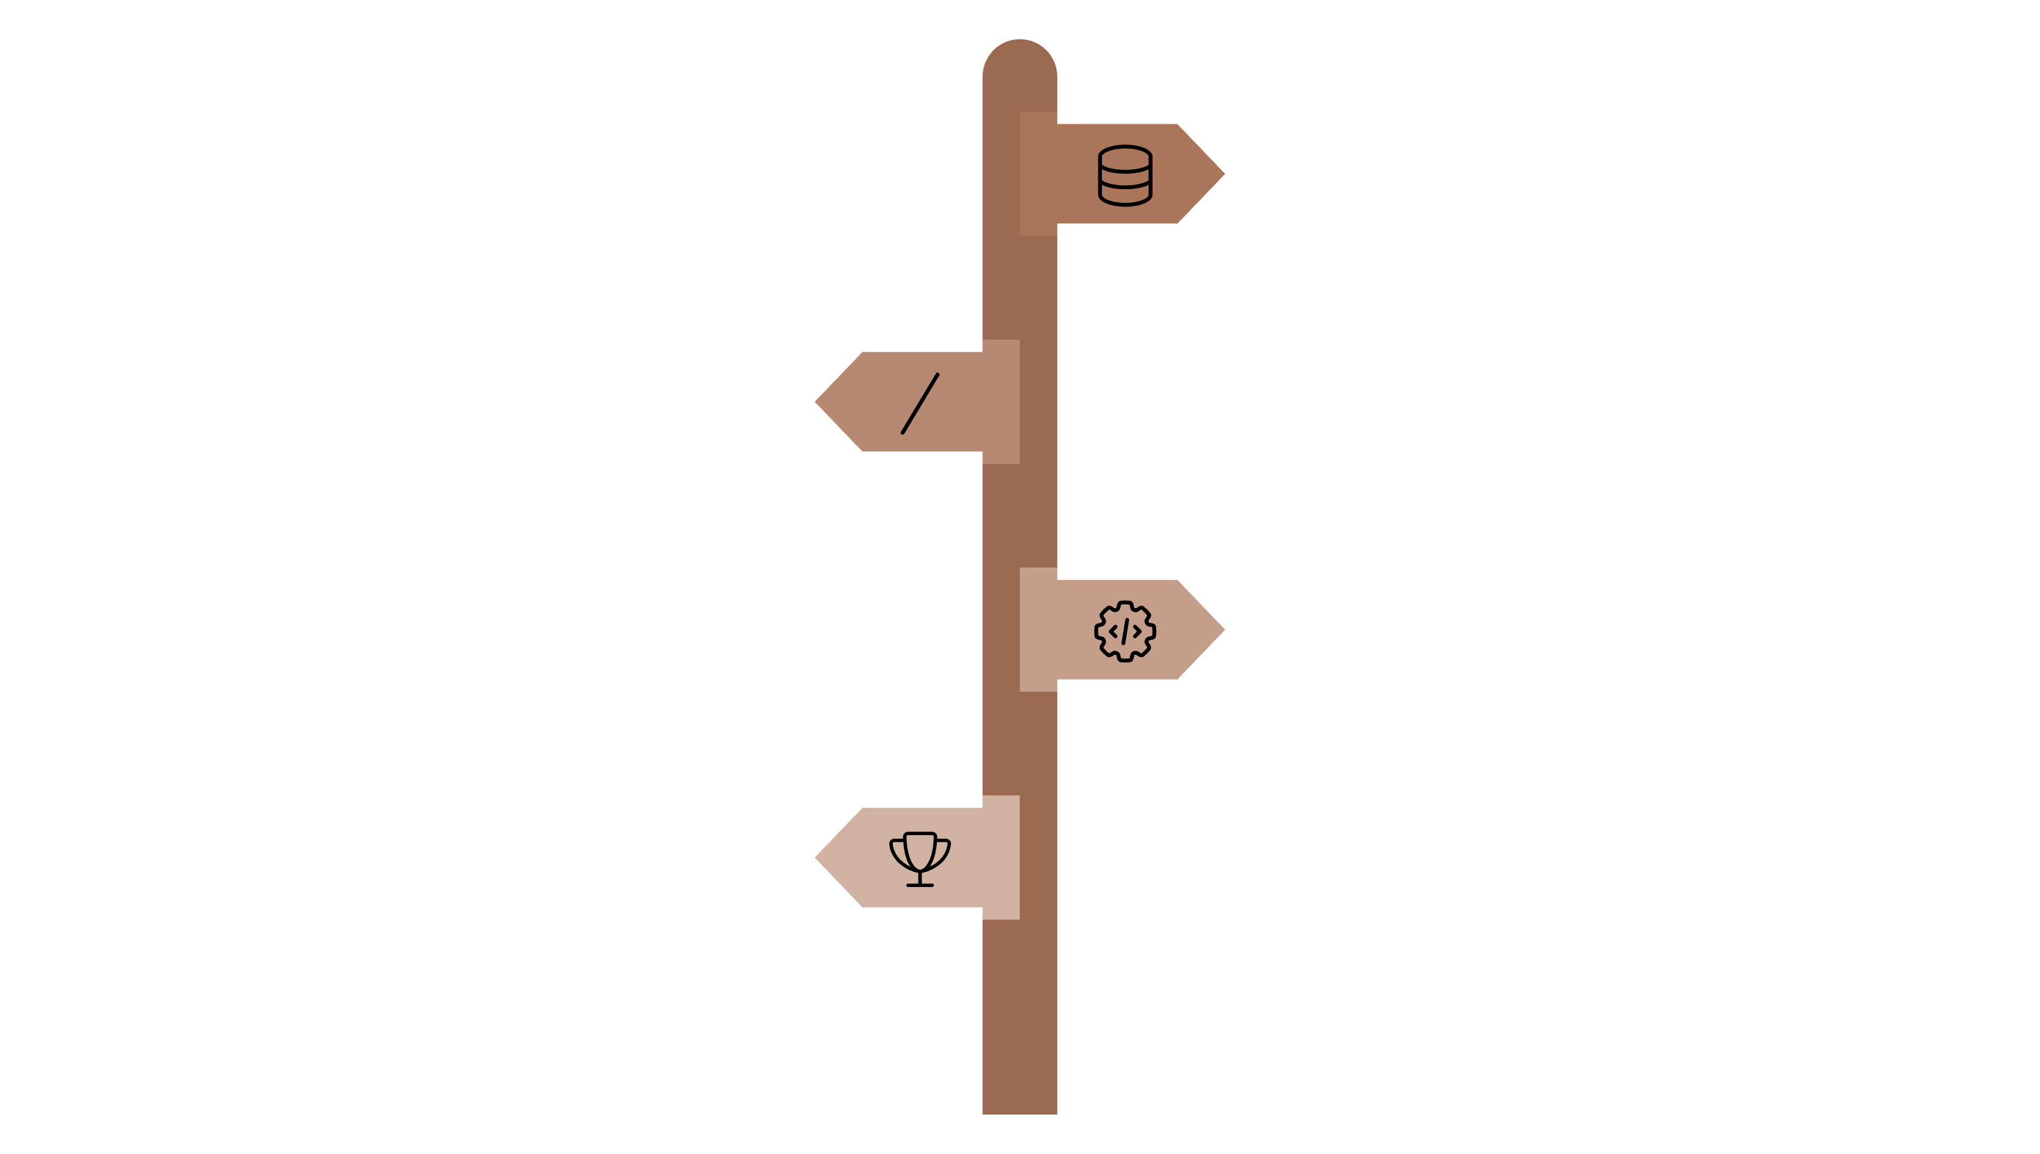




Methodology: Model Training & Selection
Input
Preprocessed tensors and features.
Choose Family
Deep learning or classical ML paths.
Training Loop
Stratified splits, optimizer, LR schedule.
Model Selection
Hyperparameter search, checkpointing, best
validation metric.

Slide 7
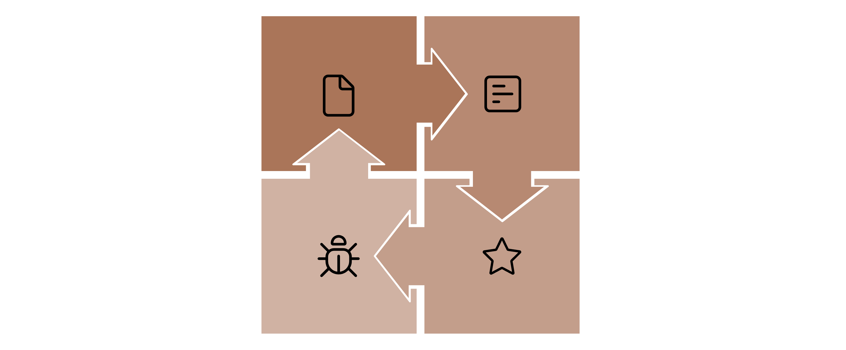




Methodology: Evaluation & Failure Analysis
Test Set Predictions
Compute Metrics
Obtained from the trained
model.
Accuracy, F1 score,
Precision, Recall, ROC,
Confusion matrices
Visual Diagnostics
Report & Decisions
Grad-CAM, Feature
Importance
(RandomForest), Error
Clusters (pose, lighting, age).
Includes relabeling, more
data, and potential model
changes.

Slide 8
Algorithm
01
02
Data Collection
Data Pre-processing
Collect cattle images research datasets, online repositories, journals or, uncurated data from Kaggle and GitHub
Resize each image to fixed dimensions.
Normalize pixel values.
Label each image with its correct cattle breed.
Perform dataset split → Training (70%), Validation (15%), Testing (15%).
03
04
Model Selection
Model Training
DL Models for Image Classification like CNN.
Train each model on the training dataset.
Use pre-trained models like ResNet, VGG16 or MobileNet
Use validation dataset for tuning hyperparameters and early stopping.
Record training curves.
05
06
Model Evaluation
Deployment
Test each trained model on the test dataset.
Save the final trained model.
Compute performance metrics: Accuracy, Precision, Recall, F1-score (per breed and macro-average), ROC curves and Precision-Recall curves, Confusion matrices
Make UI and fix bugs.
Final testing and then deploying the project.

Slide 9
Evaluation
Successes:
Challenges:
Demonstrated that automated cattle breed classification can reduce reliance on slow and inconsistent visual inspection.
Limited diversity in collected images reduced generalization across different conditions, making it difficult for the model to differentiate between similar looking breeds (like Gir and Sahiwal)
Provided a comparison of multiple algorithms, giving practical insights into which methods perform better in livestock contexts.
Imbalance in breed representation made some cattle harder to classify accurately.
Highlighted the potential of machine learning to support record-keeping and decision-making in farming.
Variations in lighting, camera quality, and posture introduced inconsistencies.

Slide 10
Conclusion & References
This project explored cattle breed classification using machine learning by comparing multiple algorithms and frameworks, including CNN, ResNet, PyTorch, SVM, Random Forest, KNN, and PCA. The findings showed that deep learning models, particularly PyTorch and CNN, provided the most reliable results, while classical approaches struggled with complex image data. The study confirmed that automated classification can reduce the subjectivity and inefficiency of traditional visual inspection, offering practical benefits for livestock management, breeding, and disease control. However, challenges such as limited dataset diversity, breed imbalance, and high computational demands remain. Overall, the project highlights both the potential and the limitations of current approaches, laying the groundwork for further improvements in data collection, lightweight models, and broader applications in precision livestock farming.
References
Journals and Research Papers-
Cattle Breed Classification Techniques: Framework and Algorithm Evaluation by Journal of Propulsion Technology
AI- enhanced real-time cattle identification system through tracking across various environments by Scientific Reports
Cowbree: A novel dataset for fine-grained visual categorization
Websites-
https://eudl.eu/pdf/10.4108/eai.23-11-2023.2343338?/
https://www.sciencedirect.com/science/article/pii/S2352340924000970?/

