Slide 1

Deep Learning Pneumonia Detection using Chest X-Ray Image
Department Of Computer Science & Engineering
Submitted By
4th Year Students
Nischhal Sharma(19EAYCS079)
Vikash Sharma(19EAYCS131)
Shrawan Kumar Gaha(19EAYCS114)
Sanskar Jain(19EAYCS112)
Submitted to Dr. Manish Kumar Mukhija HOD CSE/IT

Slide 2
Content
Abstract
Introduction
Exiting System
Proposed System
Objective
Requirements
Flow Diagram
Result & Discussion
Future Scope
Conclusion
References

Slide 3
Abstract
The project is aimed at developing an automatic system that is able to detect Pneumonia using the Chest X-Ray of the person.
Due to the popularity of deep learning algorithms in image analysing, Convolution Neural Networks (CNNs) have gained much attention for image classification for disease detection.
This automatic system for detecting pneumonia that would be benefit both the patient for treating the disease without any delay particularly in remote areas and doctors as they can spend more time on treating patients.

Slide 4
Introduction
This project is to increase the accuracy for the effective Pneumonia detection.
This will increase the productive time of the doctors.
Implementation of Deep Learning (DL) models specifically Convolution Neural Networks (CNNs) have potential of extraction of useful features in image classification.
It will be beneficial for the patients also as they will not have to wait for the doctor to just to know that he is diagnosed with Pneumonia or not.

Slide 5
Objectives
To automate the process of the diagnosis of the Pneumonia.
To decrease the time delay in treatment of Pneumonia diagnosed patient.
Increase the time where doctors can focus more on treatment.
To make the system cost effective.
To increase the accuracy of for the effective Pneumonia detection.
To be able to handle the enormous amount of data using Convolutional Neural Network model (CNN).

Slide 6
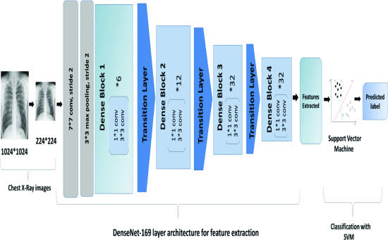
Working

Slide 7
Requirements
Numpy
Matplotlib
OpenCV
TensorFlow
Keras

Slide 8
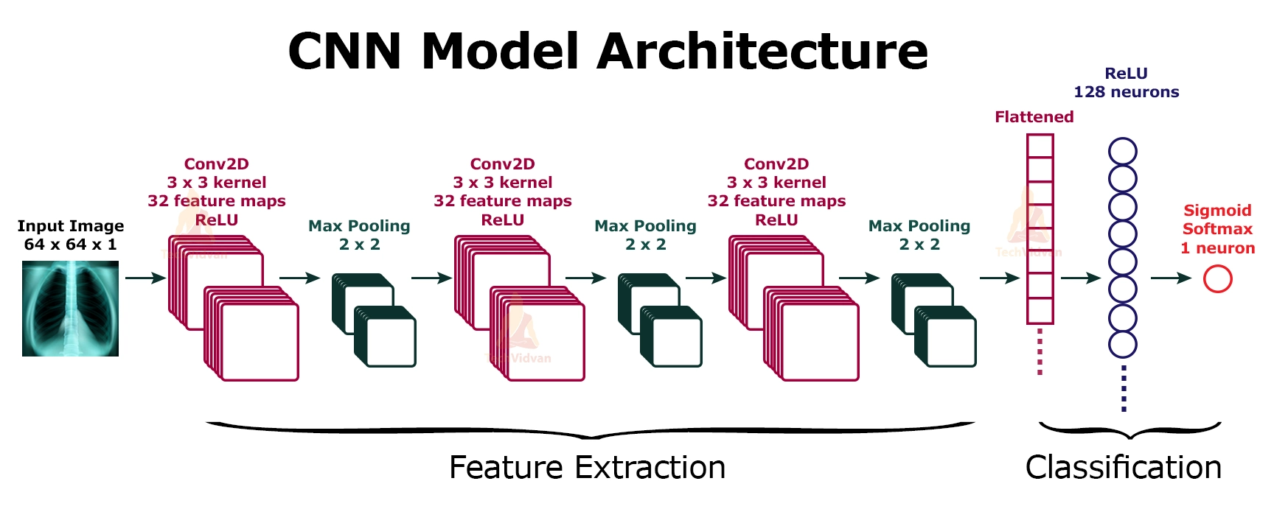
Architecture and Flowchart

Slide 9
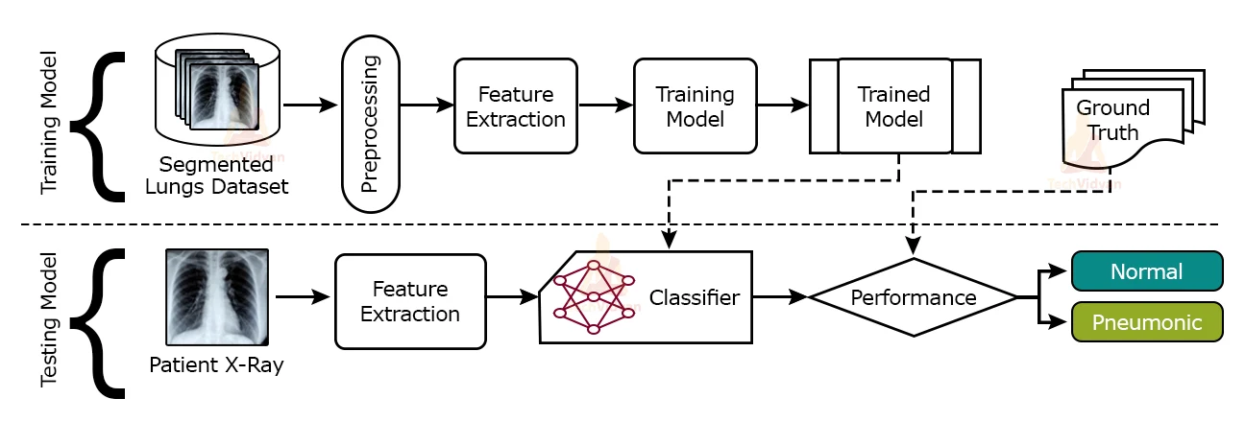

Slide 10
Result & Discussion
The customized model that we have created is a combination of CNN based feature-extraction and SVM resulted in optimal solution for the detection or classification of Pneumonia labelled and normal Chest X-Ray images with features of model and hyper-parameter values of SVM classifier.
By keeping in mind past approaches, we trained models with classifiers to determine optimal model for the purpose.
We observed from the comparative experimental results and trained CNN model that performed better same parameter values of SVM classifier is employed.

Slide 11
Future Scope
Pneumonia is one of the fatal diseases of a human body and prediction about Pneumonia diseases is also important concern for the human beings so that the accuracy for algorithm is one of parameter for analysis of performance of algorithms.
Accuracy of the algorithms in machine learning depends upon the dataset that used for training and testing purpose.
When we perform the analysis of algorithms on the basis of dataset, we find CNN is best algorithm.

Slide 12
For the Future Scope more machine learning approach will be used for best analysis of the human disease and for earlier prediction of diseases so that the rate of the death cases can be minimized by the awareness about the diseases.

Slide 13
Conclusion
This deep learning model can classify the image with 91% accuracy. Now the model we have created will work fine on classifying the data it has never seen before. So we can use this model to predict whether the person is Normal or suffering from Pneumonia with the help of that person’s Chest X-ray image.

Slide 14
Thank You
for
Giving your valuable time.

