Slide 1

Cooking recipe rating based on Sentiment analysis
Department Of Computer Science & Engineering
Submitted By
4th Year Students
Rahul Sain(19EAYCS098)
Shrawan Kumar Gaha(19EAYCS114)
Sanskar Jain(19EAYCS112)
Submitted to Dr. Manish Kumar Mukhija HOD CSE/IT

Slide 2
Content
Abstract
Introduction
Proposed System
Objective
Requirements
Flow Diagram
Result & Discussion
Future Scope
Conclusion

Slide 3
Abstract
Cooking Recipe Rating based on Sentiment Analysis is a data science project that involves applying machine learning techniques to analyse cooking recipe reviews and predict their sentiment. The project aims to help users find the best-rated recipes based on sentiment analysis of their reviews.
The project first pre-processes the dataset by cleaning the data, tokenizing it into words, removing stop words, and lemmatizing the remaining words. Then, a bag-of-words or word embedding representation of the pre-processed data is created, and the data is split into training and validation sets.

Slide 4
Next, a machine learning model (such as logistic regression, decision trees, or SVM) is trained on the training set and evaluated on the validation set using metrics such as accuracy, precision, recall, and F1-score.
Finally, the project deploys the model by creating a user interface for the rating system using a web framework such as Flask. Users can enter a recipe and get a sentiment rating based on the sentiment analysis model.

Slide 5
Introduction
Sentiment classification is a way to analyse the subjective information in the text and then mine the opinion. Sentiment analysis is the procedure by which information is extracted from the opinions, appraisals and emotions of people in regards to entities, events and their attributes.
In decision making, the opinions of customers have significant effect on customers ease as ultimately our business is to facilitate them.

Slide 6
Objectives
To automate the process of finding good and quality recipe according to your preferences.
To build brand reputation of the food brands on their social media, websites and apps.
Full use the feedbacks of the customers on the recipes.
To make the system cost effective.
Advertisement according to the feedback of the target audience of the food brand
To be able to handle the enormous amount of data using Natural Language Processing (NLP) and SVM.

Slide 7
Requirements
Numpy
Matplotlib
TensorFlow
Keras
Flask
Jupyter notebook

Slide 8
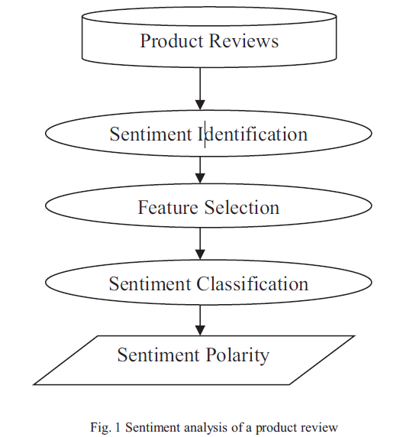
Architecture and Flowchart

Slide 9
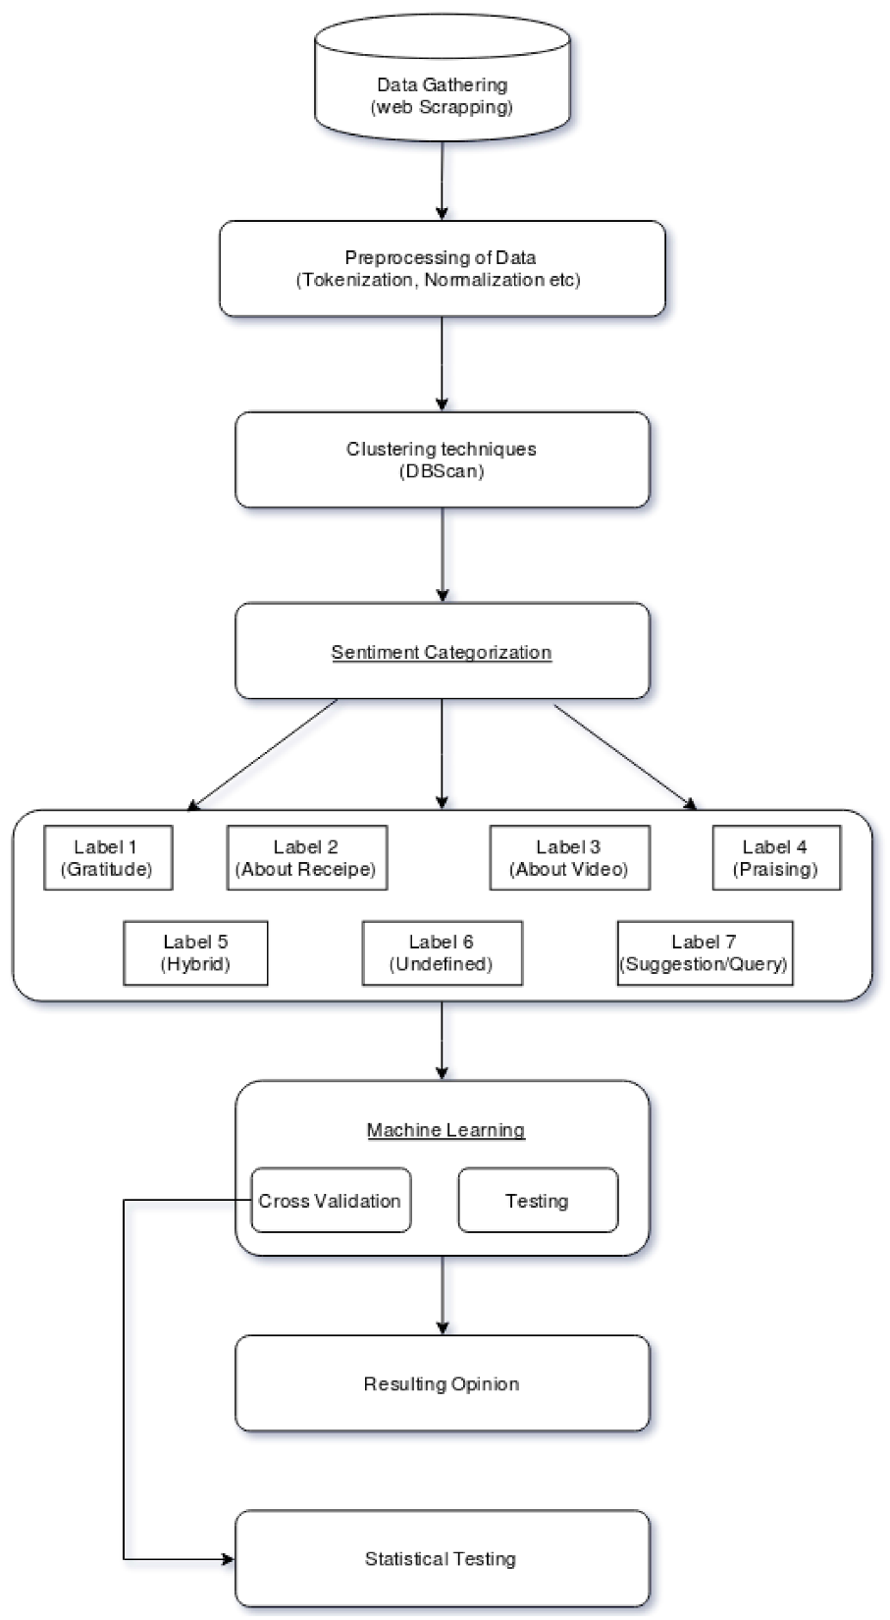

Slide 10
Result & Discussion
The customized model that we have created is a combination of NLP based feature-extraction and SVM resulted in optimal solution for the analysis of the recipe on the basis of sentiments extracted from the text.
By keeping in mind past approaches, we trained models with classifiers to determine optimal model for the purpose.
For all the classification the count of the words common to the training data have been kept as features and the accuracy of 25% approx. for the test data set and 30% approx. for the eval data set.

Slide 11
Future Scope
The future development scope for this project can be the integration of multiple language and add support for them so then it can become more diversified and people who do not speak English can also use this.

Slide 12
Conclusion
Overall, the cooking recipe rating based on Sentiment Analysis project will be a useful tool for people looking for the best-rated recipes based on sentiment analysis of their reviews. It can also be a good learning experience for data scientists interested in natural language processing, machine learning, and data visualization.

Slide 13
Thank You
for
Giving your valuable time.

