Slide 1


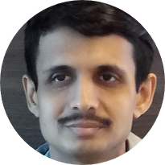

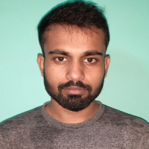
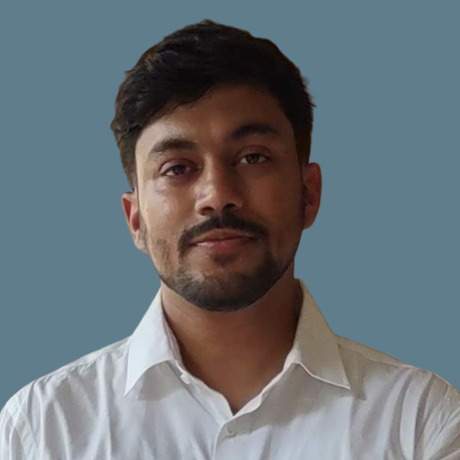
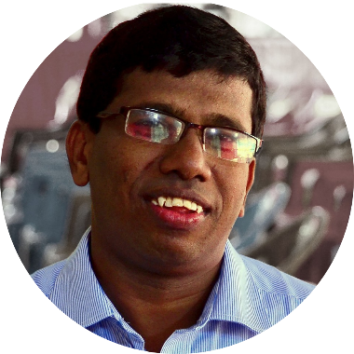
Winter School on Deep Learning Applications in Computer Vision and Language Modelling, IITG (2025)
Integrating Medical Knowledge into Deep Learning Architectures
Multimedia Lab, Computer Science and Engineering, IIT Guwahati
Our Team
Our Collaborator
Dr. Arijit Sur
Professor,
Department of Computer Science and Engineering,
IITG
Mr. Akshay Daydar
Research Scholar
Mr. Alik Pramanick
Research Scholar
Mr. Sonal Kumar
Research Scholar
Dr. S. Kanagaraj
Professor and Head,
Jyoti and Bhupen Mehta School of Health Sciences and Technology
Indian Institute of Technology Guwahati, Assam, India

Slide 2
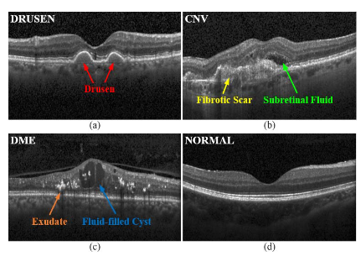
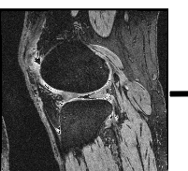
The Need of Deep Learning in Medical Imaging
Practical perspective: To help the clinicians for dependable medical assistance.
Research perspective: Medical images involves visual and latent information of disease biomarkers that can be traced using deep learning.
Tasks : Disease diagnosis, Lesion, organ, and abnormality detection, Lesion, organ segmentation, medical image registration, medical image retrieval, Medical report generation.
Challenges: Medical images are grayscale in nature, have non-differential spatial context and often contains small ROI compared to image dimensions.
OCT image
MRI
Xie, Xiaozheng, et al. "A survey on incorporating domain knowledge into deep learning for medical image analysis." Medical Image Analysis 69 (2021): 101985.

Slide 3
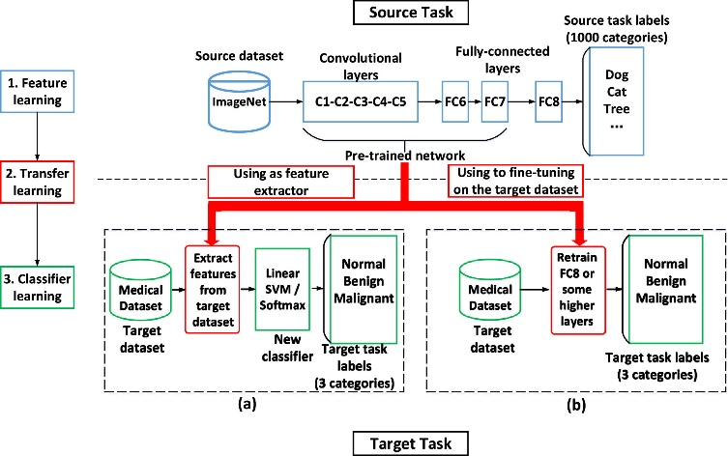
Recent Trends
Training Pattern for Medical Images
The training pattern
The general diagnostic patterns they view images- MRI, CT
The areas on which they usually focus- knee xray
The features (e.g characteristics, structures, shapes) they give special attention to, and - Cancer
Other related information for diagnosis
Two strategies to utilize the pre-trained network on natural images: (a) as a feature extractor and (b) as an initialization which will be fine-tuned on the target dataset [Xie et al.].
Xie, Xiaozheng, et al. "A survey on incorporating domain knowledge into deep learning for medical image analysis." Medical Image Analysis 69 (2021): 101985.

Slide 4
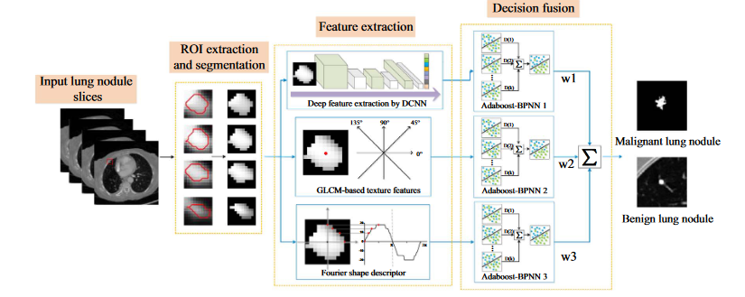
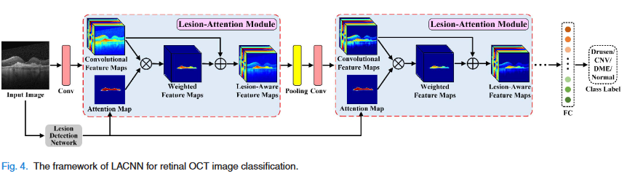
Recent Trends
Incorporating domain knowledge to Classification
1. Training Deep learning model with disease specific descriptors
2. Utilizing Attention Mechanism for guiding the classification tasks
Diagram of Fuse-TSD lung nodule classification algorithm.
Texture and shape descriptors such as gray level co-occurance matrix, faret shape measure, moment invariants, point distance histograms and fourier descriptors can be used to characterize heterogeneous shape of the nodules [Xie et al.]
The framework of LACNN for retinal OCT image classification [Fang et al.]
Xie, Yutong, et al. "Fusing texture, shape and deep model-learned information at decision level for automated classification of lung nodules on chest CT." Information Fusion 42 (2018): 102-110.
Fang, Leyuan, et al. "Attention to lesion: Lesion-aware convolutional neural network for retinal optical coherence tomography image classification." IEEE transactions on medical imaging 38.8 (2019): 1959-1970.

Slide 5
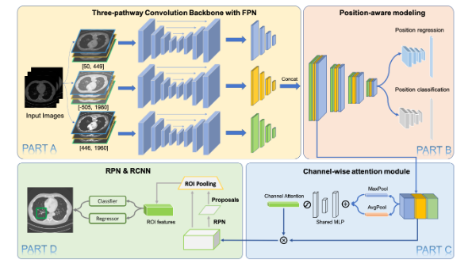
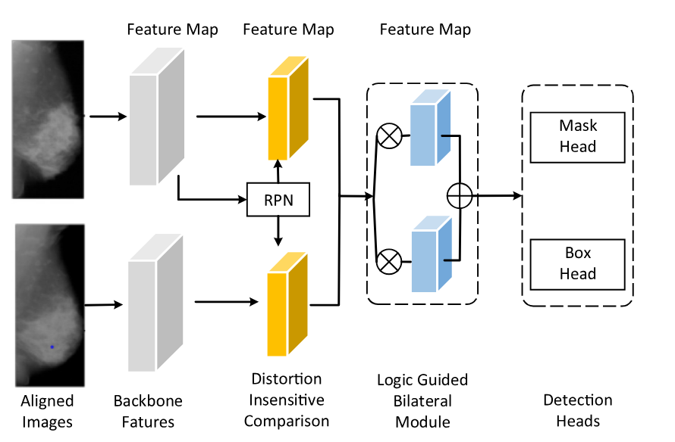
Recent Trends
Incorporating domain knowledge to Object Detection
3. Utilizing images under different settings/Multiple views/modalities/analyzing adjacent slides for computer vision tasks
The workflow of mammogram mass detection by integrating the bilateral information (Liu et al., 2019), where the aligned images are fed into two networks seperately to extract features for further detection [Liu et al.]
Overview of MVP-Net. Coarser feature maps of FPN are omitted in part C and D for clarity, they use the same attention module with shared parameters for feature aggregation [Li et al.]
Li, Zihao, et al. "MVP-Net: multi-view FPN with position-aware attention for deep universal lesion detection." International Conference on Medical Image Computing and Computer-Assisted Intervention. Springer, Cham, 2019.
Liu, Yuhang, et al. "From unilateral to bilateral learning: Detecting mammogram masses with contrasted bilateral network." Medical Image Computing and Computer Assisted Intervention–MICCAI 2019: 22nd International Conference, Shenzhen, China, October 13–17, 2019, Proceedings, Part VI 22. Springer International Publishing, 2019.

Slide 6
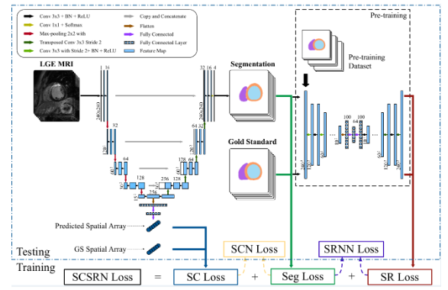
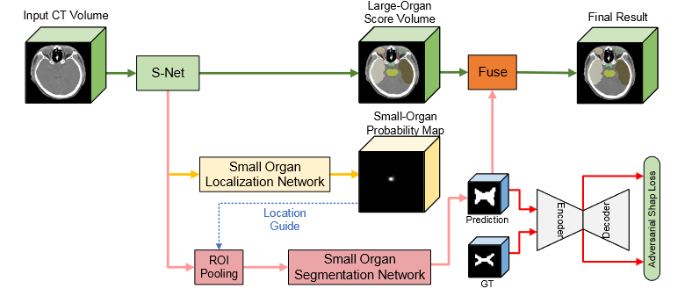
Recent Trends
Incorporating domain knowledge to Segmentation
4. Utilizing loss function as regularizing term for fine tuning the Segmentation masks
5. Utilizing localization network to locate small tissues for fine tuning the segmentation results
Overall framework - FocusNetv2 [Gao et al.]
Overall structure of SRSCN, whose loss comes from three parts: the segmentation loss is specially design as a function of cross entropy and Dice, the spatial constraint (SC) loss to assist segmentation, and the shape reconstruction (SR) loss for shape regularization [Yue et al.]
Yue, Qian, et al. "Cardiac segmentation from LGE MRI using deep neural network incorporating shape and spatial priors." International Conference on Medical Image Computing and Computer-Assisted Intervention. Springer, Cham, 2019.
Gao, Yunhe, et al. "FocusNetv2: Imbalanced large and small organ segmentation with adversarial shape constraint for head and neck CT images." Medical Image Analysis 67 (2021): 101831..

Slide 7
Our Approach
Currently our team is focused on : Disease diagnosis, Lesion, organ, and abnormality detection, Lesion, organ segmentation, and Medical report generation.
Our research Team currently working on:
Classification of Knee Osteoarthritis using Gait Data.
Medical report generation of chest X-ray using vision-language model.
Past works and Publications:
Jain, Rohit Kumar, et al. "Knee osteoarthritis severity prediction using an attentive multi-scale deep convolutional neural network." Multimedia Tools and Applications 83.3 (2024): 6925-6942.
Daydar, Akshay, et al. “Segmentation of Multiple Knee Tissues from MR images using MtRA-Unet and Incorporating Shape Information: Data from Osteoarthritis Initiative” [Under Review at Medical & Biological Engineering & Computing ]
Jain, Rohit Kumar, et al. "Knee osteoarthritis severity prediction using an attentive multi-scale deep convolutional neural network." arXiv preprint arXiv:2106.14292 (2021).

Slide 8
Our Approach
Past works and Publications:
Daydar, Akshay, et al. "Med-SeAM: Medical Context Aware Self-Supervised Learning Framework for Anomaly Classification in Knee MRI." Proceedings of the Fifteenth Indian Conference on Computer Vision Graphics and Image Processing. 2024.
Daydar, Akshay, et al. ”MedCAM-OsteoCls: Medical Context Aware Multimodal Classification of Knee Osteoarthritis”, IEEE International Conference on Acoustics, Speech, and Signal Processing (ICASSP) 2025.
Daydar, Akshay, et al. “DeepOsteoCls:Deep Learning-Based Framework for Knee Osteoarthritis Classification With Qualitative Explanations from Radiographs and MRI Volumes”, [Under Review at Biomedical Signal Processing and Control].

Slide 9
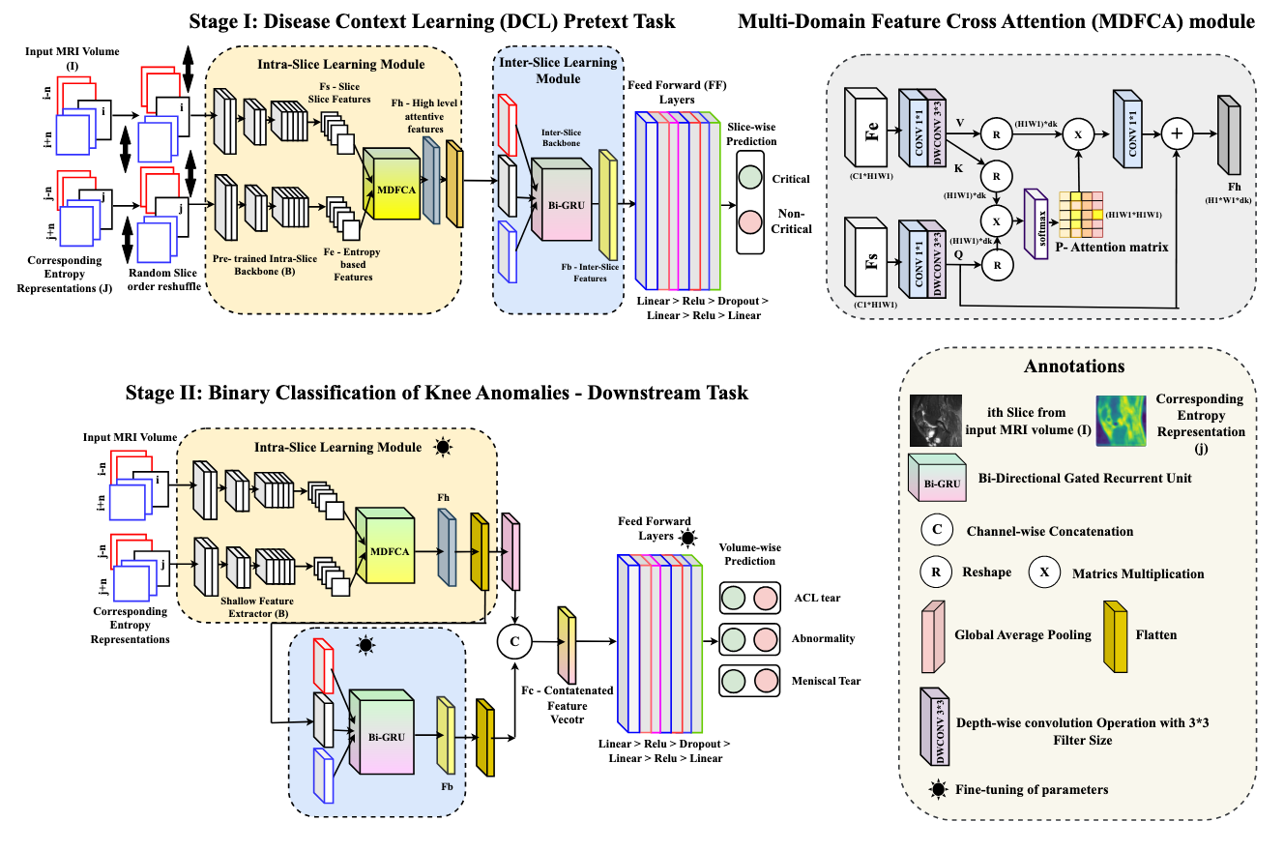
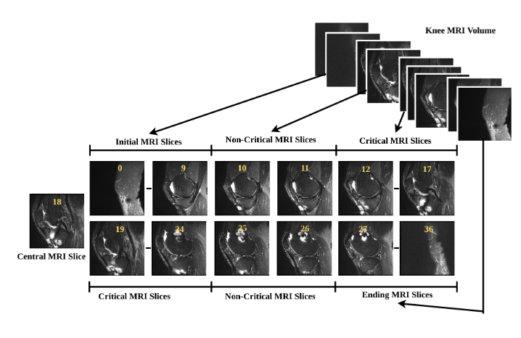
Med-SeAM Framework
Med-SeAM: Medical Context Aware Self-Supervised Learning Framework for Anomaly Classification in Knee MRI [Daydar et al.]
Figure: Schematic of the slice
selection strategy.
Daydar, Akshay, et al. "Med-SeAM: Medical Context Aware Self-Supervised Learning Framework for Anomaly Classification in Knee MRI." Proceedings of the Fifteenth Indian Conference on Computer Vision Graphics and Image Processing. 2024.
Figure: Schematic of the proposed Med-SeAM framework.

Slide 10
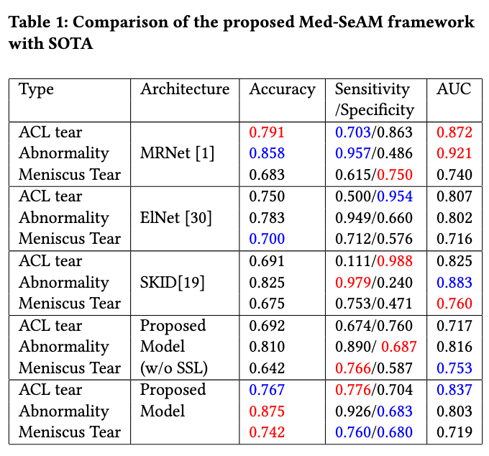
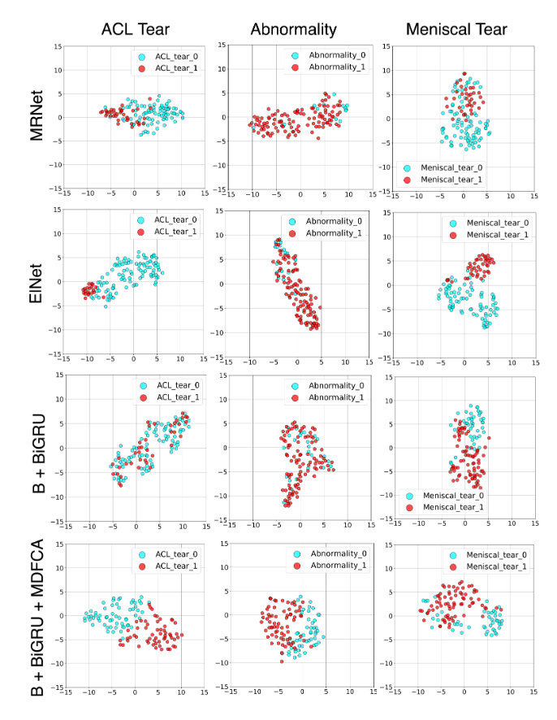
Results
Figure: tSNE Visualizations.

Slide 11
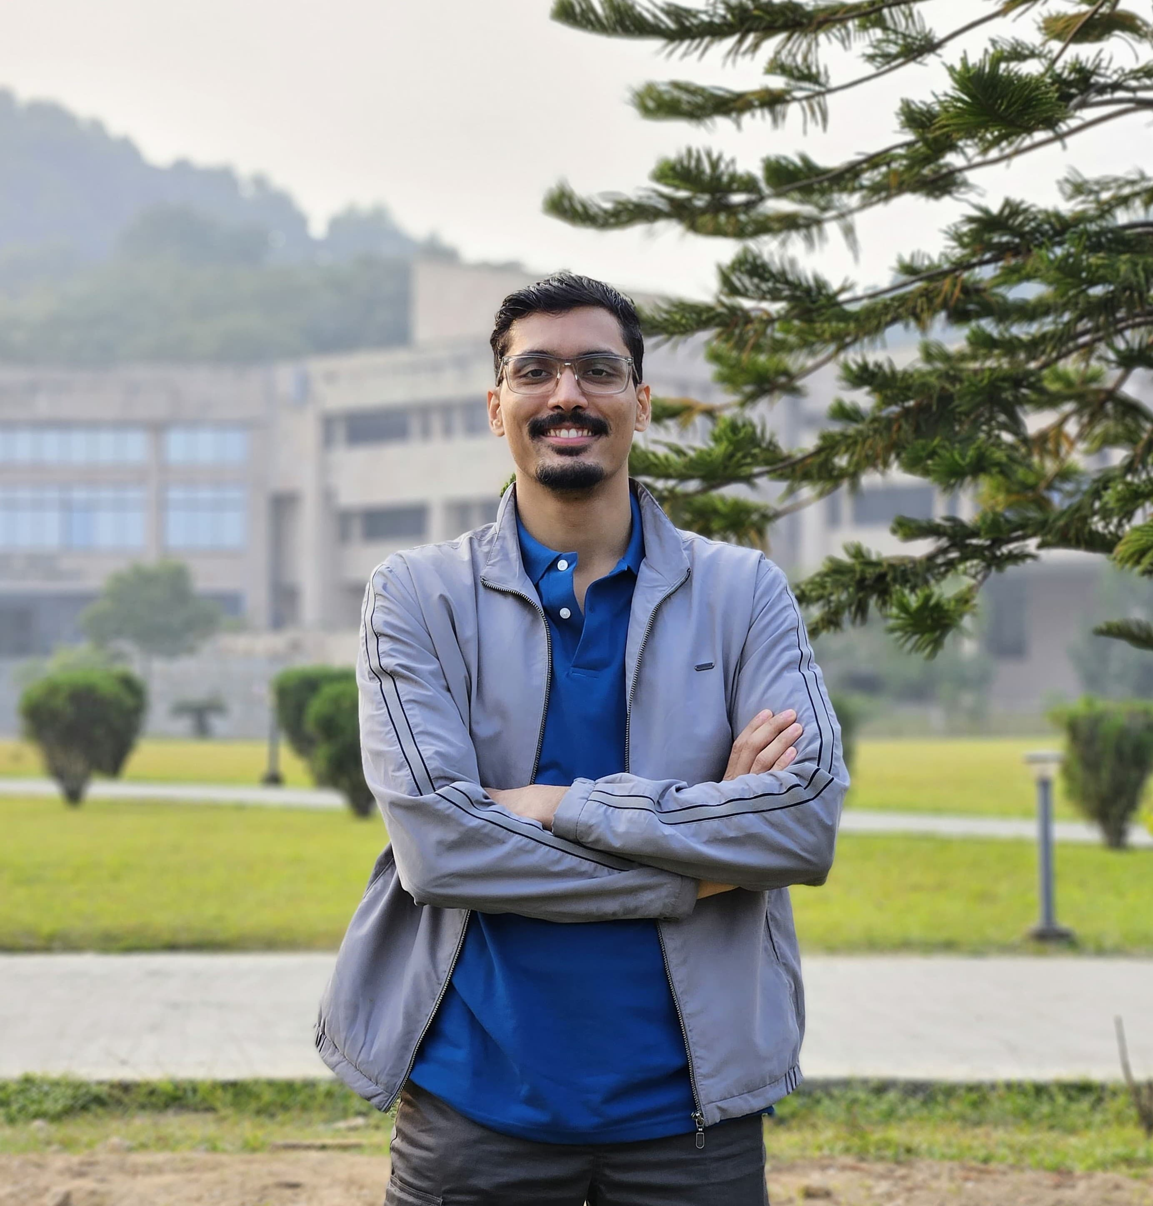



Akshay Daydar Research Scholar, IITG Research Areas: Medical Imaging, Deep Learning, Biomechanics
https://adaydar.github.io/

