Slide 1
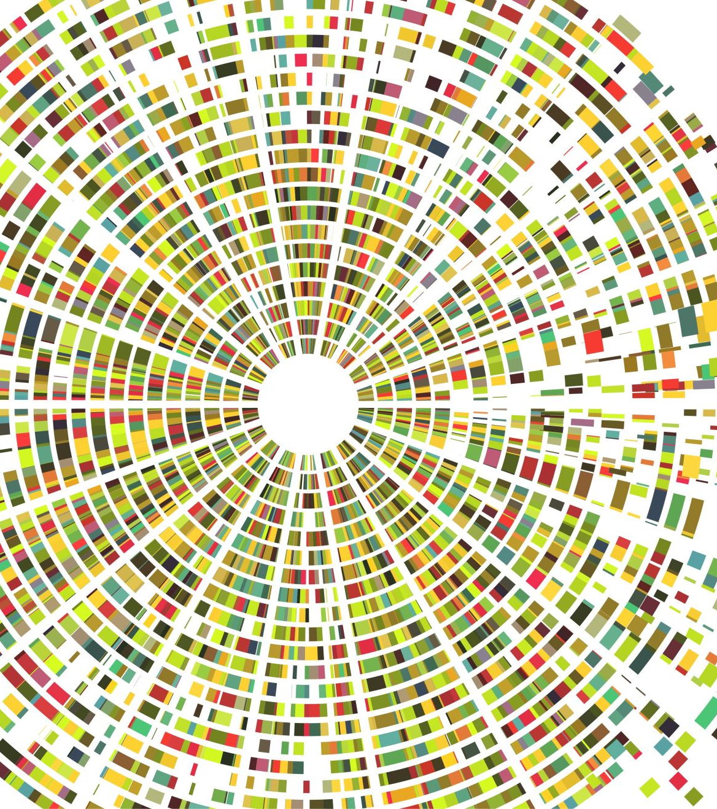
Predicting Personal Loan Acceptance: A Data-Driven Marketing & Deployment Strategy
Machine Learning for Targeted Banking
Domain: Banking, Predictive Analytics, Business Intelligence
- Sanskar Bajimaya & Amir Karki

Slide 2
Agenda/Outline
Background & Motivation
Problem Statement & Objectives
Dataset Overview
Methodology
Model Performance
Deployment Architecture
Business Impact
Future Work

Slide 3
Background & Motivation
Traditional banking marketing = broad, non-targeted campaigns
Low conversion rates, high costs, customer fatigue
Need for data-driven, personalized approach

Slide 4
Problem Statement
Problem: Banks struggle to identify customers likely to accept personal loans
Key Question: Can ML predict loan acceptance probability?

Slide 5
Objectives
Identify key predictors
Build high-recall classification model
Deploy real-time prediction API
Automate personalized email outreach

Slide 6
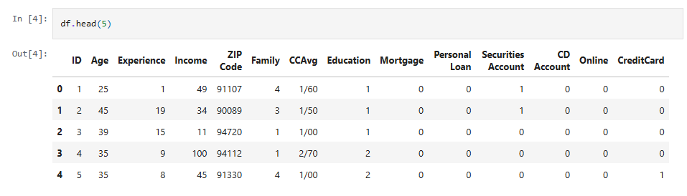
Dataset Overview
5,000 customer records, 14 variables
Demographics, financial attributes, behavioral indicators
Target: Personal Loan acceptance (binary)

Slide 7
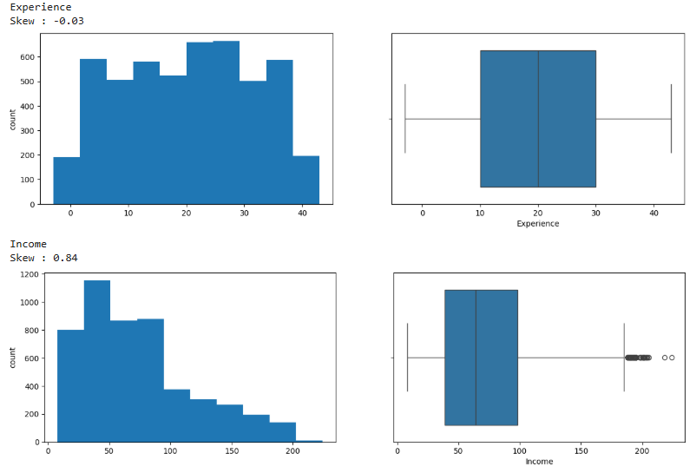
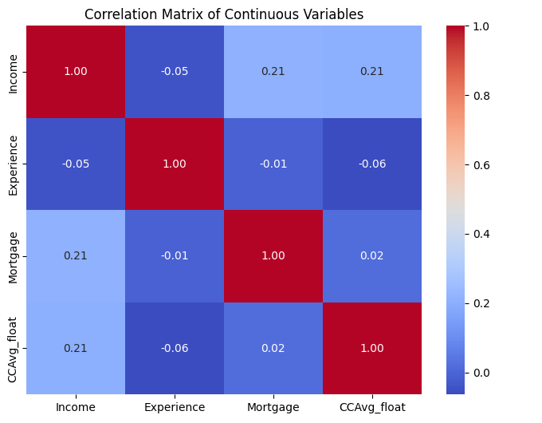
Exploratory Data Analysis - Continuous Variables
Continuous Variable
Correlation Findings
Income distribution analysis
Experience patterns: 50% have 10-30 years experience
Income range: 50% earn $40K-$100K annually
- weak linear correlations (no multicollinearity)

Slide 8
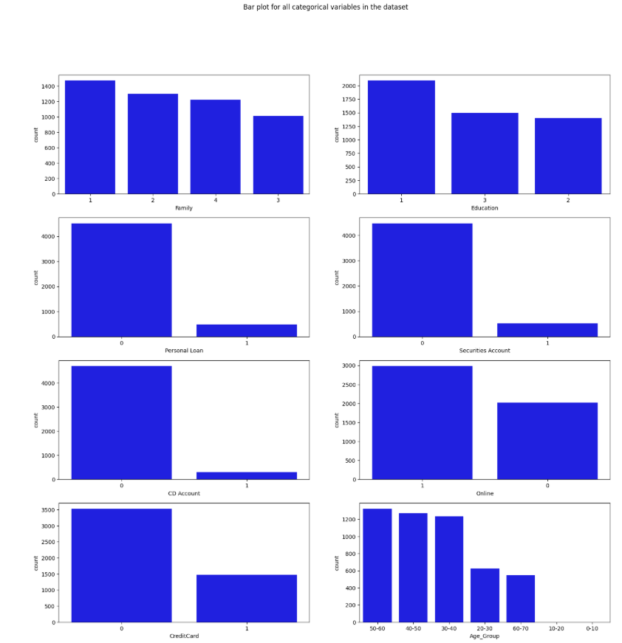
Exploratory Data Analysis - Categorical Variables
Content: Family Size & Education Level: relatively even distribution
Slight left skew toward smaller families and lower education
Class Imbalance Observed:
  Personal Loan acceptance: rare event
  Securities Account: fewer holders
  CD Account: fewer holders
Imbalance addressed through model tuning (scale_pos_weight)

Slide 9
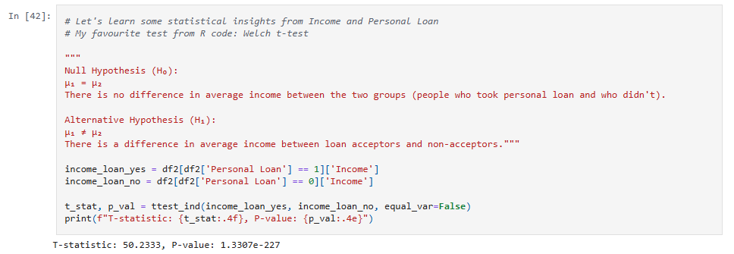
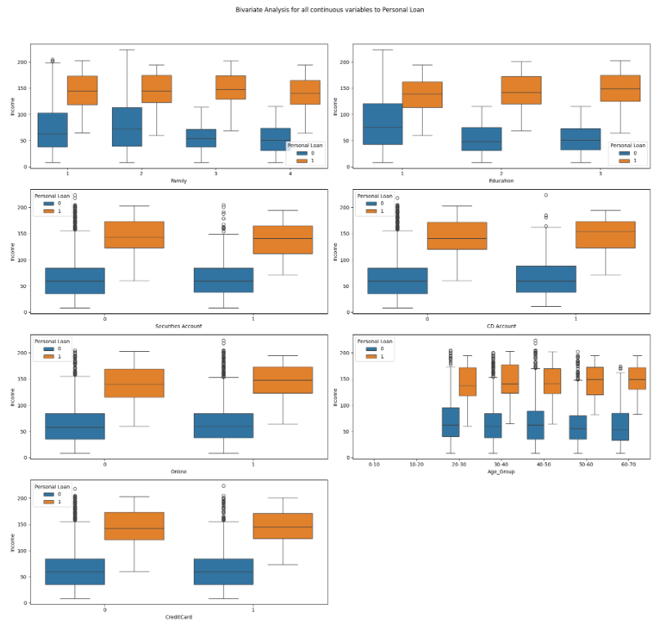
EDA - Key Insights
Content: Income is strongest predictor
Loan acceptors: primarily $100K-$200K income range
Statistical validation: Welch t-test
Extremely small p-value confirms income's predictive importance

Slide 10
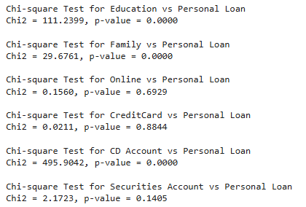
EDA - Key Insights
Chi-Square Tests performed to screen categorical variables
Notable Associations Found:
  Education Level ✓
  Family Size ✓
  CD Account ✓

Slide 11
Methodology & Feature Engineering
Data preprocessing (type correction, encoding, scaling, binning)
Label encoding for categorical variables
Standardization for numerical features
Train-test split (80-20), stratify and scale_pos
Three models trained: Logistic Regression, Random Forest, XGBoost

Slide 12
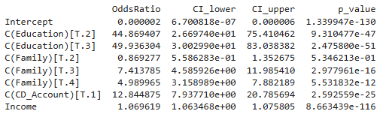
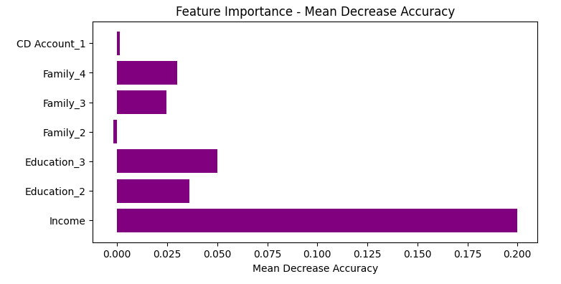
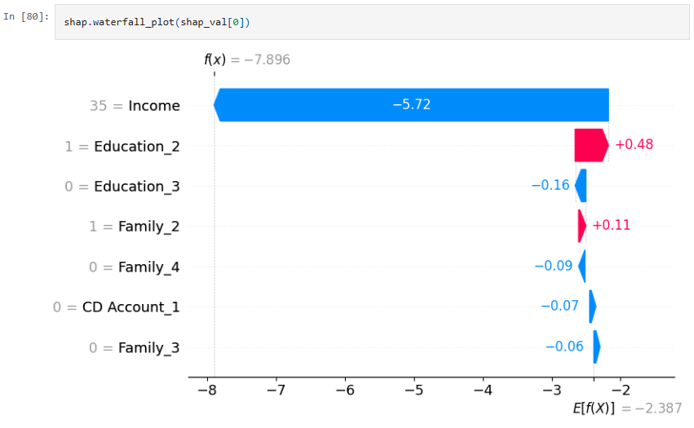
Model Explainability
Logistic Regression | Random Forest | XGBoost
Feature Coefficients | Gini Feature Importance | SHAP Analysis
Linear interpretability | Ensemble-based ranking | Shows feature contribution & direction
Direct weight analysis | Captures non-linear patterns | Model transparency for stakeholders
Direction & magnitude of impact

Slide 13
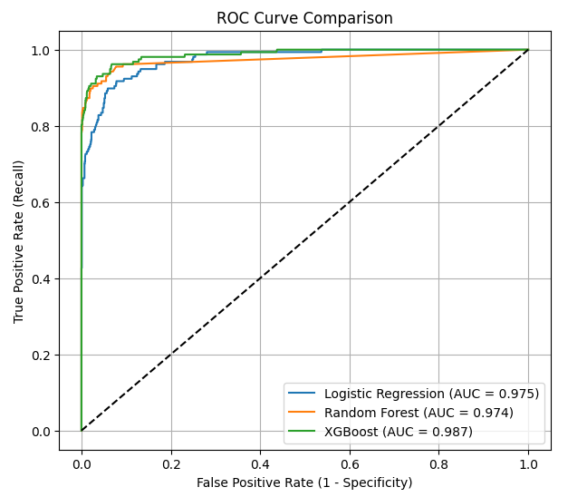
Model Performance Comparison
Metric | Logistic Regression | Random Forest | XGBoost Classifier
Accuracy | 0.88 | 0.91 | 0.93
Recall | 0.76 | 0.83 | 0.87
ROC-AUC | 0.91 | 0.95 | 0.97
Why recall matters: minimize missed opportunities (false negatives)
GridSearchCV optimization with recall scoring

Slide 14
Key Business Findings
High income customers (>$100K) = higher acceptance
Graduate/Advanced education = strong influence
CD Account holders = 13× more likely
Online/CreditCard = minimal predictive value

Slide 15
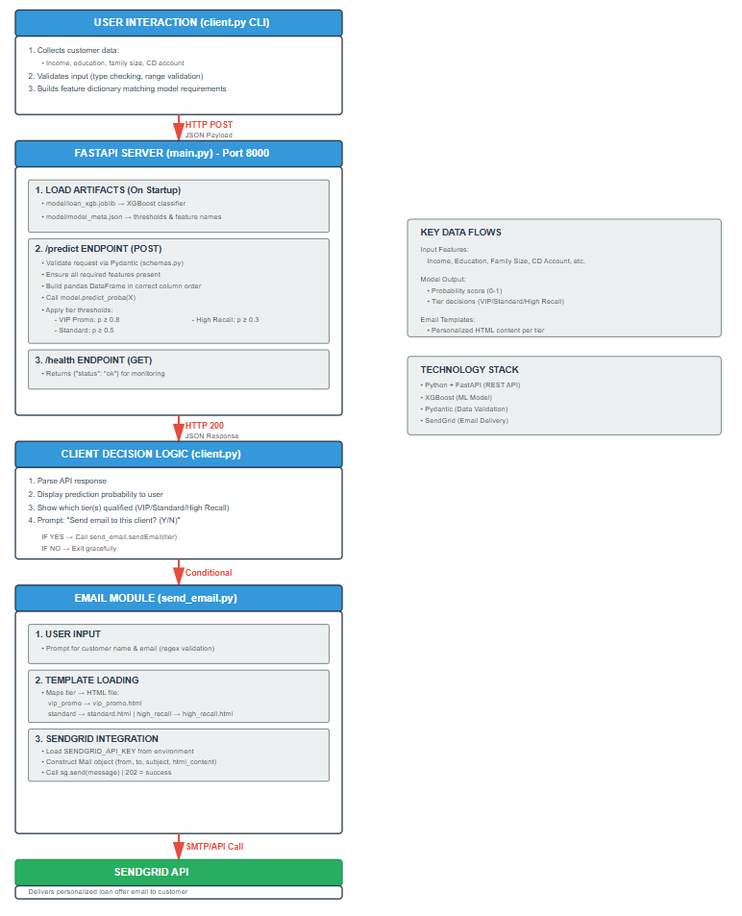
Deployment Architecture
FastAPI backend for real-time predictions
Client CLI for data input
Server (importing model for prediction)
SendGrid email automation
Three-tier system: High-Recall (0.3), Standard (0.5), VIP (0.8)

Slide 16
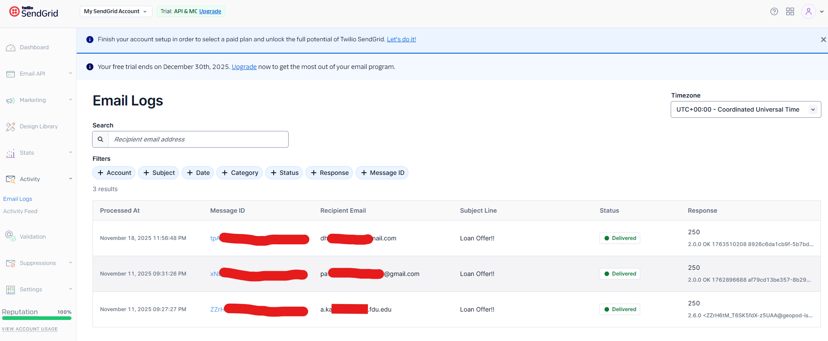
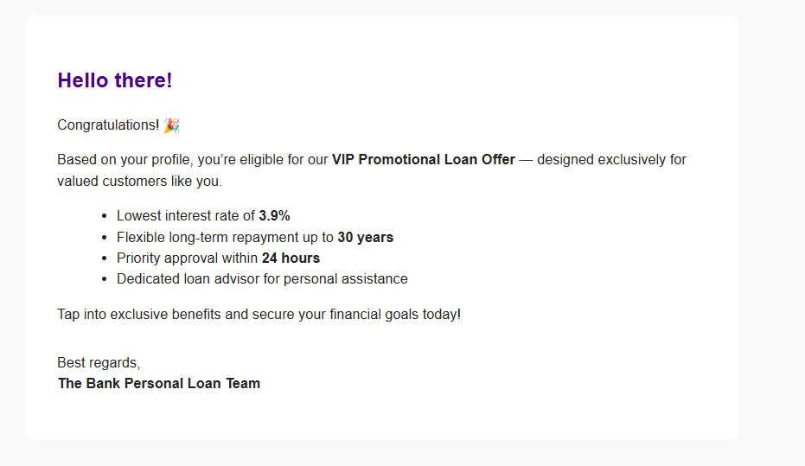
Email Automation in Action
Automated personalized outreach
Tier-based email templates
SendGrid integration
End-to-end workflow from prediction → email delivery

Slide 17
Business Value & Impact
Marketing:
Personalized targeting, higher engagement
Operational:
Automated workflow, scalable system
Financial:
Cost optimization, increased ROI, fewer false negatives

Slide 18
Limitations & Future Work
Limitations:
Static snapshot data (no temporal patterns)Missing credit risk indicators
Not tested in real production
Future Enhancements:
Cloud deployment (AWS/GCP/Azure)
Continuous learning pipeline
CRM integration
Multi-channel communication (SMS, app notifications)
A/B testing, interactive dashboards

