Slide 1
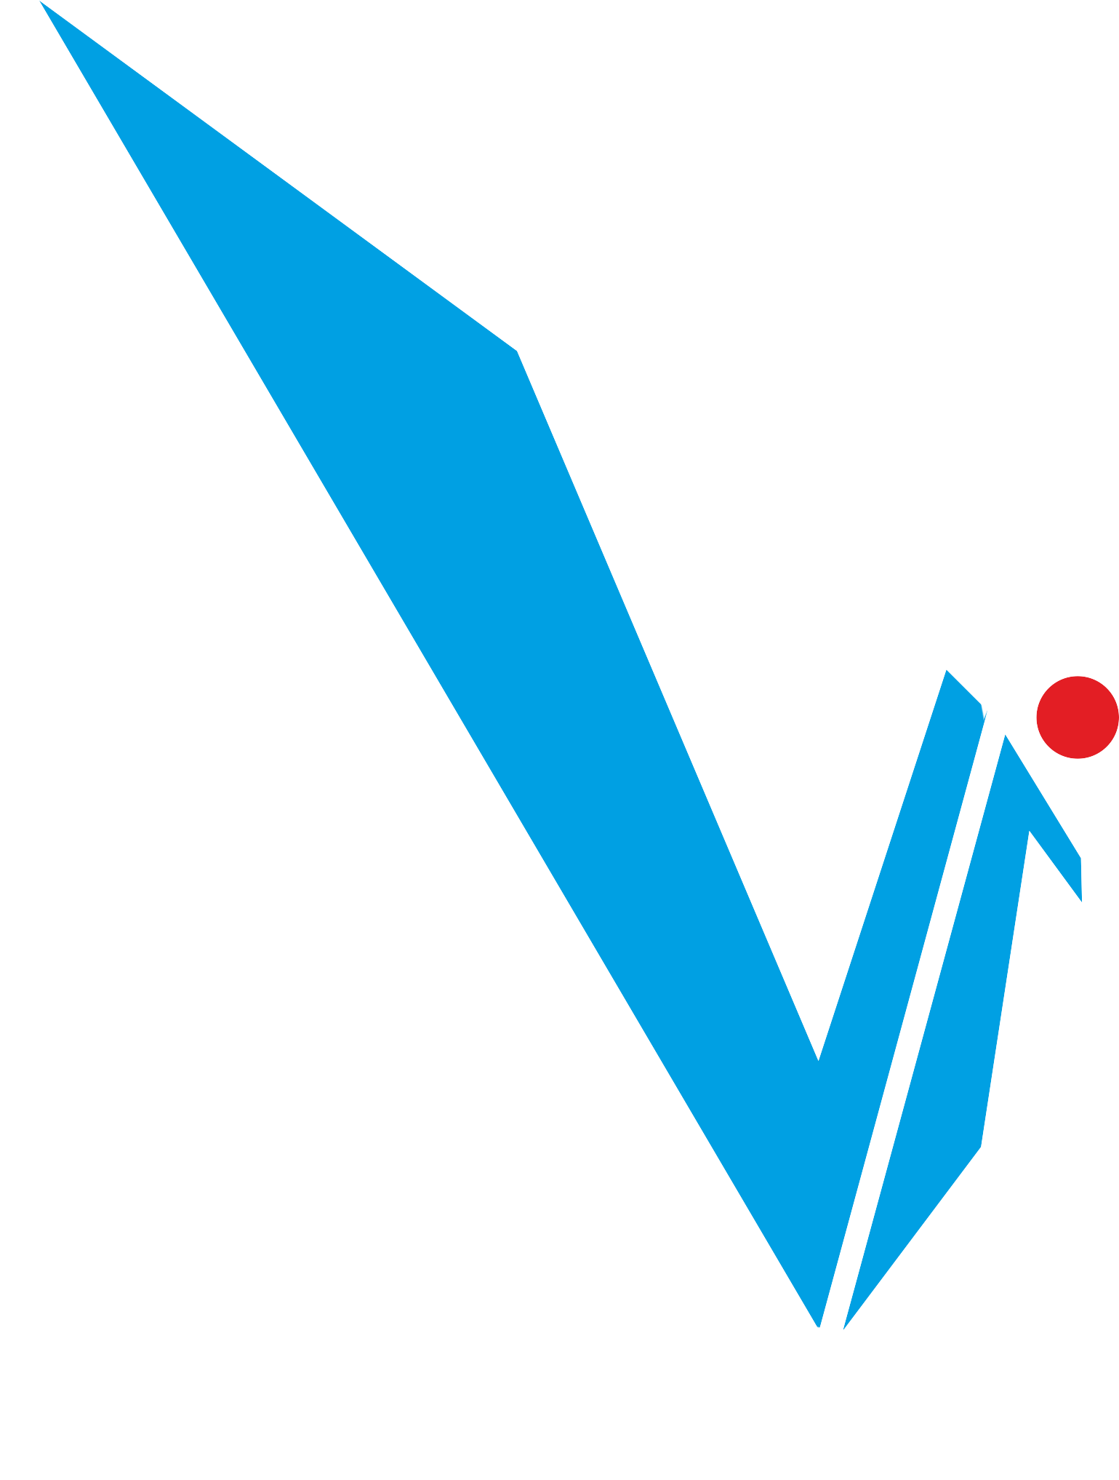
APPLIED SCIENCE AND ENGINEERING PROJECT
END-SEMESTER ASSESSMENT
JARVIS: An Autonomous AI Personal Assistant
With Comprehensive Task Management & Multi-Platform Integration
Course: AIML
Div:B
ASEP Group No. : 4
Date : 14/06/2025
PRESENTED BY :
Name | Roll No. | PRN
Shubhra Desai | 19 | 12412117
Arnav Deshmukh | 20 | 12414249
Himanshu Deshmukh | 21 | 12414955
Sanskar Deshpande | 22 | 12414328
Devang Damkondwar | 23 | 12414260
Atharva Devikar | 24 | 12410080
Ishwari Dhale | 25 | 12411884
PROJECT GUIDE:
PROF. VISHWESH RAGHUNATH DESHMUKH
DEPARTMENT OF ENGINEERING SCIENCES AND HUMANITIES (DESH)

Slide 2

INTRODUCTION
In today’s fast-paced digital world, people are overwhelmed by scattered apps, tasks, and notifications.
Constant switching between tools like WhatsApp, Google Classroom, and notes creates chaos and inefficiency.
JARVIS — Just A Really Versatile Intelligent System — is designed to solve this.
It’s not just a reminder app. It’s an autonomous AI assistant that gets things done for you.
From managing tasks to sending updates, it works quietly in the background.
It connects across platforms, understands your intent, and executes workflows without needing your constant input.
JARVIS is your Second Brain—smart, secure, and always a step ahead.

Slide 3

PROBLEM STATEMENT
❌ Disjointed Productivity Tools – No unified system for managing tasks, notes, and actions.
❌ Manual Overload – Repetitive tasks like uploading, scheduling, and reminding drain time.
❌ Platform Fragmentation – Users operate across multiple apps with no intelligent sync.
❌ Lack of Privacy Controls – Data flows without user-centric permission and encryption.

Slide 4
OBJECTIVES
✅ Build an autonomous AI assistant to manage tasks, documents, and reminders.
✅ Seamlessly integrate with widely used platforms (e.g., Google, Instagram, WhatsApp).
✅ Provide multi-agent orchestration for intelligent decision-making.
✅ Ensure privacy-first operation with end-to-end encryption and granular controls.

Slide 5


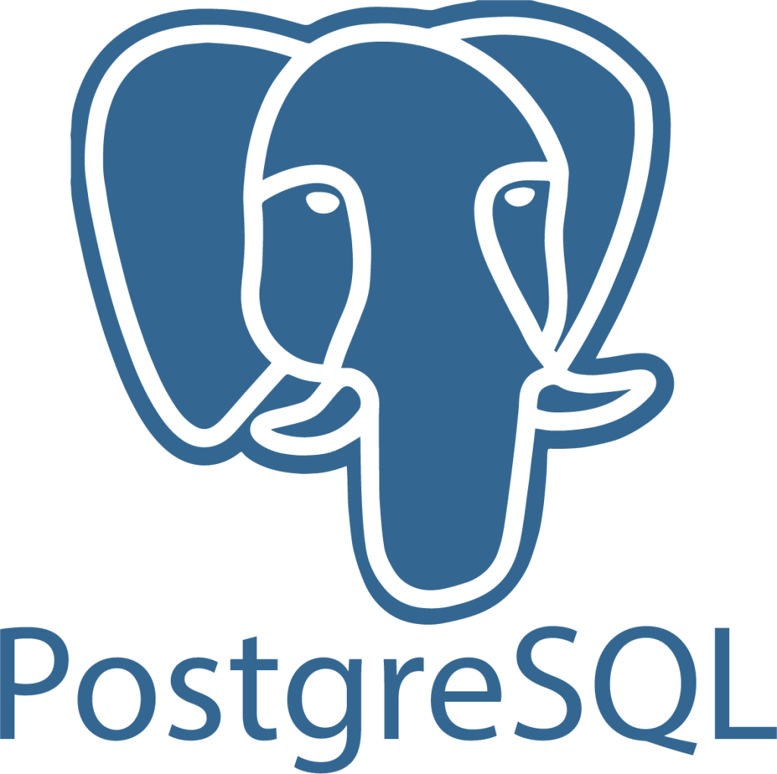
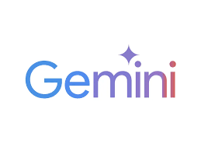

TOOLS USED
Frontend: React.js (Web & Mobile UI)
Backend: Django (Python)
Database: PostgreSQL with pgvector
NLP: Gemini API
APIs: Google Classroom API, WhatsApp Business API, Instagram Webhooks
Security: TLS, AES-256, OAuth 2.0

Slide 6
METHODOLOGY
Django was used for backend development and managing server-side logic.
React.js was used to build the user interface for web interaction.
PostgreSQL served as the primary database for storing user data.
pgvector extension was used for handling vector embeddings for RAG.
Redis was used for caching session data and context states.
spaCy & BERT were used for natural language processing and intent recognition.
Google Classroom API was integrated for assignment automation.
WhatsApp Business API & Instagram Webhooks were used for notifications and interactions.
AES-256 encryption and OAuth 2.0 were implemented for data security and authentication.

Slide 7
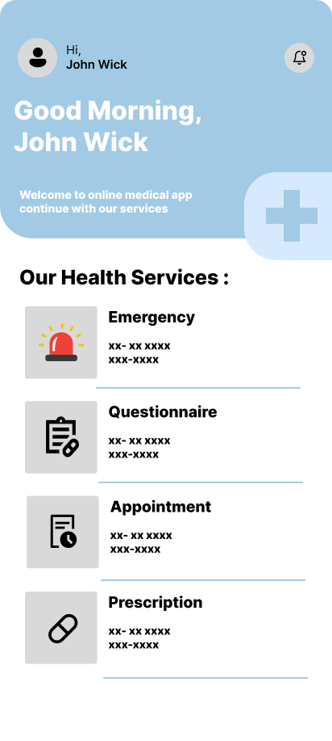
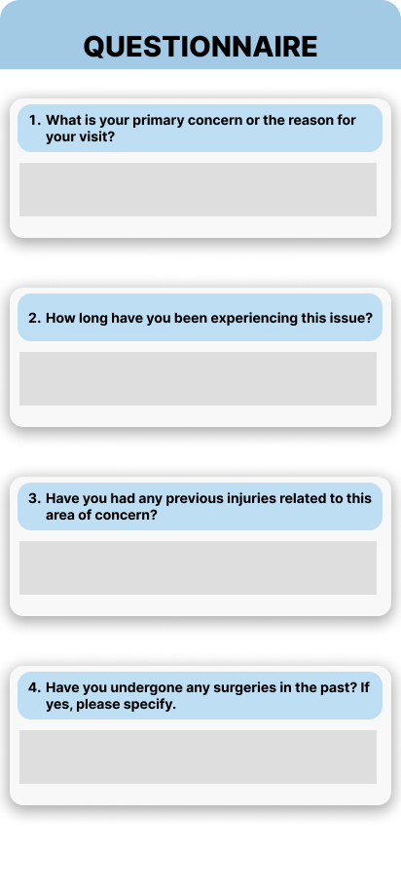
Django was used for backend development and managing server-side logic.
React.js was used to build the user interface for web interaction.
PostgreSQL served as the primary database for storing user data.
METHODOLOGY
pgvector extension was used for handling vector embeddings for RAG.
Redis was used for caching session data and context states.
Pypdf was used for creating word files.
Google Classroom API was integrated for assignment automation.
WhatsApp Business API & Instagram Webhooks were used for notifications and interactions.
AES-256 encryption and OAuth 2.0 were implemented for data security and authentication.

Slide 8
Django was used for backend development and managing server-side logic.
React.js was used to build the user interface for web interaction.
PostgreSQL served as the primary database for storing user data.
pgvector extension was used for handling vector embeddings for RAG.
Redis was used for caching session data and context states.
METHODOLOGY
spaCy & BERT were used for natural language processing and intent recognition.
Google Gemini API was integrated to work as LLM and NLP.
WhatsApp Business API & Instagram Webhooks were used for notifications and interactions.
AES-256 encryption and OAuth 2.0 were implemented for data security and authentication.

Slide 9
Challenges & Limitations
Learning Django Framework: Took time to understand how to structure backend logic and handle APIs efficiently.
NLP Integration Difficulties: Fine-tuning models for accurate intent detection and entity extraction was challenging.
Platform API Issues: Faced difficulties with API limitations, especially with WhatsApp and Instagram integrations.
Vector Database Setup: Initial setup and tuning of pgvector for similarity search required trial and error.
Maintaining Context State: Ensuring correct context retention during multi-turn interactions was technically complex.

Slide 10
Future Scope & Enhancements
📹 Telepresence: Add voice/video interaction for meetings or task briefings.
🧠 Adaptive Learning: Use RL to tune to user’s work habits and preferences.
📊 Predictive Suggestions: Pre-emptively suggest actions like “Prepare for tomorrow’s class.”
👥 Collaborative Workspaces: Teams can co-manage tasks, docs, and deadlines.
📱 Mobile Native App: For always-available assistance.

Slide 11
Results and Discussion
The development and initial testing phase of JARVIS showed highly promising outcomes across multiple dimensions. Through real-world use cases like assignment management, automated messaging, and document handling, the system consistently delivered smooth, hands-free task execution.
Improved Efficiency
Users reported feeling significantly more organized and in control of their workload. Routine tasks like uploading assignments or sending reminders—once manual and repetitive—were now handled effortlessly in the background.
Smoother Cross-Platform Workflows
Whether it was Google Classroom, WhatsApp, or email, JARVIS successfully demonstrated its ability to operate across platforms without requiring user intervention each time. The integration felt seamless and saved a lot of back-and-forth switching.
Enhanced User Trust
With features like permission-based access, encrypted communication, and transparent activity logs, users felt reassured that their data was secure. This created a strong foundation of trust between the user and the assistant.
Low Friction, High Impact
Despite the complexity behind the scenes—multi-agent systems, NLP pipelines, task planning—users experienced a smooth and responsive interface. They didn’t have to learn anything new; JARVIS fit naturally into their workflow.

Slide 12
THANK YOU

