Slide 1


INSTITUTE FOR ADVANCED COMPUTING AND SOFTWARE DEVELOPMENT AKURDI, PUNE
IDPS USING SNORT/SURICATA AND ALERT
VIA MAIL
GROUP NO: 26
SANSKAR GUPTA (233452)
KULDEEP PATEL (233416)
MR. KARTIK AWARI MR. ROHITPURANIK PROJECT GUIDE CENTRE COORDINATOR

Slide 2
INDEX
INTRODUCTION
PROBLEM STATEMENT
PROPOSED SOLUTION
TECHNOLOGY USED
INFORMATION ABOUT IDPS TOOLS
ADVANTAGES OF IDPS TOOLS WITH EXAMPLE
ARCHITECTURE OF SNORT AND SURICATA
ALERT SYSTEM PROCESS
IMPLEMENTATION SCREENSHOTS
FUTURE ENHANCEMENT
CONCLUSION
REFERENCES

Slide 3
INTRODUCTION
Intrusion detection and prevention systems (IDS/IPS) are security tools that monitor network traffic for malicious activity. IDS systems detect intrusions, while IPS systems can also prevent them.
Snort and Suricata are two popular open-source IDS/IPS systems. They are both capable of detecting a wide range of threats, including network scanning, port scanning, and denial-of-service attacks.
Alert notification is an important feature of IDS/IPS systems. It allows you to be notified of potential threats so that you can take action to mitigate them. Email is a common method for alert notification.
In this project, we will use Snort or Suricata to detect intrusions and send alerts via email. We will also configure the system to detect specific threats, such as network scanning or port scanning.
In this project we will demonstrate how to use Snort or Suricata to protect a network from malicious activity. It will also show how to configure alert notification to ensure that you are notified of potential threats in a timely manner.

Slide 4
PROBLEM STATEMENT
Network security is a critical issue for businesses of all sizes. Intrusions and other malicious activities can cause significant damage, including data loss, financial losses, and reputational harm.
IDS/IPS systems are an important tool for protecting networks from malicious activity. However, they can be complex to configure and maintain. Additionally, they can generate a large number of alerts, which can make it difficult to identify and respond to real threats.

Slide 5
PROPOSED SOLUTION
This project will use Snort or Suricata to detect intrusions and send alerts via email. The system will be configured to detect specific threats, such as network scanning or port scanning. This will help to reduce the number of false alerts and make it easier to identify and respond to real threats.
The project will also demonstrate how to use Snort or Suricata to protect a network from malicious activity. It will also show how to configure alert notification to ensure that you are notified of potential threats in a timely manner.
Benefits:
The benefits of this project include:
Improved network security
Reduced number of false alerts
Easier identification and response to real threats
Increased visibility into network traffic
Improved compliance with security standards

Slide 6
TECHNOLOGY USED
Hardware Requirement :
• RAM: 16 GB
• HDD: 512GB
Software Requirement :
• Operating System: Windows 10
• Tool: VMWare Workstation Pro

Slide 7
INFORMATION ABOUT IDPS TOOLS
Snort is an open-source, free and lightweight network intrusion detection system (NIDS) software for Linux and Windows to detect emerging threats. It is one of the most popular IDS tools available. Snort can be used to detect a wide range of threats, including network scanning, port scanning, and denial-of-service attacks. It can also be used to detect more advanced threats, such as malware and zero-day attacks.
Suricata is another popular open-source IDS/IPS system. It is similar to Snort in many ways, but it offers some additional features, such as multi-threading and support for more protocols. Suricata is also more flexible than Snort, making it a good choice for advanced users.
Both Snort and Suricata are capable of detecting a wide range of threats. The choice of which tool to use depends on your specific needs and requirements. If you are looking for a lightweight and easy-to-use IDS tool, Snort is a good choice. If you need a more powerful and flexible IDS tool, Suricata is a good option.

Slide 8
ADVANTAGES OF IDPS TOOLS
Improved network security: IDPS tools can help to protect networks from a variety of threats, including malware, denial-of-service attacks, and network intrusions.
Reduced number of false alerts: IDPS tools can be configured to filter out false alerts, which can help to reduce the workload on security teams.
Easier identification and response to real threats: IDPS tools can help to identify real threats more quickly, which can help to reduce the damage caused by these threats.
Increased visibility into network traffic: IDPS tools can provide visibility into network traffic, which can help to identify potential threats and vulnerabilities.
Improved compliance with security standards: IDPS tools can help organizations to comply with security standards, such as PCI DSS and HIPAA.

Slide 9
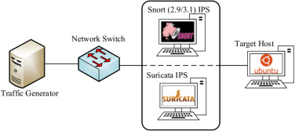
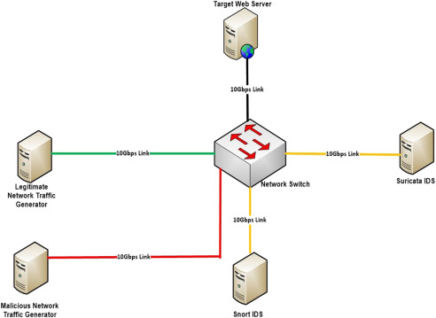
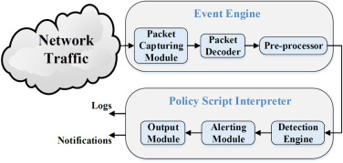
ARCHITECTURE OF SNORT SURICATA

Slide 10
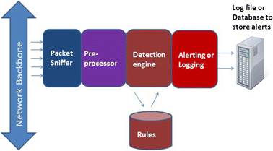
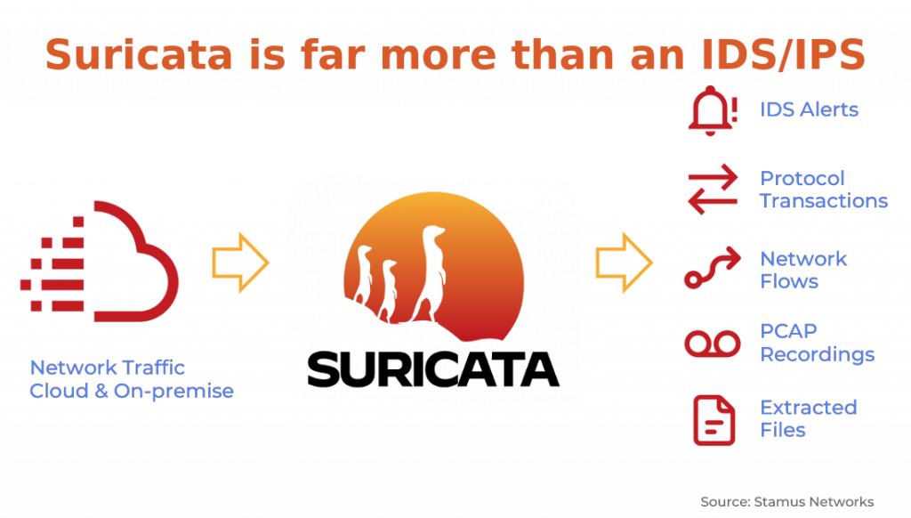
ALERT SYSTEM PROCESS

Slide 11
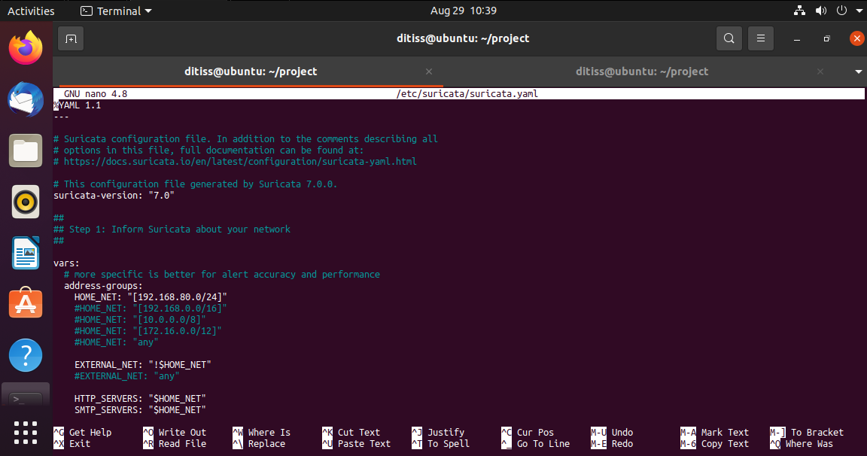
IMPLEMENTATION SCREENSHOTS

Slide 12
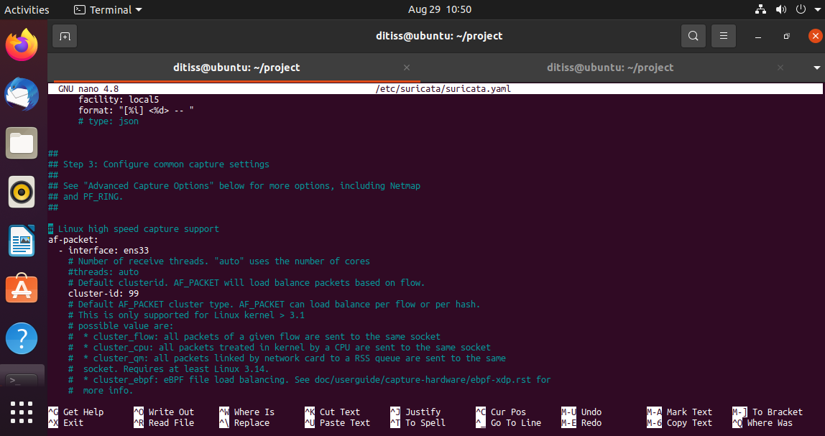

Slide 13
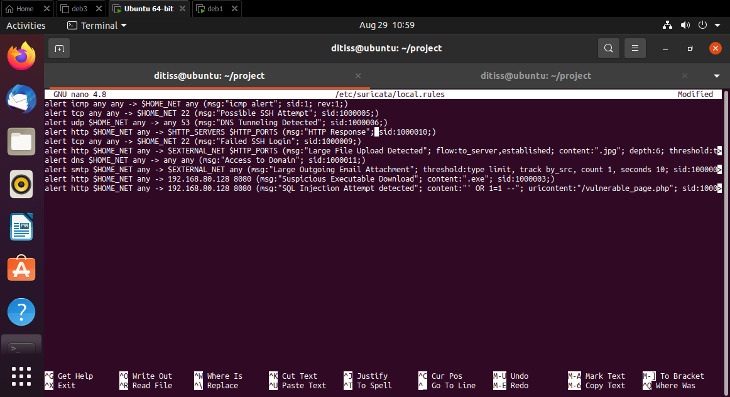

Slide 14
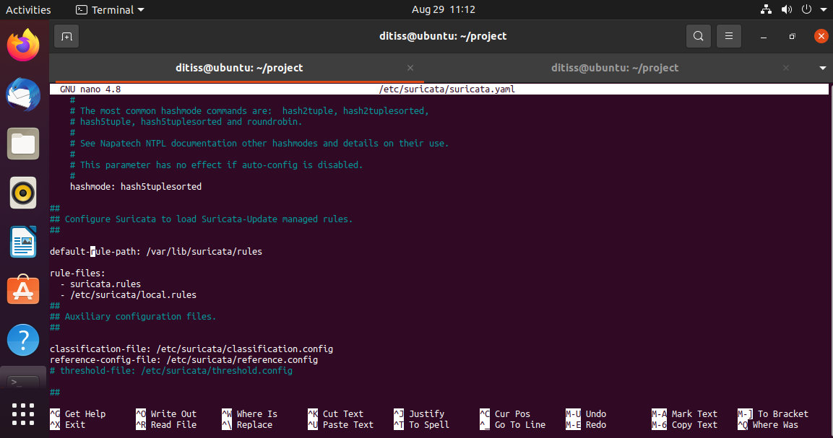

Slide 15
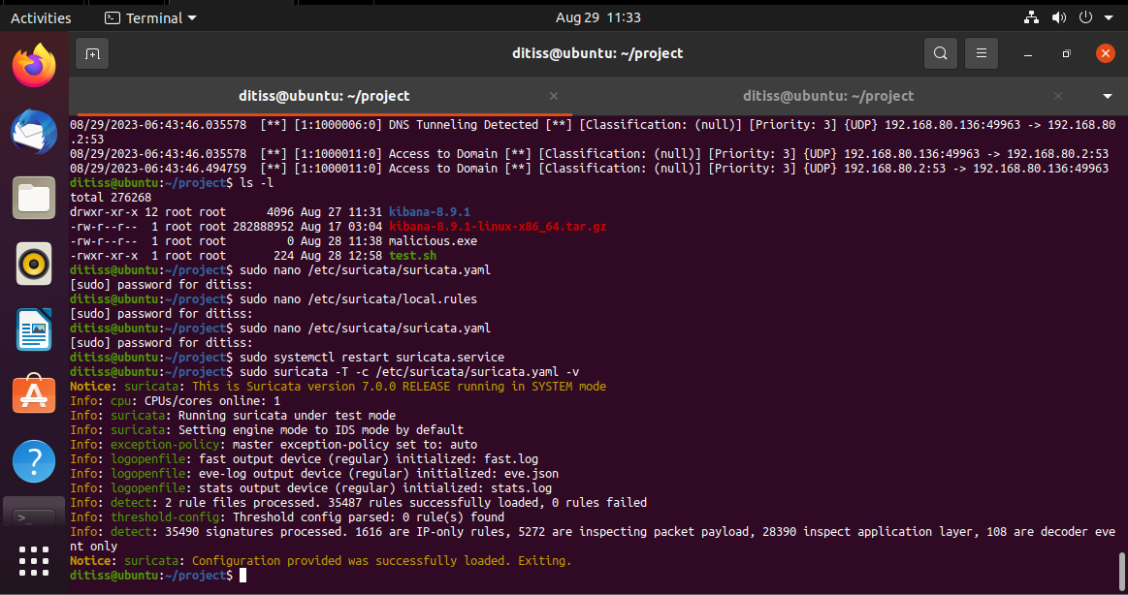

Slide 16
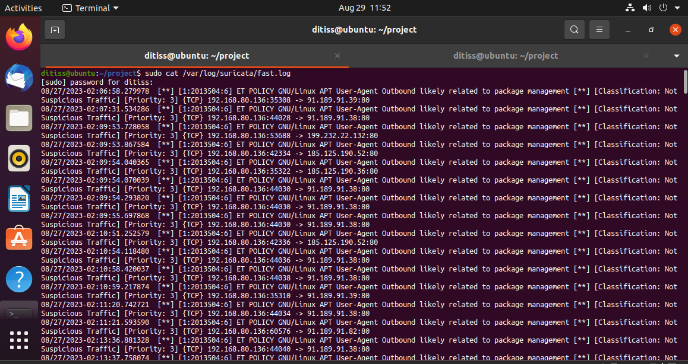

Slide 17
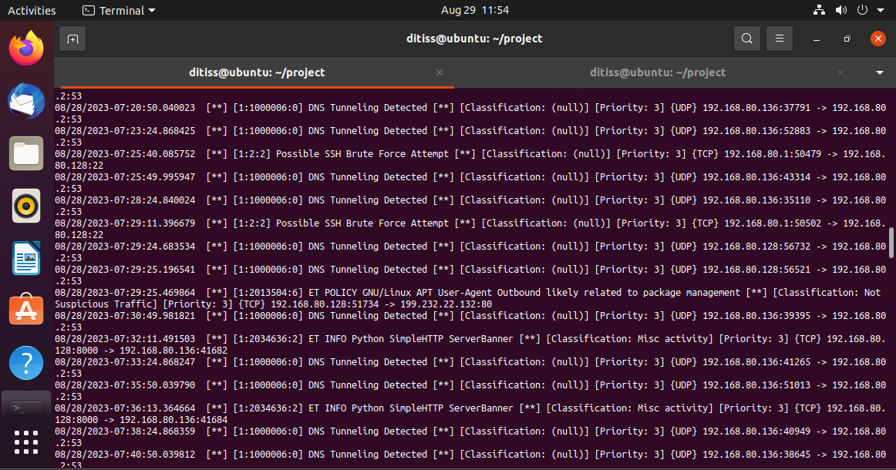

Slide 18
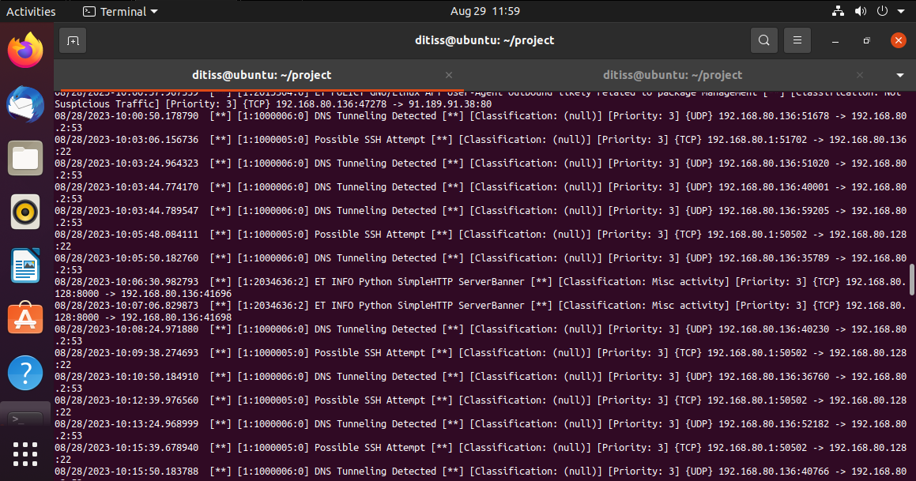

Slide 19
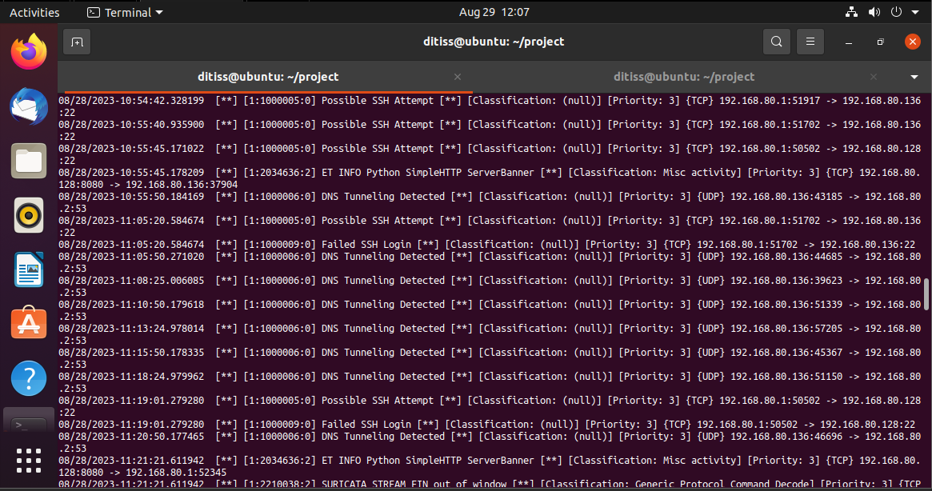

Slide 20
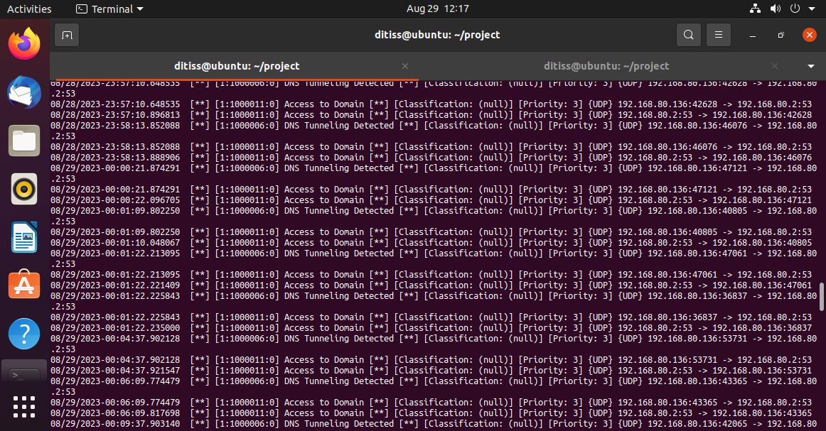

Slide 21
FUTURE ENHANCEMENTS
Use a more powerful IDPS tool: If you are using Snort, you could consider using Suricata instead. Suricata is more powerful and flexible than Snort, and it offers some additional features, such as multi-threading and support for more protocols.
Use a cloud-based IDPS tool: Cloud-based IDPS tools are becoming increasingly popular. These tools offer a number of advantages, such as scalability, ease of deployment, and cost-effectiveness.
Integrate your IDPS with other security tools: You could integrate your IDPS with other security tools, such as firewalls and intrusion prevention systems. This would allow you to get a more comprehensive view of your network security and to take a more proactive approach to threat detection and mitigation.
Use machine learning to improve your IDPS's detection capabilities: Machine learning can be used to improve the detection capabilities of IDPS tools. This is because machine learning can be used to identify patterns in network traffic that are indicative of malicious activity.
Automate the response to IDPS alerts: You could automate the response to IDPS alerts. This would allow you to take action on alerts more quickly and efficiently.

Slide 22
CONCLUSION
In conclusion, this project has demonstrated how to use Snort or Suricata to detect intrusions and send alerts via email. The system was configured to detect specific threats, such as network scanning or port scanning. This helped to reduce the number of false alerts and made it easier to identify and respond to real threats. The project also showed how to configure alert notification to ensure that you are notified of potential threats in a timely manner. This is an important step in protecting your network from malicious activity.

Slide 23
REFERENCES
Suricata documentation: https://suricata.io/
Snort documentation: https://www.snort.org/
Bard: https://bard.google.com/
Youtube: https://www.youtube.com/
Google: https://www.google.com/
Some extra notes and suggestions from mentors.

Slide 24
THANK YOU!
-Sanskar Gupta
Kuldeep Patel

