Slide 1
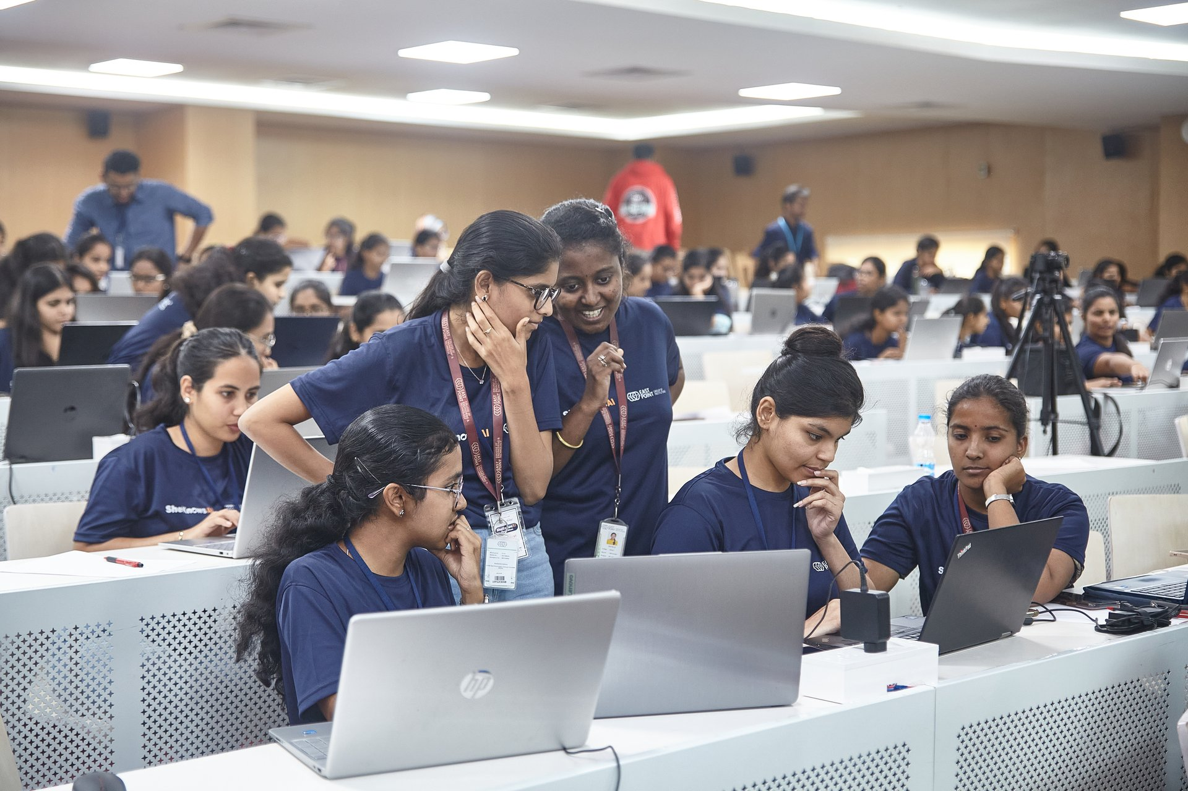


ASPIRE FOR HER × LOGITECH
🏆 In collaboration with AICTE & applied for “Guinness Book of World Records”
Women Who Master — Individual GenAI Hackathon Submission
Submitted by: Sanskriti Shukla| Registration/Roll number: WWM26-MUM-G-T044-M04 | Location: Mumbai

Slide 2
Before the hackathon, each participant is expected to:
Complete the ‘Introduction to PartyRock’ prerequisite course.
Review the recommended tutorial: https://youtu.be/rlRuKTKuhnA
Confirm access to PartyRock, email, cloud storage and the submission portal.
Bring a charged laptop and charger. All competitive work must be completed individually during the official four-hour window.

Slide 3
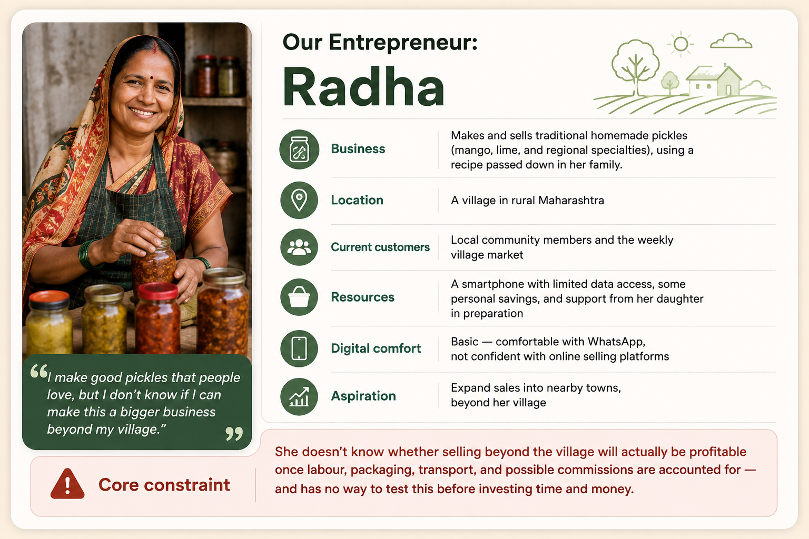
Challenge Selected
Problem Statement 3 | Rural Entrepreneurship: From Local Opportunity to the Next Evidence-Based Decision
What We're Solving:
Rural women have real skills and products — but no reliable way to know if an idea is actually profitable before investing savings
Generic business plans don't answer: Will customers pay? What's the real margin? Should she proceed or pause?
Nirnay turns her raw idea into one clear, evidence-based next decision — Proceed, Pilot, Modify, Collaborate, Test Further, or Pause

Slide 4
User and Problem Definition — Maximum 100 Words
The Real Problem
Who experiences it:
Radha — and thousands of rural women like her, who have a genuine skill and product but no way to know if it can become a real business
The gap:
Generic business advice tells her to "make a plan" — but never tells her whether this specific idea, at this specific price, in this specific location will actually work
What currently happens:
She makes and sells a good product, but only within arm's reach — her village
Every time she thinks about expanding, she's stuck guessing: Will it sell? Will it be profitable? Is it even worth trying?
With no reliable way to test this, she either stays small out of fear, or expands blindly and risks her savings
Success looks like:
Radha moves from "I can make this, but I don't know if it'll work" → to "I know exactly what to test, what it will cost, and what to do next"

Slide 5
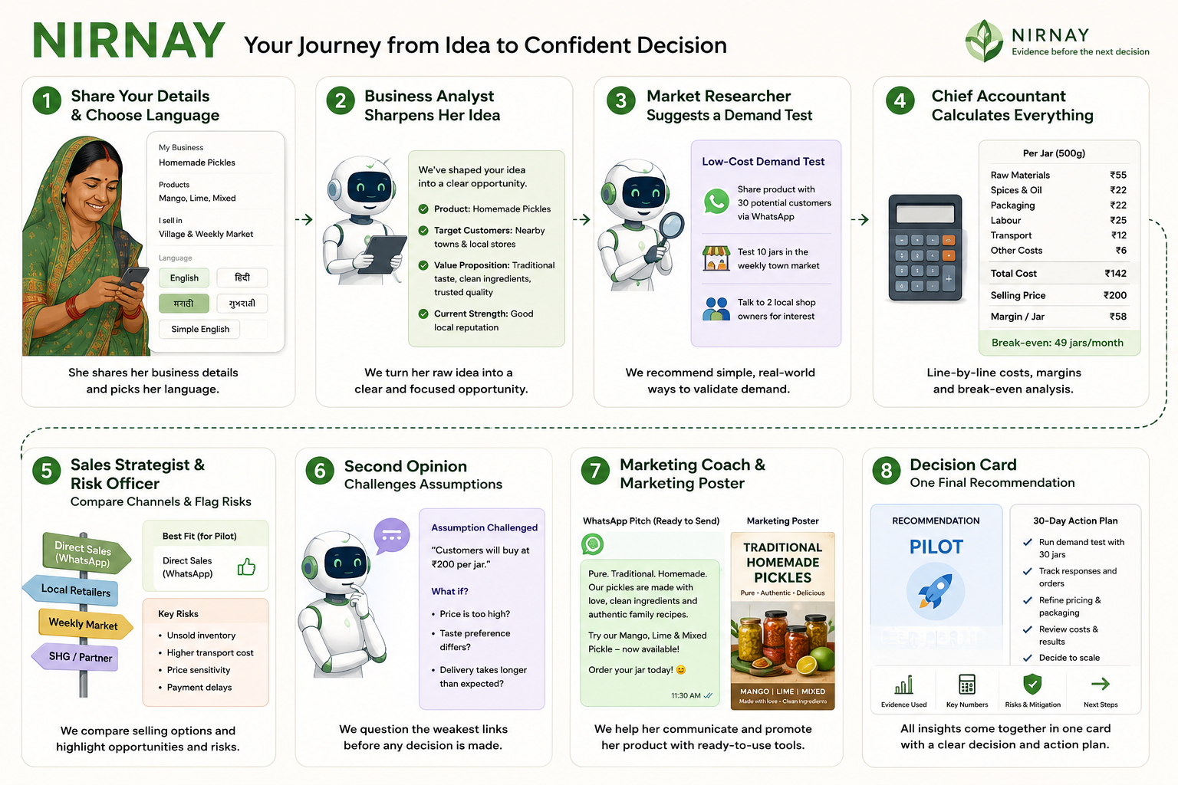
Proposed Solution — Maximum 200 Words
How Nirnay Works
Solution Overview:
Nirnay is a team of specialist AI advisors, built entirely in PartyRock, that takes a rural woman entrepreneur's raw business idea and turns it into one clear, evidence-based decision.
What's Distinctive:
Not one chatbot — 11 specialist agents working together like a real advisory panel
Every number is calculated transparently, never guessed
The system actively challenges her, instead of just agreeing with her
Multilingual — including her own regional language, not just English
GenAI Capability Used:
Built on Claude (via Amazon Bedrock/PartyRock), using chained AI agents that reference each other's outputs to reason step-by-step toward a final decision.
Try it live: https://partyrock.aws/u/Kuromi05/SgVDia2mn/Nirnay%253A-Rural-Women-Entrepreneur-Decision-Guide

Slide 6
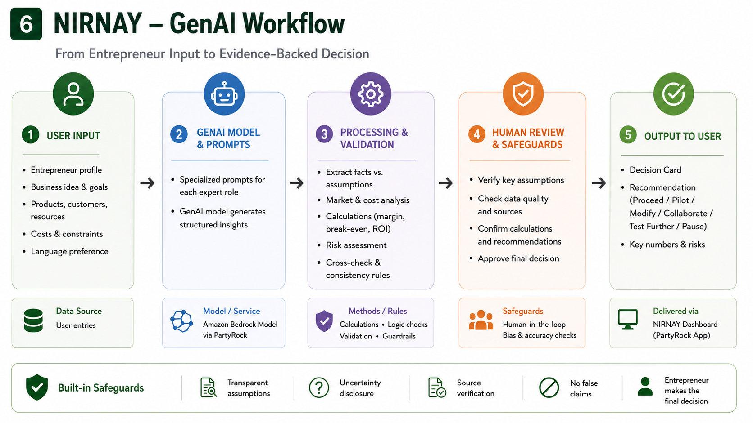
GenAI Workflow or System Design

Slide 7
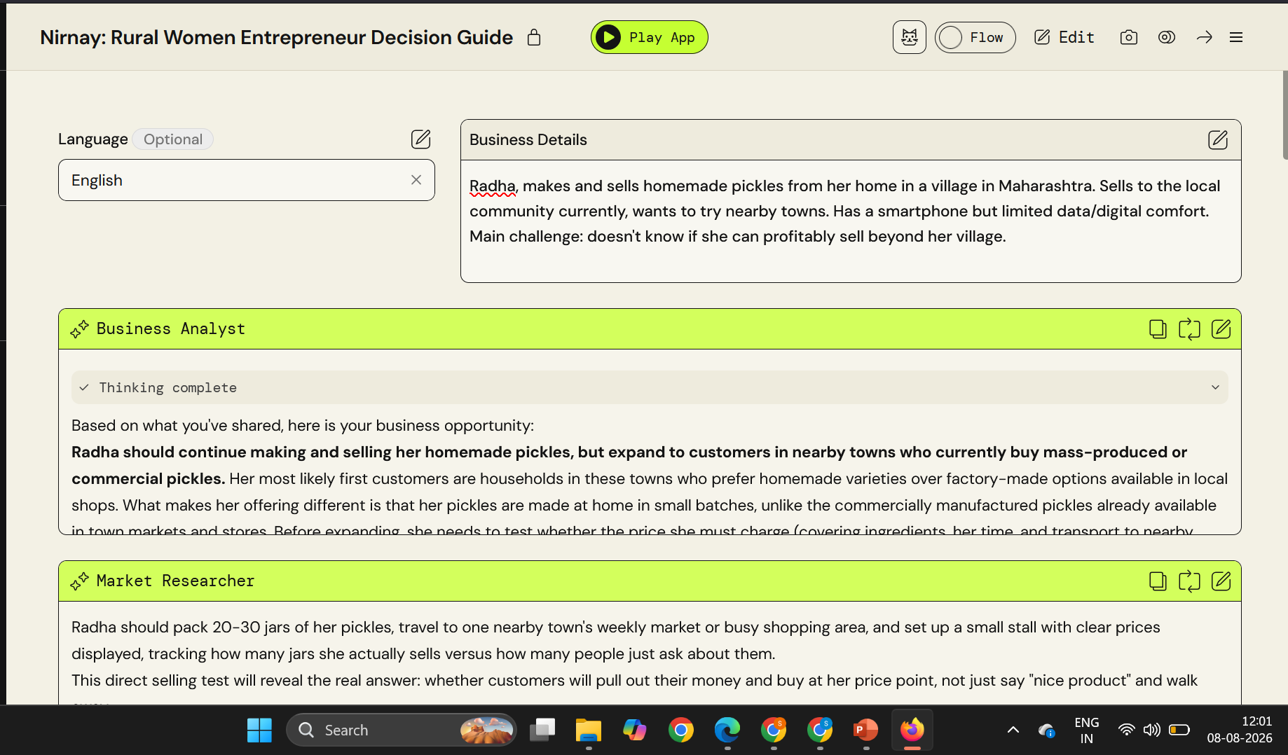
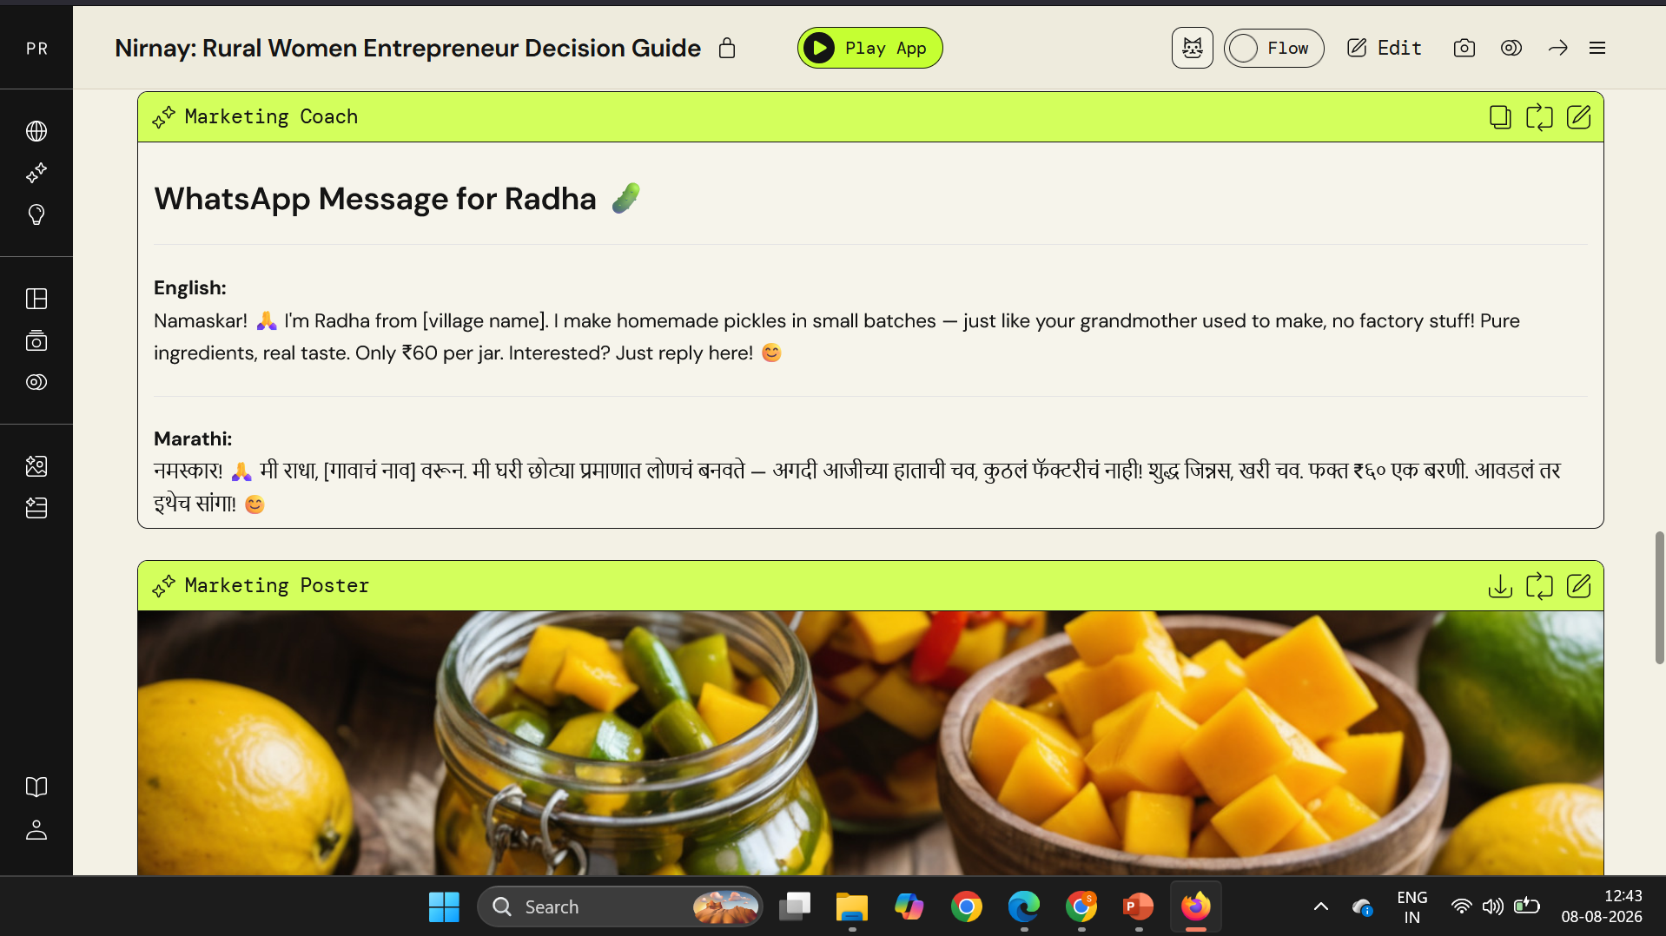
Mandatory Progress Evidence — 10:00 AM and 12:00 PM
• 10:00 AM: early build — PartyRock was unavailable during the initial checkpoint due to a platform crash; therefore, no valid uncropped solution screenshot could be captured.
• 12:01 PM: developed build — Core advisory workflow working: Business Analyst and Market Researcher generating business-specific insights.
• 12:43 PM: developed build — Expanded prototype with refined outputs, multilingual marketing support, WhatsApp-ready messaging, and AI-generated product visuals.

Slide 8
AI Tools and Prompts Used
Prompting NIRNAY to Think, Not Just Respond
AI Platform : Amazon PartyRock
Used to build and orchestrate NIRNAY's GenAI workflow through specialized prompts and connected components.
GenAI Model: Anthropic Claude 4.6 Sonnet IMAGE MODEL : Stability AI Stable Image Core v1.1
Key Prompts
01 — Business Analysis
“Convert the entrepreneur's skills, resources and initial idea into one clearly defined business opportunity. Separate facts provided by the entrepreneur from assumptions.”
02 — Evidence & Decision
“Evaluate demand, unit economics, sales channels and risks. Clearly distinguish verified information, assumptions, calculations and missing evidence before recommending one next decision.”
03 — Second Opinion
“Challenge the weakest assumption in this business case. Identify what could make the recommendation fail and specify the smallest practical test that would validate it.”
Prompt Refinement
Version 1 — Broad Guidance
→ Produced generic business suggestions without clearly distinguishing facts, assumptions, and unknowns.
Version 2 — Structured Reasoning
→ Added explicit instructions to separate evidence from assumptions, show calculations, identify missing information, and justify the recommendation.
Final Result
→ More transparent, grounded, and decision-focused outputs that tell the entrepreneur what is known, what still needs testing, and why a particular next step is recommended.

Slide 9
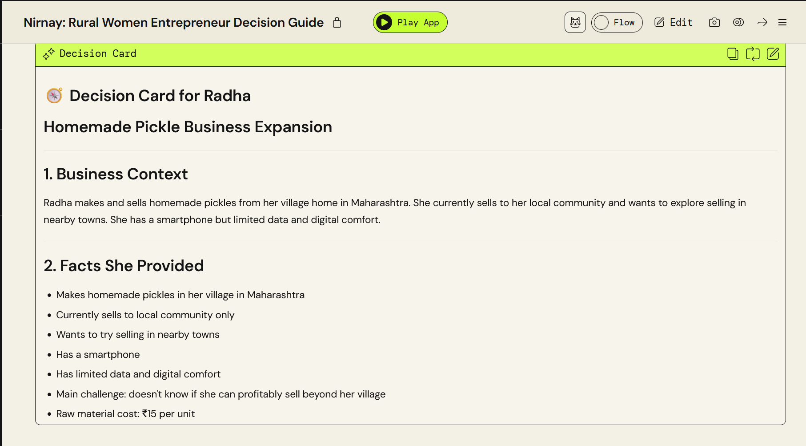
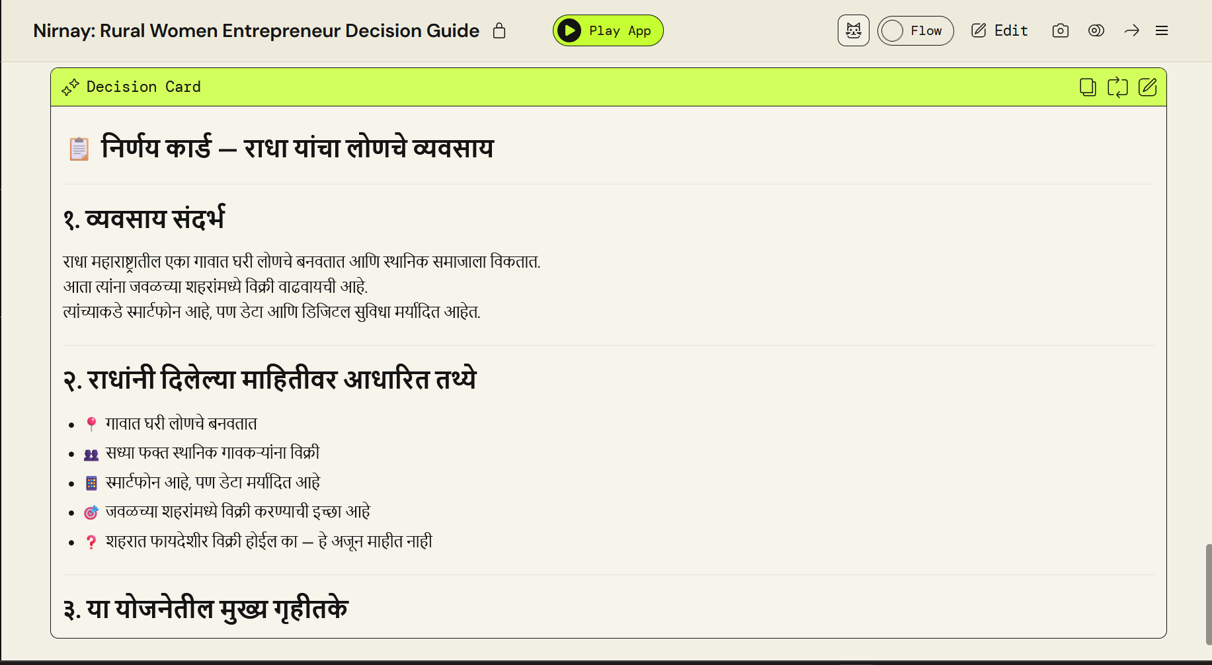
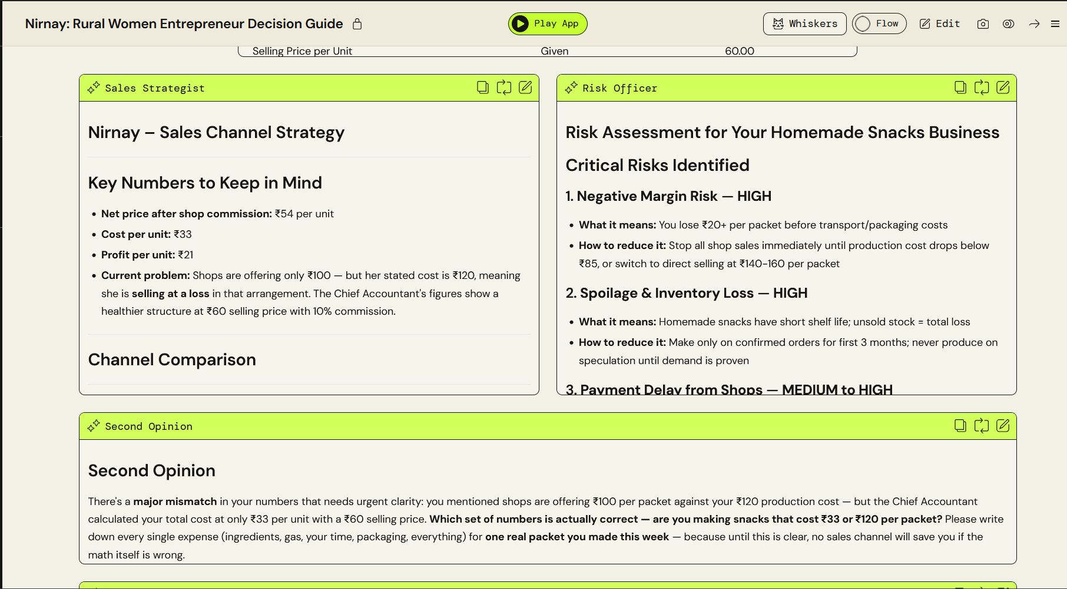
Testing Performed and Results
Test | Scenario & Input | Expected Result | Actual Result | Status
01 — Standard Case [Snapshot link] | Radha: Homemade pickles, rural Maharashtra. ₹55 raw material + ₹25 labour + ₹22 packaging + ₹12 transport. ₹200 selling price, 20% commission, 100 units/month. | Correct unit economics; channel comparison; relevant risks; recommendation based on both profitability and untested demand. |  | 🟢 PASS
02 — Language & Accessibility [Snapshot link] | Same business profile with Marathi selected. | Business analysis, calculations, recommendations and Decision Card remain clear and usable in Marathi, without losing numerical accuracy. |  | 🟢 PASS
03 — Difficult Case [Snapshot Link 1] [Snapshot Link 2] | New entrepreneur provides incomplete information and has a product whose estimated selling price is below total cost. | NIRNAY should not invent missing facts; it should expose uncertainty, show the negative margin and recommend validation/adjustment rather than blindly approving the idea. |  | 🟡ITERATED (needed prompt refinement to explicitly flag missing data)

Slide 10
Responsible AI Considerations
Risk | NIRNAY Safeguard
Privacy & consent — Business details may include personal or financial information. | Collect only information needed for analysis; avoid requesting unnecessary personal data.
Bias / exclusion — Recommendations may favour digitally accessible or urban sales channels. | Compare channels against the entrepreneur's location, language, digital access, resources and constraints rather than assuming one channel fits all.
Inaccurate outputs — AI may invent market data, schemes or financial assumptions. | Clearly separate user-provided facts, assumptions and verified information; never fabricate missing data; flag uncertainty.
Financial harm — An overly optimistic recommendation could cause the entrepreneur to invest savings unnecessarily. | Show line-by-line costs, margins, break-even limitations and missing evidence before recommending expansion.
Security / misuse — Outputs could be manipulated or misleadingly presented as verified advice. | No credentials or sensitive data; distinguish AI-generated analysis from verified sources and avoid unsupported claims.
Lack of human oversight — AI should not make the final business decision for her. | NIRNAY recommends; the entrepreneur decides. The Second Opinion challenges the weakest assumption before the final Decision Card.

Slide 11
Impact, Feasibility and Sustainability
1. BUSINESS & SOCIAL IMPACT
Reduce premature investment risk through evidence-led validation.
Help entrepreneurs understand costs, demand, margins and risks before expanding.
Turn a business idea into a clear, actionable next decision.
2. WHO BENEFITS
Rural women entrepreneurs → Better-informed business decisions with limited financial/digital resources.
SHGs • NGOs • Entrepreneurship programs → A repeatable AI-assisted framework to support more entrepreneurs.
3. IMPLEMENTATION REQUIREMENTS
Amazon Bedrock API + backend orchestration for the advisor workflow
Verified local data sources for market, schemes and opportunities
Mobile-first multilingual interface for accessibility
Human oversight for high-impact financial decisions
4. COST, SCALE & ADOPTION
Cloud-based, pay-per-use GenAI → low upfront infrastructure cost
Reusable AI workflow → same system can support many entrepreneurs
SHG / NGO partnerships → practical route to user onboarding and trust
Scale by region & language → add verified local data rather than rebuilding the core system
5. BEYOND THE PROTOTYPE
Today: 11 specialized AI advisors • 6 language options • Decision Card
Next: verified local market data • stronger financial validation • NGO/SHG partnerships
Long term: expand across regions, languages and rural enterprise categories.

Slide 12
How Your Submission Will Be Evaluated
CRITERION — WHAT EVALUATORS WILL LOOK FOR | WEIGHT | MAX SCORE
Technical implementation — working configuration, appropriate model choice, prompt quality and reliable core functionality | 30 % | 30
Solution effectiveness — alignment to the selected challenge, usefulness to the target user and quality of the user experience | 30 % | 30
Innovation and creativity — distinctive approach, thoughtful use of GenAI and clear value beyond a basic chatbot wrapper | 20% | 20
Implementation quality — completeness, testing evidence, clarity of explanation and effectiveness of the prototype demonstration | 15% | 15
Responsible AI — privacy, bias, accuracy, security, transparency, human oversight and broader social impact | 5% | 5
TOTAL | 100% | 100

Slide 13
Final Submission Checklist
Before submitting, confirm that:
Slides 3–11 contain your own work and all mandatory evidence.
The presentation is uploaded with ‘Anyone with the link can view’ access.
Both links open in an incognito/private window without requesting access.
File names include your registration/roll number. Keep a local backup.
Late, inaccessible or incomplete submissions may not be evaluated.

