Slide 1
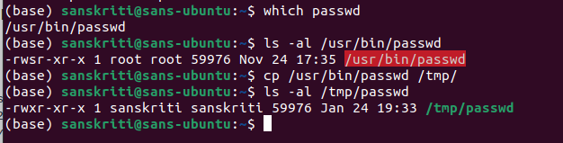
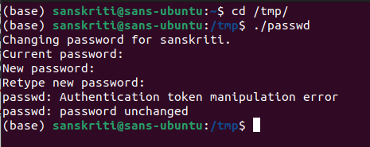
Sanskriti Singh
2001CS60
CS392 Assignment-1
Q1
First copy the ‘passwd’ to another directory (say /tmp/ )
Then execute the ‘passwd’ file
Password is unchanged

Slide 2
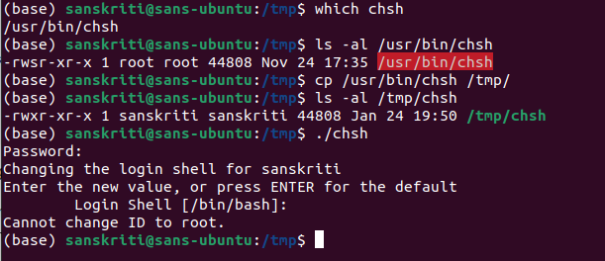
Q1
Doing the same with ‘chsh’ file
Cannot change ID to root
If we had the root privilege, we would be able to make changes to the password or even to ID. Since the output as shown in these images give error messages, it’s clear that there are no root privileges.

Slide 3
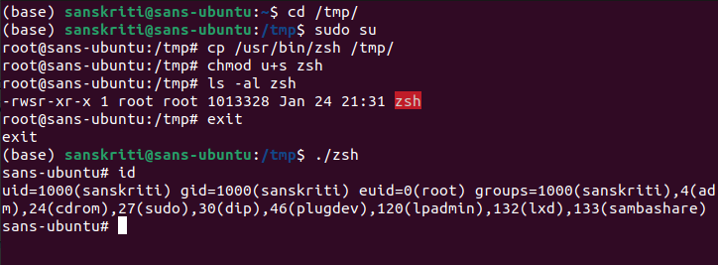
Q2-a
Copying and running ‘bin/zsh’ as normal user
Now, normal user gets root privilege

Slide 4
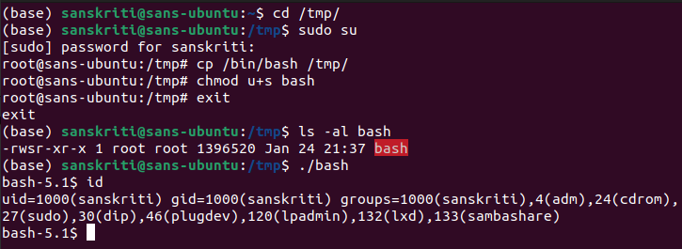
Q2-b
Copying and running ‘bin/bash’ as normal user
Here, normal user does not get root privilege

Slide 5
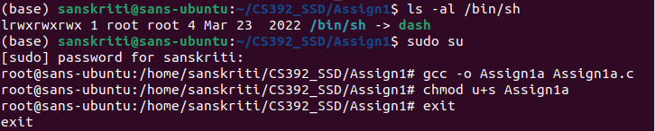
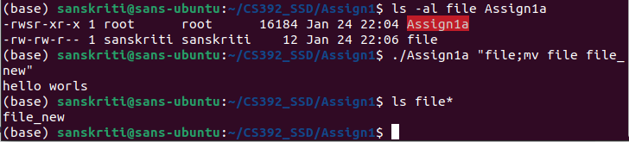
Q3
Using system()
‘Assign1a’ is not safe as Anil now can read, write or move files which should be only be allowed to root users

Slide 6
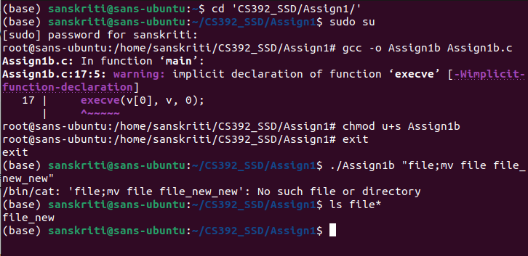
Q3
Using execve()
The attack by normal user (here, Anil) is ineffective

Slide 7
Q3
Explanation:
The reason why the before attack is effective in case of system() because system() call ‘/bin/sh’, which links ‘dash’.
After running cat file with root privilege, it runs “mv file file_new”.
But in the case of execve(), it will regard “file;mv file file_new_new” as a folder name, so system will prompt there have no the file.

