Slide 1
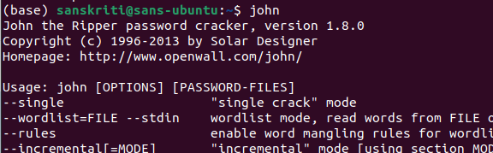
CS392 Secure System Design: Threats and Countermeasures
Assignment 3
Sanskriti Singh
2001CS60
Aim:
First-hand experience on using password cracking tool
to check for the weak passwords
Preparations:
$ sudo apt-get install john
→ to use John-the-ripper
$ sudo apt-get install adduser
→ to add users

Slide 2

Steps:
Step1
Use ‘su’ to change to ‘root’
Step2
Make directory ‘test’ and use ‘chmod’ to change its permissions to 777

Slide 3
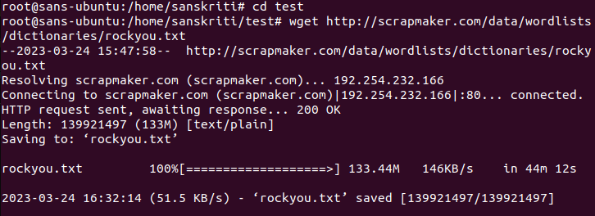
Step3
Change directory to ‘test’
Download wordlist containing probable passwords (it is ‘rockyou.txt’)

Slide 4
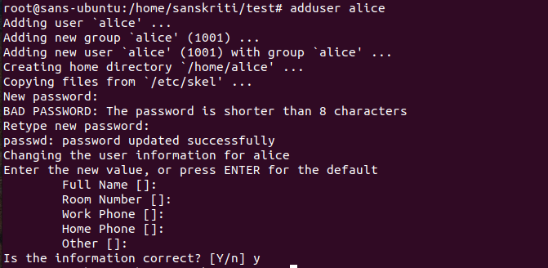
Step4
Add user ‘alice’ with password [ alice ]

Slide 5
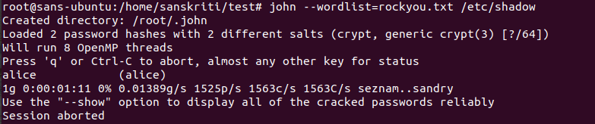
Step5
Use ‘john’ to crack passwords
The password was cracked in few seconds

Slide 6
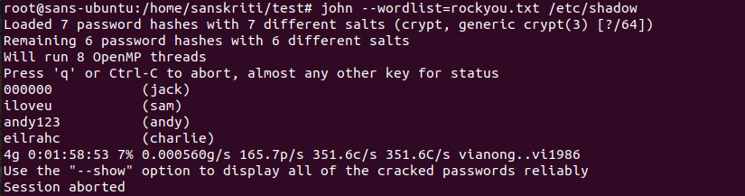
Step6
Use ‘john’ to crack the passwords and observe

Slide 7
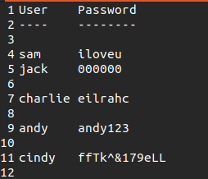
Step6
Make other new users and passwords to experiment
Add two users and their passwords will be chosen from the rockyou wordlist file.
Add one user with password as the reverse of the username.
Add one user with password as the 123 extension of the username.
Add one user with randomly generated strong password
The list of username and passwords that was formed
1)
2)
3)
4)

Slide 8
Observations:
→ The password cracking process ran for 3 hours
→ For the users with passwords from the wordlist gave instant results
→ For the user with password with 123 as extension to username gave result in about 10 min
→ For the user with reverse username as password gave result in about 30-40 min
→ For the user with extremely random and strong password did not give result even after 3 hours

Slide 9
Conclusion:
→ For the users with passwords from the wordlist, it was instant as the password was available in the list and hence can be found by trying out the passwords from the list
→ For the user with password with 123 as extension to username and with reverse of username took sometime but not long enough as they follow certain common patterns
→ For the user with extremely random and strong password did not give result because of the extremely unpredictable and uncommon nature

