Slide 1

Project Title:-Seasonal_Agriculture_Performance_Data_Analytics
Student Name-Sanskruti Ramesh Dumbre
CollegeName-RASIKLAL.M.DHARIWAL
SINHGAD TECHNICAL INSTITUTE
AICTE STU ID :STU666aa75ff03a31718265695

Slide 2

PROBLEM STATEMENT
Agricultural performance varies across crops, seasons, and regions.
Factors such as weather, soil conditions, irrigation, and fertilizers may influence crop productivity.
Differences in production cost, revenue, and profit affect overall farm performance.
Data analysis can help identify patterns and relationships in agricultural performance.
This project aims to provide data-driven insights for better agricultural decision-making.

Slide 3
Project Description
This project focuses on analyzing seasonal agricultural performance using data analytics techniques. The dataset contains information related to different crops, seasons, regions, environmental conditions, soil characteristics, farming practices, water usage, yield, production, and economic performance.
The project aims to identify patterns and relationships between these factors and understand how they influence crop productivity, resource efficiency, and farm profitability. The analysis involves data preprocessing, exploratory data analysis, statistical analysis, and visualization to generate meaningful insights.
The findings can help in understanding variations in agricultural performance across seasons and crops and support data-driven decision-making for improving agricultural productivity and profitability.

Slide 4

WHO ARE THE END USERS?
Farmers – To understand crop performance, profitability, and resource efficiency.
Agricultural Planners & Experts – To support data-driven agricultural planning and decision-making.
Agribusinesses – To evaluate crop performance, production costs, and profitability.
Researchers & Students – To study agricultural trends and relationships between different factors.
Government & Agricultural Departments – To support evidence-based agricultural policies and resource planning.

Slide 5

Technology Used
Python – Data analysis and preprocessing
Pandas & NumPy – Data manipulation and numerical analysis
Matplotlib & Seaborn – Data visualization
Jupyter Notebook / Google Colab – Analysis and implementation environment
CSV Dataset – Data storage and input format

Slide 6
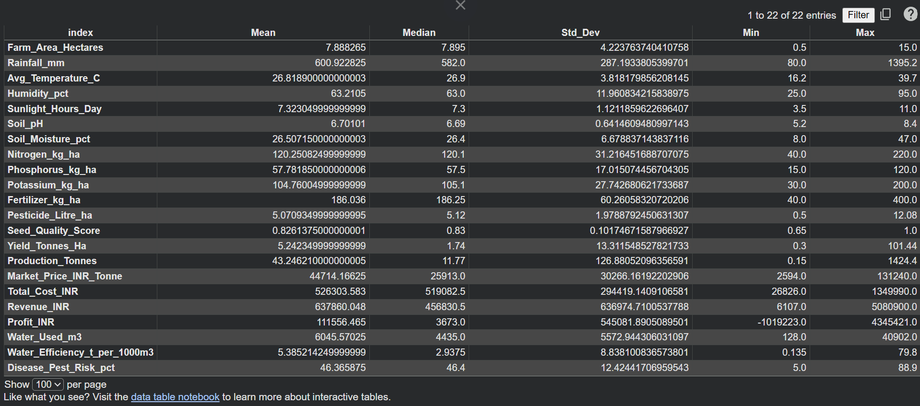
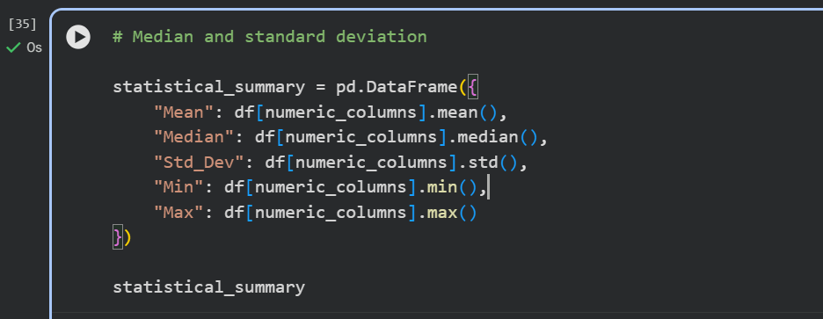
RESULTS

Slide 7
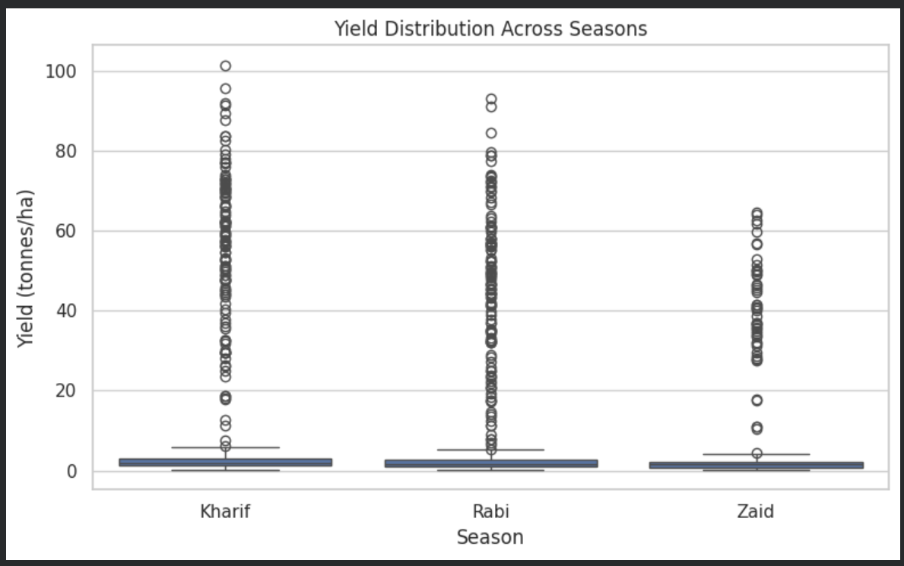
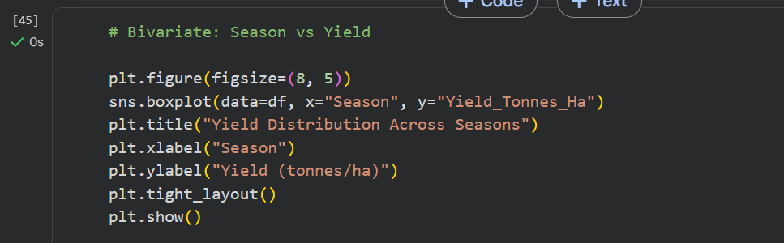
RESULTS
[Add screen shots of your code ]

Slide 8
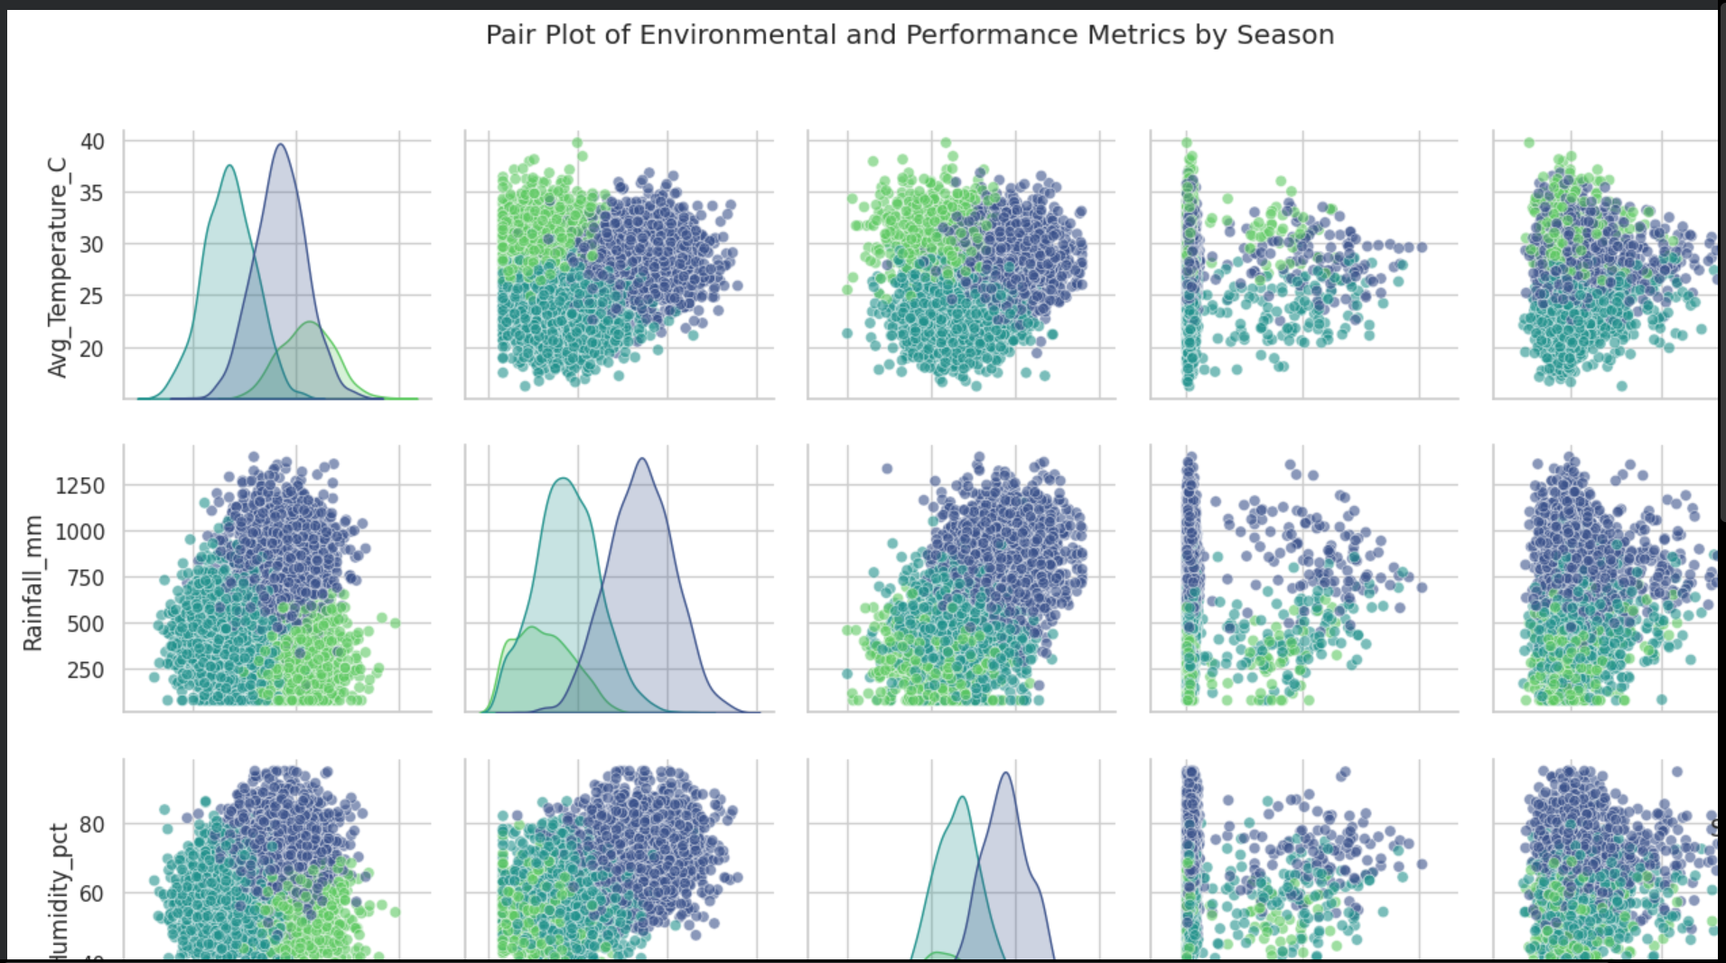
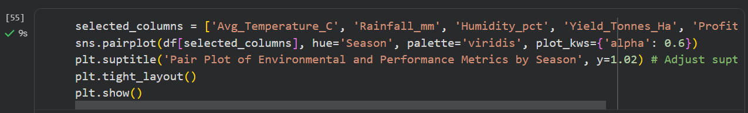
RESULTS
[Add screen shots of your code ]

Slide 9
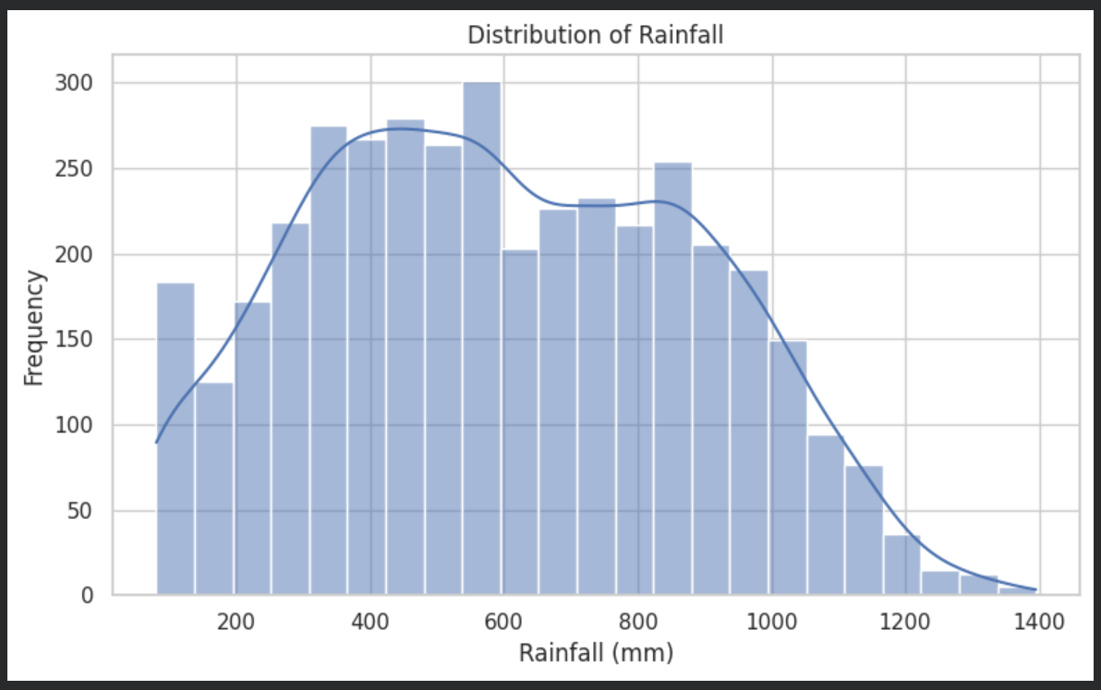
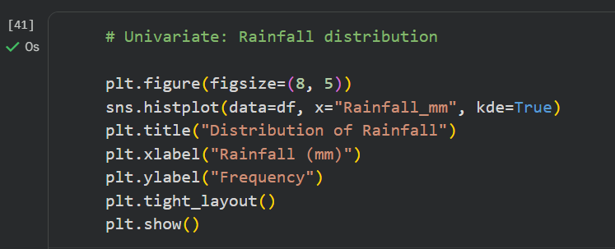
RESULTS
[Add screen shots of your code ]

Slide 10
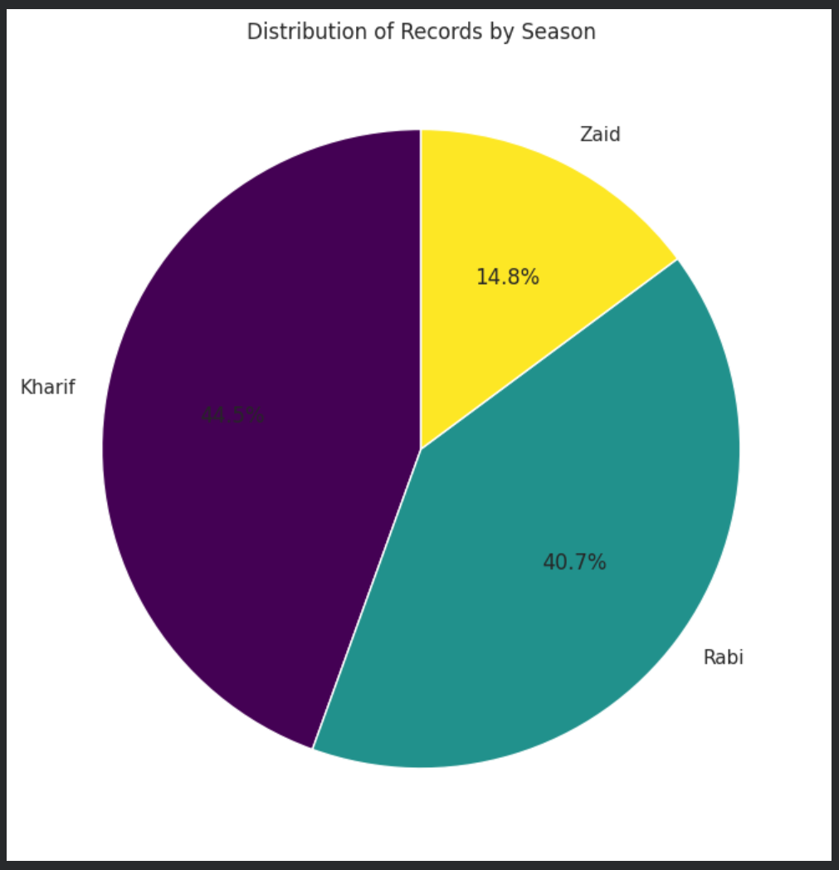
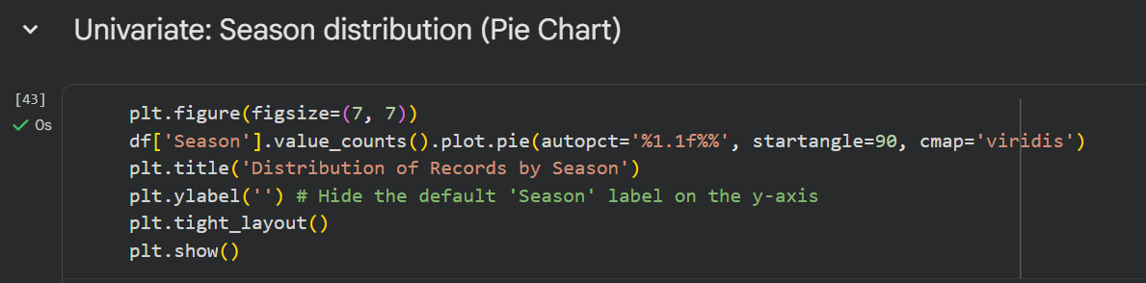
RESULTS
[Add screen shots of your code ]

Slide 11
Future scope
Crop Yield Prediction – Develop models to forecast crop yield.
Crop Recommendation – Recommend suitable crops based on soil and environmental conditions.
Weather Integration – Incorporate real-time and historical weather data.
Resource Optimization – Improve water, fertilizer, and pesticide utilization.
Interactive Dashboard – Develop dashboards for real-time agricultural insights.
Advanced Analytics – Apply machine learning for better prediction and decision-making.

Slide 12
GitHub Link

Slide 13
VOIS Course completion certificate - Course name- Data Visualization

Slide 14
Thank you
.
.

