Slide 1
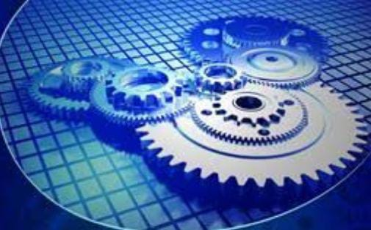
CAPSTONE PROJECT
PRESENTATION

Slide 2
:
NAME OF THE PROJECT :
SELF BALANCING GYROBIKE.
PROJECT BY: GROUP Q12
ROLL NO. | GR NO. | NAME OF THE STUDENT
61 | 12010442 | SHIKALGAR MOHIDDIN KAMALUDDIN
62 | 12011236 | SHIMPLE SANSKRUTI SANJAY
63 | 12010823 | SHIINDE ARYAN GOPALAN
64 | 12011223 | SHINDE CHETAN SHANTARAM
65 | 12010267 | SHINDE GAYATRI VISHVANATH
UNDER THE GUIDANCE OF : PROF. RANJEETSINGH SURYAWANSHI

Slide 3
INTRODUCTION IN BRIEF
OBJECTIVE
LITERATURE REVIEW
CONTENTS
TOOLS AND COMPONENTS USED
METHODOLOGY IMPLEMENTED
PROGRESS MADE SO FAR
PRESENT STATUS OF PROJECT

Slide 4
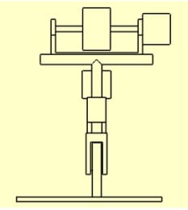
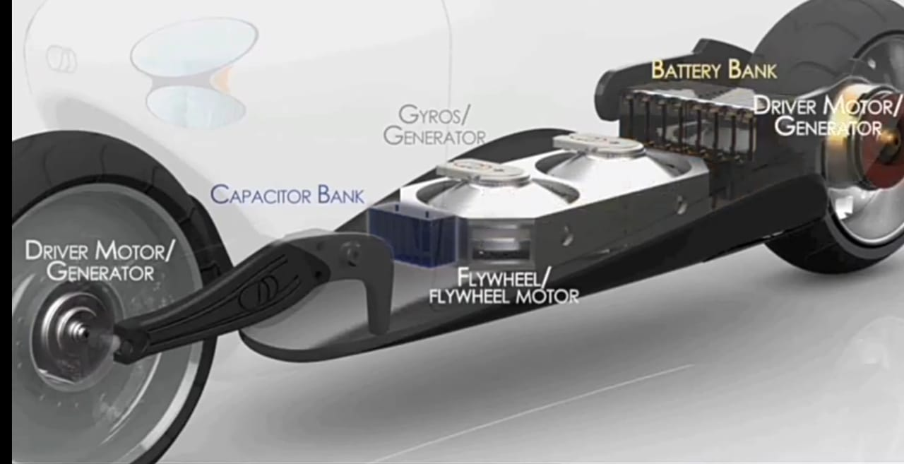
INTRODUCTION TO GYROBIKE :
Bikes show different behaviour in different conditions. When bike is in motion it can be stable. But it is not possible when bike is in standstill condition. Purpose of this project arises here. We can balance bike in static condition using gyroscope principle device which is known as Control Motor Gyro (CMG).
CMG (Control Motor Gyro) controls the angular direction of the entire device to which this CMG is mounted according to input given to the heavy rotational mass rotating inside it at a high speed. In-built motor is fixed in inside it which rotates that heavy mass. This entire unit is the combination of mechanical and electronic components which make it possible.
This technology is generally used in heavy ships to neutralize the effect of wave forces.
This project basically surrounds the central idea of using the same Gyroscopic principle in order balance a bike.

Slide 5
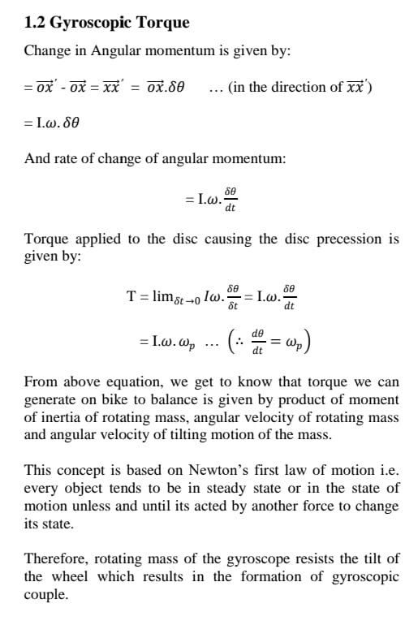
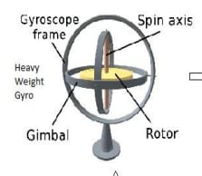
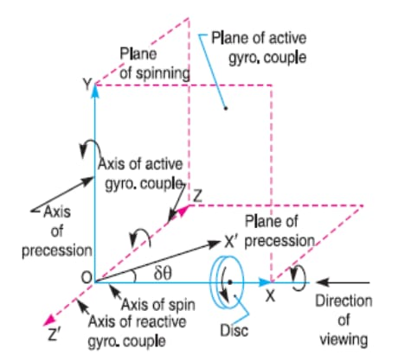
……contd.
PHYSICS BEHIND THE PROTOTYPE :

Slide 6
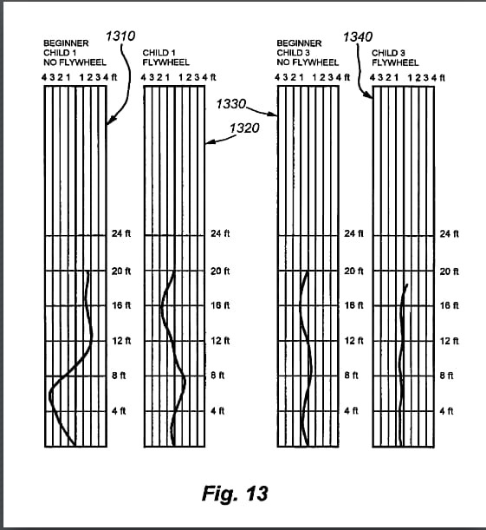
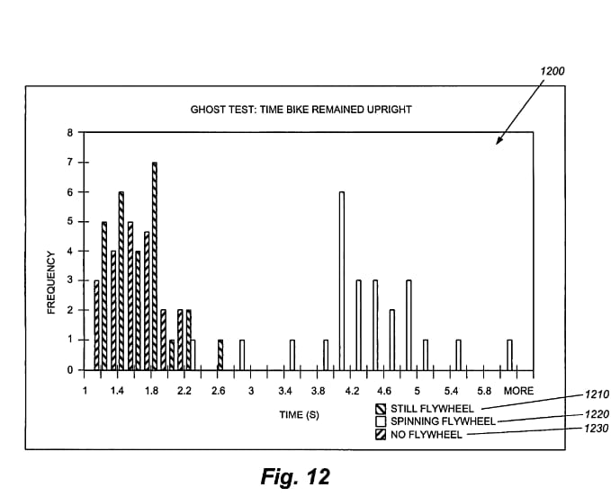
STATISTICAL DATA :

Slide 7
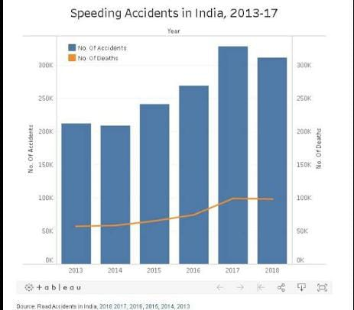
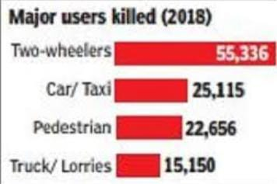
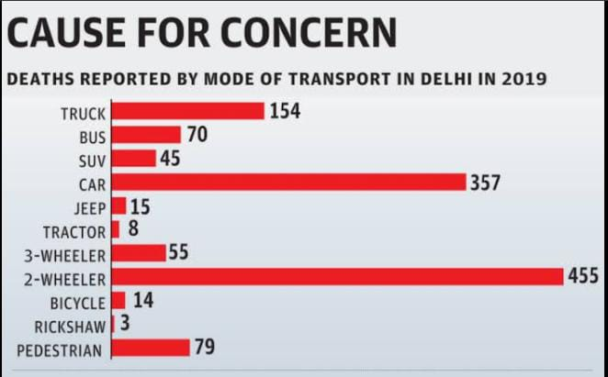
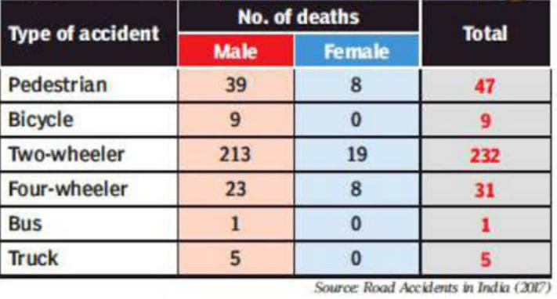
Considerable contribution of two wheelers in road accidents :
(need for development of Gyrobike.)

Slide 8
ANALYSIS OF STATISTICAL DATA :
Bikes are one of the most common mode of recreational transportation in the world today. But despite of its advantages, controlling a bike and keeping it stable and safe is relatively complicated due to the governing mechanics and dynamics associated with its physical construction and usage. Although simply losing control and falling over onto the ground is sufficient to cause discomfort and pain, the contribution of two wheeler vehicles in the road accidents is highly considerable. The point here is that a bike is inherently unstable and unsafe until riders become adapted to riding it.
Therefore, the development of a prototype which could help in decreasing the danger of bike accidents and increasing the stability of a two wheeler vehicle gains very much importance in consideration of the above analysis.

Slide 9
Lt t
……contd.
RESEARCH SUMMARY :
From the study analysis , we understood that if we give some input to rotating force mass it will experience a mutually perpendicular rotating force on that mass. This principle can be used to balance the bike.
Firstly, a heavy mass is attached to the frame of the bike which will be rotating at a high speed. This heavy mass will act like a mechanical gyroscope which is our final output.
Now, consider that bike is trying to tilt in a particular direction. Here the tilting motion of the gyroscopic mass will produce anti-torque to bike’s tilting motion which will oppose bike inclination and keep the bike in stable vertical position.
Thus, an enclosed bike is possible because of the Gyroscopic Technology which can make the ride more and more comfortable.
Further studies on this topic include the compensating speed of the rotating mass in accordance with the weight of rider and the adaptive control to the system so that the system can react to the changes in the payloads.

Slide 10
OBJECTIVES OF THE PROJECT :
To develop a technology which would make
two-wheeler driving easier than ever before.
To develop a prototype which would help
In reduction of 2-wheeler accident rates.
To help the disabled/learners to access the
bike without any fear of disbalance.
To analyze the controlled algorithm to
control a C.M.G. which in turn generates
Torque to control the bike.
To develop a website in order to provide 3D model, data analysis and much more specific information of the prototype.

Slide 11
HISTORICAL OVERVIEW :
Between 2004 and 2007, the inventors of the technique conceived and tested the concept as a part of their Graduate Project.
In 2006, the invention won the Break Through Award from Popular Mechanics.
In 2010, a Darthmouth student, licensed the technology from its inventors and set up a company in USA called Gyrobike Inc. The company launched Gyrowheel that replaced front wheel of conventional bicycles.
In October 2003, a British Enterpreneur Robert Bodill acquired the intellectual property rights and set up Jyrobike Limited in December 2003. The Gyrobike trademarks are owned by Jyrobike Limited, which holds global patents for a “system for gyroscopic stabilization to a two-wheeled vehicle", protecting the invention.

Slide 12
LITERATURE REVIEW :
SR.NO. | 1 | 2 | 3
AUTHORS | Daniel Raviv(PhD) Anthony Radzins Morad Rahmani | Pratik D. Tak (Asst.Systems Engineer, TCS Pune.) | Pom Yuan Lam (B.E.(Hons.), NTU)
PAPER TITLE | FROM OBSERVATION TO PROTYPE :A HANDS ON UG RESEARCH. | SELF-STABILIZING BIKE USING GYROSCOPE | DESIGN AND DEVELOPMENT OF A SELF BALANCING BIKE USING C.M.G.
YEAR | 2017 | 2017 | 2012
JOURNAL | IEEE Conference Paper. | IJRET : International Journal of Research in Engineering and Technology | Research Paper published by University of Singapore.
DESCRIPTION | This research is aimed at working out a safety complication that two wheeled vehicles experience | This research paper is about the concept of C.M.G. which when applied to the bike, it can be balanced without any support. | This thesis presents the work on the use of C.M.G. as a momentum exchange actuator to balance a bike.
FINDINGS | The Gyroscopic model has found to be convinient and reliable in case of balancing the bike. | A C.M.G. can be effectively used on bikes for self balancing purpose inspired from ships and airplane. | The C.M.G. is an effective torque amplification device and has short response time.

Slide 13
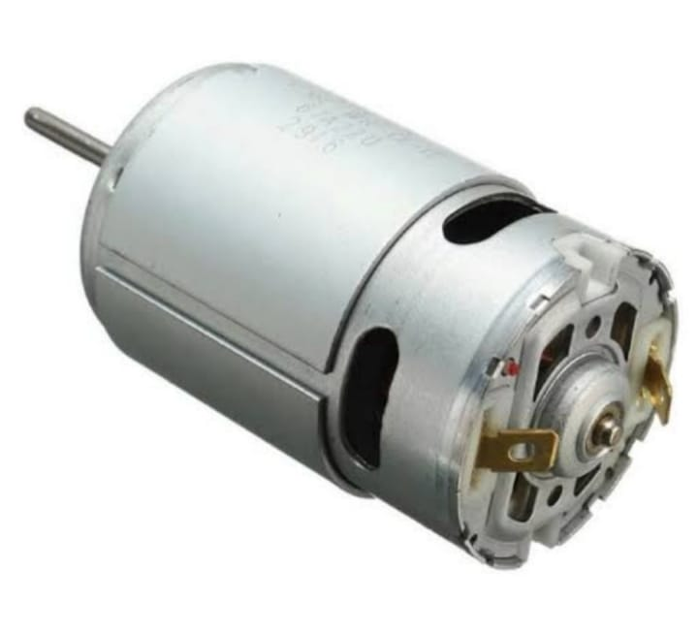

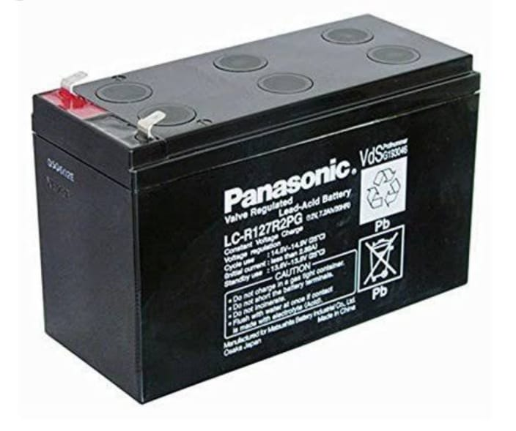
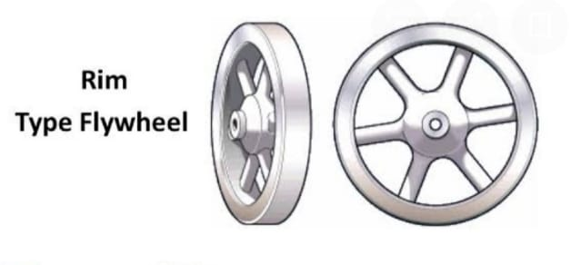
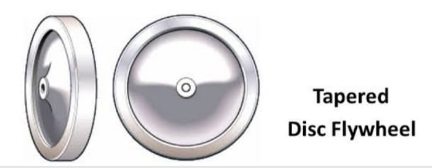
TOOLS AND COMPONENTS USED :
COMPONENTS :
HIGH RPM DC MOTOR.
FLYWHEEL / DISC.
3) 12 VOLT DC BATTERY.
4) SWITCH.
TOOLS :
HTML-5
CSS-3
JAVASCRIPT

Slide 14
Ready to present the prototype
Assembling the parts and Testing the Prototype
Making a 3D Model of the Prototype.
Review the past study on the Prototype.
Understanding Principle and Physics behind the Prototype.
METHODOLOGY
IMPLEMENTED

Slide 15
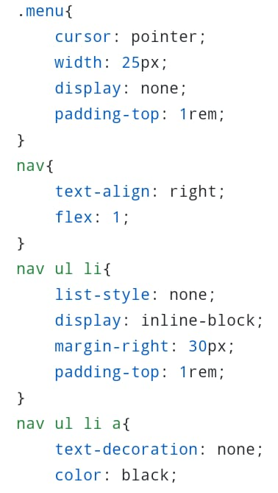
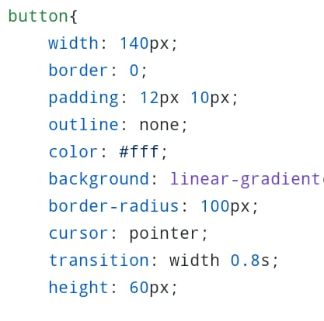
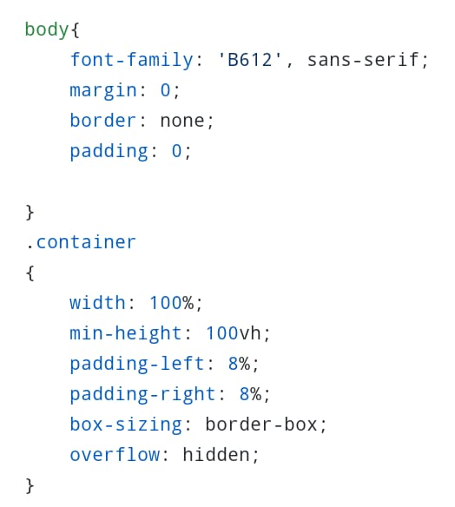
PROGRESS MADE SO FAR :
Based on the previous studies on the prototype data was collected, analyzed and efforts were taken to set the data in a proper structure.
Along with this, we are developing a 3D model of the prototype project which is presently almost completed.
In order to elaborate the prototype and to provide more specific data about the : SELF BALANCING CONTROL MOTOR GYRO BIKE, we have developed an optimized and convenient website.
The components required for the assembly have been collected and a layout has been set to assemble them together followed by testing of the prototype.

Slide 16
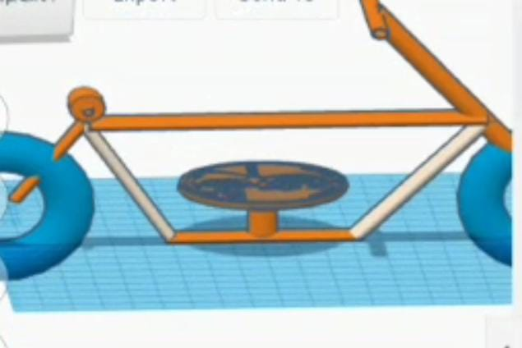
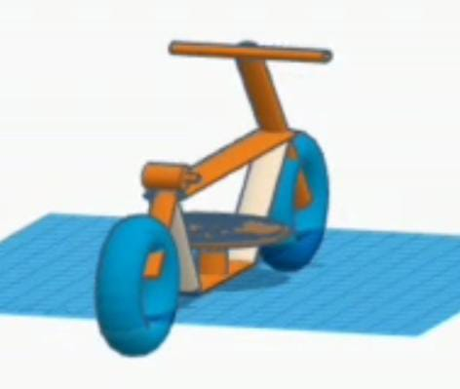
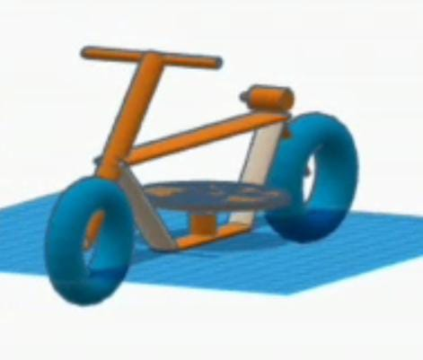
3D MODEL at a glance..
To view the source code of the website browse: http://github.com/AryanShinde/Gyrobike

Slide 17
PRESENT STATUS OF PROJECT :
100%
CREATING A 3D MODEL OF THE PROTOTYPE
100%
LITERATURE REVIEW
Analysis of past research on the prototype
100%
WEBSITE DEVELOPMENT
(Using HTML, CSS and JAVASCRIPT)
100%
MAKING OF THE MODEL
Collecting and Assembling the parts and Testing the model.

Slide 18
REFERENCES :
Research Papers:
IEEE Conference Papers.
[1 Pratik D. Tak, “Self Stabilizing Bike Using Gyroscope.”, IJRET Nov.2017.
Other Sources:
Google, Wikipedia ,YouTube , etc.
THANK YOU..

