Slide 1

Global Country Data Analysis
By
Sanskruti Patil

Slide 2
About me
Background
My name is Sanskruti Ravindra Patil. I have recently completed my Master of Science (M.Sc) in Computational Mathematics from Kavayitri Bahinabai Chaudhari North Maharashtra University, Jalgaon.
Why you want to learn Data Science
I want to learn Data Science to develop analytical and predictive models that can transform raw data into valuable information and support informed decision-making.
Profiles:
LinkedIn: http://www.linkedin.com/in/sanskruti-patil-2374662ab
GitHub: Sanskruti121412 (Sanskruti Patil) · GitHub

Slide 3
Index
Objective of the Project.
Web Scrapping process of the project.
Key Visulization.
Key insights for analysis.
Conculsion.

Slide 4
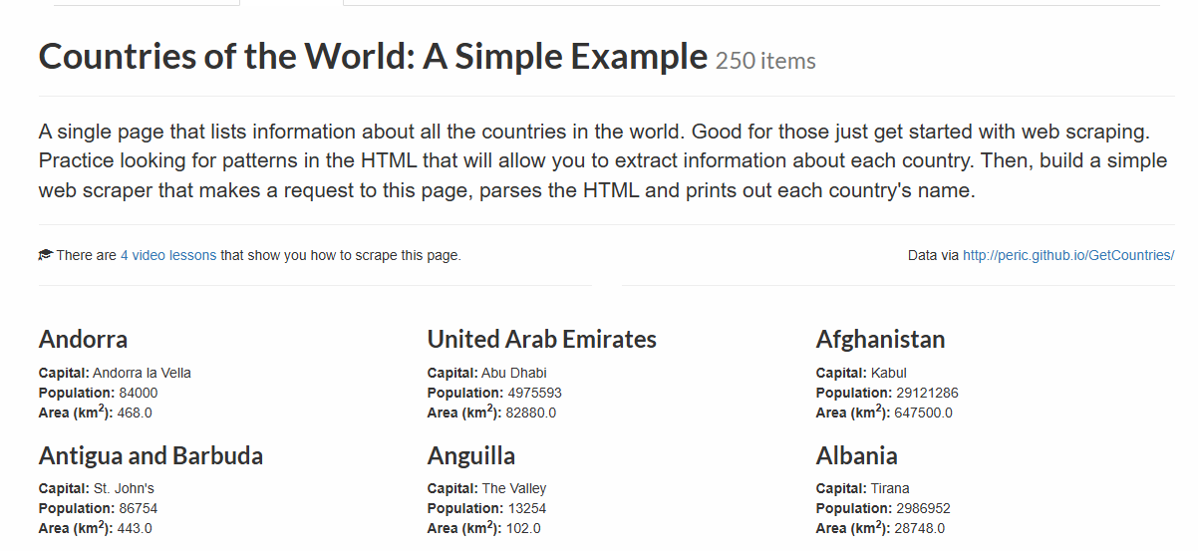
Website:

Slide 5
Objective of the Project :
Includes demographic, geographic, and socio-economic attributes per country.
Structured for categorical grouping by size, population, and density.
Andorra: small population & area, medium density.
Afghanistan: large area, medium population.
Anguilla & Antigua and Barbuda: very small populations and small sizes.

Slide 6
Webscrapping process of the project :
Select the website
Sending Request and Fetching Data
Importing Requried Libraries
Extracting Table Data
Converting Extract Data Into DataFrame
Cleaning and Formating the Data
Save and Analyze the Data

Slide 7
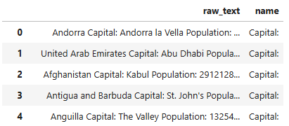
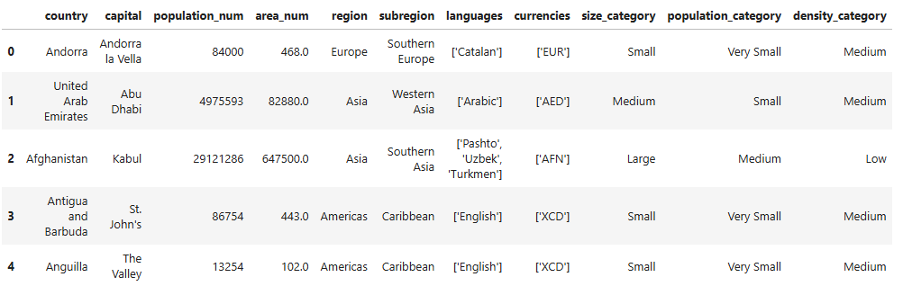
Before Cleaning the data:
After Cleaning the data:

Slide 8
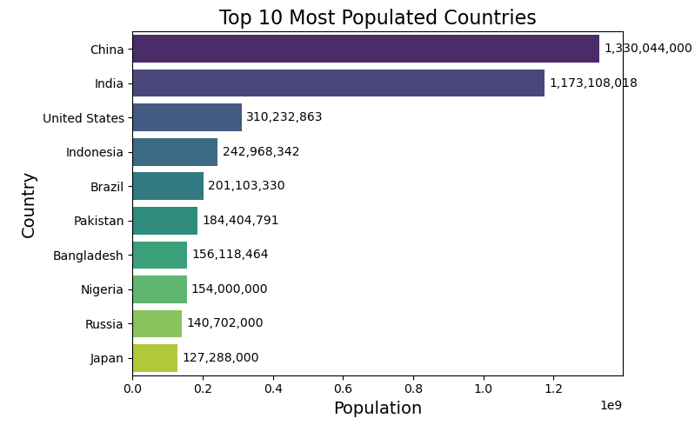
Top 10 Most Populated Countries:
There is a large population gap between India and the United States.
Asian countries dominate the top positions.
Population gradually decreases from top to bottom.

Slide 9
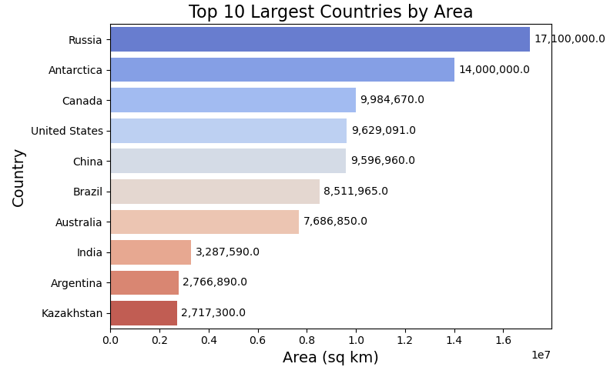
Top 10 Largest Countries by Area:
Antarctica is the second largest region by area.
India ranks eighth despite having a very large population.
Area size gradually decreases from top to bottom.

Slide 10
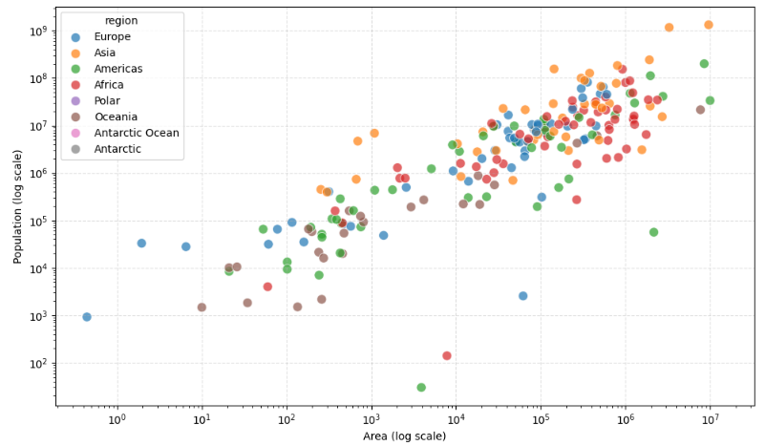
Population vs Geographic Area:
There is a positive relationship between area and population (generally).
Asian countries dominate the upper-right region (large area & large population).
Smaller countries appear in the lower-left corner.

Slide 11
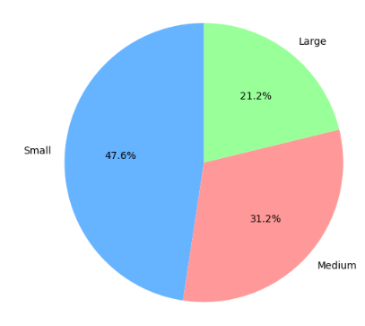
Distribution by Country Size Category
Small countries make up the largest share (47.6%).
Medium-sized countries account for 31.2%.
Large countries represent the smallest portion (21.2%).

Slide 12
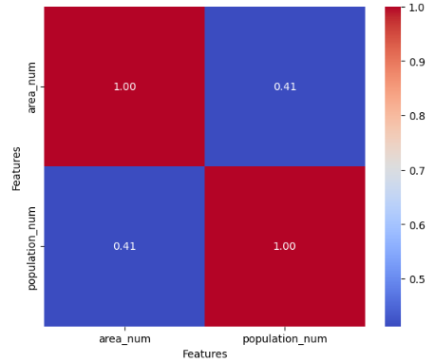
Correlation Heatmap: Population vs Area
The correlation value 0.41 indicates a moderate positive relationship.
Generally, countries with larger areas tend to have higher
Populations.
However, the relationship is not very strong.

Slide 13
Conclusion :
Population distribution is highly concentrated in a few countries.
Most countries fall under the small size category, but large countries dominate land area.
There is a moderate positive correlation (0.41) between area and population.
Regional differences significantly influence population and land distribution.

Slide 14

THANK YOU

