Slide 1
DIABETES PREDICTION System
Project made by:
Sanskruti Agrawal (SAP: 60001200017)

Slide 2
About…
Diabetes is a chronic condition that affects your body's ability to turn food into energy
WHO Statistics - 422 million diabetics with 1.6 million deaths worldwide, and expected growth up to 693 million diabetics by 2045
To get the prediction of the disease, several parameters must be collected - plasma glucose concentration, diastolic blood pressure, triceps skinfold thickness, serum insulin, body mass, and age

Slide 3
The Problem
One of the main reasons for disability and premature mortality in the world is diabetes disease, which can cause different sorts of damage to organs such as kidneys, eyes, and heart arteries
The deaths by diabetes are increasing each year, so the need to develop a system that can effectively diagnose diabetes patients becomes inevitable

Slide 4
The Solution
In this work, an efficient medical decision system for diabetes prediction is presented
These are predicted with medical knowledge to improve decision-making, effectiveness, adaptability, and transparency
This improvement can reduce time, efforts, and labour in healthcare services as well as increasing the final decision accuracy

Slide 5
The MODELS
With the intention of delivering the best and accurate results to users, several different ML models, were implemented and analysed and the accuracy of each model was noted as below:
Logistic Regression – 0.81
Support Vector Machine (SVM) – 0.80
KNN – 0.88
Random Forest Classifier – 0.99
Naïve Bayes Theorem – 0.77
Gradient Boost Classifier – 0.91

Slide 6
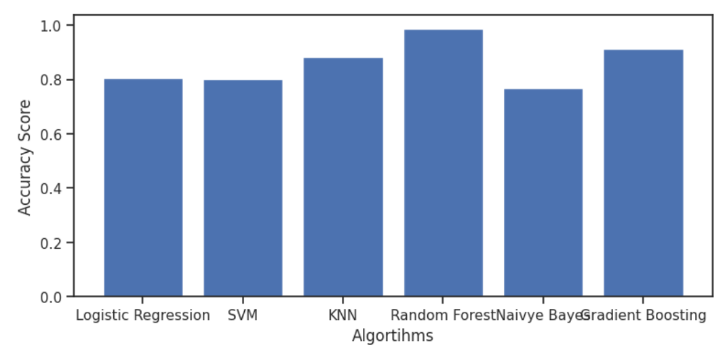
Comparison

Slide 7
Random forest classifier
One of the most popular Supervised Learning Algorithms, used for both Classification and Regression problems in Machine Learning
Based on the concept of ensemble learning – a process of combining multiple classifiers to solve a complex problem and to improve the performance of the model
Instead of relying on one decision tree, the random forest takes the prediction from each tree and based on the majority votes of predictions, and it predicts the final output.
The greater number of trees in the forest leads to higher accuracy and prevents the problem of overfitting.

Slide 8
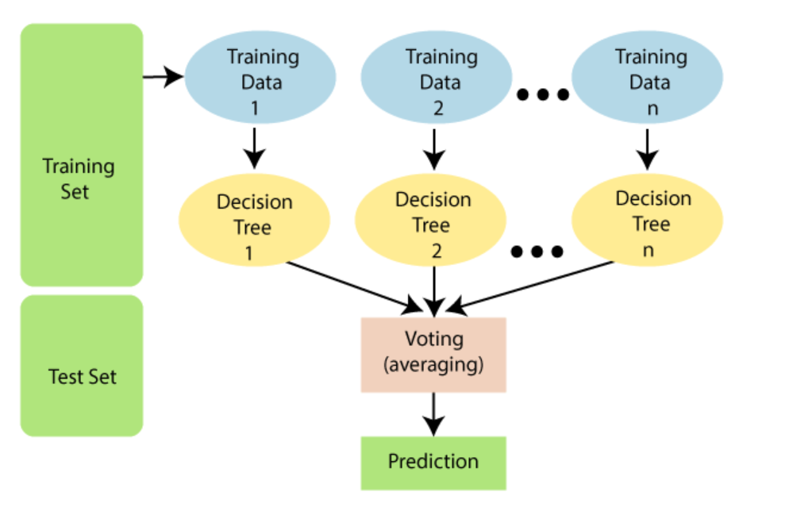
Random forest classifier

Slide 9
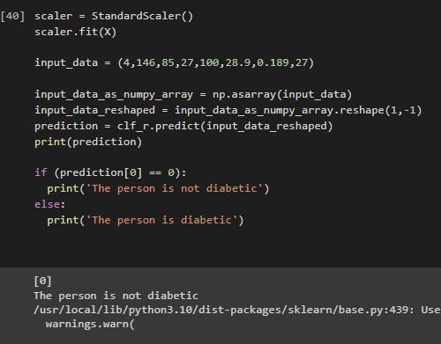
Output of the Code

Slide 10
Gradio
For user-convenience, a GUI was designed, for which open-source Python library ‘Gradio’ was used
Simplifies the process of building interactive UI components around the model, making it easier to showcase, test, and deploy them
Possible to create input and output interfaces for the model using a variety of input types such as text boxes, sliders, checkboxes, images, and more
Provides a simple API that allows you to define the input and output types, customize the UI components, and specify the model's behavior.

Slide 11
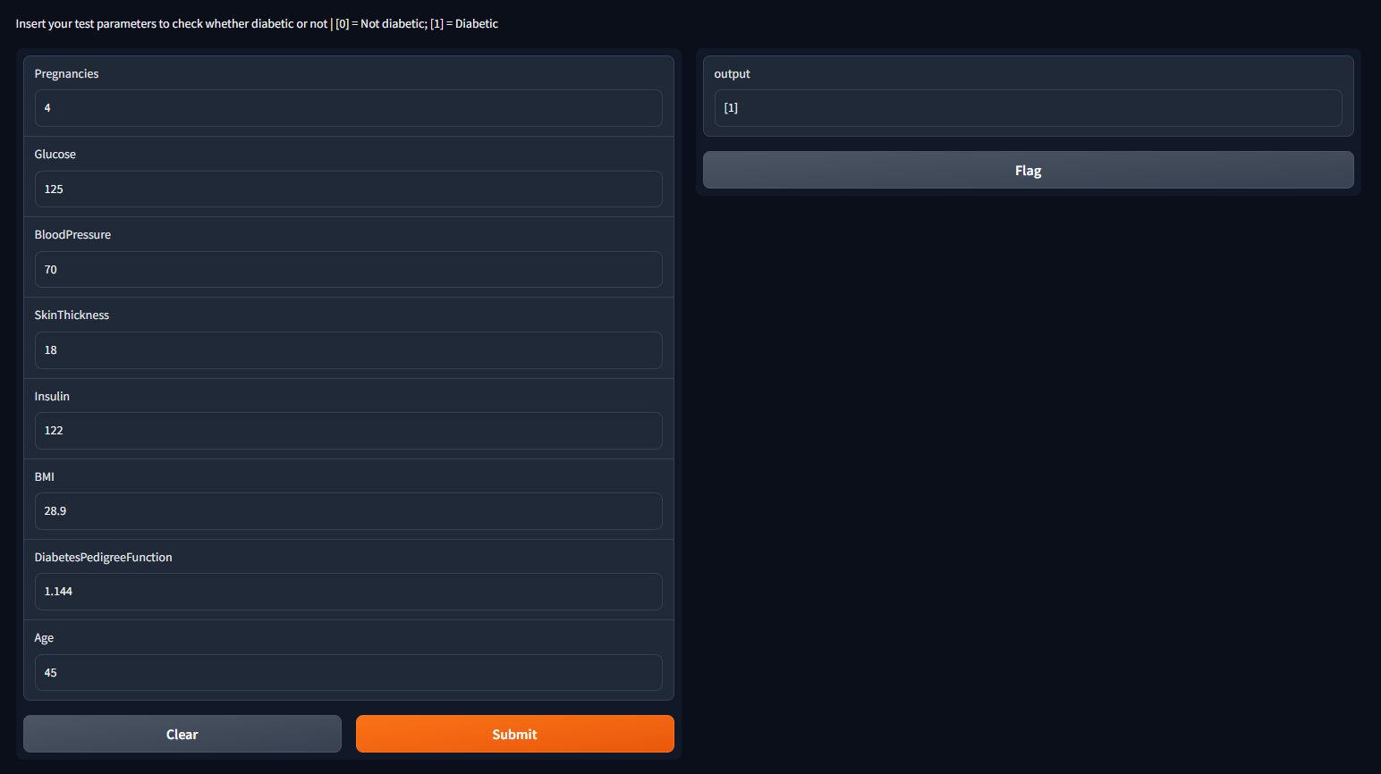
GUI

Slide 12
FUTURE SCOPE
The given system deals with prediction of diabetes in females and the algorithm can be further trained to predict diabetes for the general population as well as classify diabetes as Type I and Type II
Since the GUI designed currently remains accessible for 72 hours after creation, a mobile application – having better and more efficient user interface, can be designed

Slide 13
Conclusion
Thus, we have created a Diabetes Prediction System using Supervised Machine Learning Models
This system allows user to perform a secondary check for diabetes at initial stage by providing medical parameters
With this project, we learned to use advanced computer and information technologies such as machine learning algorithms rather than traditional approaches
Along with this, we learned to design GUI based on machine learning models, and make user-convenient interface

Slide 14
Thank You !!

