Slide 1
P1212 Zomato Analytics Project: Unlocking Restaurant Insights
GROUP 4 TEAM MEMBERS
Neetu Porwal
Pranashree
Sanskruti
Sumeet
Swati
Deekshith
Mani Shankar

Slide 2
Project Overview & Objectives
The Challenge: To analyze Zomato's restaurant and customer data to uncover key trends and actionable insights.
Our Mission: To leverage advanced data analysis tools to understand restaurant performance, customer behavior, and market dynamics.
Team: A dedicated team of 6 data enthusiasts.
Tools: SQL, Advanced Excel, Tableau, Power BI.

Slide 3
Our Data Toolkit: From Raw Data to Insights
SQL: For efficient data extraction, cleaning, and transformation from the Zomato dataset.
  Key Operations: SELECT, FROM, WHERE, GROUP BY, Window Functions.
Advanced Excel: For detailed data manipulation, pivot tables, and initial data exploration.
  Key Functions: VLOOKUP, SUMIFS, PivotTables, Conditional Formatting.

Slide 4
Visualizing the Landscape: Tableau & Power BI
Tableau: For creating interactive dashboards and compelling visual storytelling of restaurant data.
Power BI: For developing dynamic reports and business intelligence solutions, offering deep dives into trends.
Combined Power: Enabling comprehensive analysis of location, opening trends, ratings, and price ranges.

Slide 5
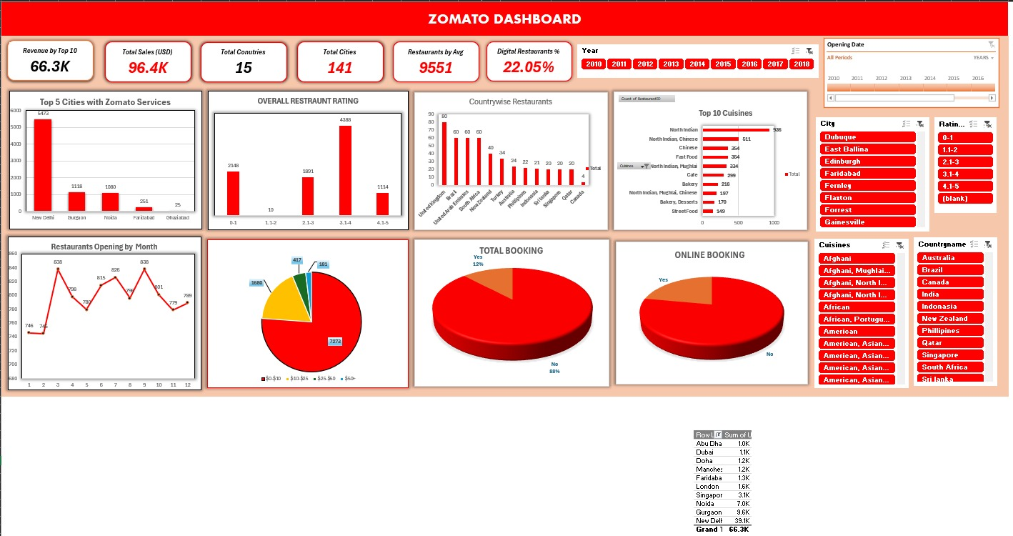
EXCEL DASHBOARD

Slide 6
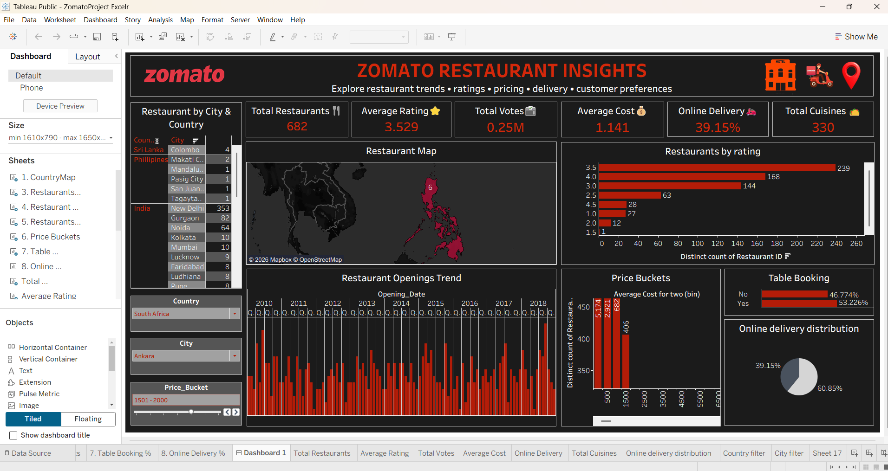
TABLEAU DASHBOARDS

Slide 7
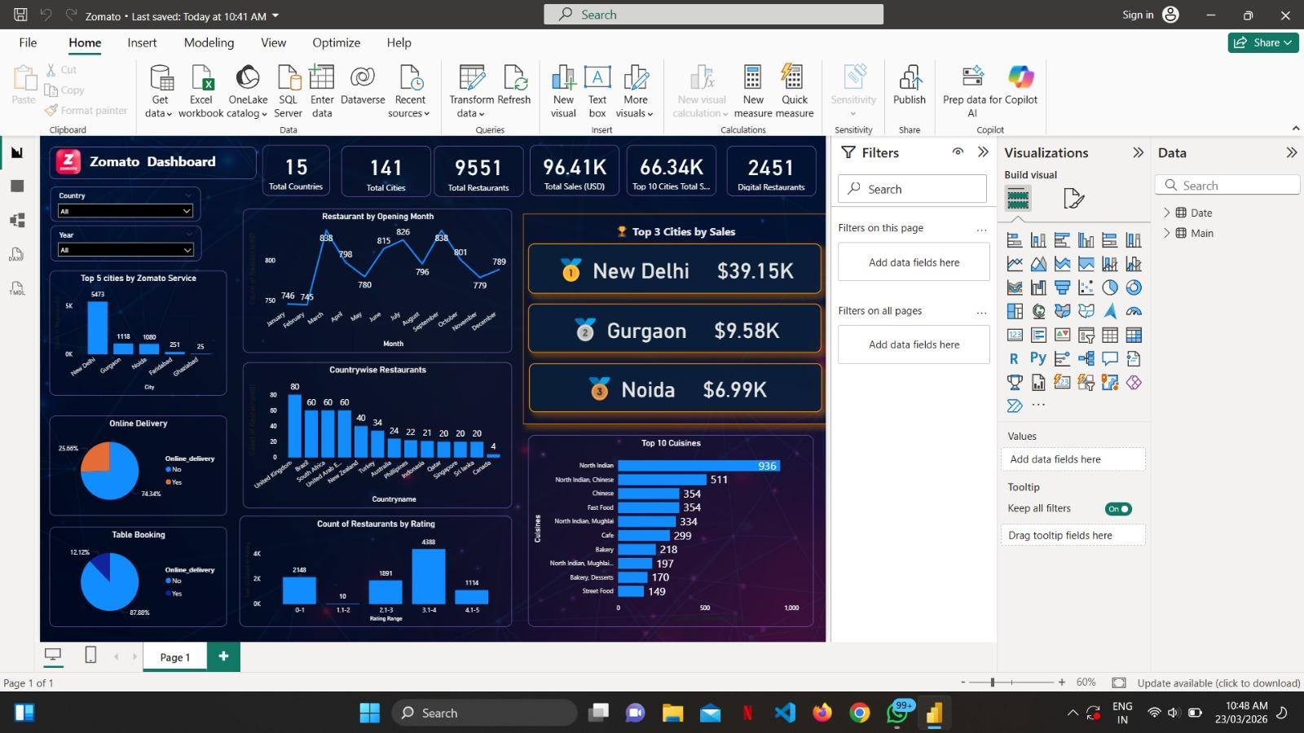
POWER BI DASHBOARDS

Slide 8
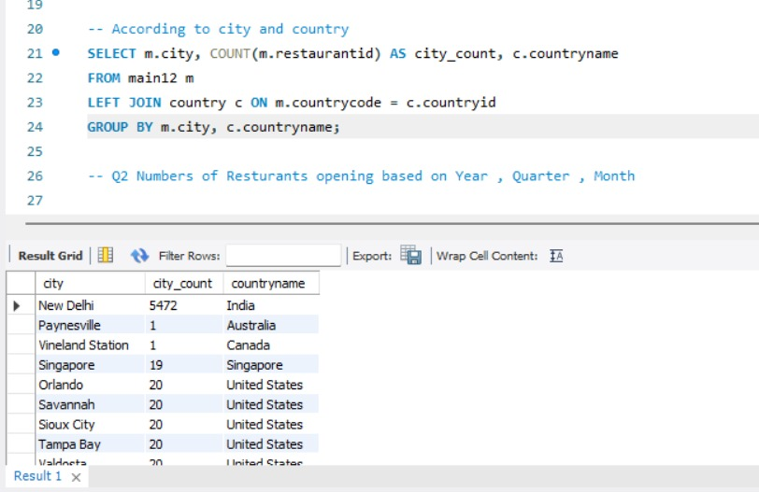
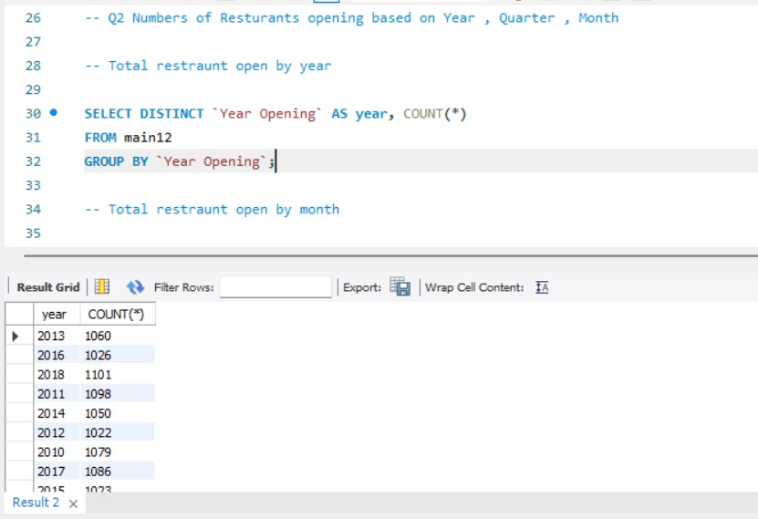
SQL OUTPUTS

Slide 9
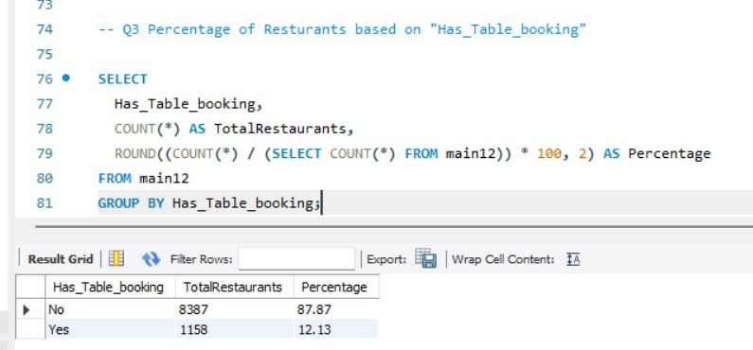
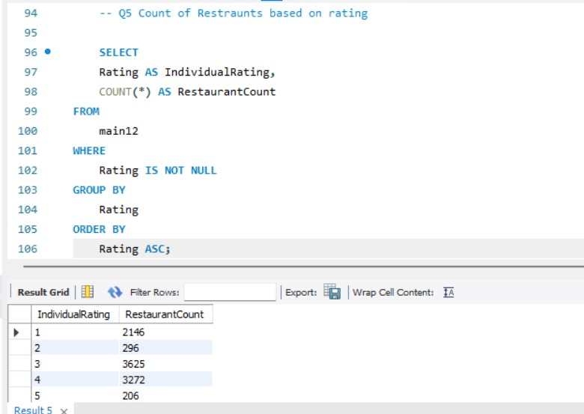

Slide 10
Key Analytical Focus Areas
Restaurant Performance: Analyzing ratings, reviews, and popularity across different cities.
Opening Trends: Identifying patterns in new restaurant launches by year, quarter, and month.
Cuisine Analysis: Understanding the popularity and distribution of various cuisines.
Customer Behavior: Insights into table booking and online delivery preferences.

Slide 11
Uncovering Insights: A Glimpse into the Data
Location Intelligence: Mapping restaurant density and identifying high-potential areas.
Rating Distribution: Analyzing the spread of ratings and their correlation with other factors.
Price Range Segmentation: Categorizing restaurants and understanding market positioning.
Service Options: Quantifying the prevalence of table booking and online delivery.

Slide 12
Interactive Dashboards: Bringing Data to Life
Tableau Dashboard Example: [Visual representation of a Tableau dashboard showing restaurant distribution by city and cuisine type]
Power BI Dashboard Example: [Visual representation of a Power BI dashboard highlighting opening trends and average ratings over time]
These dashboards provide a user-friendly interface for stakeholders to explore data and derive insights.

Slide 13
Project Impact & Key Findings
Actionable Insights: Identified key factors influencing restaurant success and customer choice.
Data-Driven Recommendations: Provided data-backed suggestions for potential business strategies.
Demonstrated Proficiency: Showcased mastery of SQL, Excel, Tableau, and Power BI in a real-world scenario.

Slide 14
The Team's Journey: Collaboration & Skill Development
Teamwork: Successfully collaborated as a 6-members team to achieve project goals.
Skill Enhancement: Deepened expertise in data analysis, visualization, and business intelligence tools.
Problem-Solving: Overcame data challenges through collective effort and innovative solutions.

Slide 15
Conclusion: Data-Driven Success
The Zomato Analytics Project successfully transformed raw data into strategic insights.
Our team's combined skills in SQL, Excel, Tableau, and Power BI delivered a comprehensive analysis.
This project exemplifies the power of data analytics in understanding and optimizing business operations.

Slide 16
THANK YOU

