Slide 1


SUBJECTSUBJECTSUBJECT CODECODECODE
TYPETYPETYPE THETHETHE SUBJECTSUBJECTSUBJECT NAMENAMENAME HEREHEREHERE
SOLVEATHON
Reg.Number: 1. 412414921042
2.412414921004
3. 412414921039
Name : 1. ROHITH VIJAY R
2. AKASH SANTHNU SUNDAR
3. PUNEETESHWAAR S P
Project Title : FULLY AUTOMATED ROBOTIC SYSTEMS
II III
LIVE-IN-LAB PROJECT WORK
GUIDE NAME :
Dr. P . Rayavel

Slide 2

FULLY AUTOMATED ROBOTIC SYSTEMS
DOMAIN : MACHINE LEARNING AND ROBOTICS
Primary Goal No : 09 – Industry, Innovation and Infrastructure
Secondary Goal No : 08 – Decent work and economic growth
Tertiary Goal No : 17 – Partnership for all the goals

Slide 3

JUSTIFICATION FOR SDG & SAP No.
SDG 9: Industry, Innovation, and Infrastructure :
•Objective: Foster innovation and build resilient infrastructure.
•Impact: Developing a robot that integrates advanced technologies like AI and IoT contributes to innovation.
It supports the creation of smart classrooms and workplaces, promoting technological advancement and efficiency.
SDG 16: Peace, Justice, and Strong Institutions :
•Objective: Promote transparent and accountable institutions.
•Impact: An automated logging system enhances transparency and accountability in both educational and corporate institutions.
It ensures accurate record-keeping and reduces the potential for human error or manipulation.
SDG 8: Decent Work and Economic Growth
•Objective: Increase productivity and efficiency in the workplace.
•Impact: In a corporate setting, the robot can log employee attendance, manage schedules, and track
performance metrics.

Slide 4
CORE OBJECTIVES OF THE PROJECT
To develop a fully automated robotic system(FARS) that integrates face recognition using machine learning, Real time data analytics, cloud based database system and IoT technologies to enhance campus security and operational efficiency.
This system will automate the identification of individuals, manage access control, and provide real-time data to administrators.

Slide 5
PROBLEM STATEMENT
The need for enhanced security and operational efficiency in management is critical.
Traditional security systems often rely on manual processes, leading to human errors, delays in response times, and increased operational costs.
the growing complexity of management environments, coupled with evolving security threats, necessitates innovative solutions that can proactively identify risks, automate routine tasks, and provide real-time insights for informed decision-making.

Slide 6
Abstract
This system uses machine learning to automatically monitor and record key activities in schools and workplaces, offering real-time data and insights to improve decision-making and efficiency.
It's designed to integrate easily with existing systems, prioritize data privacy, and adapt to changing needs, making it a valuable tool for optimizing resources and boosting productivity.

Slide 7
LITERATURE REVIEW
S.No. | Title of the Journal Article | Authors | Year of Publication | Problem Defined | Drawback
01 | "Face Recognition Systems in Security Applications" | Mathew Turk and Alex Pentland | 2018 | The study highlights the limitations of traditional security systems and the need for advanced face recognition technologies. | The existing systems often struggle with accuracy in diverse lighting conditions and require significant computational resources.
02 | “Machine Learning for IoT Security” | Jane Smith | 2020 | This paper discusses the challenges of securing IoT devices and networks.. | The integration of machine learning in IoT security is still in its infancy, with issues related to data privacy and real-time processing..

Slide 8
S.No. | Title of the Journal Article | Authors | Year of Publication | Problem Defined | Drawback
03 | "Wearable Computing and Augmented Reality for Enhanced Accessibility" | Davis.L., & Kim.J. | 2019 | This study explores the potential of wearable computing and AR in improving accessibility for individuals with cognitive disabilities, focusing on real-time feedback and contextual information. | The article points out that while wearable AR devices offer potential, issues such as user comfort and device accuracy remain challenging.
04 | "Real-Time Object Recognition and Description Systems for the Visually Impaired" | Lee.C., & Martinez.A | 2022 | The research investigates systems that use real-time object recognition to aid visually impaired users, providing descriptions of objects within their environment. | A significant drawback identified is the latency in object recognition and description, which affects the real-time usefulness of such systems.

Slide 9
EXISTING SYSTEM DESIGN
Manual Monitoring and Surveillance
  Security Personnel: Guards patrol and monitor feeds, prone to human error.
  CCTV Cameras: Require continuous supervision, lack intelligent detection.
Access Control Systems
  ID Cards and Badges: Prone to loss, theft, and duplication.
  Keypad Entry Systems: Vulnerable to shared or observed PIN codes.
Alarm Systems
  Intrusion Alarms: Prone to false alarms, triggering on motion detection.
  Fire Alarms: Focused on fire safety, not comprehensive security.
Data Storage and Retrieval
  Local Servers: Difficult real-time access and analysis.
  Manual Review: Time-consuming, impractical for immediate threat detection.
Communication Systems
  Intercoms and Hotlines: Outdated, limited efficiency in emergencies.
  Lack of Real-Time Alerts: Reduces effectiveness of immediate responses.

Slide 10
DESIGN OF THE PROPOSED SOLUTION
The proposed FARS system includes the following components:
  Hardware: NodeMCU ESP32, IR sensors, camera modules, networking equipment (routers, hubs), and Raspberry Pi.
  Software: Python for OpenCV face recognition, Firebase Cloud Server for authentication and data storage, HTML/CSS/JavaScript for the web/admin interface.
  Libraries/Frameworks: OpenCV, TensorFlow, Firebase SDK.
The system will use machine learning algorithms to improve face recognition accuracy and adapt to changing conditions. It will integrate with existing campus networks for seamless communication and coordination.

Slide 11

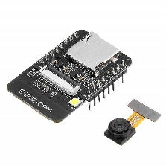
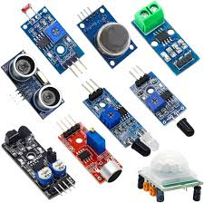
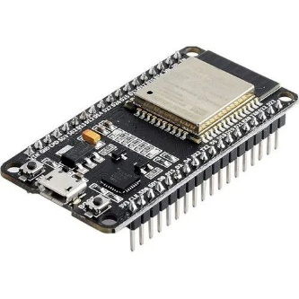
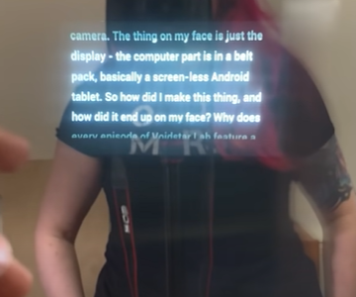


SYSTEM ARCHITECTURE
HARDWARE
CAM MODULE
SENSORS
USER
HAPTICS
AND
BATTERIES
ENHANCED
ROBOTIC VISION
Wi-Fi
AND BLUETOOTH
VOICE COMMAND INTERFACE
MICRO CONTROLLER
MACHINE LEARNING MODELS
CLOUD SERVICES

Slide 12
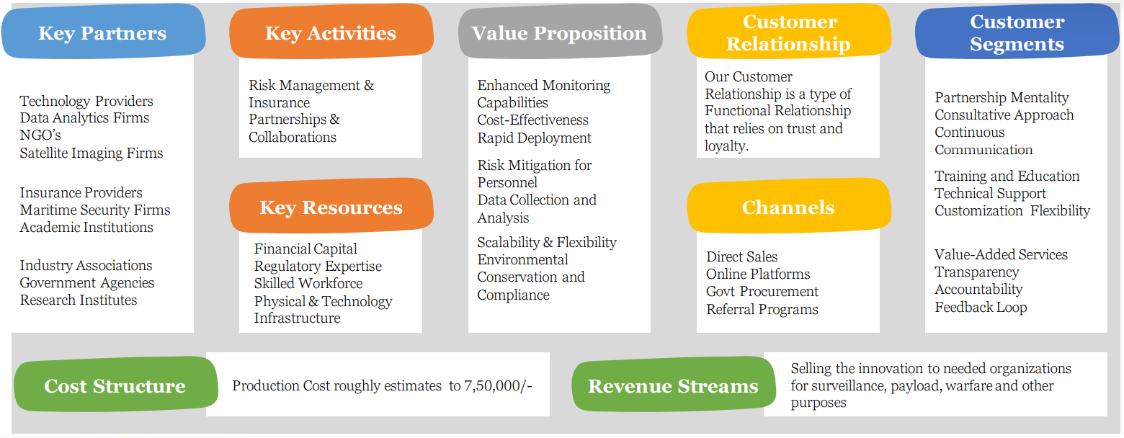
BUSINESS MODEL CANVAS
NGOs: Organizations working with differently-abled individuals.
Research Institutes: Institutions focusing on assistive technologies and AR research.
Educational Institutions: Schools, colleges, and universities.
Product development, R&D, marketing,
customer support.
Enhanced Independence: Provides differently-abled individuals with greater autonomy in navigation and object recognition.
Real-Time Assistance: Instant haptic feedback and guidance through AR overlays and voice commands.
Cost-Effective Solution: Affordable pricing compared to traditional assistive technologies.
Personal Assistance: Dedicated support for setup and troubleshooting.
Feedback Systems: Regular surveys and feedback mechanisms to gather user input for improvements.
Visually Impaired Individuals: Primary target users who will benefit from navigation and object recognition features.
NGOs: Organizations working with differently-abled communities.
Government Agencies: Programs focused on enhancing accessibility and independence for differently-abled individuals.
Educational Institutions: Schools and universities looking to provide inclusive education tools.
Financial capital,
technical expertise, manufacturing facilities.
Direct sales,
online platforms, healthcare providers, educational institutions.
Production cost roughly estimated : $199.30 = ₹16,698.52
Product sales, subscription services, partnerships, grants, customization services.

Slide 13
PROPOSED BUDJET
S.NO | NAME | AMOUNT
01. | Hardware Components ( ESP BOARDS, Micro - Controllers ) : | $35.81
02. | Manufacturing : | $14.33
03. | Assembly : | $9.55
04. | Software development : | $23.88
05. | Database management ( AWS, AZURE ) : | $12.65 ( per month )
06. | Generation of ML model, AR Integration : | $41.94
07. | Maintenance : | $11.94
08. | Customer Support : | $14.33
09. | Initial Marketing : | $17.31
10. | Miscellaneous Components (sensors, wiring): | $17.91
 | GRAND TOTAL : | $199.35 = ₹16,698.52

Slide 14
FUTURE ENHANCEMENT
Scalability :
  Expansion to Larger Areas: The system can be extended to cover more extensive areas, such as additional campus buildings, parking lots, and nearby off-campus locations, ensuring comprehensive security coverage.
Advanced Analytics :
  Predictive Analytics for Threat Identification: Implementing machine learning models that analyze historical data to predict potential security threats, enabling proactive measures to prevent incidents.
  Behavioral Analysis: Using advanced analytics to study the behavior patterns of individuals, identifying anomalies that may indicate suspicious activities or security breaches.
Mobile Integration :
  Administrator Mobile App: Developing a mobile application that allows administrators to monitor live feeds, receive real-time alerts, and control the security system remotely, enhancing their ability to respond quickly to incidents.
Enhanced Privacy :
  Advanced Encryption Methods: Incorporating state-of-the-art encryption techniques to secure data transmission and storage, ensuring that sensitive information remains protected from unauthorized access.
  Data Anonymization: Implementing anonymization protocols to protect the privacy of individuals captured in surveillance footage, making it possible to use the data for analysis without compromising personal privacy.

Slide 15
REFERENCE
Title of Journal Article: "Real-time Face Detection and Recognition Using Improved Viola-Jones Algorithm and Deep Learning"
  Author: A. Khraisat, I. Alsmadi, A. Awajan
  Problem Defined: The paper addresses the need for real-time and accurate face detection and recognition systems.
  IEEE Journal: IEEE Xplore Link
Title of Journal Article: "IoT-Based Smart Surveillance Security System Using Deep Learning for Home Automation"
  Author: H. N. Dai, R. C. Y. Ngai, M. Lyu
  Problem Defined: The study focuses on the implementation of a smart surveillance system using IoT and deep learning technologies.
  IEEE Journal: IEEE Xplore Link

Slide 16


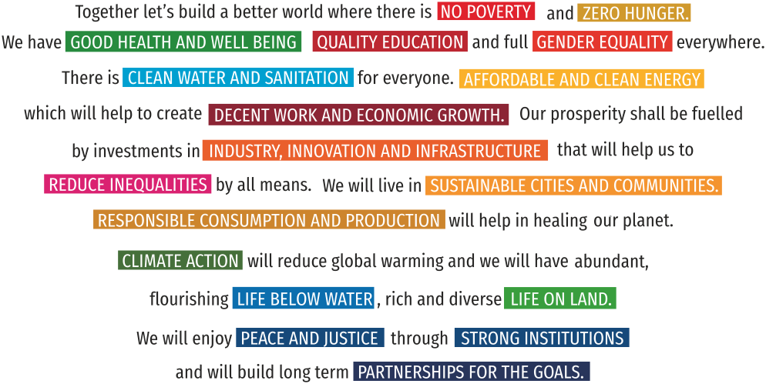


Slide 17


“We must be the change that we wish to see in the world”
- Mahatma Gandhi
Back

