Slide 1
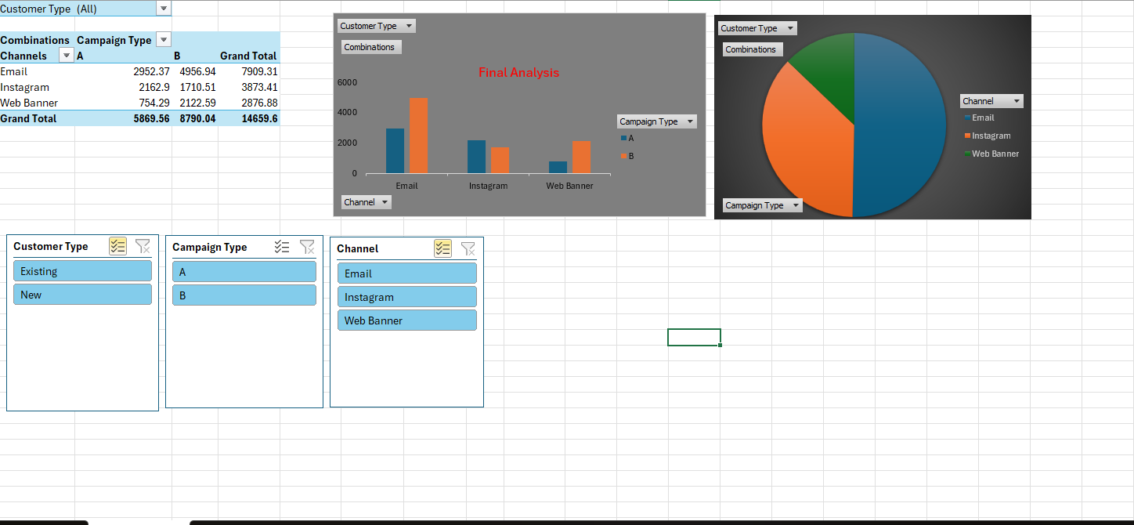
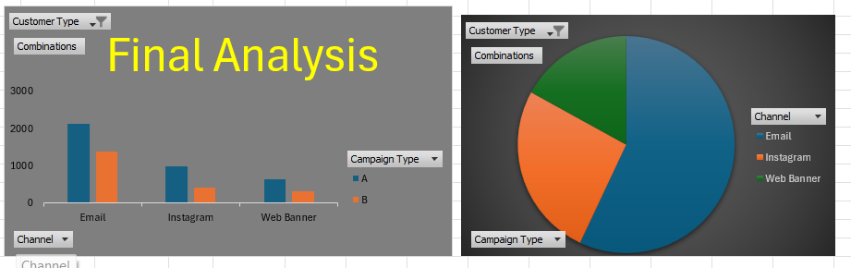
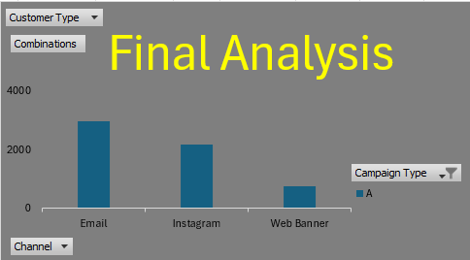
All Combinations of Campaign Types and Channels
Existing Customers Analysis
New Customer Growth All Combinations
Email + Campaign A
Recommendation: By Analyzing all the trends, the best combo should the client double down on to grow new customer is [EMAIL + CAMPAIGN A].It helps the growth of new customers by increasing to 60%.Thus, this combination works well and also best decision for NewCo.

