Slide 1

Bank Customer Segmentation

Slide 2

About Project
Bank Customer Segmentation
Most banks have a large customer base - with different characteristics in terms of age, income, values, lifestyle, and more. Customer segmentation is the process of dividing a customer dataset into specific groups based on shared traits. According to a report from Ernst & Young, “A more granular understanding of consumers is no longer a nice-to-have item, but a strategic and competitive imperative for banking providers. Customer understanding should be a living, breathing part of everyday business, with insights underpinning the full range of banking operations.
About this Dataset
This dataset consists of 1 Million+ transaction by over 800K customers for a bank in India. The data contains information such as - customer age (DOB), location, gender, account balance at the time of the transaction, transaction details, transaction amount, etc.
Application of Analysis
Perform Clustering / Segmentation on the dataset and identify popular customer groups along with their definitions/rules

Slide 3
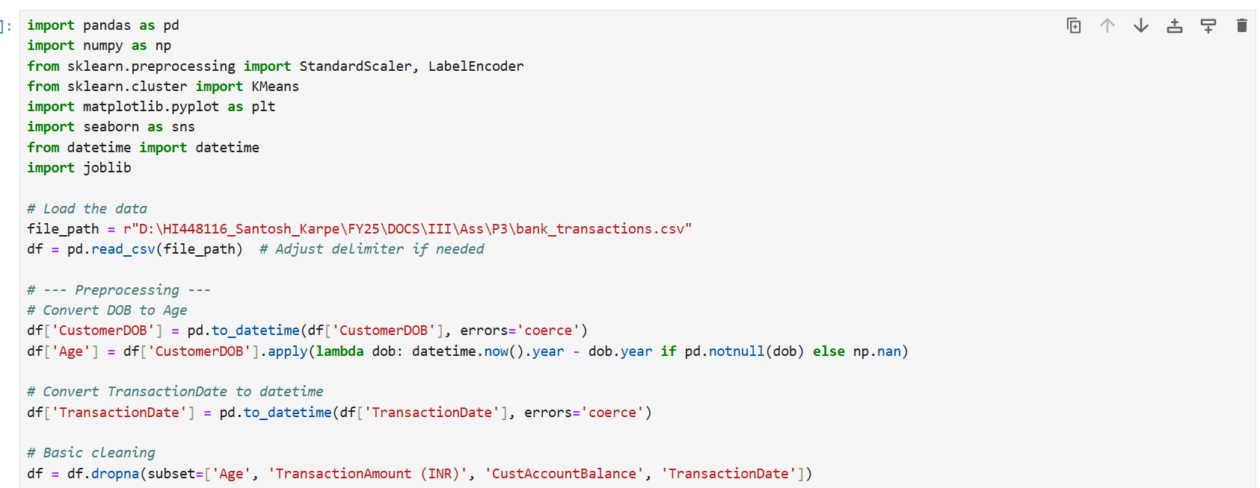
Read data set, format and update for model train the model

Slide 4
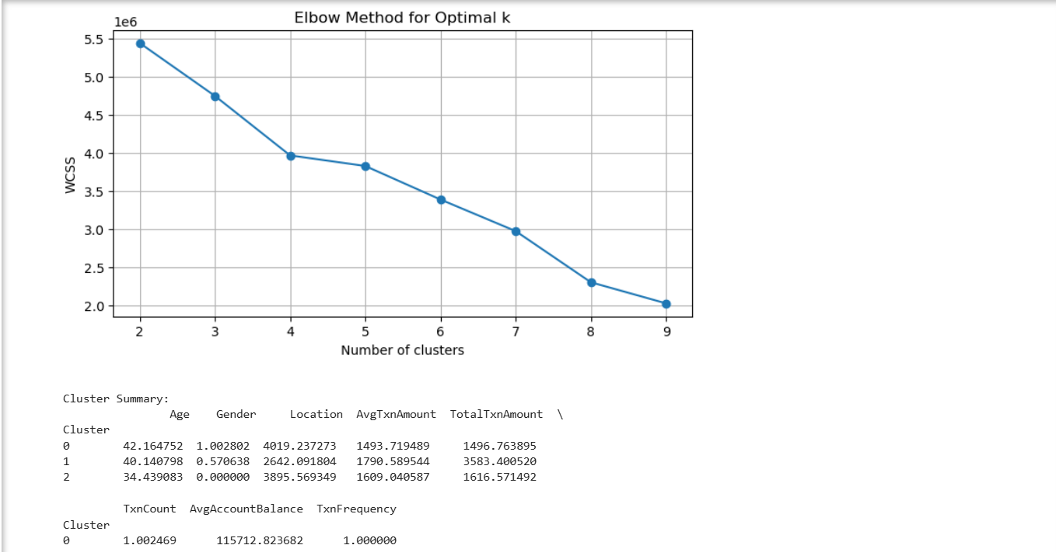
Read data set, format and update for model train the model

Slide 5
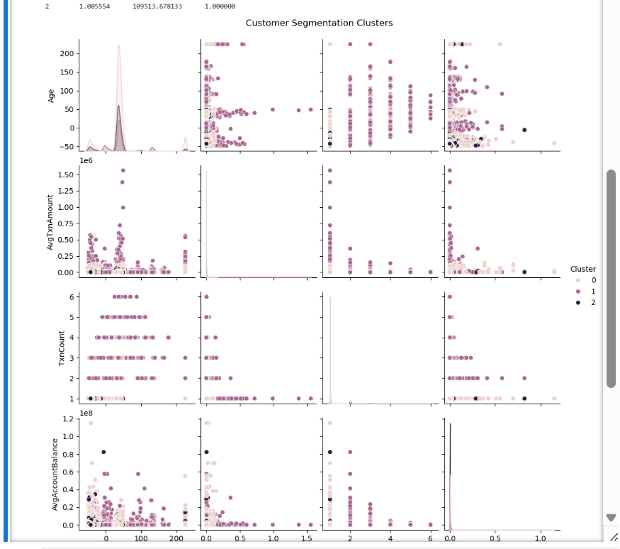
Read data set, format and update for model train the model

Slide 6
Read data set, format and update for model train the model

Slide 7
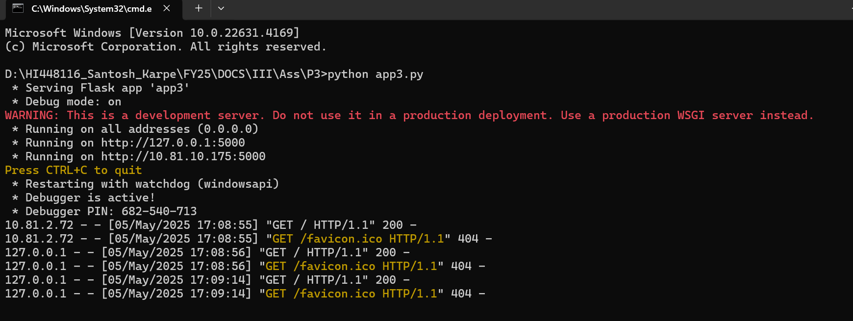
Read data set, format and update for model train the model

Slide 8
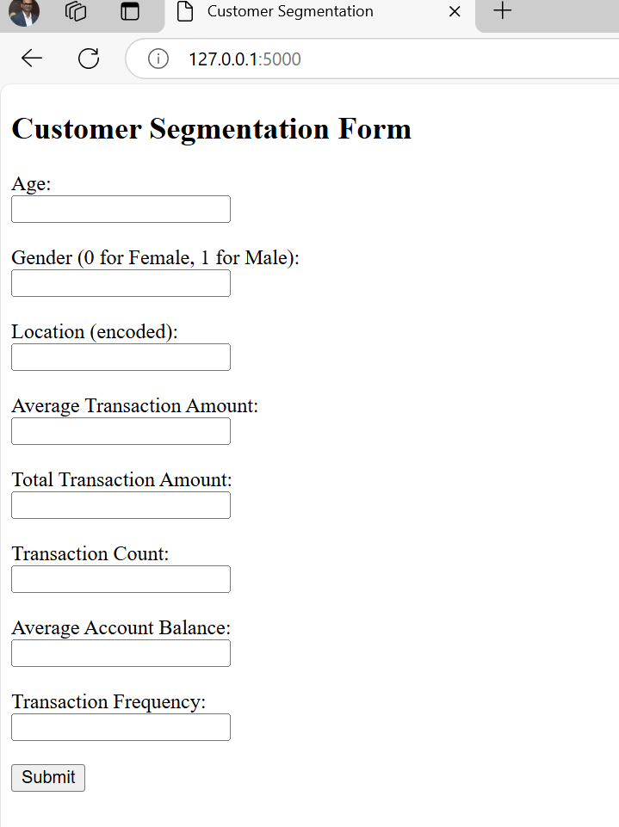
Read data set, format and update for model train the model

Slide 9
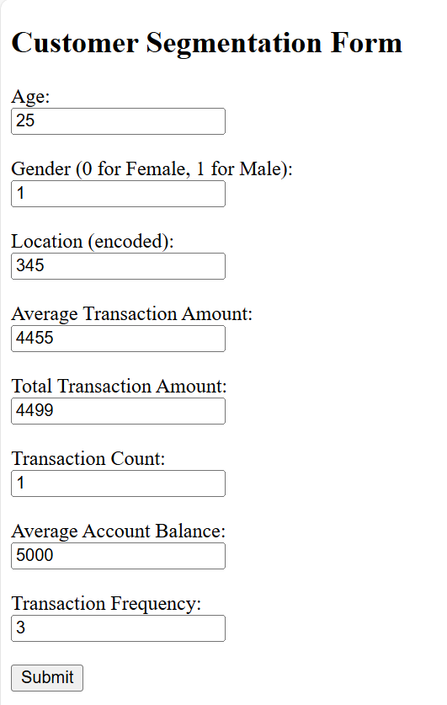
Read data set, format and update for model train the model

Slide 10




Thank You
Santosh Vishnu Karpe
+91 8779697280
Santosh.karpe11@gmail.com

