Slide 1


INSURANCE ANALYTICS
-SANTOSH BHAVSAR

Slide 2
CONTENTS
DASHBOARDS
OUTCOME

Slide 3
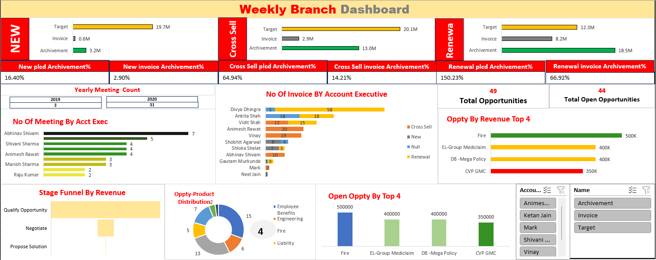
EXCEL DASHBOARD

Slide 4
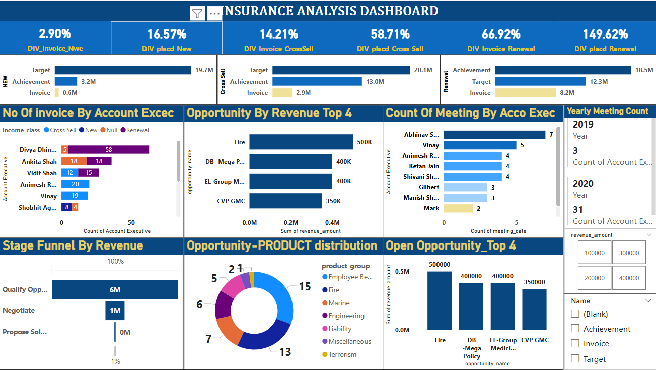
POWER BI DASHBOARD

Slide 5
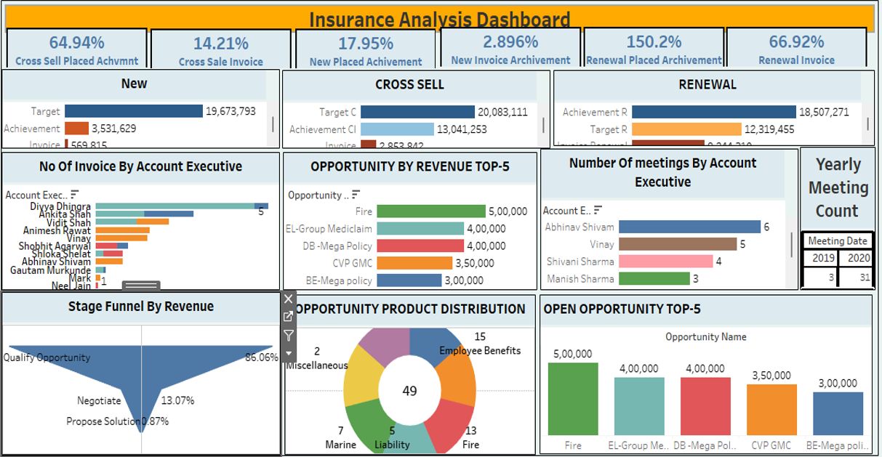
TABLEAU DASHBOARD

Slide 6
OUTCOME
1.GAINED EXPERINCE
2.SKILLS IMPROVEMENT
3.SOLVING REAL BUSINESS PROBLEM
4.BOOSTED OUR CONFIDENT

Slide 7
OUTCOME
1.GAINED EXPERINCE
2.SKILLS IMPROVEMENT
3.SOLVING REAL BUSINESS PROBLEM
4.BOOSTED OUR CONFIDENT

Slide 8
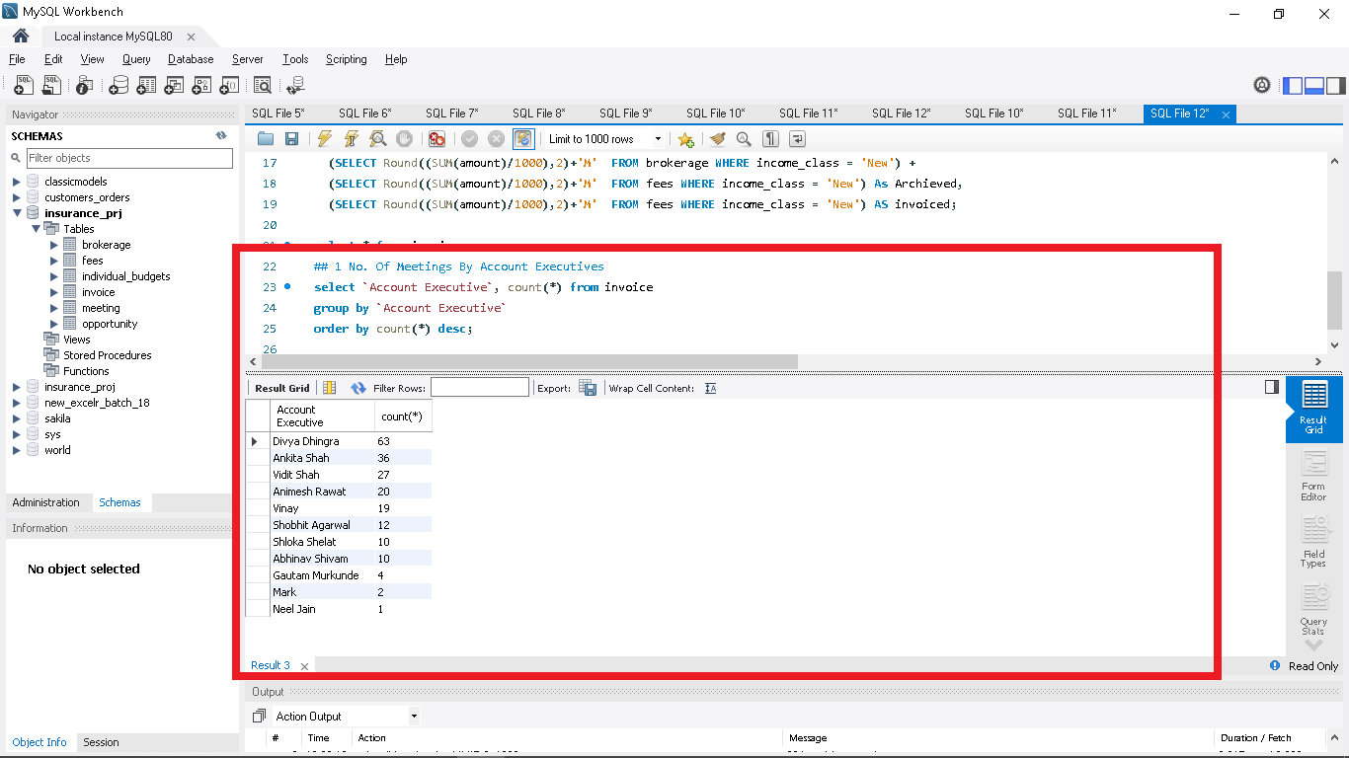
No. Of Meetings By Account Executives

Slide 9
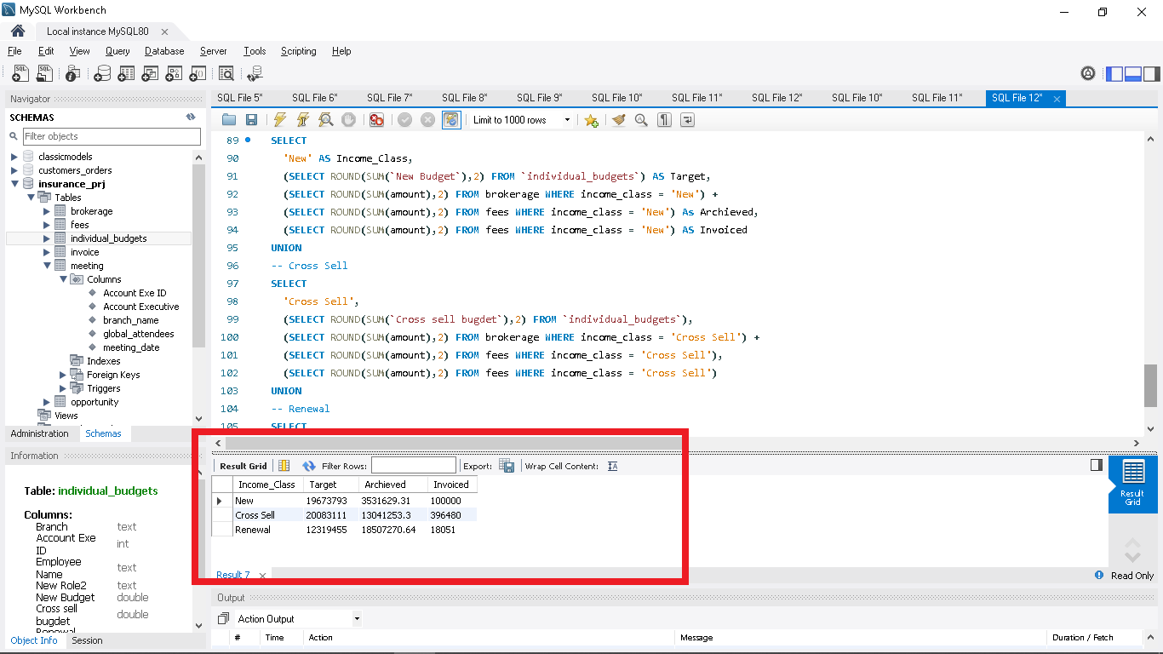
New, Cross Sell & Renewal Vs Target, Achieved & Invoiced

Slide 10
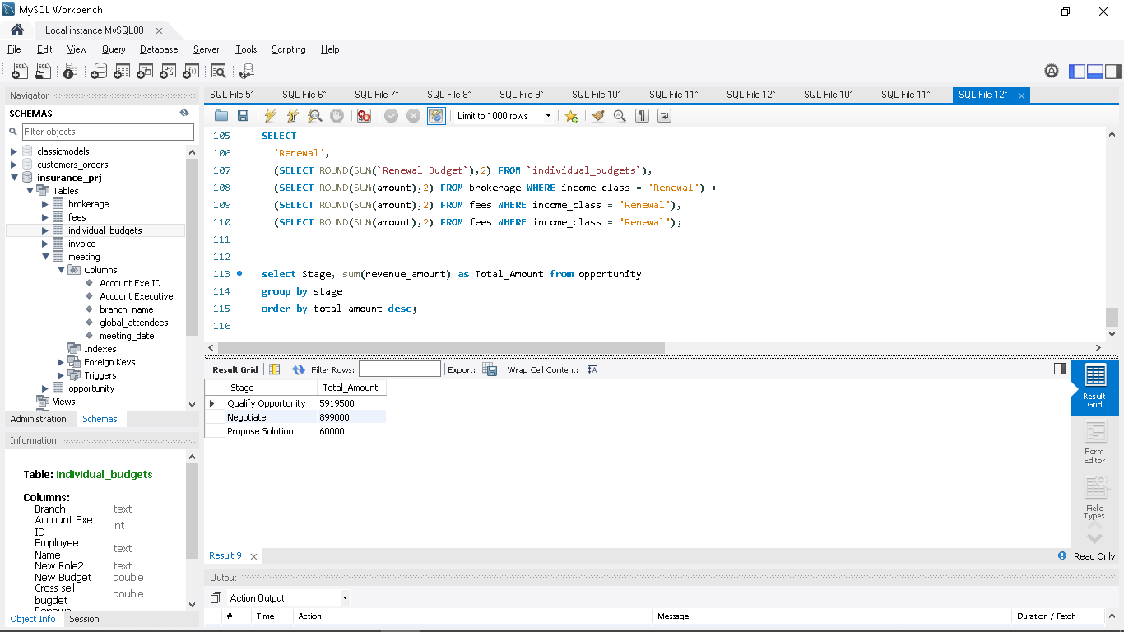
Stage Funnel By Revenue

Slide 11
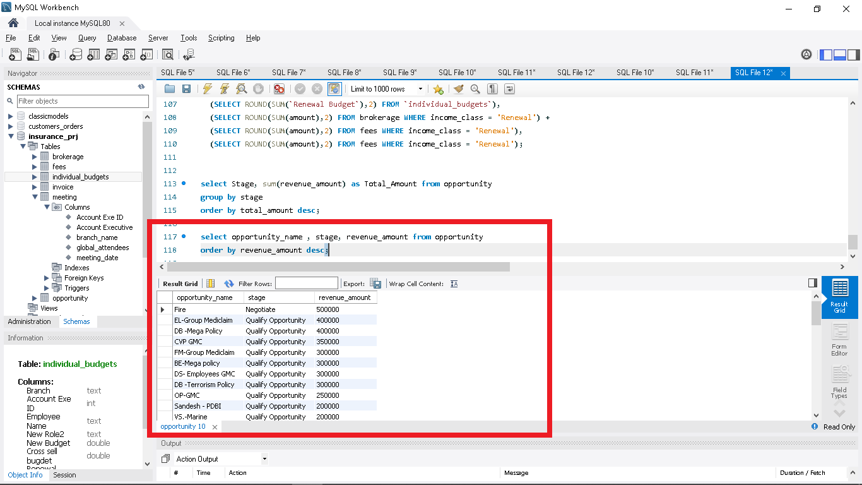
Opportunity By Revenue

Slide 12
THANK YOU

