Slide 1




CRM ANALYTICS
….Santosh Bhavsar

Slide 2

Contents
Project Summary
KPI List
Excel Dashboard
Tableau Dashboard
Power BI Dashboard
SQL Query Image
Key Takeaways

Slide 3
CRM Analytics Summary Report
Company Introduction Axon is a dynamic and rapidly growing retail brand specializing in : Manufacturing, distribution, and sales of high-quality consumer products. Known for strong emphasis on innovation, design, and customer satisfaction. Serves a diverse customer base with an extensive product range and widespread retail presence.
Problem Statement
CRM Challenges As Axon expands, it faces significant challenges in leveraging its CRM system effectively to drive business outcomes. Key Issues Identified:
Siloed Customer Data Customer information is scattered across systems, preventing unified insights.
Lack of Real-Time Insights Delayed data makes it difficult to respond to changing customer behavior quickly.
No KPI-Driven Dashboards Absence of performance metrics hampers strategic decision-making.
Poor CRM Reporting Experience Reports are either delayed, incomplete, or not actionable.

Slide 4
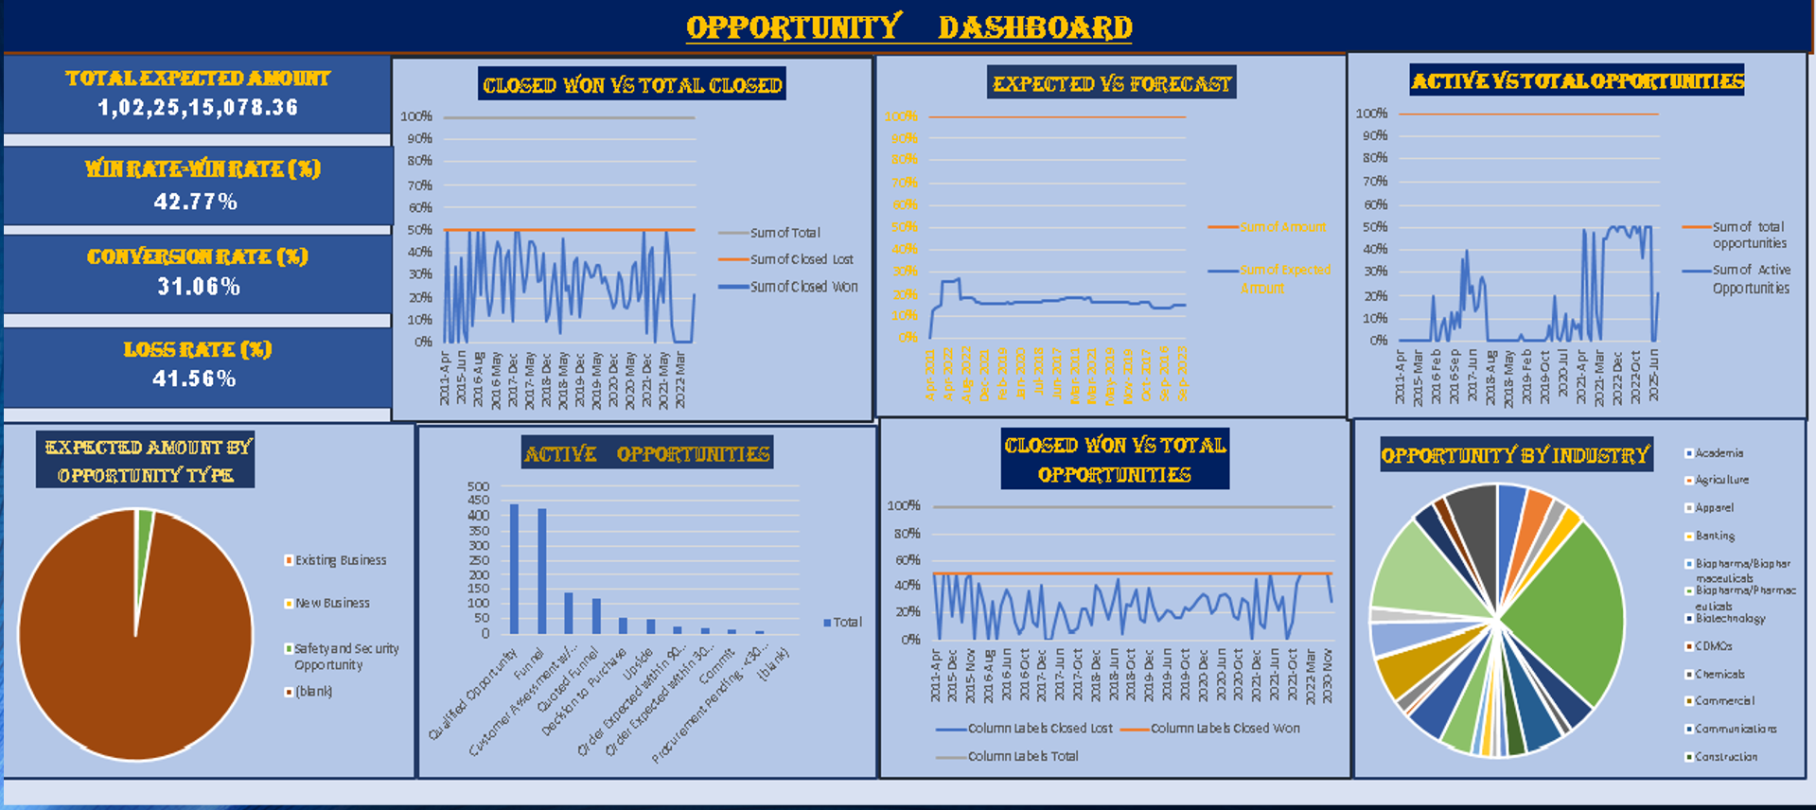
Opportunity Dashboard (EXCEL)

Slide 5
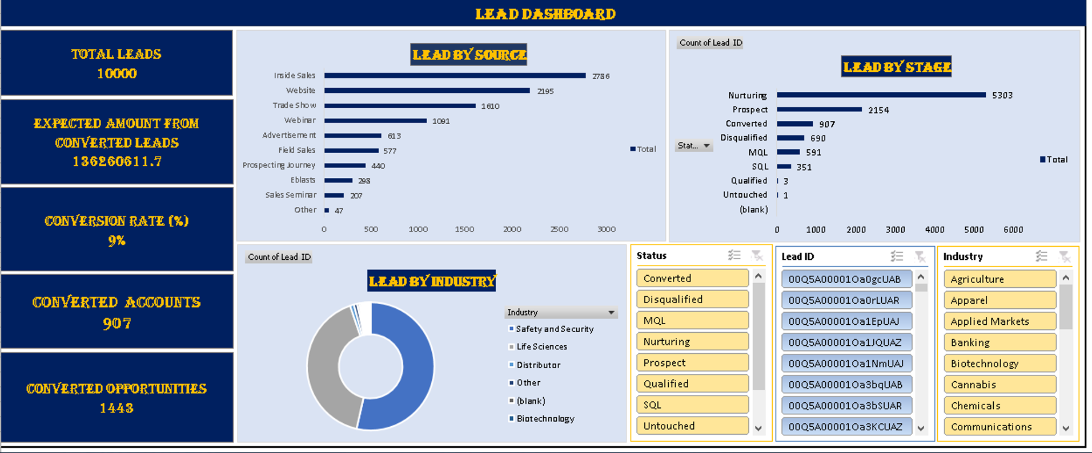
Lead Dashboard (EXCEL)

Slide 6
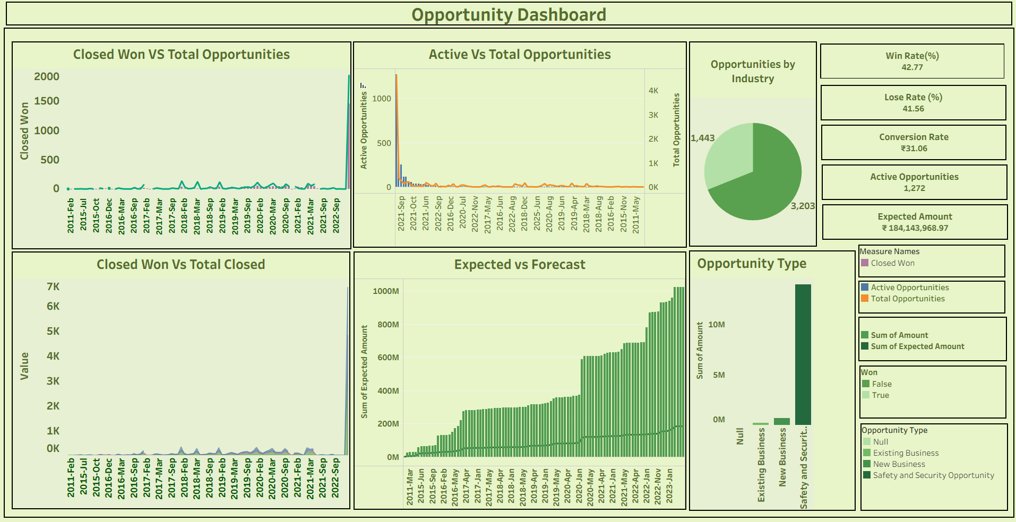
Opportunity Dashboard (Tableau)

Slide 7
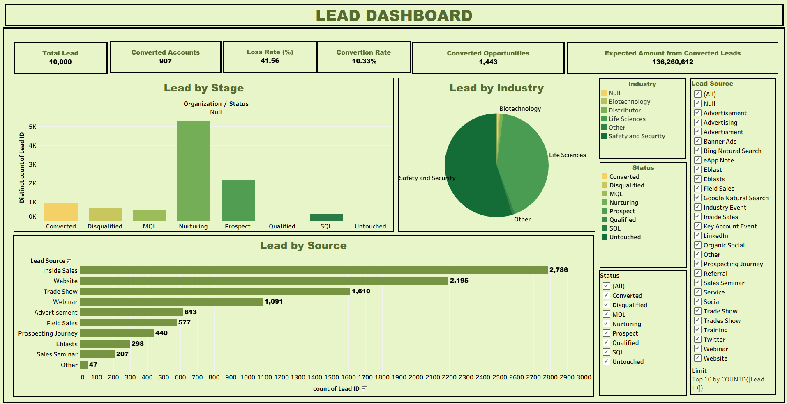
Lead Dashboard (Tableau)

Slide 8
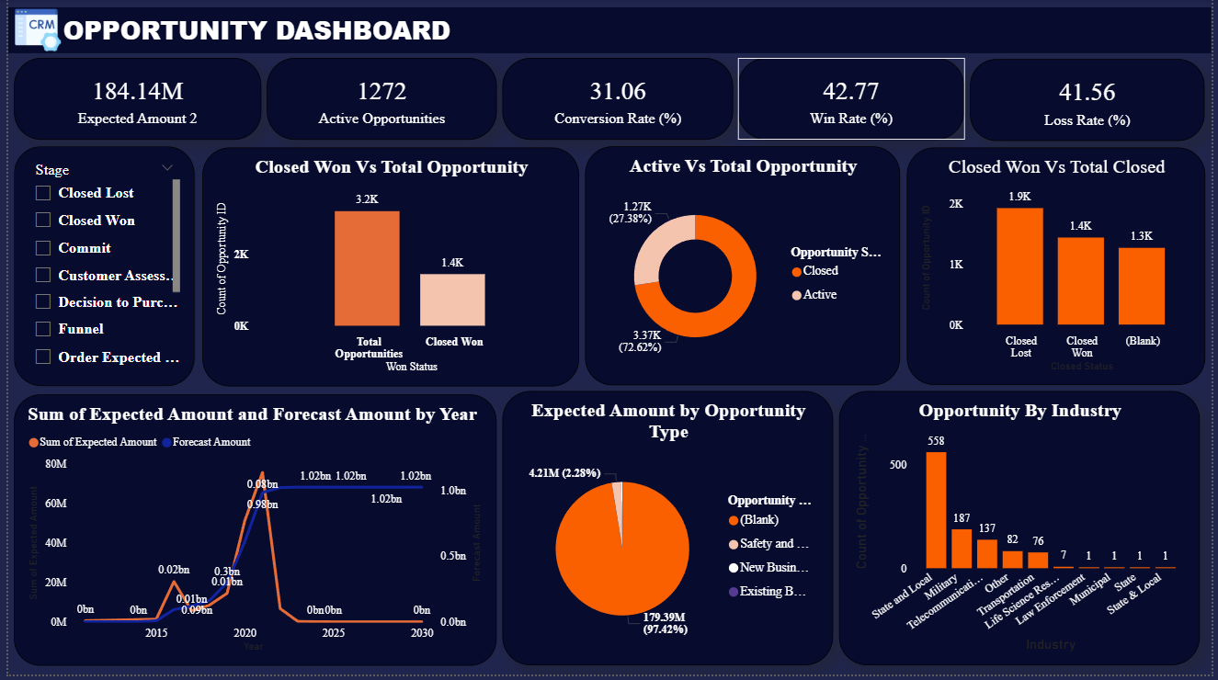
Opportunity Dashboard (Power BI)

Slide 9
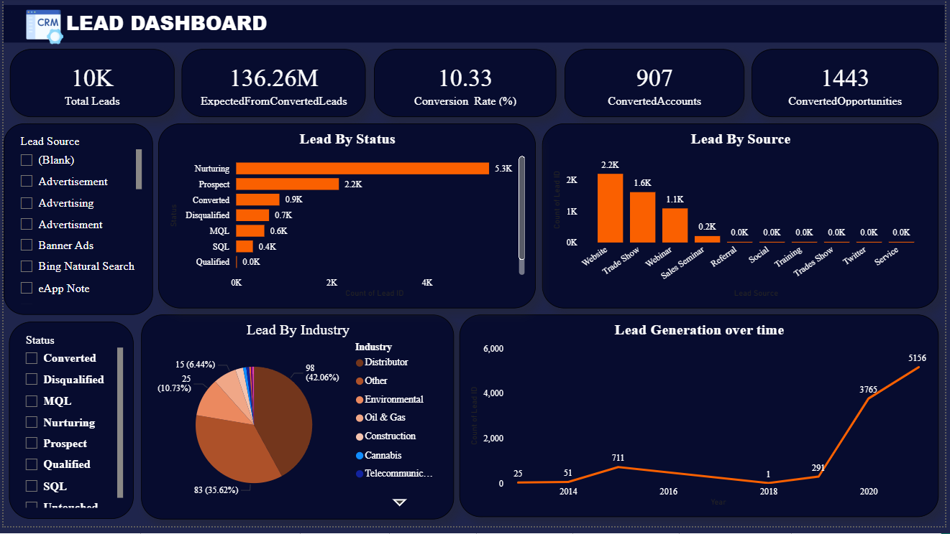
Lead Dashboard (Power BI)

Slide 10
SQL Queries
Lead KPIs & Charts
Opp. KPIs & Charts

Slide 11



Lead Dashboard Analysis
Conversion
Conversion rate is low (10.33%)
01
High Loss Rate
High loss rate (41.56%) indicates possible lead quality or follow-up issues
High expected revenue
High expected revenue from conversions indicates good quality of converted leads
02
03

Slide 12
Lead Dashboard Analysis
Lead by Stage
Most leads in Nurturing (~5K)
Few Converted (~600)
Many Null/ Untouched – poor tracking.
Lead by Industry
Top: Life Sciences, Biotech, Safety.
Many marked Other/Null – poor classification
Lead by Source
Main: Inside Sales (2.786).
Others: Website, Trade Show, Webinar.
High source dependency – needs review.

Slide 13




Active opportunities
Active opportunities declining
High expected value : ₹184M+
Low new client acquisition
High dependency on existing business
Strong Conversion rate
42.77%
Recent win spike likely from new efforts or seasonal trend

Slide 14
01
Performance Over Time
Flat till 2022; spike in 2023-24. Recent drop in active deals
02
Closed Won vs Total Closed
Closed deals rise post-2020 shows sales maturity
03
Expected vs Forecast
Steady growth since 2015; major jump after 2021
04
Opportunities by Industry
Two Industries dominates: 3.2k and 1.4k opportunities
05
Opportunity Type
Existing Business Leads (~₹11M); New Business is minimal

Slide 15
ACTION PLAN / RECOMMENDATIONS
Gaps / Problem Areas
Low lead conversion rate & high loss rate
Many leads stuck in Nurturing or Null stage
Incomplete or inconsistent data (Null entries)
Over-reliance on Inside Sales as the main source

Slide 16

ACTION PLAN / RECOMMENDATIONS
Review Campaign Effectiveness
Improve Lead Qualification
07
01
Use Lead Segmentation
06
02
Enhance Follow-Up
05
03
Improve Funnel Movement
04
Fix Data Quality
Refine Conversion Strategy

Slide 17

SUMMARY / CONCLUSION
This Lead dashboard shows a classic lead leakage issue with too many untracked or stagnating leads.
With structured qualification, improved follow-up, and better data handling, both conversion and revenue can significantly improve.

Slide 18
Thank You

