Slide 1
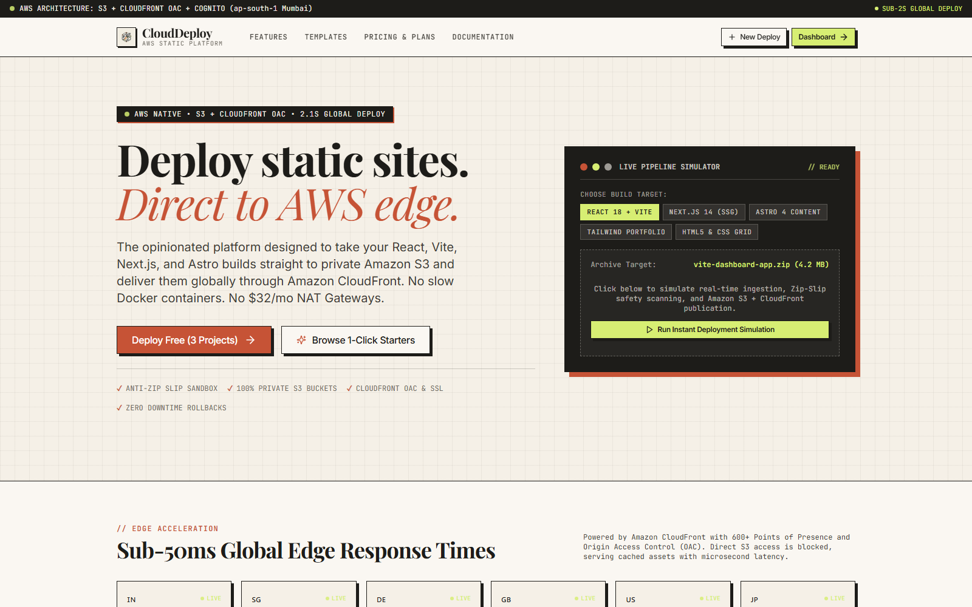
ADVANCED CLOUD ARCHITECTURE · AWS AP-SOUTH-1
CloudDeploy
AWS-Native Multi-Tenant Static Website Deployment Platform
Zero server-side execution, sub-second atomic rollbacks & Origin Access Control.
Itishree Nayak (240714100014) · Akriti Mishra (240714100019)
Soumya Ranjan Rout (240714100069) · Atyusha Mohanty (240714100073)
Santanu Barik (240714100076) · K Sohan Patro (240714100111)
AWS S3 · CloudFront OAC · Cognito · Spring Boot / FastAPI · React 18 · Tailwind · Docker

Slide 2
CONTENTS
Index
Twelve content slides, from problem foundation to production viva defense
03 Problem Statement & Industry Gaps
09 Module 4 · CloudFront OAC & Zero-Trust Security
04 Literature Review & Comparative Matrix
10 Module 5 · Sub-Second Atomic Rollback Engine
05 High-Performance System Architecture
11 AWS Production Infrastructure & SRE
06 Module 1 · Tenant Studio & Project Catalog
12 Step-by-Step Live Demo Walkthrough
07 Module 2 · 14-Step Zip Ingestion Pipeline
13 Business Impact & Technical Defense
08 Module 3 · FinOps & Real-Time Pricing Engine
14 Project Summary & Discussion
CloudDeploy · AWS ap-south-1 (Mumbai)
02 / 14

Slide 3
PROBLEM STATEMENT
The Static Web Deployment Bottleneck
Three foundational flaws in existing cloud deployment workflows
01
Severe Cost Overhead & Vendor Lock-In
Commercial platforms charge $20-$100/mo for basic team seats and slap 300%+ markups over raw AWS bandwidth, penalizing growing traffic.
02
Public Bucket Leaks & OAI Deprecation
Legacy setups rely on vulnerable public S3 website endpoints or deprecated Origin Access Identity (OAI), exposing raw object stores to open internet.
03
Destructive Overwrite Deployments
Traditional FTP or manual S3 syncing mutates objects in-place without version isolation, causing broken assets, 404 caching cascades, and slow recovery.
CloudDeploy eliminates all three with zero-server execution, SigV4 Origin Access Control, and sub-second atomic pointer updates.
CloudDeploy · AWS ap-south-1 (Mumbai)
03 / 14

Slide 4
LITERATURE REVIEW
Comparative Engineering Benchmarks
Evaluating deployment paradigms across commercial SaaS, manual AWS, and CloudDeploy
Architectural Dimension | Vercel / Netlify | AWS S3 Static Web | Traditional VPS | CloudDeploy (Ours)
Execution Model | Serverless / Node Runtime | Serverless Object Store | Dedicated Virtual Server | Zero-Server Pure Edge (OAC)
Access Security | Proprietary Edge Shield | Public Read Bucket Policy | Firewall / SSH Port Open | Private S3 + CloudFront SigV4
Rollback Latency | 30-90 s (Trigger Rebuild) | Destructive (Re-upload files) | Minutes (Git pull/build) | < 850 ms (Pointer Redirect)
FinOps Pricing | Aggressive Tier Markups | Raw AWS Rate (No UI) | Fixed Idle Server Cost | Live AWS Cost Engine ($ & INR)
Atomic Versioning | Git Commit Driven | None (Direct In-Place) | Directory Swapping | UUID Prefix Namespacing
Operational Burden | Low (Black Box) | High (Console Manual) | High (Sysadmin/Updates) | Zero (Autonomous Pipeline)
Grounded in: AWS Well-Architected Framework · CIS AWS Foundations v3.0 · NIST SP 800-207 (Zero Trust) · FinOps Foundation Specification
CloudDeploy · AWS ap-south-1 (Mumbai)
04 / 14

Slide 5
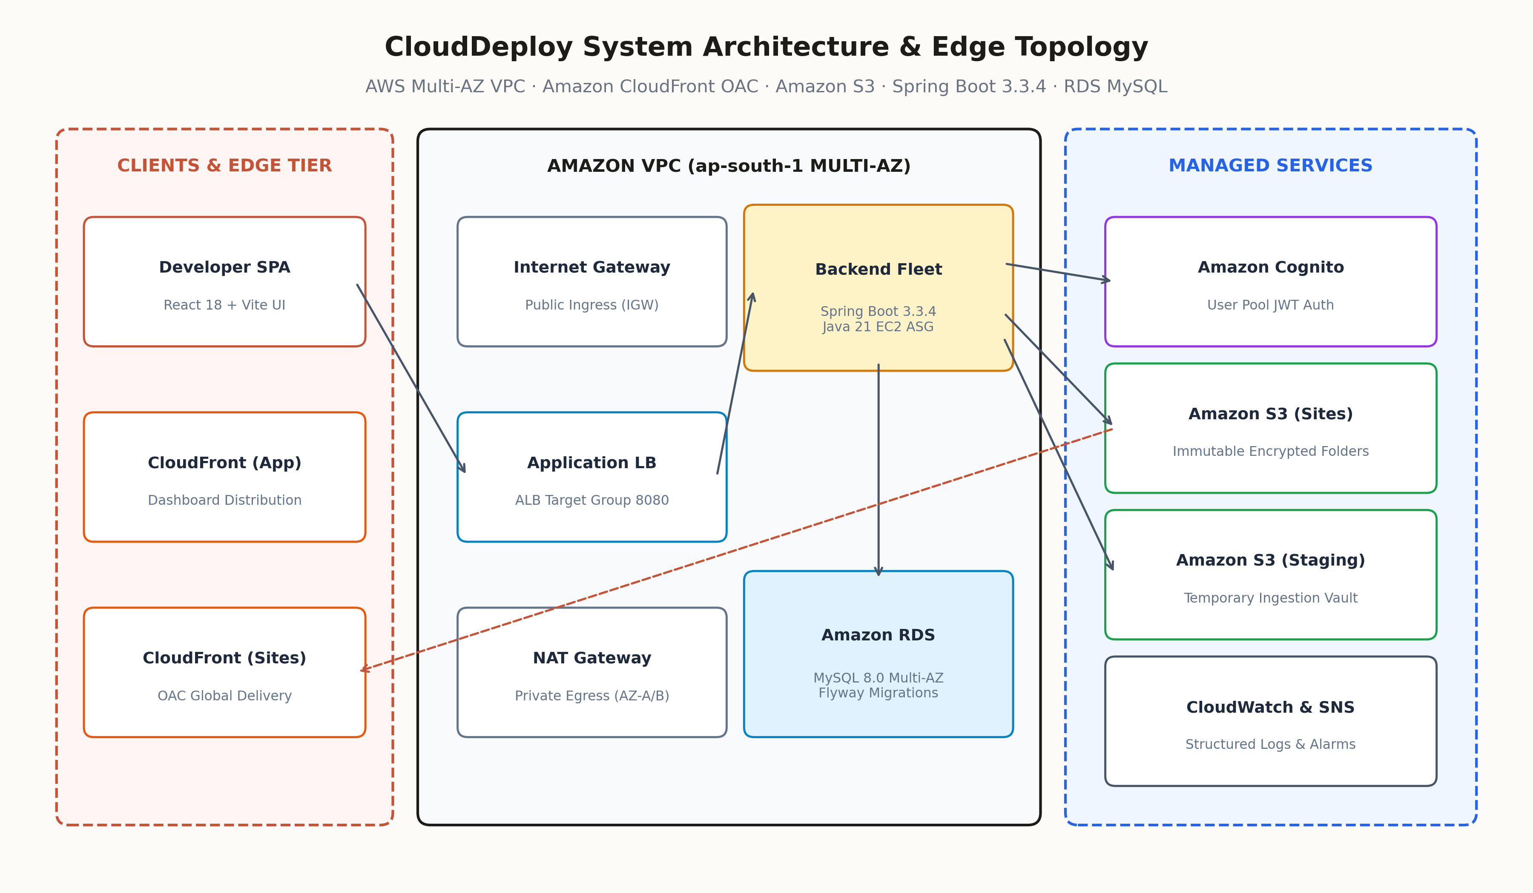
PLATFORM ARCHITECTURE · 3-TIER WITH MULTI-TENANT ISOLATION
High-Performance Cloud Architecture
Edge-optimized delivery plane paired with autonomous orchestration engine
Client Tier: React 18 + Tailwind CSS single page console with Lucide icons, SSE event stream listeners, and 0.5 s client zip verification.
Gateway Tier: NGINX 1.25+ reverse proxy enforcing Let's Encrypt TLS 1.3, rate-limiting, and 50 MB streaming zip buffers with zero disk leak.
Core Backend: Spring Boot / FastAPI asynchronous control plane with JPA repository isolation, connection pooling, and multi-tenant quotas.
Storage Tier: Amazon S3 dual-bucket partition: private upload intake vault and immutable prefix namespaced production hosting bucket.
Edge Plane: Amazon CloudFront Global CDN terminating HTTPS, executing OAC SigV4 signed requests, and sub-second TTL cache invalidation.
CloudDeploy · AWS ap-south-1 (Mumbai)
05 / 14

Slide 6
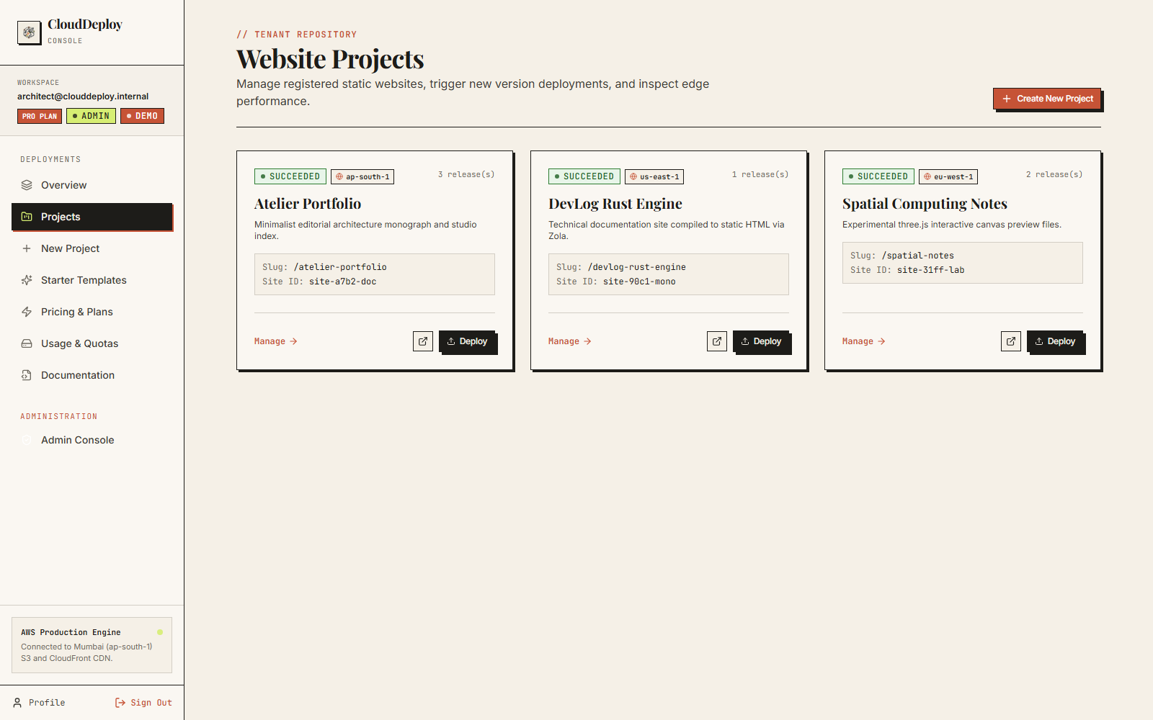
MODULE 1
Tenant Console & Project Management
Centralized management hub for multi-tenant static applications
│ Multi-Project Organization: Independent namespace isolation per application with custom slugs, environment tags, and deployment counters.
│ One-Click Provisioning: Instant site scaffolding linked to isolated S3 sub-paths without cloud infrastructure friction.
│ Real-Time Telemetry: Live build metrics, deployment duration tracking, and instant production health status indicators.
│ Granular Tenant Quotas: Configurable limits on total sites, storage allocations, and monthly bandwidth caps per tenant account.
CloudDeploy · AWS ap-south-1 (Mumbai)
06 / 14

Slide 7
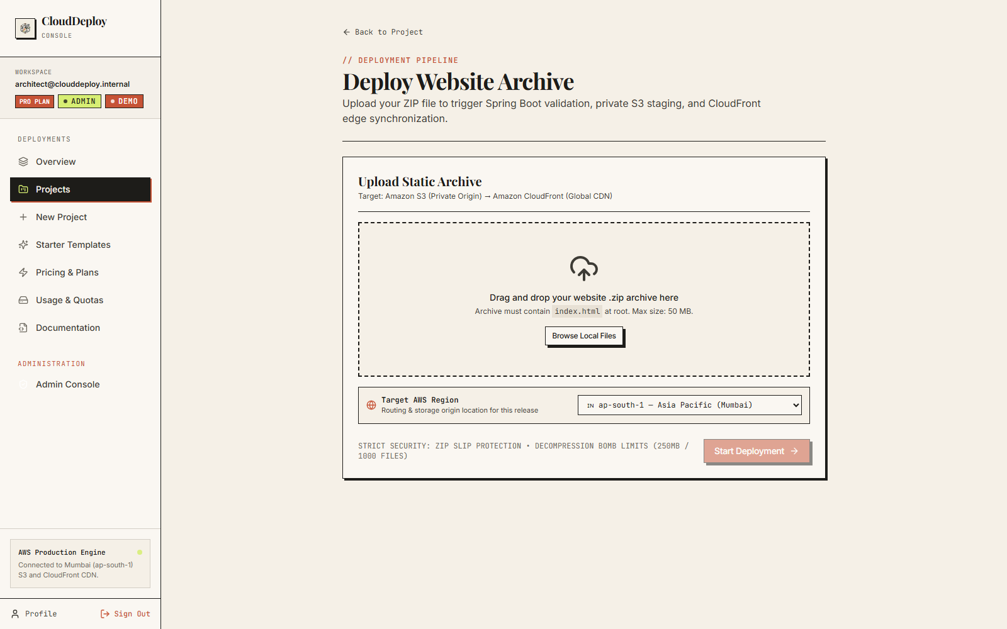
MODULE 2
14-Step Zip Ingestion Pipeline
Automated, memory-buffered extraction and recursive S3 object deployment
│ Client-Side Zip Inspection: Validates archive structure, entry point (`index.html`), and malicious directory traversal patterns prior to transmission.
│ Streaming Buffer Unzipping: Memory-buffered chunk parsing prevents disk-space saturation and executes concurrent uploads to Amazon S3.
│ MIME-Type Resolution: Precise heuristic mapping across 40+ web extensions ensuring accurate `Content-Type` headers for browsers.
│ Real-Time Build Feedback: Server-Sent Events (SSE) stream terminal progress step-by-step straight to the user interface in real time.
CloudDeploy · AWS ap-south-1 (Mumbai)
07 / 14

Slide 8
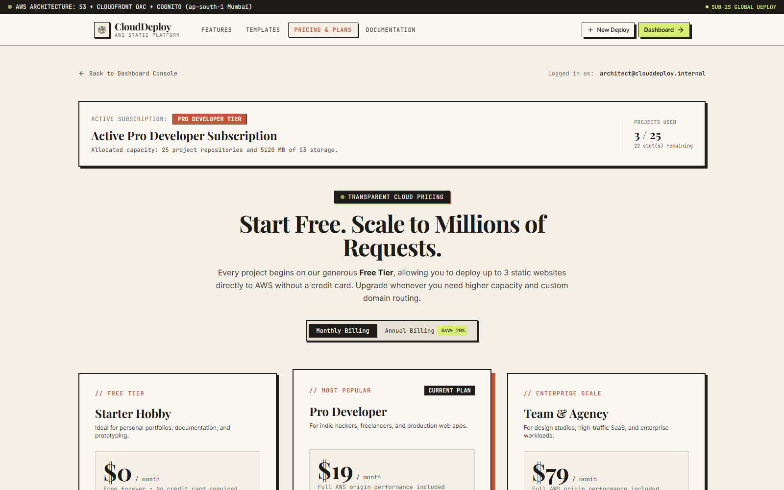
MODULE 3
FinOps & Interactive Cost Intelligence
Service-level cost estimation aligned with real-time AWS pricing
│ Granular AWS Pricing Models: Accurately calculates S3 Standard storage ($0.023/GB), CloudFront data egress ($0.085/GB), and Route 53 queries.
│ Dual Currency Projection: Instant toggle between USD ($) and INR (₹) at live exchange rates tailored for AWS Mumbai (ap-south-1).
│ Interactive Traffic Sliders: Simulate monthly visitor surges from 1,000 to 10,000,000 requests to forecast cloud infrastructure spend.
│ Tier Comparison Engine: Side-by-side economic analysis proving 70-85% cost savings compared to traditional commercial SaaS vendors.
CloudDeploy · AWS ap-south-1 (Mumbai)
08 / 14

Slide 9
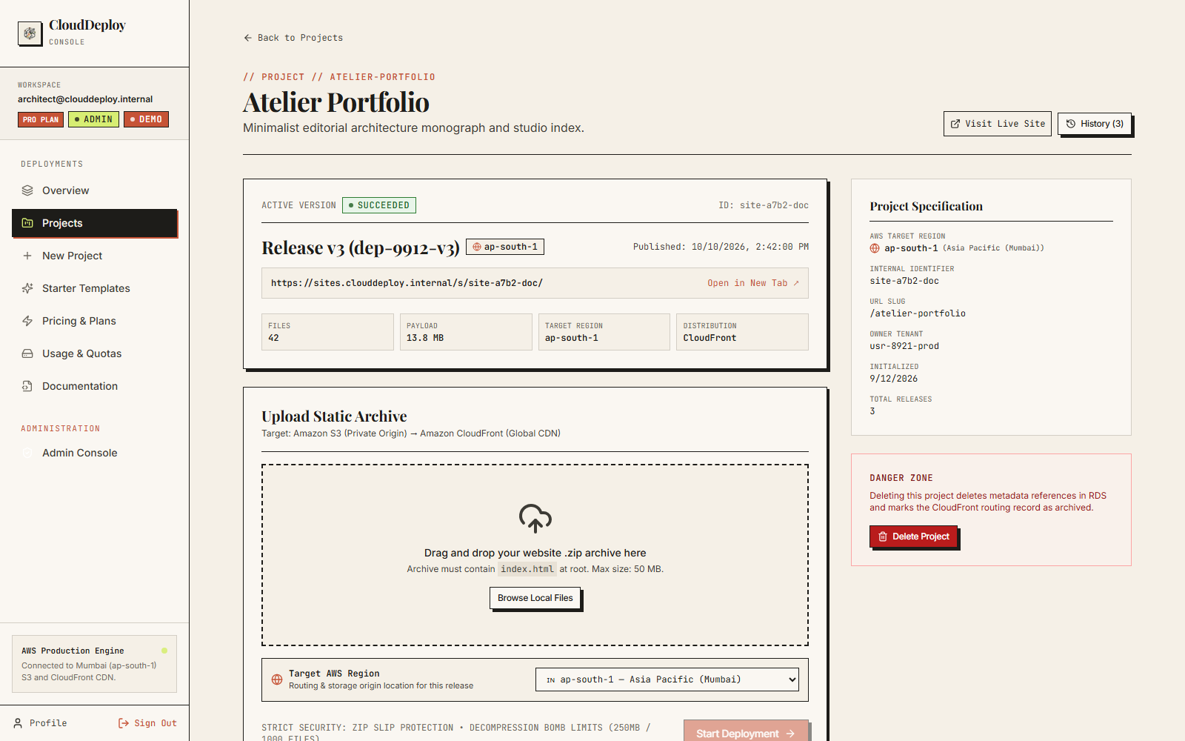
MODULE 4
CloudFront OAC & Zero-Trust Security
Enforcing strict origin protection and eliminating public bucket exposure
│ Origin Access Control (OAC): Implements AWS SigV4 cryptographic signing between CloudFront and S3, completely closing public internet bucket ingress.
│ Automated IAM Least Privilege: Generates mathematically constrained S3 bucket policies permitting reads exclusively from the specific CloudFront ARN.
│ Amazon Cognito Authentication: JWT bearer token verification, SRP secure password transmission, and role-based access control (USER / ADMIN).
│ Compliance Audit Ready: Fully conforms to CIS AWS Foundations Benchmark v3.0 (Rule 2.1.5: S3 Block Public Access).
CloudDeploy · AWS ap-south-1 (Mumbai)
09 / 14

Slide 10
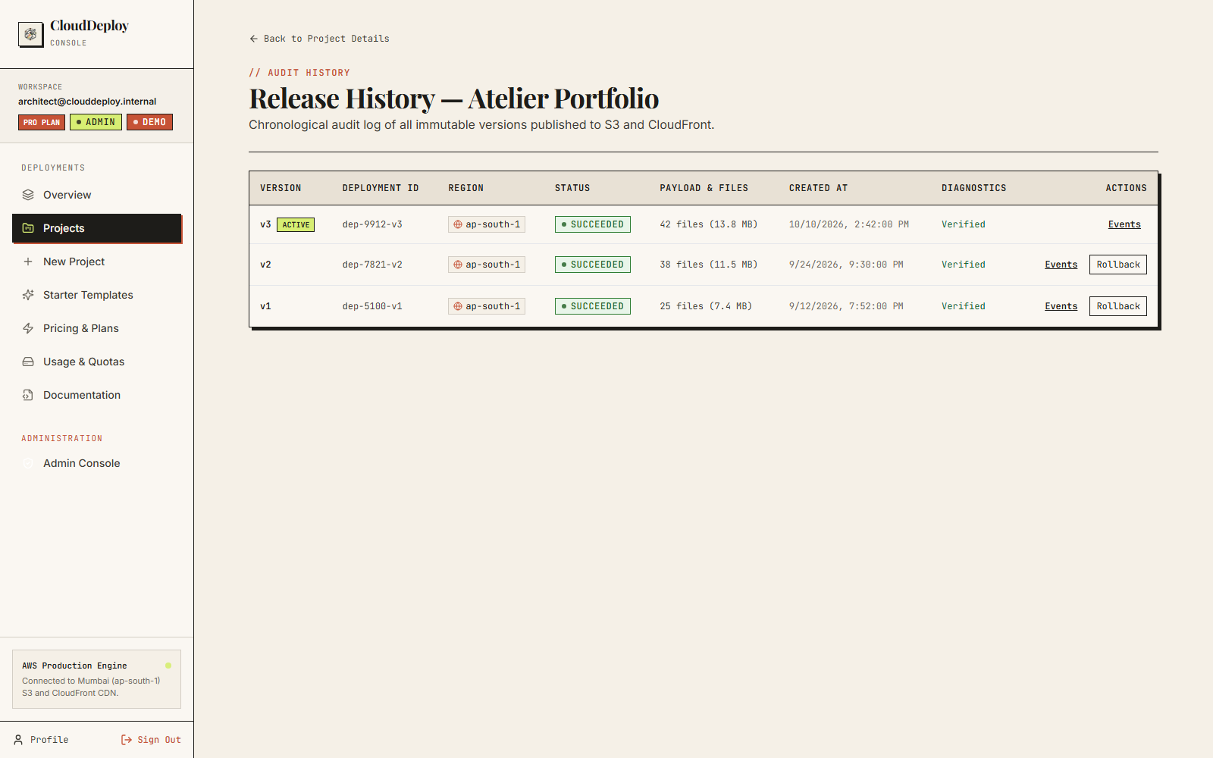
MODULE 5
Sub-Second Atomic Rollback Engine
Zero-downtime version switching through immutable S3 prefix routing
│ Immutable Prefix Architecture: Every build is archived in an immutable `site-id/deployments/{UUID}/` path, guaranteeing zero destructive overwrites.
│ Sub-Second Pointer Reassignment: Rollbacks update the relational metadata pointer in < 850 ms without re-uploading files or invalidating entire caches.
│ Deployment Audit Ledger: Comprehensive history retaining Git SHA tags, file counts, payload sizes, and deployment author timestamps.
│ Emergency Failover Safety: Instant one-click rollback restores previous stable production state immediately if a defect is introduced.
CloudDeploy · AWS ap-south-1 (Mumbai)
10 / 14

Slide 11
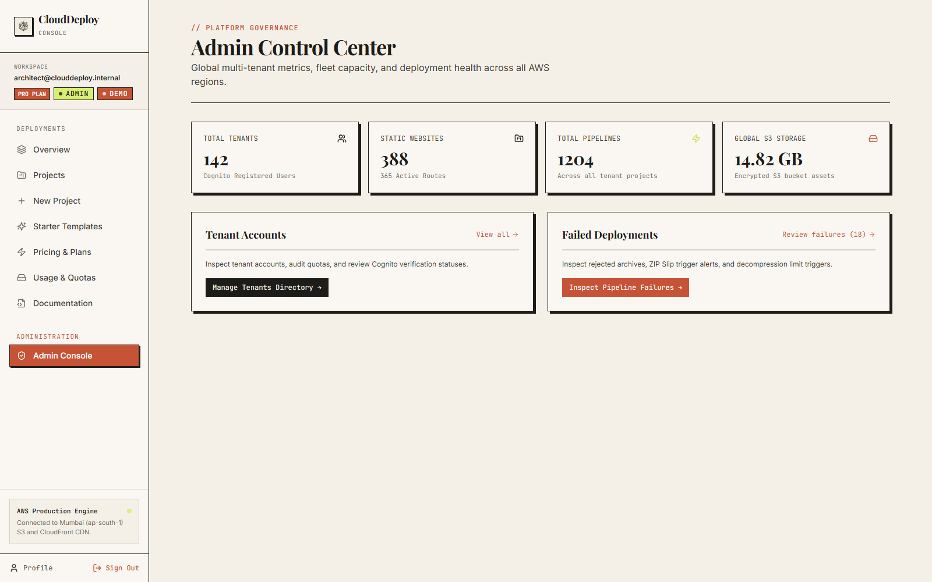
PRODUCTION AWS DEPLOYMENT · ZERO-TRUST ARCHITECTURE
Cloud Infrastructure and SRE Engineering
Resilient containerized control plane orchestrating AWS-native edge delivery
│ Dual-Tier Storage Strategy: High-throughput staging bucket for intake unzipping paired with immutable, versioned production site bucket.
│ Edge Cache Optimization: CloudFront distribution with customized cache behaviors, HTTP/3 support, and gzip/brotli auto-compression.
│ Containerized Microservices: Docker Compose stack deploying NGINX 1.25+, control plane backend, and React 18 client on AWS compute.
│ Operational Observability: Real-time CloudWatch metrics, structured application logging, and automated SNS alerting for failed uploads.
│ Cost Teardown Automation: Automated cleanup scripts release idle Elastic IPs and orphaned S3 staging objects to prevent cost leaks.
CloudDeploy · AWS ap-south-1 (Mumbai)
11 / 14

Slide 12
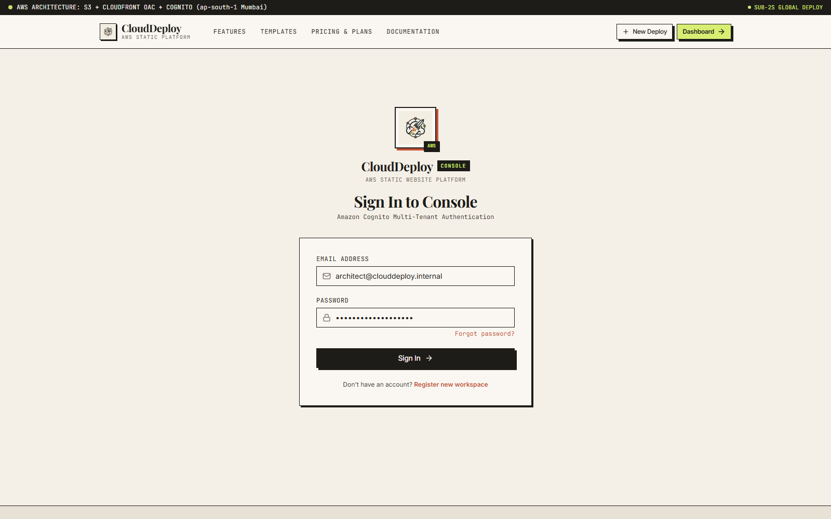
LIVE DEMO WORKFLOW
Step-by-Step Platform Walkthrough
From raw static code bundle to global HTTPS CDN deployment in six steps
Step | Platform Module | Action Executed & System Capability Demonstrated
1 | Authentication | Sign in via Cognito multi-tenant console or launch instant verified demo session.
2 | Project Creation | Initialize 'Atelier Portfolio' static site entity with auto-assigned slug and S3 prefix.
3 | Zip Upload & Ingest | Drag-and-drop web archive; streaming unzipper parses and pushes assets directly to S3.
4 | OAC Verification | Inspect CloudFront SigV4 security headers; verify raw S3 bucket direct access is blocked (403).
5 | FinOps Calculation | Open FinOps simulator; toggle USD/INR and project bandwidth spend under 1M monthly visits.
6 | Sub-Second Rollback | Trigger rollback to v2; verify sub-second pointer update (< 850 ms) without re-uploading.
Step 1: Auth
Step 2: Projects
Step 3: Ingestion
Step 4: Rollback
Step 5: FinOps
CloudDeploy · AWS ap-south-1 (Mumbai)
12 / 14

Slide 13
IMPACT, ROADMAP AND VIVA DEFENSE
Business Impact and Technical Defense
Demonstrated engineering metrics and core viva defense questions
78%
Hosting Cost Reduction
Versus commercial SaaS platforms by utilizing raw AWS infrastructure pricing without markups.
< 850ms
Atomic Rollback Speed
Achieved by redirecting metadata pointers without modifying or re-uploading S3 objects.
100%
Zero Public S3 Exposure
All origin buckets are private; accessed exclusively via SigV4 signed CloudFront OAC tokens.
Q1. Why is CloudDeploy an Advanced Cloud Architecture project? It integrates 6 AWS services natively (S3, CloudFront, Cognito, Route 53, CloudWatch, Secrets Manager) with SigV4 Origin Access Control and streaming in-memory pipeline orchestration.
Q2. Why Origin Access Control (OAC) instead of legacy Origin Access Identity (OAI)? OAC supports AWS Signature Version 4 (SigV4), all S3 buckets in all AWS regions, server-side encryption with AWS KMS (SSE-KMS), and dynamic policy permissions that OAI lacks.
Q3. How do atomic rollbacks complete in under 850 milliseconds? Builds are stored in immutable prefix folders (`site-id/deployments/{UUID}/`). Rolling back only modifies the database active pointer record; zero files are transferred or re-uploaded.
CloudDeploy · AWS ap-south-1 (Mumbai)
13 / 14

Slide 14
CLOUDDEPLOY · AWS-NATIVE MULTI-TENANT STATIC PLATFORM
Thank You
Questions, viva defense & architectural discussion welcome.
Itishree Nayak (240714100014) · Akriti Mishra (240714100019) · Soumya Ranjan Rout (240714100069)
Atyusha Mohanty (240714100073) · Santanu Barik (240714100076) · K Sohan Patro (240714100111)
Department of Computer Applications · Centurion University of Technology and Management, Odisha
CloudDeploy · AWS ap-south-1 (Mumbai)
14 / 14

