Slide 1

GloBox
Promoting food/drinks products - Banner

Slide 2


Why were here
GloBox
Tremendous increase in Foods and Drinks category
Capatilize this thrend

Slide 3

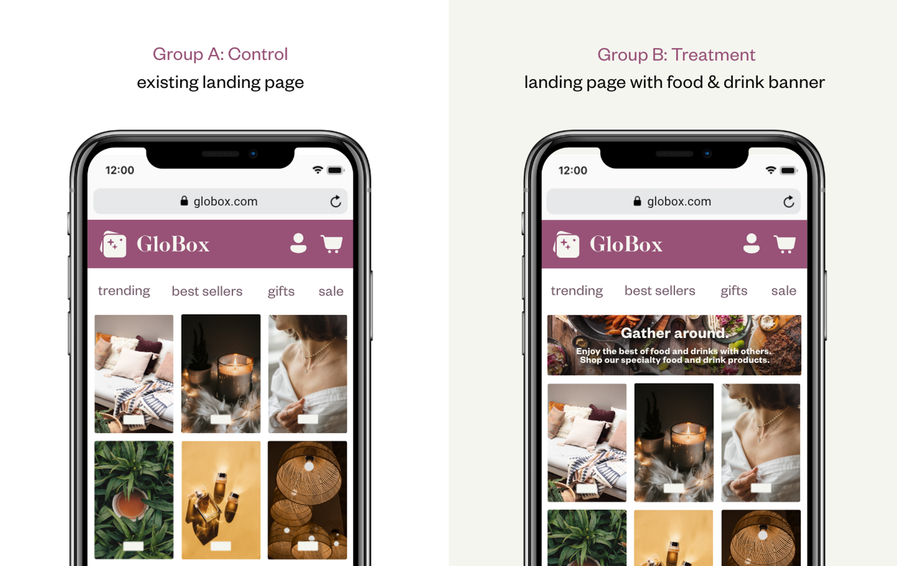
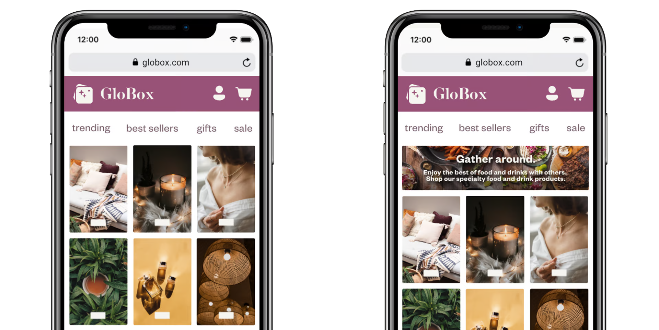
How
GloBox
Expirement Questions
Group A – No banner
Visitor
Group B – Banner
Does the conversion rate increase?
Does revenue increase?

Slide 4
Experiment Questions
GloBox
Group A – No banner
Visitor
Group B – Banner
Does the conversion rate increase?
Does revenue increase?

Slide 5
Experiment Overview
GloBox
Test duration: 2 Weeks
Participants: 49000 users
Conversion average: 4,3%
Group A (no banner)
Conversion rate: 3,9%
Revenue: 82.146
Group B (banner)
Conversion rate: 4,6%
Revenue: 83.415

Slide 6
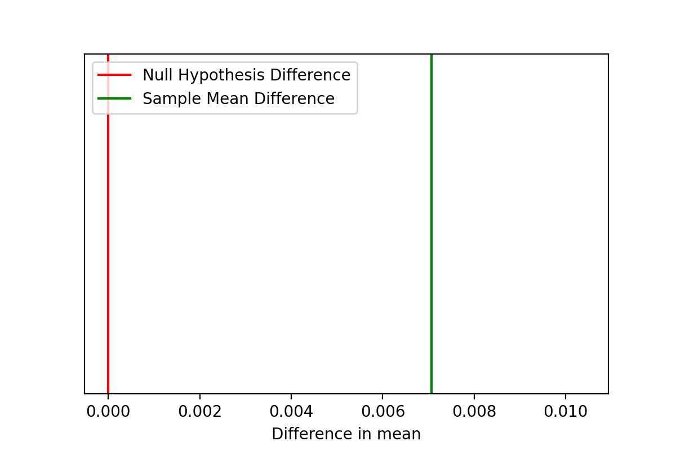
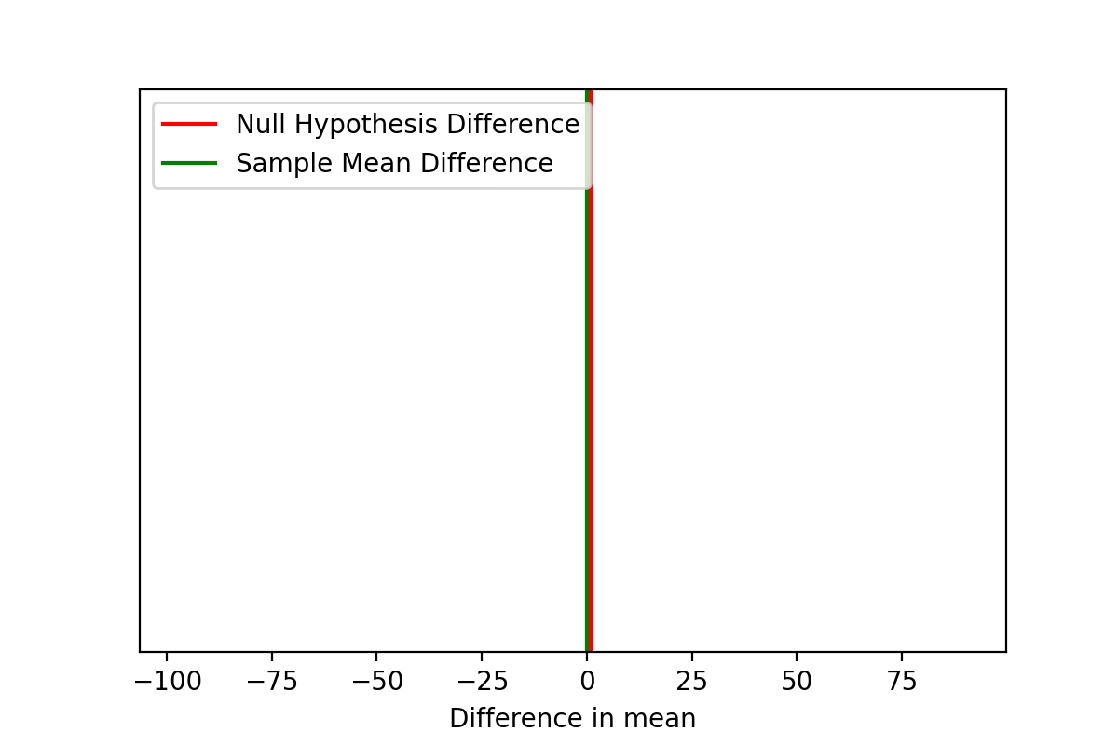
Results
GloBox
Group A (no banner)
Conversion rate: 3,9%
Revenue: 82.146
Group B (banner)
Conversion rate: 4,6%
Revenue: 83.415
Conversion rate significantly increased
Revenue didn’t increase significantly

Slide 7
Conclusion
GloBox
Don’t implement banner
Increase conversion

Slide 8
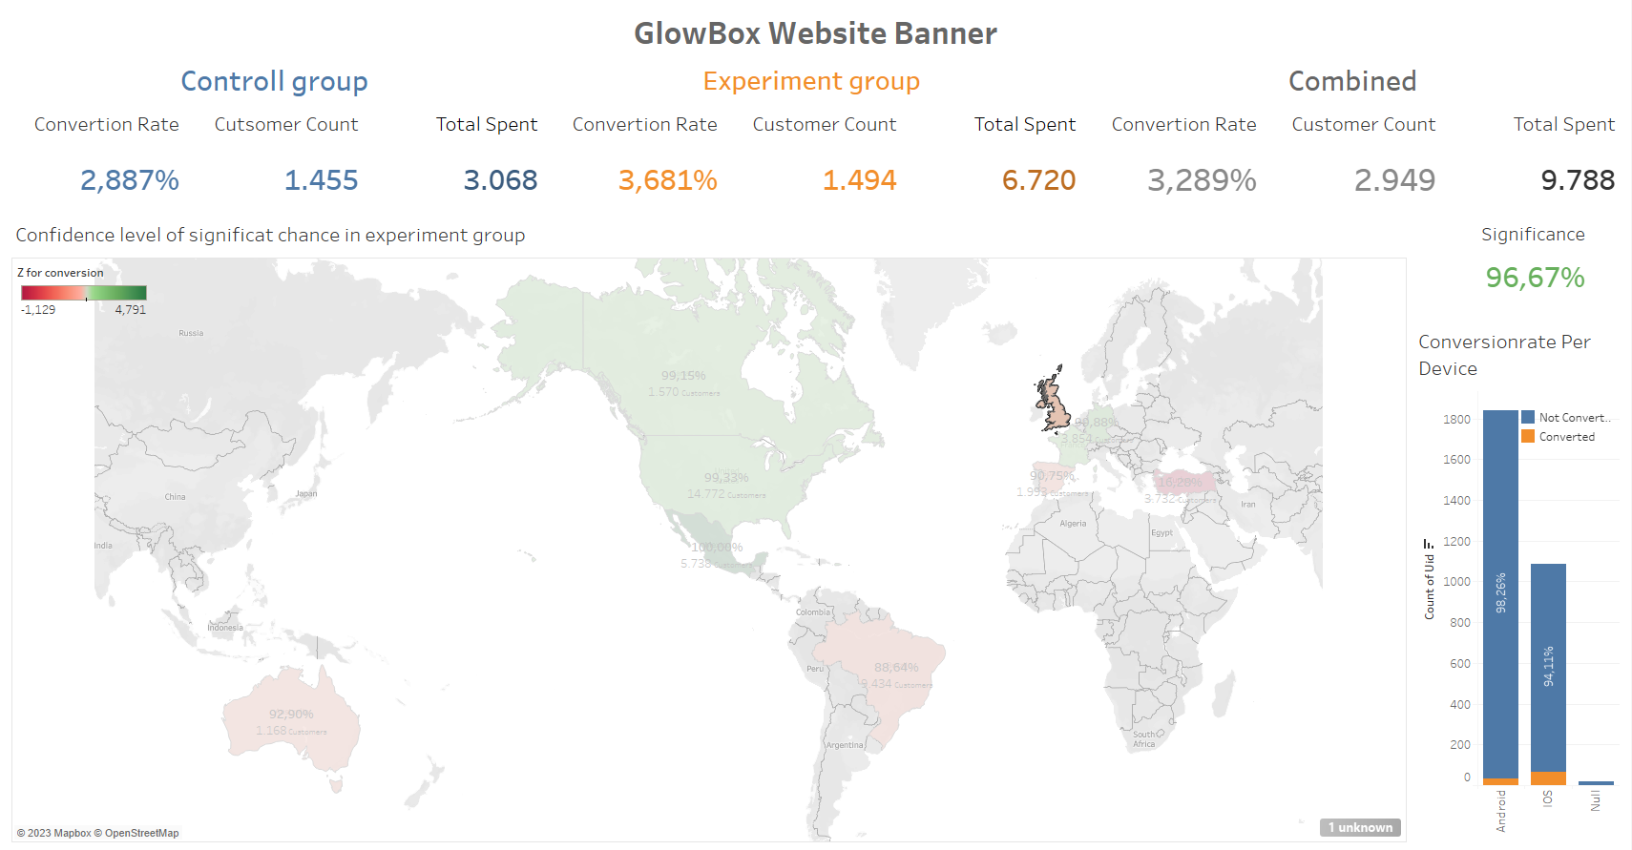
GloBox

Slide 9
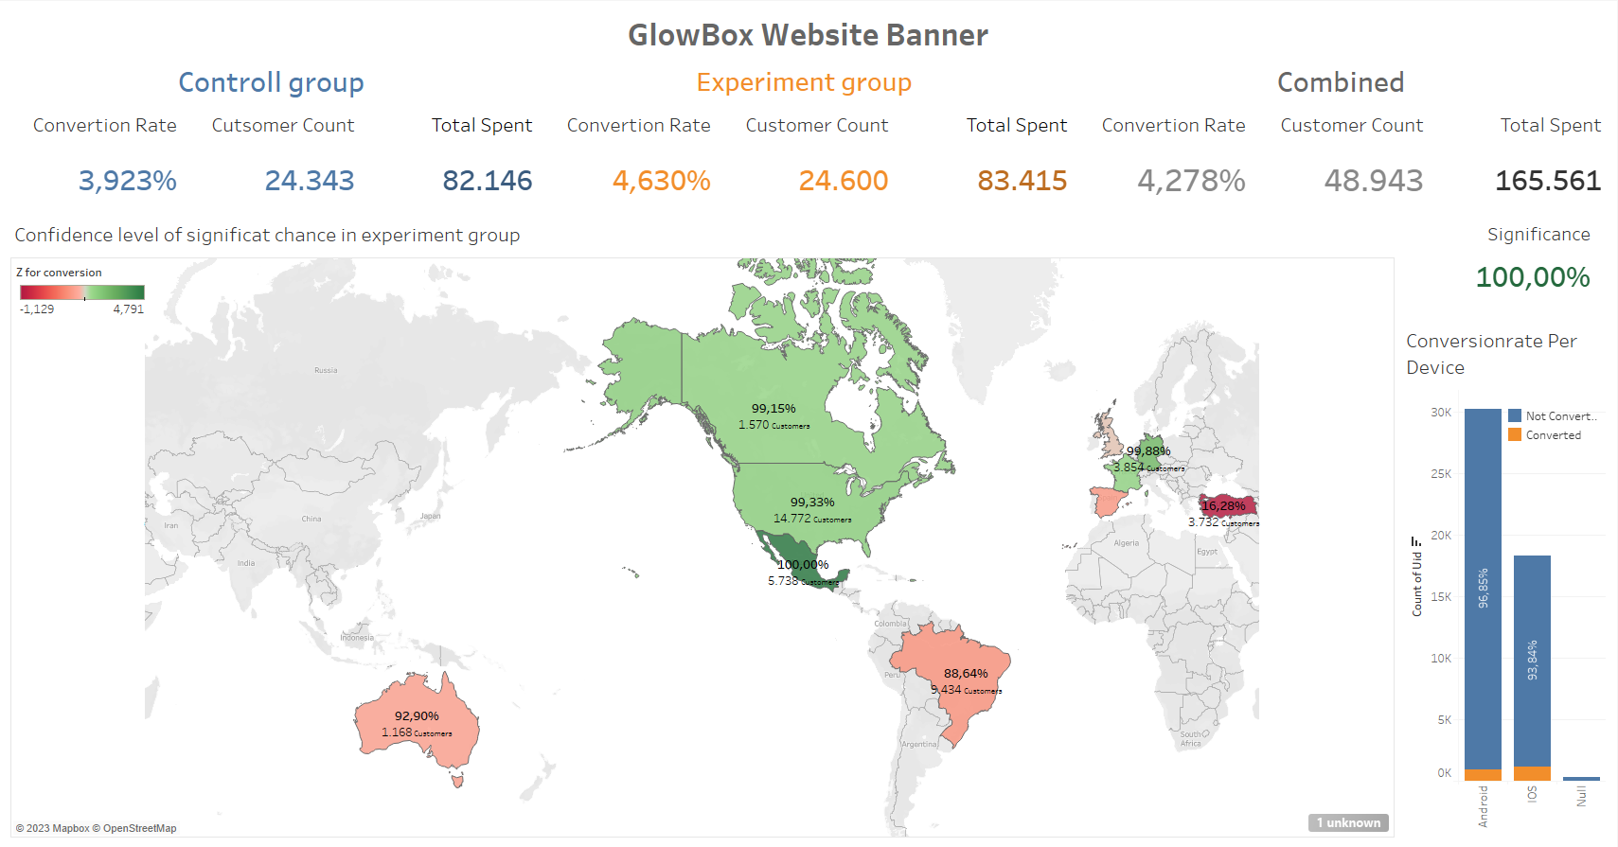
GloBox

