Slide 1
Project Presentation
Team Members:
1. Praveenkumar S
2. Saraswathi

Slide 2
Python Project
Student Academic Management System
The Student Academic Management System is a Python-based application designed to manage students, lecturers, and courses in an educational environment. It provides an efficient way to add, manage, and update information about students, lecturers, and courses. The system enables the following operations:
Adding Entities: Users can add new students, lecturers, and courses to the system. Each entity has its own set of attributes, such as student ID, name, age, and the courses they are enrolled in.
Assigning Courses: Courses can be assigned to students and lecturers. This feature ensures that each student is linked to the courses they are enrolled in, and each lecturer is linked to the courses they teach.
Editing and Deleting Entries: The system allows users to edit student or course details (such as changing names) and delete any unwanted entries (students or courses).
Viewing Information: Users can view all students and courses stored in the system, displaying key details about each entity.

Slide 3
Python Project
Key Features
Abstract Base Class for Person: The system uses an abstract base class, Person, that defines the structure for its subclasses Student and Lecturer. This ensures that each subclass implements the get details method to provide consistent output.
Modular Design: The system is built using object-oriented principles such as inheritance and polymorphism, making it modular and easily extendable in the future.
In-Memory Storage: Data is temporarily stored in lists during execution, making it suitable for lightweight applications. However, it does not include persistent storage like databases.
User Interaction: A user-friendly text-based interface allows users to interact with the system through a menu-driven approach. They can input choices to perform various operations such as adding or deleting students, assigning courses, and viewing details.
Error Handling: Basic error handling ensures smooth operation by checking if the required entities (students, lecturers, courses) exist before performing actions like assignment or deletion.

Slide 4
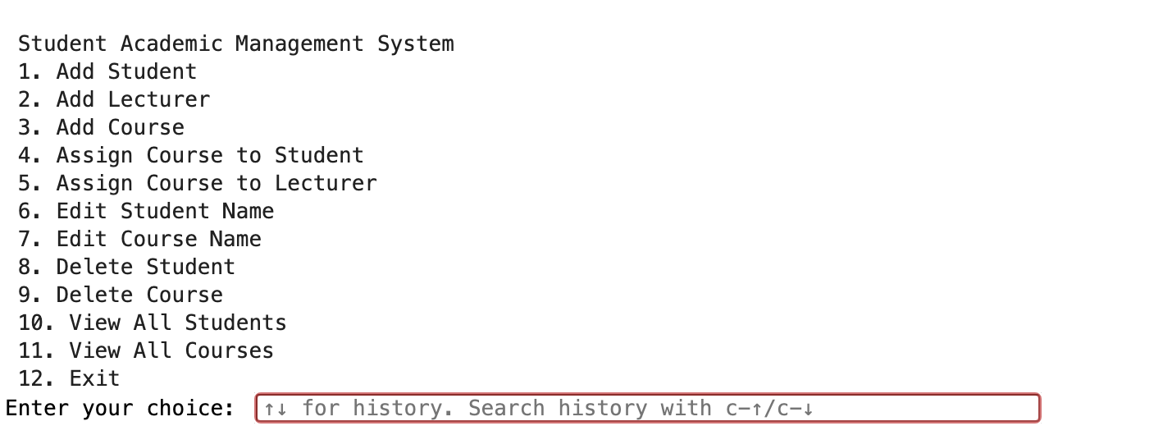
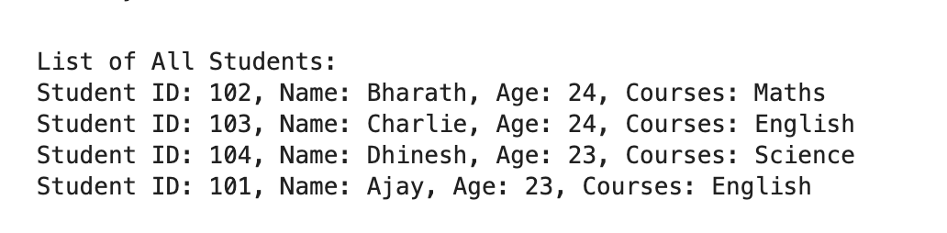
Python Project
Conclusion
The Student Academic Management System offers efficient management of students, lecturers, and courses, featuring flexible operations like adding, editing, and assigning, with a modular design that allows easy expansion and customization.

Slide 5
Machine Learning Project
Heart, Mobile Predictions and Telco-Customer datasets
Logistic Regression
Used as a baseline model for classification tasks. Logistic regression is efficient for binary classification problems like predicting heart disease presence.
Decision Tree Classifier
This tree-based model splits the data into branches to make predictions. It’s often interpretable and handles non-linearity well.
Support Vector Classifier (SVC)
Utilizes hyperplanes for separating data into classes. Often effective with well-separated or high-dimensional data.

Slide 6
Machine Learning Project
Heart, Mobile Predictions and Telco-Customer datasets
Naive Bayes (GaussianNB)
Based on Bayes' theorem, this probabilistic algorithm assumes independence among predictors, typically used for text or categorical data.
K-Nearest Neighbors (KNN)
A non-parametric algorithm that predicts based on the proximity of a point to its neighbors in the feature space.
GridSearchCV
Applied for hyperparameter tuning across multiple models. This ensures the best-performing parameters are selected for each algorithm.

Slide 7
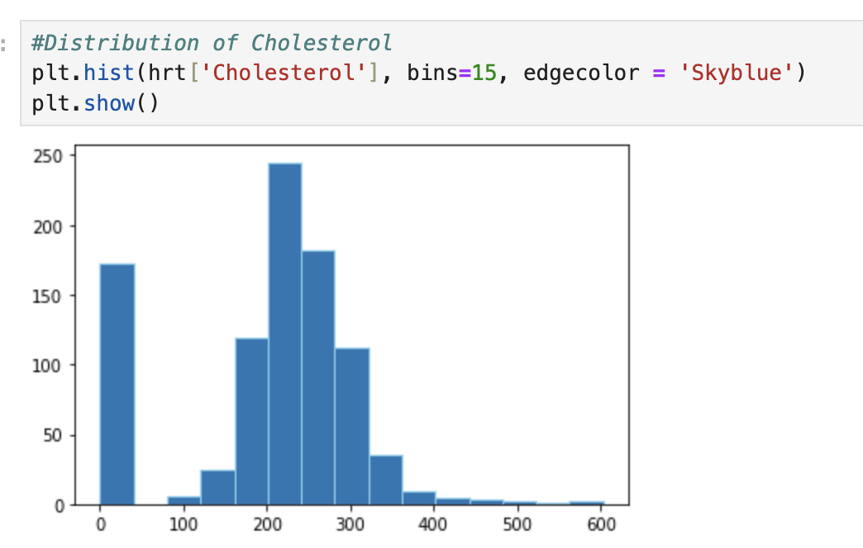
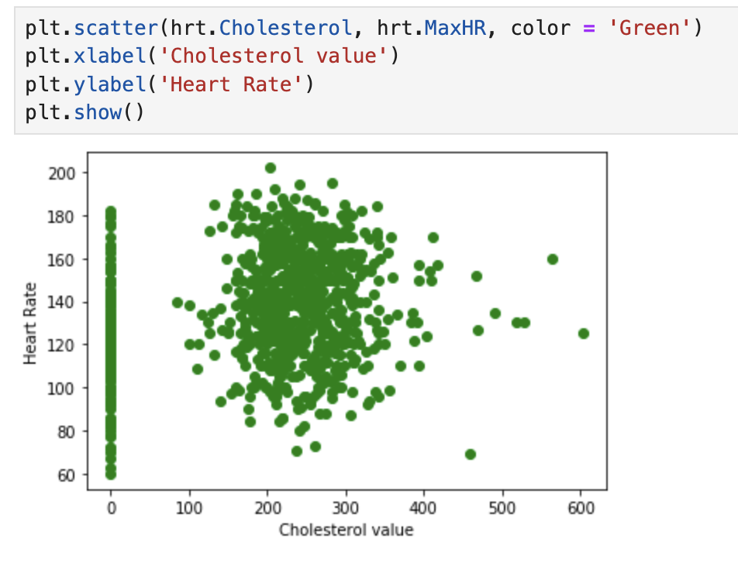
Machine Learning Project
Heart, Mobile Predictions and Telco-Customer datasets

Slide 8
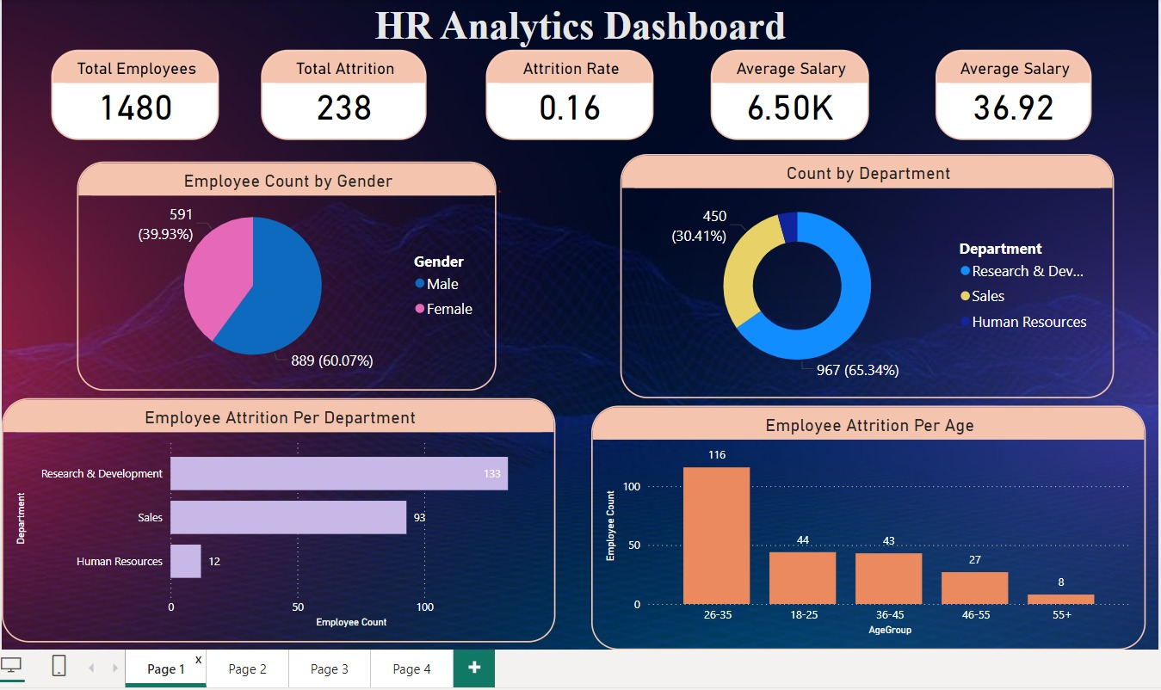
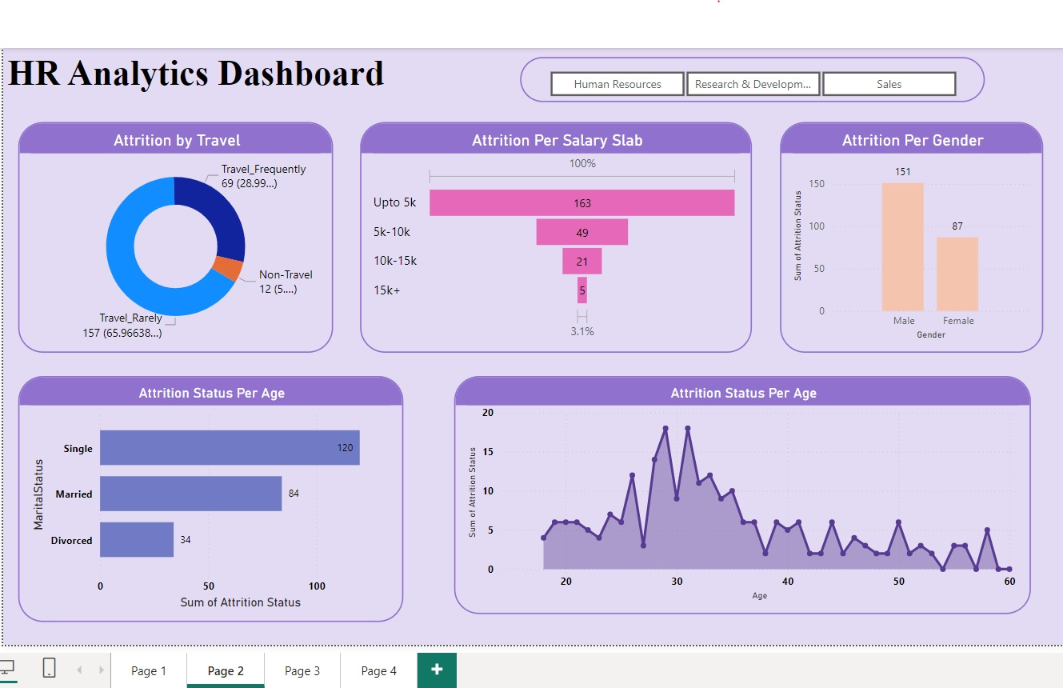
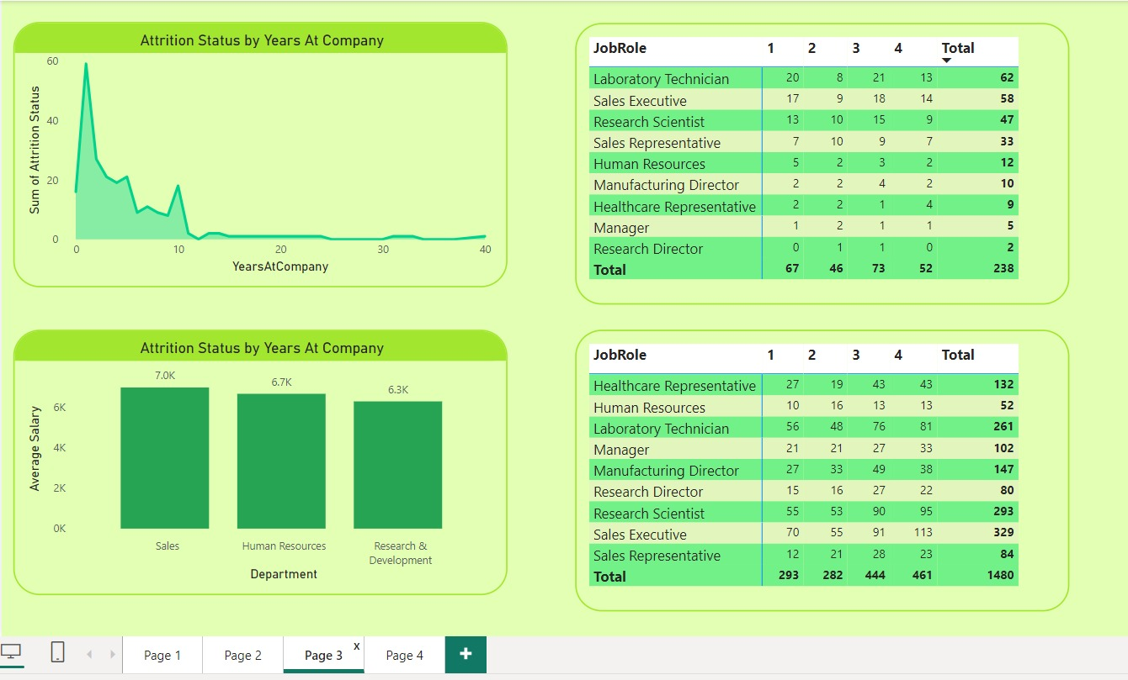
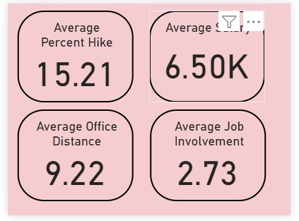
Power BI Project
Global Superstore Datasets

Slide 9
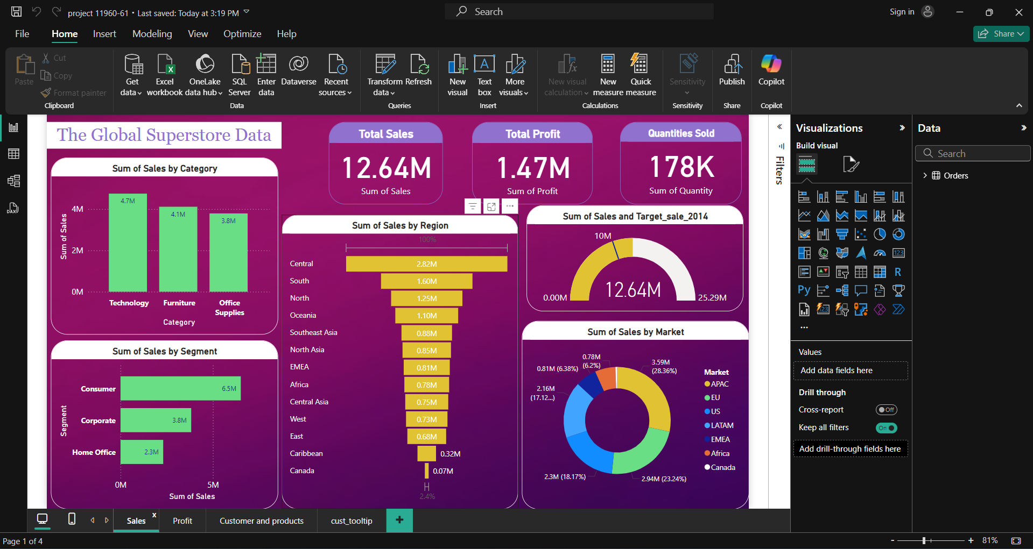
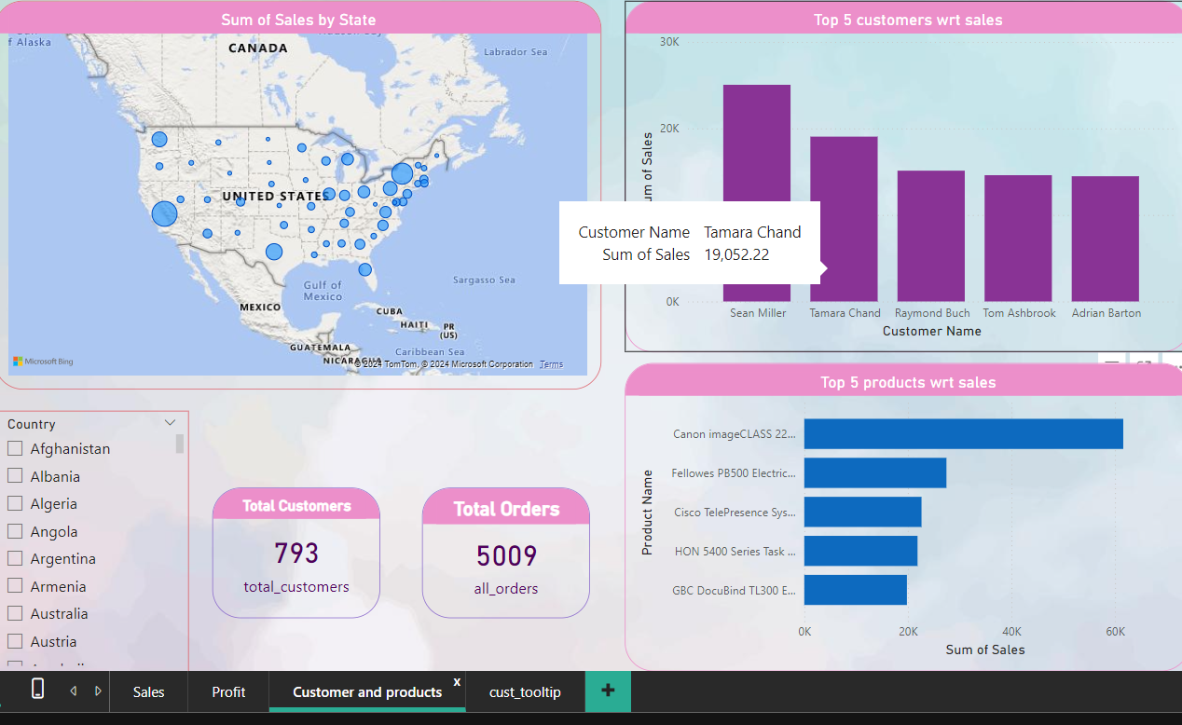
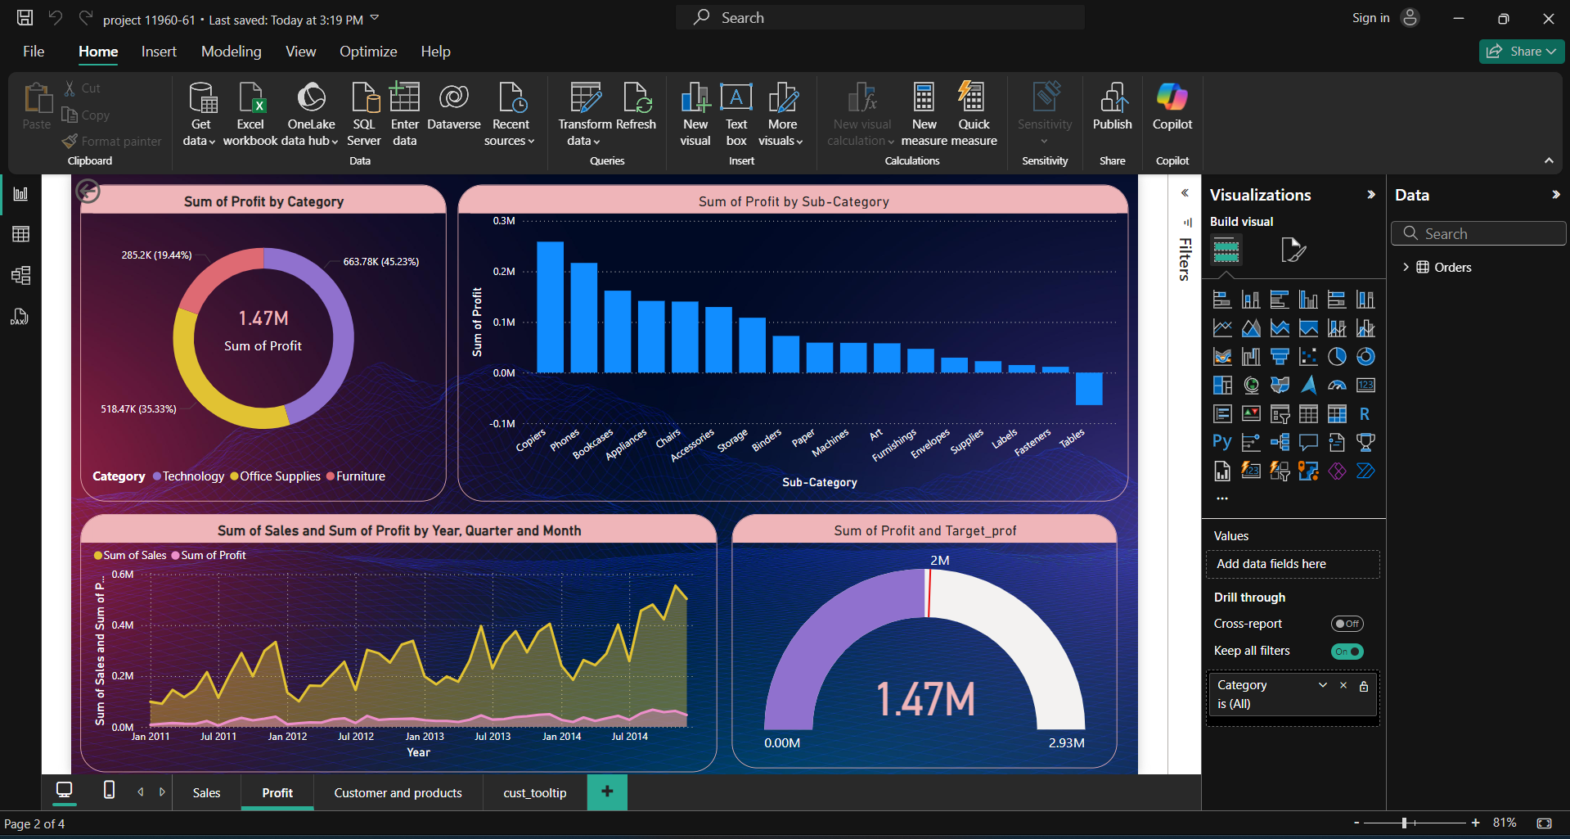
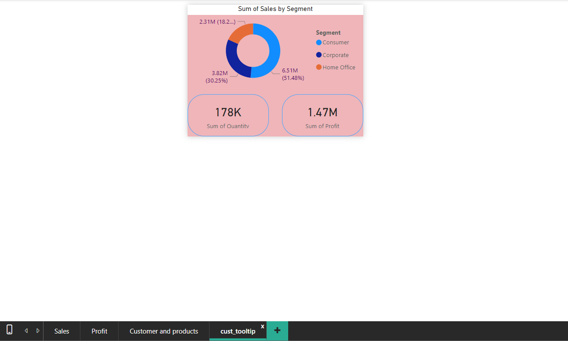
Power BI Project
Global Superstore Datasets

Slide 10
Thank You

