Slide 1



Data Mining (Minería de Datos)
Decision Trees: Regression
Sixto Herrera
Grupo de Meteorología
Univ. de Cantabria – CSIC
MACC / IFCA

Slide 2
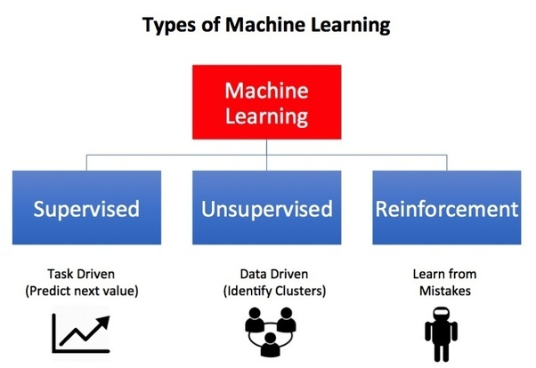
Oct | 29 | Aplazada (sesión de refuezo)
 | 31 | Presentación, introducción y perspectiva histórica
Nov | 5 | Paradigmas, problemas canonicos y data challenges
 | 7 | Reglas de asociación
 | 12 | Práctica: Reglas de asociación
 | 14 | Evaluación, sobrejuste y crossvalidacion
 | 19 | Práctica: Cross-validación
 | 21 | Árboles de clasificacion y decision
 | 26 | Practica: Árboles de clasificación
 |  | T01. Datos discretos
 | 28 | Técnicas de vecinos cercano (k-NN)
Dic | 3 | Práctica: Vecinos cercanos
 | 5 | Reducción de dimensión no lineal
 | 10 | Práctica: Reducción de dimensión no lineal
 |  | T02. Clasificación
 | 12 | Árboles de clasificación y regresion (CART)
 | 17 | Práctica: Árboles de clasificación y regresion (CART)
 | 19 | Ensembles: Bagging and Boosting
Ene | 7 | Práctica Random Forests
 | 9 | Práctica Gradient boosting
 |  | T03. Prediccion
 | 14 | Técnicas de agrupamiento
 | 16 | Practica: Técnicas de agrupamiento
 | 21a | Practica: El paquete CARET
 | 21b | Examen
NOTA: Las líneas de código de R en esta presentación se muestran sobre un fondo gris
Calendar

Slide 3
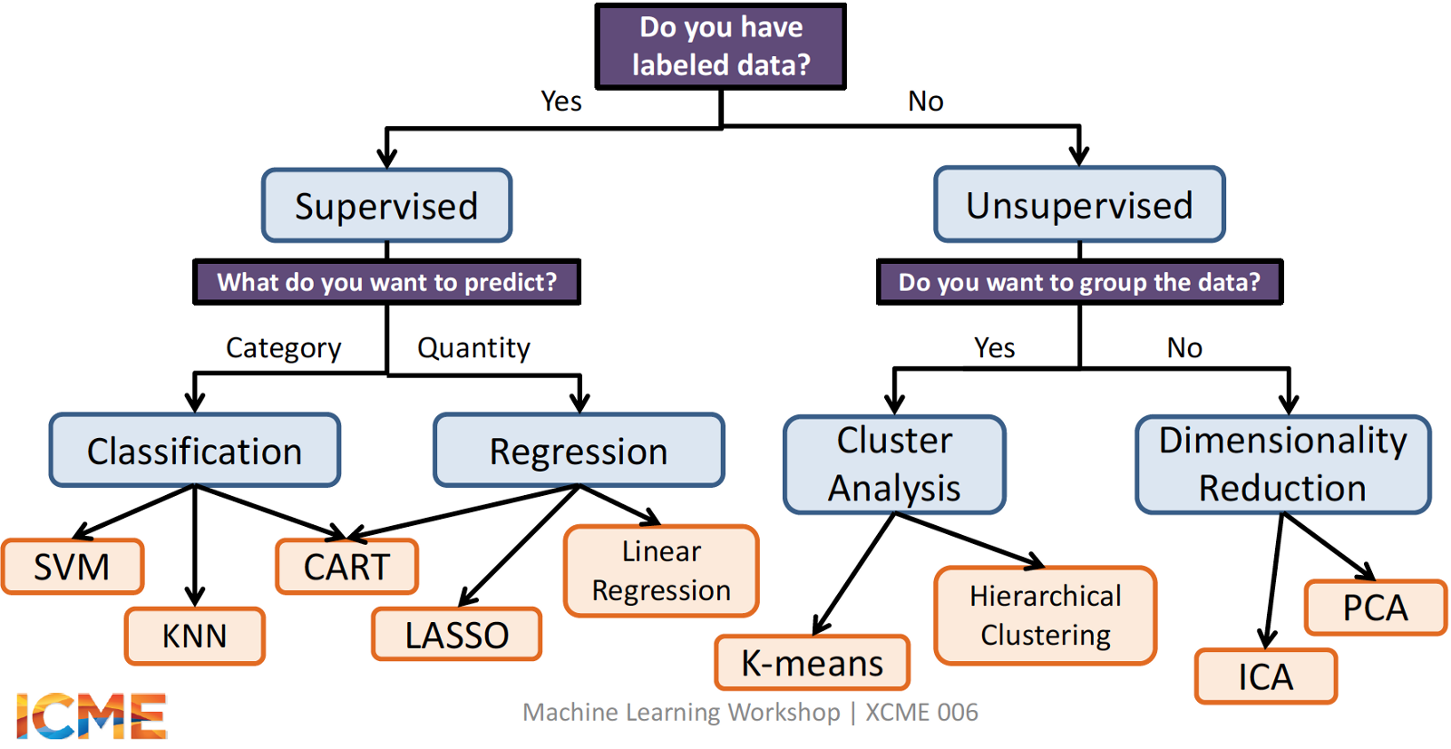
Target variable
Learning paradigms

Slide 4
Target variable
Learning paradigms

Slide 5
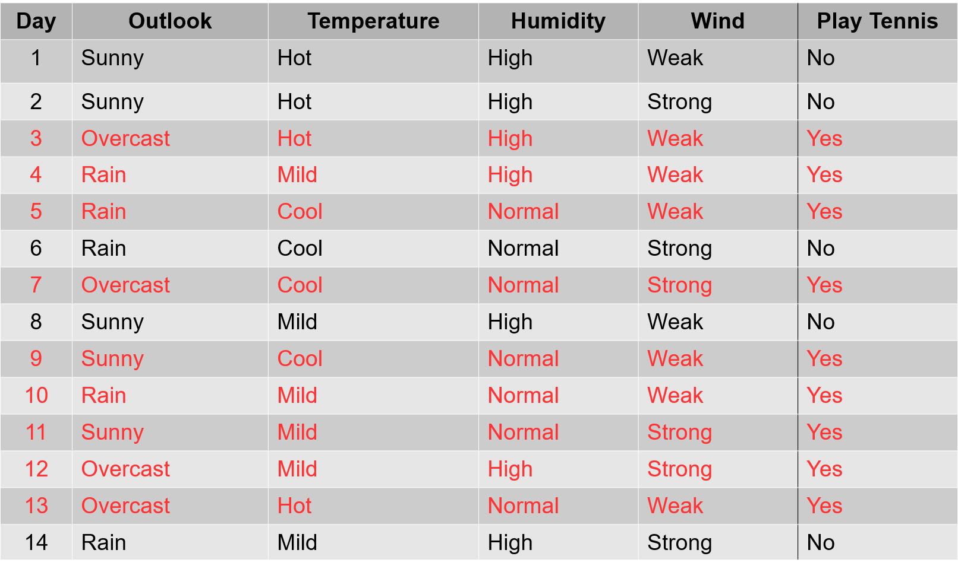
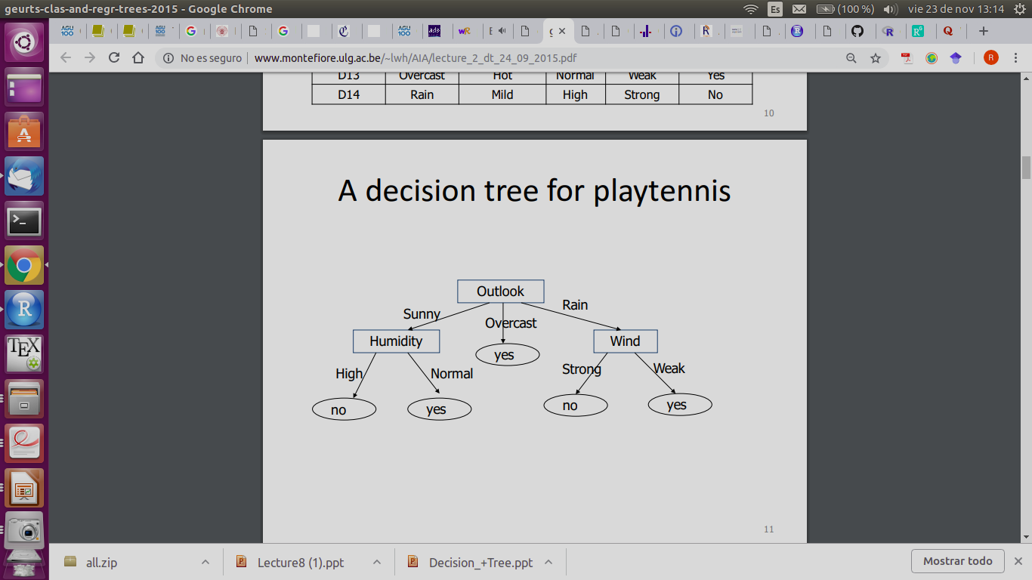
Classification Trees
Aim:
To classify a categorical target variable (R factor) based on a set of categorical or continuous predictors.
Structure:
- Each node corresponds to a test on an attribute
- Each branch corresponds to an attribute value
- Each leaf (terminal node) represents a final class
- Each path is a conjunction of attribute values
Key Points:
- Due to their intuitive representation, they are easy to assimilate by humans
- They can be constructed relatively fast as compared to other methods
- In general, they provide as good results as other more complex methods
PlayTennis dataset: https://github.com/sjwhitworth/golearn/blob/master/examples/datasets/tennis.csv
Introduction

Slide 6
Classification Trees
Aim:
To classify a categorical target variable (R factor) based on a set of categorical or continuous predictors.
Structure:
- Each node corresponds to a test on an attribute
- Each branch corresponds to an attribute value
- Each leaf (terminal node) represents a final class
- Each path is a conjunction of attribute values
Key Points:
- Due to their intuitive representation, they are easy to assimilate by humans
- They can be constructed relatively fast as compared to other methods
- In general, they provide as good results as other more complex methods
Regression Trees
Aim:
To predict a continuous target variable based on a set of categorical or continuous predictors.
Structure:
- Each node corresponds to a test on an attribute
- Each branch corresponds to an attribute value
- Each leaf (terminal node) represents a final class
- Each path is a conjunction of attribute values
Introduction

Slide 7
Tree construction
There are several algorithms to build up the tree. However, the idea of all of them is the same: evaluate attribute according to its power of separation.
Many variants for attribute selection:
from machine learning: ID3 (Iterative Dichotomizer), C4.5 and C5.0 (Quinlan 86, 93)
from statistics: CART (Classification And Regression Trees) (Breiman et al. 84)
from pattern recognition: CHAID (CHi-squared Automated Interaction Detection) (Magidson 94)
Their main difference is the criterion followed to perform the division of the node (splitting)
Tree construction

Slide 8
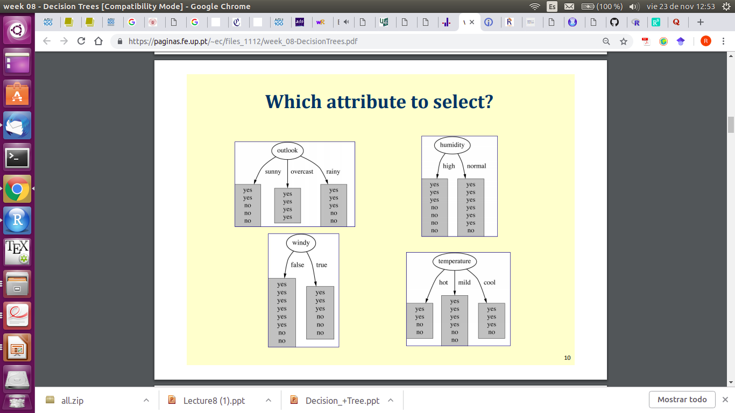
Tree construction
There are several algorithms to build up the tree. However, the idea of all of them is the same: evaluate attribute according to its power of separation.
Many variants for attribute selection:
from machine learning: ID3 (Iterative Dichotomizer), C4.5 and C5.0 (Quinlan 86, 93)
from statistics: CART (Classification And Regression Trees) (Breiman et al. 84)
from pattern recognition: CHAID (CHi-squared Automated Interaction Detection) (Magidson 94)
Their main difference is the criterion followed to perform the division of the node (splitting)
Tree construction

Slide 9
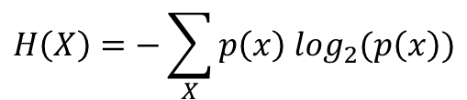

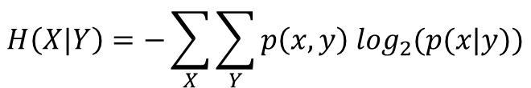
Tree construction
There are several algorithms to build up the tree. However, the idea of all of them is the same: evaluate attribute according to its power of separation.
Many variants for attribute selection:
from machine learning: ID3 (Iterative Dichotomizer), C4.5 and C5.0 (Quinlan 86, 93)
from statistics: CART (Classification And Regression Trees) (Breiman et al. 84)
from pattern recognition: CHAID (CHi-squared Automated Interaction Detection) (Magidson 94)
Their main difference is the criterion followed to perform the division of the node (splitting)
ID3 → Information Gain (IG) & Entropy (H)
Tree construction

Slide 10

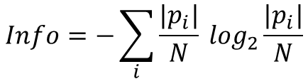
Tree construction
There are several algorithms to build up the tree. However, the idea of all of them is the same: evaluate attribute according to its power of separation.
Many variants for attribute selection:
from machine learning: ID3 (Iterative Dichotomizer), C4.5 and C5.0 (Quinlan 86, 93)
from statistics: CART (Classification And Regression Trees) (Breiman et al. 84)
from pattern recognition: CHAID (CHi-squared Automated Interaction Detection) (Magidson 94)
Their main difference is the criterion followed to perform the division of the node (splitting)
ID3 → Information Gain (IG) & Entropy (H)
C4.5 → Information Gain (IG) & Gain Ratio (GR)
Tree construction

Slide 11
Tree construction
There are several algorithms to build up the tree. However, the idea of all of them is the same: evaluate attribute according to its power of separation.
Many variants for attribute selection:
from machine learning: ID3 (Iterative Dichotomizer), C4.5 and C5.0 (Quinlan 86, 93)
from statistics: CART (Classification And Regression Trees) (Breiman et al. 84)
from pattern recognition: CHAID (CHi-squared Automated Interaction Detection) (Magidson 94)
Their main difference is the criterion followed to perform the division of the node (splitting)
ID3 → Information Gain (IG) & Entropy (H)
C4.5 → Information Gain (IG) & Gain Ratio (GR)
What is the measure considered for Regression Trees?
Regression Trees

Slide 12

Tree construction
There are several algorithms to build up the tree. However, the idea of all of them is the same: evaluate attribute according to its power of separation.
ID3 → Information Gain (IG) & Entropy (H)
C4.5 → Information Gain (IG) & Gain Ratio (GR)
What is the measure considered for Regression Trees?
Residual Sum of Squares (RSS)
Regression Trees

Slide 13
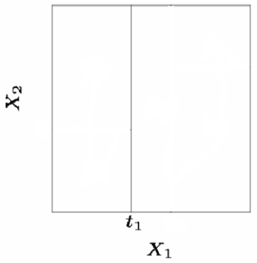

Generally we create the partitions by iteratively splitting one of the X variables into two regions.
First split on: X₁=t₁
Regression Trees

Slide 14
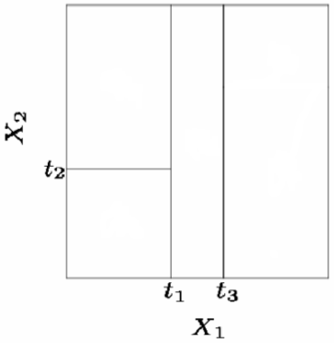
Generally we create the partitions by iteratively splitting one of the X variables into two regions.
First split on: X₁=t₁
If X₁<t₁ split on: X₂=t₂
If X₁>=t₁ split on: X₁=t₃
Regression Trees

Slide 15
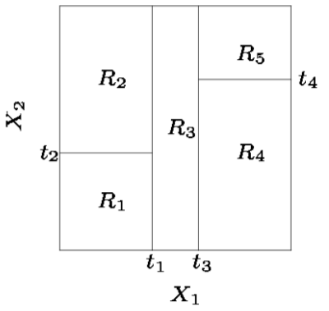
Generally we create the partitions by iteratively splitting one of the X variables into two regions.
First split on: X₁=t₁
If X₁<t₁ split on: X₂=t₂
If X₁>=t₁ split on: X₁=t₃
If X₁>=t₃ split on: X₂=t₄
…
until the tree correctly predicts the sample ...
Regression Trees

Slide 16
Generally we create the partitions by iteratively splitting one of the X variables into two regions.
First split on: X₁=t₁
If X₁<t₁ split on: X₂=t₂
If X₁>=t₁ split on: X₁=t₃
If X₁>=t₃ split on: X₂=t₄
…
until the tree correctly predicts the sample or some stop criteria has been reached:
Reduction cost too small vs Complexity
Max. depth
Purity
Sub-sample too small
Regression Trees

Slide 17
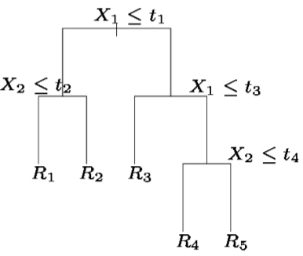
Types of trees:
Classification: discrete outputs
  CLS, ID3, C4.5, ID4, ….
Regression: continuous outputs
  CART, M5, M5', ….
Internal
Nodes
yes
no
yes
no
Branches
yes
no
yes
no
Leaves
Regression Trees

Slide 18
library(MASS)
? Boston
Housing Values in Suburbs of Boston
Description:
The Boston data frame has 506 rows and 14 columns.
Format:
This data frame contains the following columns:
crim - per capita crime rate by town.
zn - proportion of residential land zoned for lots over 25000 sq.ft.
indus - proportion of non-retail business acres per town.
chas - Charles River dummy variable (= 1 if tract bounds river; 0 otherwise).
nox - nitrogen oxides concentration (parts per 10 million).
rm - average number of rooms per dwelling.
age - proportion of owner-occupied units built prior to 1940.
dis - weighted mean of distances to five Boston employment centres.
rad - index of accessibility to radial highways.
tax - full-value property-tax rate per 10000 $.
ptratio - pupil-teacher ratio by town.
black - 1000(Bk - 0.63)^2 where Bk is the proportion of blacks by town.
lstat - lower status of the population (percent).
medv - median value of owner-occupied homes in 1000s $.
Regression Trees: Example

Slide 19
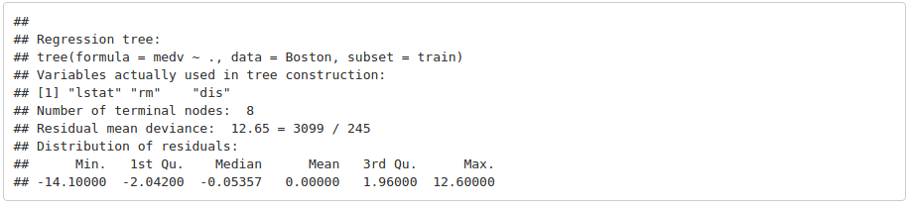
library(tree)
set.seed(1)
indTrain <- sample(1:nrow(Boston), nrow(Boston)/2) ## Splitting the sample
tree.boston <- tree(medv~., Boston, subset = indTrain) ## Adjusting the regression tree.
summary(tree.boston)
Regression Trees: Example

Slide 20
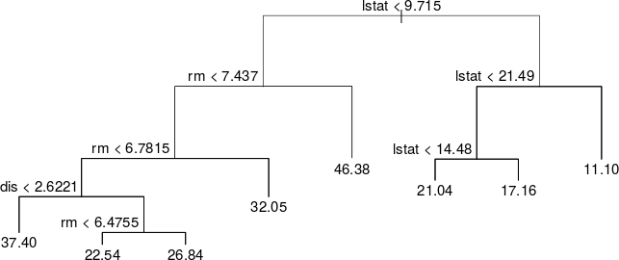
library(tree)
set.seed(1)
indTrain <- sample(1:nrow(Boston), nrow(Boston)/2) ## Splitting the sample
tree.boston <- tree(medv~., Boston, subset = indTrain) ## Adjusting the regression tree.
summary(tree.boston)
plot(tree.boston)
text(tree.boston, pretty = 0)
Regression Trees: Example

Slide 21
library(tree)
set.seed(1)
indTrain <- sample(1:nrow(Boston), nrow(Boston)/2) ## Splitting the sample
tree.boston <- tree(medv~., Boston, subset = indTrain) ## Adjusting the regression tree.
summary(tree.boston)
? tree.control
tree.control
Use:
tree.control(nobs, mincut = 5, minsize = 10, mindev = 0.01)
Arguments:
nobs - the number of observations in the training set.
mincut - the minimum number of observations to include in either child node.
minsize - the smallest allowed node size.
mindev - the within-node deviance must be at least this times that of the root node for the node to be split.
Regression Trees: Example

Slide 22
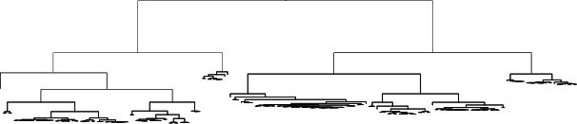
library(tree)
set.seed(1)
indTrain <- sample(1:nrow(Boston), nrow(Boston)/2) ## Splitting the sample
## Building the deepest tree.
deepTree.boston <- tree(medv~., Boston, subset = indTrain, split = "deviance", control = tree.control(length(indTrain), mincut = 1, minsize = 2, mindev = 0))
plot(deepTree.boston)
Regression Trees: Example

Slide 23
Complete Tree
Default Tree
Regression Trees: Example

Slide 24
library(tree)
set.seed(1)
indTest <- setdiff(1:nrow(Boston), indTrain) ## Splitting the sample
## Verification (Default Tree):
train.boston <- predict(tree.boston, newdata = Boston[indTrain,])
test.boston <- predict(tree.boston, newdata = Boston[indTest,])
## RMSE:
sqrt(mean((Boston$medv[indTrain]-train.boston)^2, na.rm = TRUE))
## [1] 3.499638
sqrt(mean((Boston$medv[indTest]-test.boston)^2, na.rm = TRUE))
## [1] 5.004557
Complete Tree
Default Tree
Regression Trees: Example

Slide 25
library(tree)
set.seed(1)
indTest <- setdiff(1:nrow(Boston), indTrain) ## Splitting the sample
## Verification (Default Tree):
train.boston <- predict(tree.boston, newdata = Boston[indTrain,])
test.boston <- predict(tree.boston, newdata = Boston[indTest,])
## RMSE:
sqrt(mean((Boston$medv[indTrain]-train.boston)^2, na.rm = TRUE))
## [1] 3.499638
sqrt(mean((Boston$medv[indTest]-test.boston)^2, na.rm = TRUE))
## [1] 5.004557
## Verification (Deepest Tree):
train1.boston <- predict(deepTree.boston, newdata = Boston[indTrain,])
test1.boston <- predict(deepTree.boston, newdata = Boston[indTest,])
## RMSE:
sqrt(mean((Boston$medv[indTrain]-train1.boston)^2, na.rm = TRUE))
## [1] 0.03976214
sqrt(mean((Boston$medv[indTest]-test1.boston)^2, na.rm = TRUE))
## [1] 4.465788
Complete Tree
Complete Tree
Regression Trees: Example

Slide 26
library(tree)
set.seed(1)
indTest <- setdiff(1:nrow(Boston), indTrain) ## Splitting the sample
## Verification (Default Tree):
train.boston <- predict(tree.boston, newdata = Boston[indTrain,])
test.boston <- predict(tree.boston, newdata = Boston[indTest,])
## RMSE:
sqrt(mean((Boston$medv[indTrain]-train.boston)^2, na.rm = TRUE))
## [1] 3.499638
sqrt(mean((Boston$medv[indTest]-test.boston)^2, na.rm = TRUE))
## [1] 5.004557
## Verification (Deepest Tree):
train1.boston <- predict(deepTree.boston, newdata = Boston[indTrain,])
test1.boston <- predict(deepTree.boston, newdata = Boston[indTest,])
## RMSE:
sqrt(mean((Boston$medv[indTrain]-train1.boston)^2, na.rm = TRUE))
## [1] 0.03976214
sqrt(mean((Boston$medv[indTest]-test1.boston)^2, na.rm = TRUE))
## [1] 4.465788
Complete Tree
Overfitting
Complete Tree
Regression Trees: Example

Slide 27
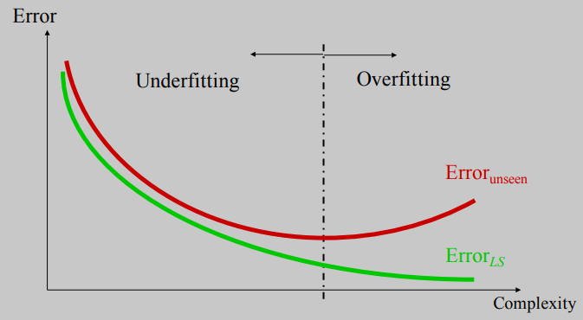
Overfitting
A large tree (i.e. with many terminal nodes) may tend to overfit the training data, leading to poor performance in the test set. Generally, we can improve this behavior by pruning the tree, i.e., cutting off some of the terminal nodes.
test
training
Overfitting: Pruning the tree

Slide 28
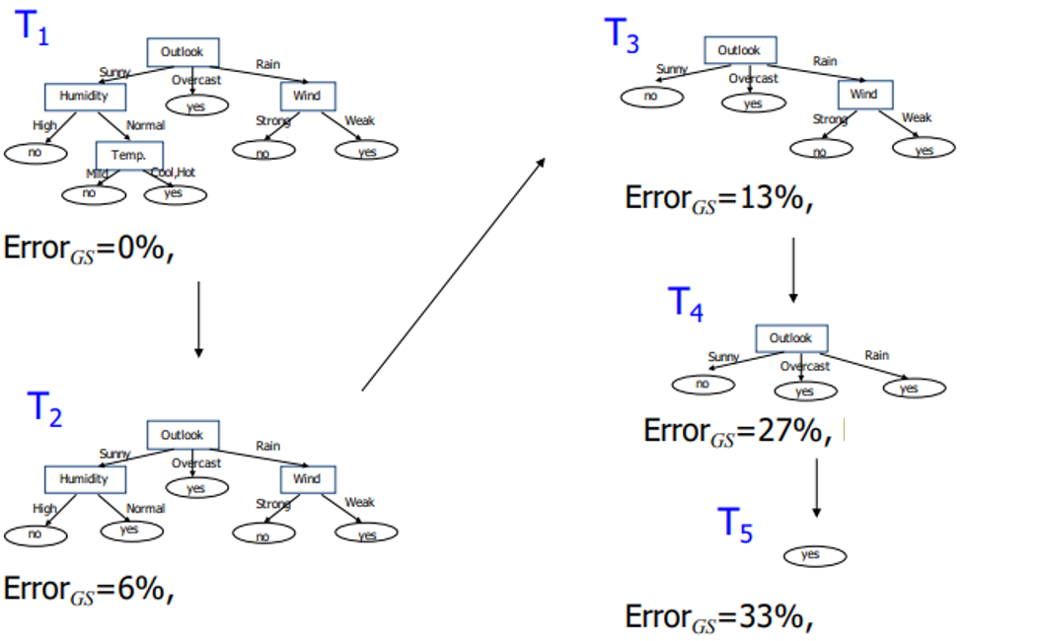
How can we avoid overfitting?
Pre-pruning: stop growing the tree before it reaches the point at which it perfectly classifies
the learning sample. Procedure:
Stop splitting a node if:
  The number of objects is too small
  The impurity is low enough
  This approach leads to small trees but can remove relevant splits
Post-pruning: allow the tree to overfit
and then, one finalized, remove the less
useful nodes. In general, this is
preferred option. Procedure:
Compute a sequence of trees
{T1, T2, …} where T1 is the complete
tree. T2 is obtained by removing from
T1 the node that less increases the
error. Sometimes, this process is guided
based on some cost-complexity
criterion (e.g. in medicine)
The question is: where to stop? In practice,
it is usual to split the learning dataset into
two subsets: a training sample for growing
the tree and a test sample for evaluating
its generalization error (e.g. hold-out
cross-validation).
Overfitting: Pruning the tree

Slide 29
library(tree)
set.seed(1)
indTrain <- sample(1:nrow(Boston), nrow(Boston)/2) ## Splitting the sample
tree.boston <- tree(medv~., Boston, subset = indTrain) ## Adjusting the regression tree.
summary(tree.boston)
Regression trees: CART
Output corresponds to the response mean value.
Valid for any kind of attributes
Residual Sum of Squares (RSS)
Regression Trees: Example

Slide 30
library(tree)
set.seed(1)
indTrain <- sample(1:nrow(Boston), nrow(Boston)/2) ## Splitting the sample
tree.boston <- tree(medv~., Boston, subset = indTrain) ## Adjusting the regression tree.
summary(tree.boston)
Regression trees: CART
Output corresponds to the response mean value.
Valid for any kind of attributes
Residual Sum of Squares (RSS)
We want to select a subtree that leads to the lowest test error rate
Regression Trees: Example

Slide 31
Complete Tree
Given a subtree, we can estimate the test error rate
Choose the subtree with the lowest test error rate
Residual Sum of Squares (RSS)
We want to select a subtree that leads to the lowest test error rate
Regression Trees: Example

Slide 32
Complete Tree
Given a subtree, we can estimate the test error rate
Computationally expensive ¡¡¡
Choose the subtree with the lowest test error rate
Residual Sum of Squares (RSS)
We want to select a subtree that leads to the lowest test error rate
Regression Trees: Example

Slide 33
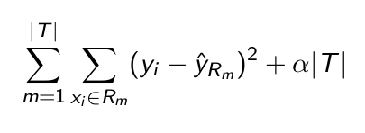
Cost complexity Pruning → Regularization
Residual Sum of Squares (RSS)
We want to select a subtree that leads to the lowest test error rate
Regression Trees: Example

Slide 34
Cost complexity Pruning → Regularization
Number of terminal nodes
Controls a trade-off between the subtree’s complexity and its
fit to the training data
Residual Sum of Squares (RSS)
We want to select a subtree that leads to the lowest test error rate
Regression Trees: Example

Slide 35
Cost complexity Pruning → Regularization
Number of terminal nodes
Controls a trade-off between the subtree’s complexity and its
fit to the training data
For each value of the regularization parameter exists a subtree minimizing the expression above.
Minimization problem ↔ Lagrange Multipliers
Residual Sum of Squares (RSS)
We want to select a subtree that leads to the lowest test error rate
Regression Trees: Example

Slide 36
Pros:
  Trees are very easy to explain to people (probably even easier than linear regression)
  Trees can be plotted graphically, and are easily interpreted even by non-expert
  Trees can easily handle qualitative predictors without the need to create dummy variables.
  They work fine on both classification and regression problems
Cons:
  Trees don’t have the same prediction accuracy as some of the more complicated approaches that we examine in this course.
  Trees tend to overfit.
Pros & Cons

Slide 37
library(tree)
set.seed(1)
indTrain <- sample(1:nrow(Boston), nrow(Boston)/2) ## Splitting the sample
tree.boston <- tree(medv~., Boston, subset = indTrain) ## Adjusting the regression tree.
summary(tree.boston)
Model trees: M5, M5', ...
Output corresponds to a linear regression model of the instances that reach the leaf.
Residual Sum of Squares (RSS)
Regression Trees: Example

Slide 38
library(tree)
set.seed(1)
indTrain <- sample(1:nrow(Boston), nrow(Boston)/2) ## Splitting the sample
tree.boston <- tree(medv~., Boston, subset = indTrain) ## Adjusting the regression tree.
summary(tree.boston)
Model trees: M5, M5', ...
Output corresponds to a linear regression model of the instances that reach the leaf.
M5 is included in the caret R-package (Cubist-implementation)
library(caret)
if (!require(Cubist)) install.packages(”Cubist”)
? models
autoTree <- train(form = medv~., data= Boston, subset = indTrain, method = "cubist")
summary(autoTree)
Rules ↔ Decision Trees
Regression Trees: Example

Slide 39
Pros:
  Trees are very easy to explain to people (probably even easier than linear regression)
  Trees can be plotted graphically, and are easily interpreted even by non-expert
  Trees can easily handle qualitative predictors without the need to create dummy variables.
  They work fine on both classification and regression problems
Cons:
  Trees don’t have the same prediction accuracy as some of the more complicated approaches that we examine in this course.
  By aggregating many decision trees, the predictive performance of trees can be substantially improved.
  Bagging, Random Forest, Boosting
Pros & Cons

Slide 40


Which model is better?
  If the relationship between the predictors and response is linear, then classical linear models such as linear regression would outperform regression trees
  On the other hand, if the relationship between the predictors is non-linear, then decision trees would outperform classical approaches
  Categorical variables can be used for trees.
  Trees are more easily interpretable than linear models.
  Visualization. The graphical representation of the trees is very useful.
Trees vs Linear Models

Slide 41
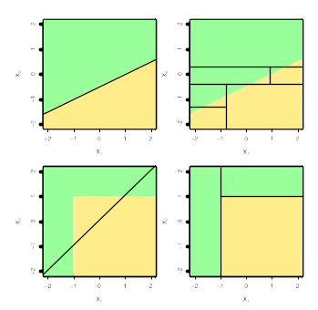
Which model is better?
  If the relationship between the predictors and response is linear, then classical linear models such as linear regression would outperform regression trees
  On the other hand, if the relationship between the predictors is non-linear, then decision trees would outperform classical approaches
  Categorical variables can be used for trees.
  Trees are more easily interpretables than linear models.
  Visualization. The graphical representation of the trees is very useful.
  Top row: the true decision boundary is linear
    Left: linear model (good)
    Right: decision tree
  Bottom row: the true decision boundary is non-linear
    Left: linear model
    Right: decision tree (good)
Trees vs Linear Models

