Slide 1
Unidata TDS Workshop THREDDS Data Server Overview
23-24 July 2015

Slide 2
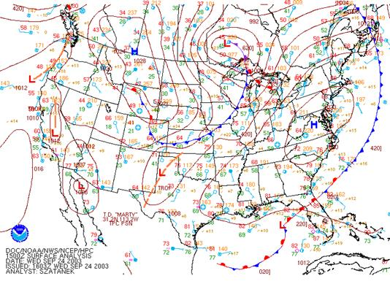
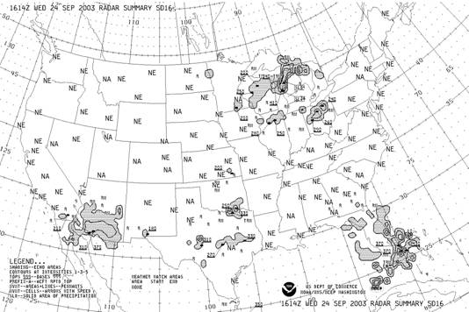
Unidata: Core Activities
Facilitate access to (real-time) data by the University research and education community
Support the community in their use of the data
Help build, represent, and advocate on behalf of the community

Slide 3
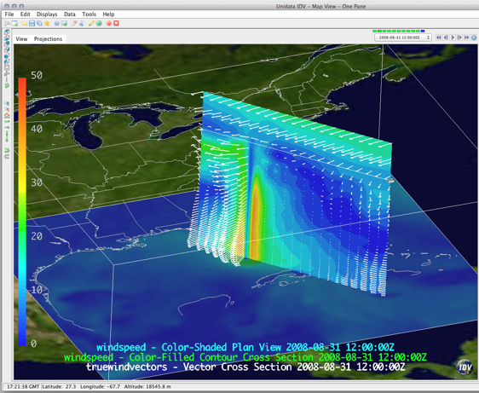
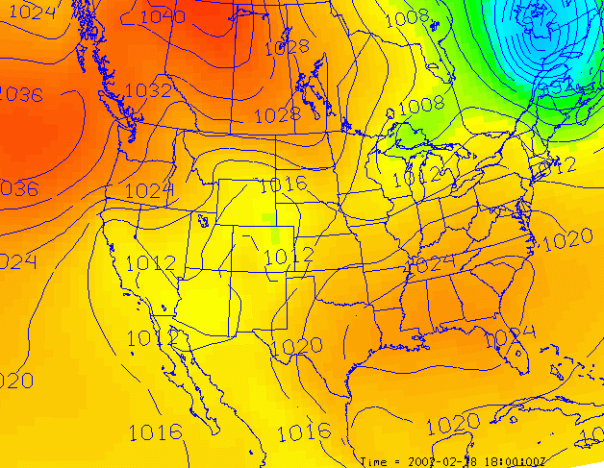
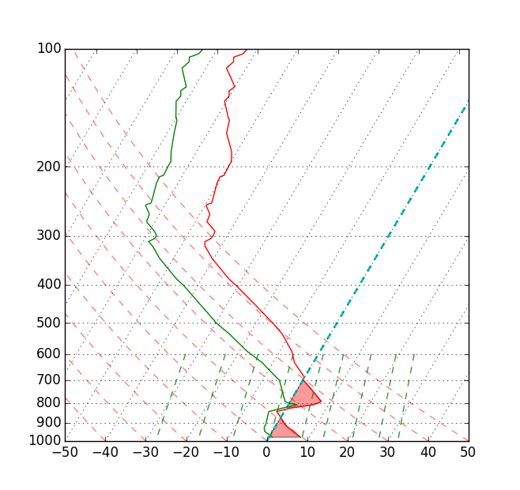
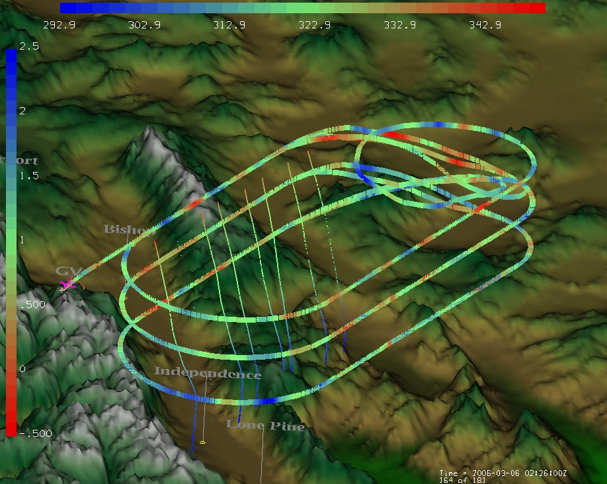
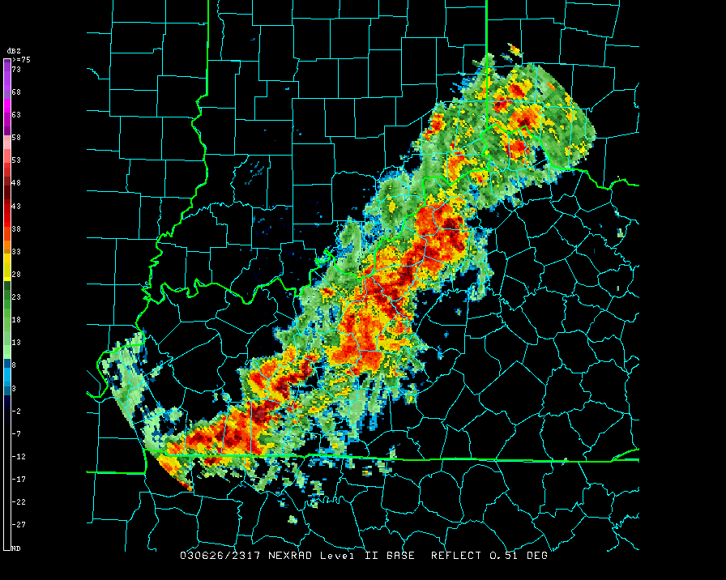
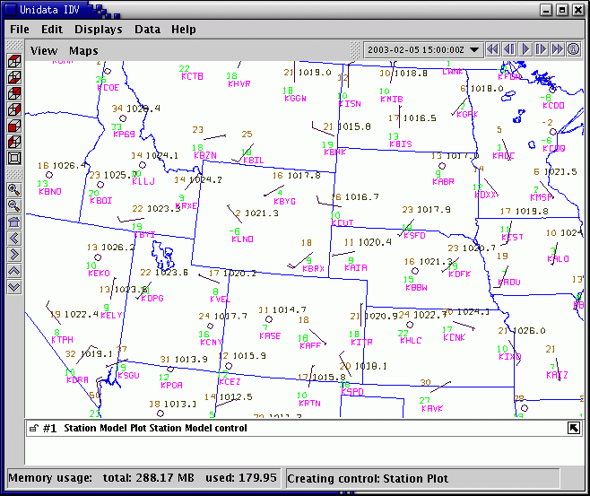
Unidata: Facilitate access to real-time data

Slide 4
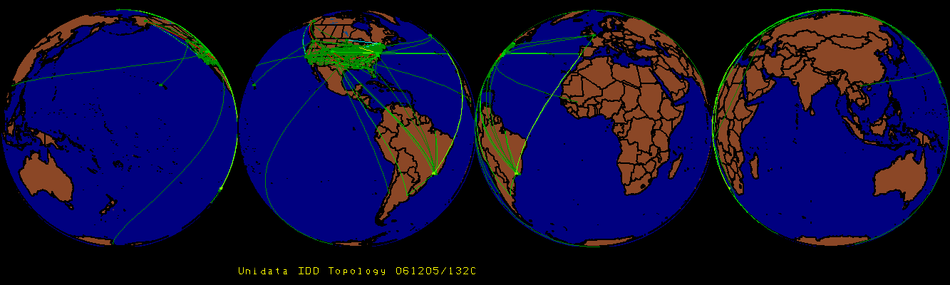
Unidata: Facilitate access to real-time data
Push
IDD: Real-Time Data Distribution
Over 200 sites. Approx 15 GB/hour
Unidata’s LDM
Protocol and client/server software
Event-driven data distribution
Supports subscription to subsets of data feeds

Slide 5
Unidata: Facilitate access to real-time data
Pull
IDD data from Unidata available via
Servers:
McIDAS ADDE
TDS
RAMADDA
Protocols:
HTTP, FTP
ADDE, OPeNDAP
OGC WCS and WMS
The Unidata TDS server thredds.ucar.edu “archives” latest 30 days or so of IDD data

Slide 6
Unidata: Core Activities
Facilitate access to (real-time) data by the University research and education community
Support the community in their use of the data
Help build, represent, and advocate on behalf of the community

Slide 7
Unidata: Core Activities
Facilitate access to (real-time) data by the University research and education community
Support the community in their use of the data
Help build, represent, and advocate on behalf of the community
Develop open source tools and infrastructure for data access, analysis, visualization, and data management
Advance metadata standards for the earth science community
Support users of our technologies

Slide 8
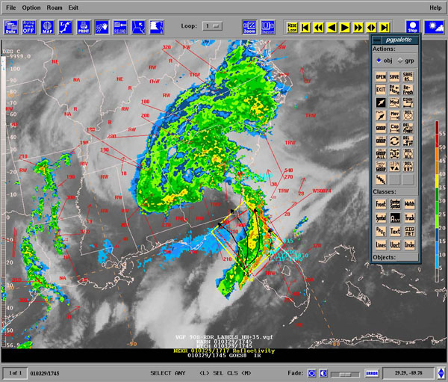
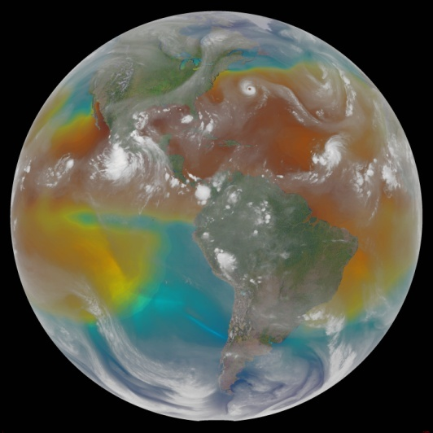
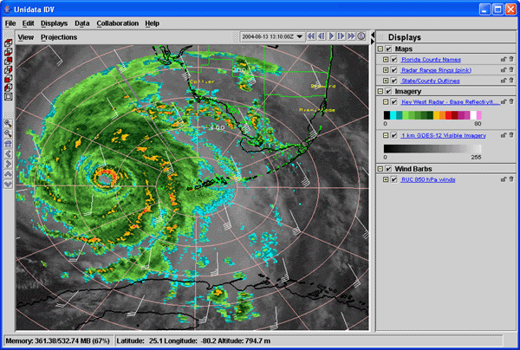
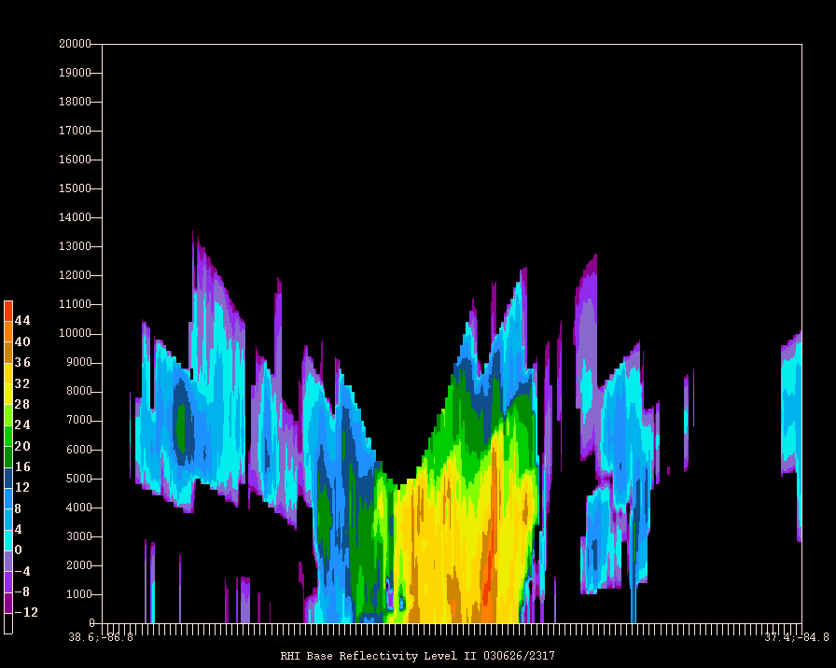
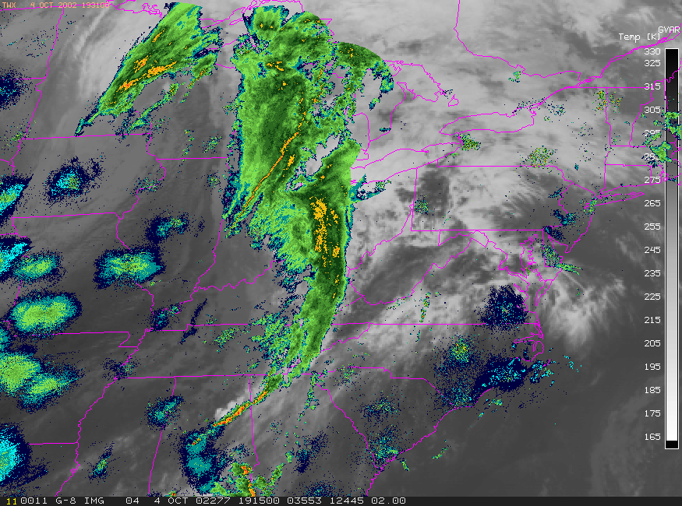
Visualizing and Analyzing Data
GEMPAK
McIDAS-X
IDV

Slide 9
Unidata User Community
Support the community
User Workshops
Training Workshops
Mailing lists
For specific software packages
“community” email list – for Unidata community announcements
Represent and advocate for the community
More: http://www.unidata.ucar.edu/

Slide 10
Why TDS? Users
As a user, some things I want to be able to do:
Easily ‘see’ information regarding the dataset, without the need to download any files
Temporal / spatial ranges, available variables, contact info, dataset details
Get only the data I need/want
Temporal, spatial, and variable subsetting
Get data remotely in a variety of ways
Download one file, even if data span multiple files

Slide 11
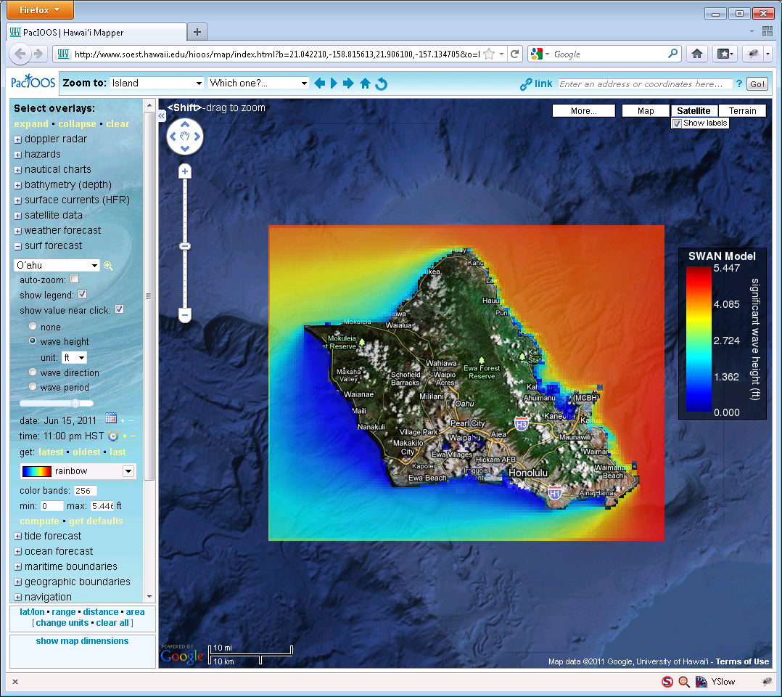
Why TDS? Users
* From PacIOOS site, developed by John Maurer, U of HI

Slide 12
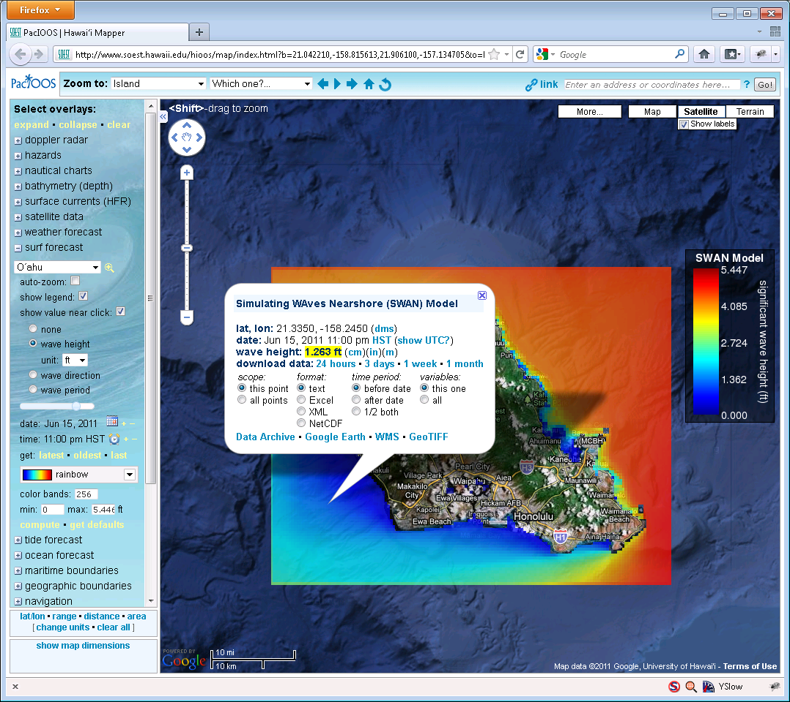
Why TDS? Users
* From PacIOOS site, developed by John Maurer, U of HI

Slide 13
Why TDS? Data Providers
As a data provider, I want to be able to:
Catalog my data holdings
Aggregate data files
Provide a ‘quick view’ of my data
Easily add information (metadata) to my datasets
Fix ‘incorrect’ datasets*
Allow flexibility in the way users access my data
Give users what they need to do science!

Slide 14
Why TDS? Data Providers
As a data provider, I want to be able to:
Catalog my data holdings
Aggregate data files
Provide a ‘quick view’ of my data
Easily add information (metadata) to my datasets
Fix ‘incorrect’ datasets*
Allow flexibility in the way users access my data
Give users what they need to do science!

Slide 15
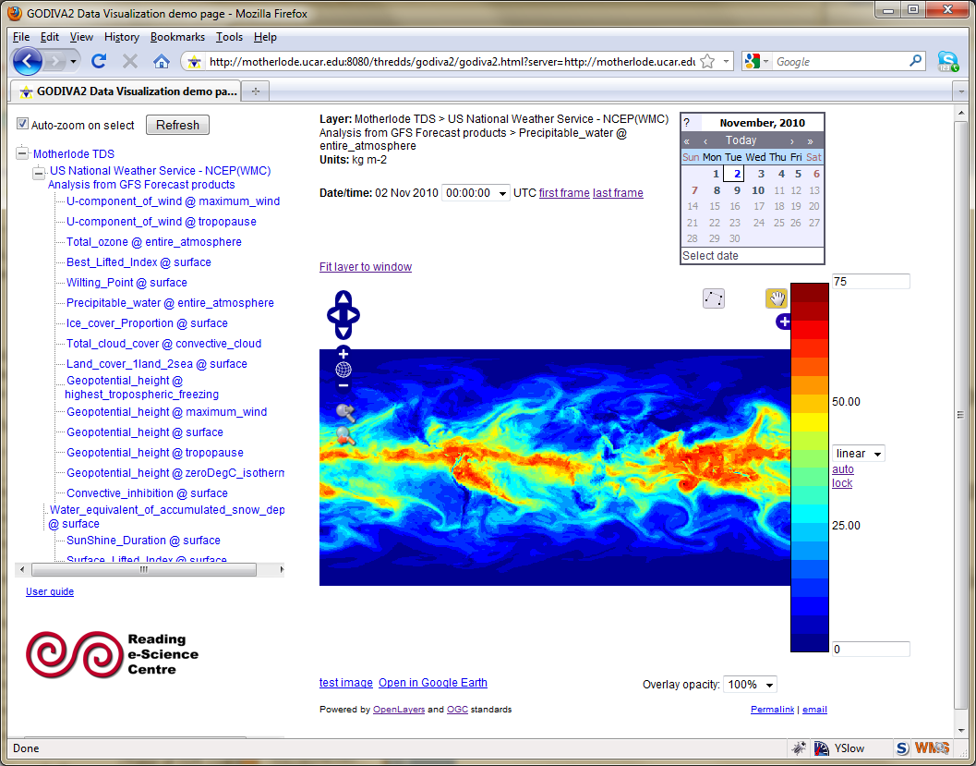
Why TDS? Data Providers
As a data provider, I want to be able to:
Catalog my data holdings
Aggregate data files
Provide a ‘quick view’ of my data
Easily add information (metadata) to my datasets
Fix ‘incorrect’ datasets*
Allow flexibility in the way users access my data
Give users what they need to do science!

Slide 16
THREDDS Data Server (TDS)
Web server for scientific data (written in 100% Java*)
Can serve any dataset the netCDF-Java library can read
E.g., netCDF-3, netCDF-4, HDF-4, HDF-5, HDF-EOS, GRIB-1, GRIB-2
Advertise available datasets and services via catalogs
Data access (subset) services:
OPeNDAP
OGC WMS and WCS
NCSS
Data collection services
Aggregation
Point/station collection
Metadata services
THREDDS Catalog XML
ncISO: ISO, UDDC, NcML
* Writing netCDF-4 requires the netCDF-C library

Slide 17
THREDDS Data Server
Servlet Container
catalog.xml
Remote Access
Client
THREDDS Server
WCS
OPeNDAP
HTTPServer
WMS
NetCDF-Java
Library
configCatalog.xml
IDD Data
Datasets
thredds.ucar.edu

Slide 18
THREDDS Data Server Getting Started
TDS is written in 100% Java
TDS uses the Java Servlet framework
Need to Install Tomcat or other servlet container
Tomcat used in many places (The Weather Channel, Netflix, LinkedIn, to name a few)
Note: many cloud services can use servlets (e.g. Amazon Web Services, CloudBees, Google App Engine, Windows Azure Compute, etc.)
First up: Install and configure Tomcat Docker Docker Docker and TDS

Slide 19
THREDDS Data Server Getting Started
TDS is written in 100% Java
TDS uses the Java Servlet framework
Need to Install Tomcat or other servlet container
Tomcat used in many places (The Weather Channel, Netflix, LinkedIn, to name a few)
Note: many cloud services can use servlets (e.g. Amazon Web Services, CloudBees, Google App Engine, Windows Azure Compute, etc.)
First up: Install and configure Tomcat Docker D ddddocker Docker and TDS

