Slide 1



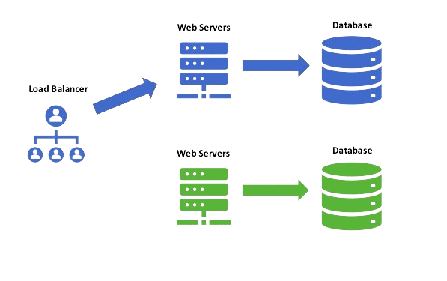
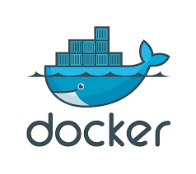
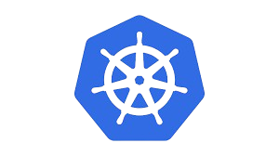
Blue Green Deployment
Athora Agos Team

Slide 2
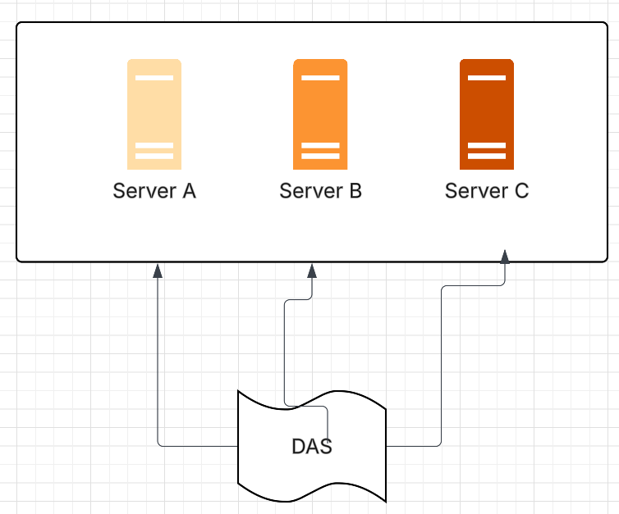
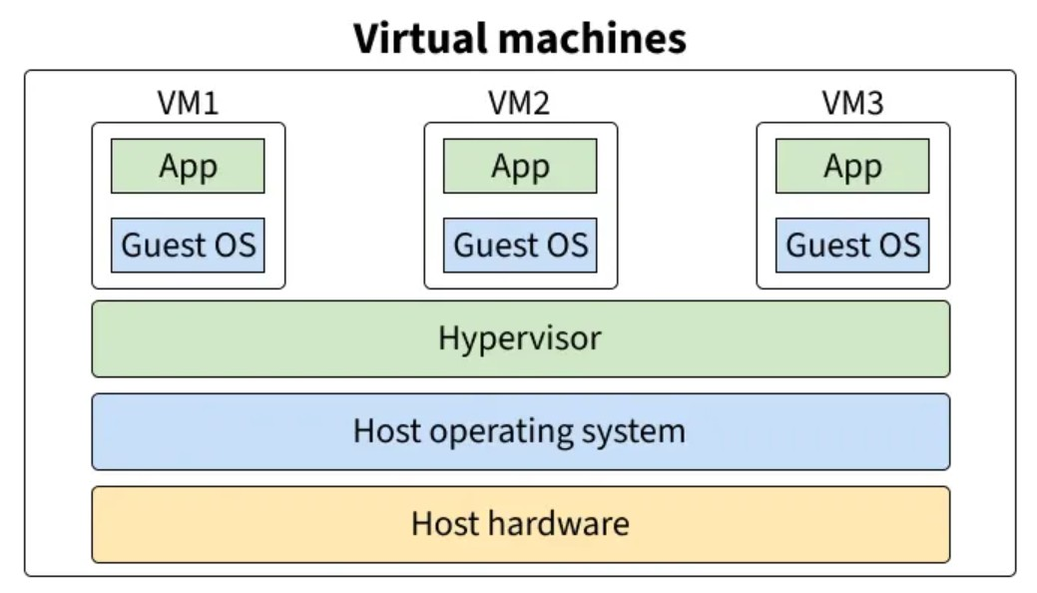
Current Scenario
Applications are tightly coupled.
Application runs on top of middleware
During deployment - undeploy the current version, deploy the latest one.
Restart instance
Results in downtime
Deployment only in maintenance window
Quick validation before next day business starts.

Slide 3
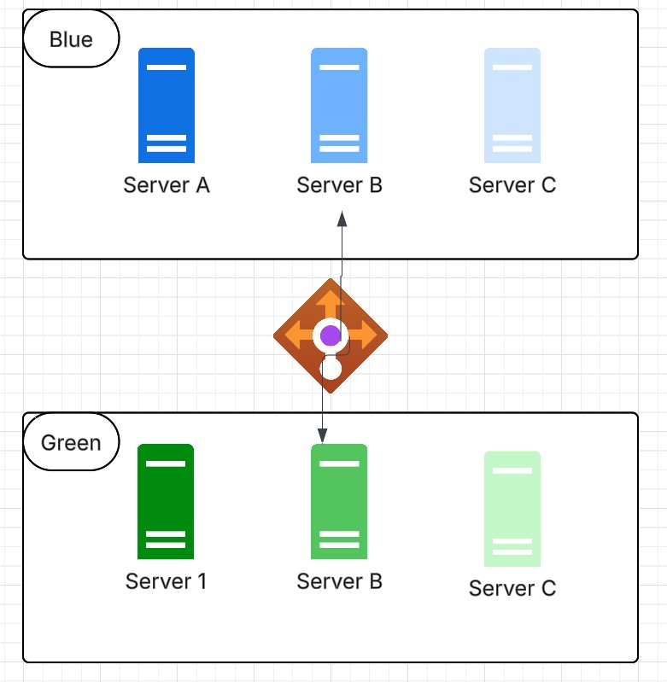
Blue Green Concept (Traditional)
Two set of servers
Active/ Passive
Blue is the productive one
Green is the environment with latest servers
Load balancer decides the environment
Testing validation regression performed on Green
Traffic switches to Green and becomes operational
Change deployed to Blue
Blue and Green interchanges
Almost zero or negligible downtime

Slide 4
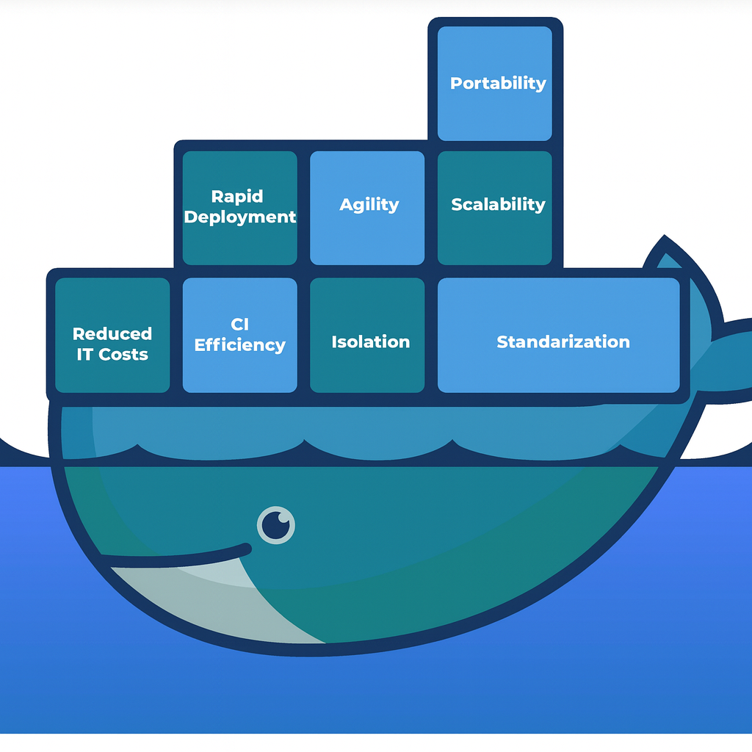
What Docker Brings in
Containerization: Each Java app (Payara Micro or Payara Full Profile) can be packaged into a Docker image.
Containerization: Each Java app (Payara Micro or Payara Full Profile) packaged into a Docker image
Consistency: Same image runs in dev, QA, pre-prod, and prod
Lightweight: Containers share the host OS kernel.
Portability: Easier to move workloads across servers/cloud.

Slide 5
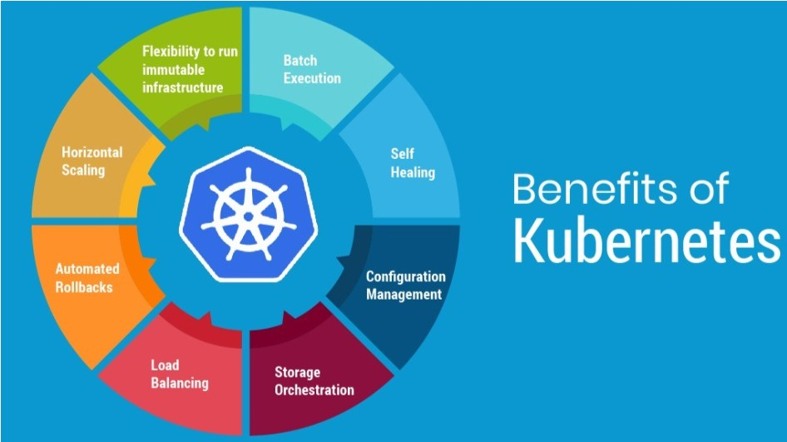
Fly with K8s
Orchestration: manages scheduling, scaling, and health checks of containers.
Environment Separation: namespaces for dev, QA, pre-prod, prod instead of separate servers.
- Auto-Scaling: Worker nodes scale up/down based on load.
- Modern Practices: Blue-Green, Canary, Rolling updates become native.
- Cloud-Native Ready: Easier integration with CI/CD, monitoring

Slide 6
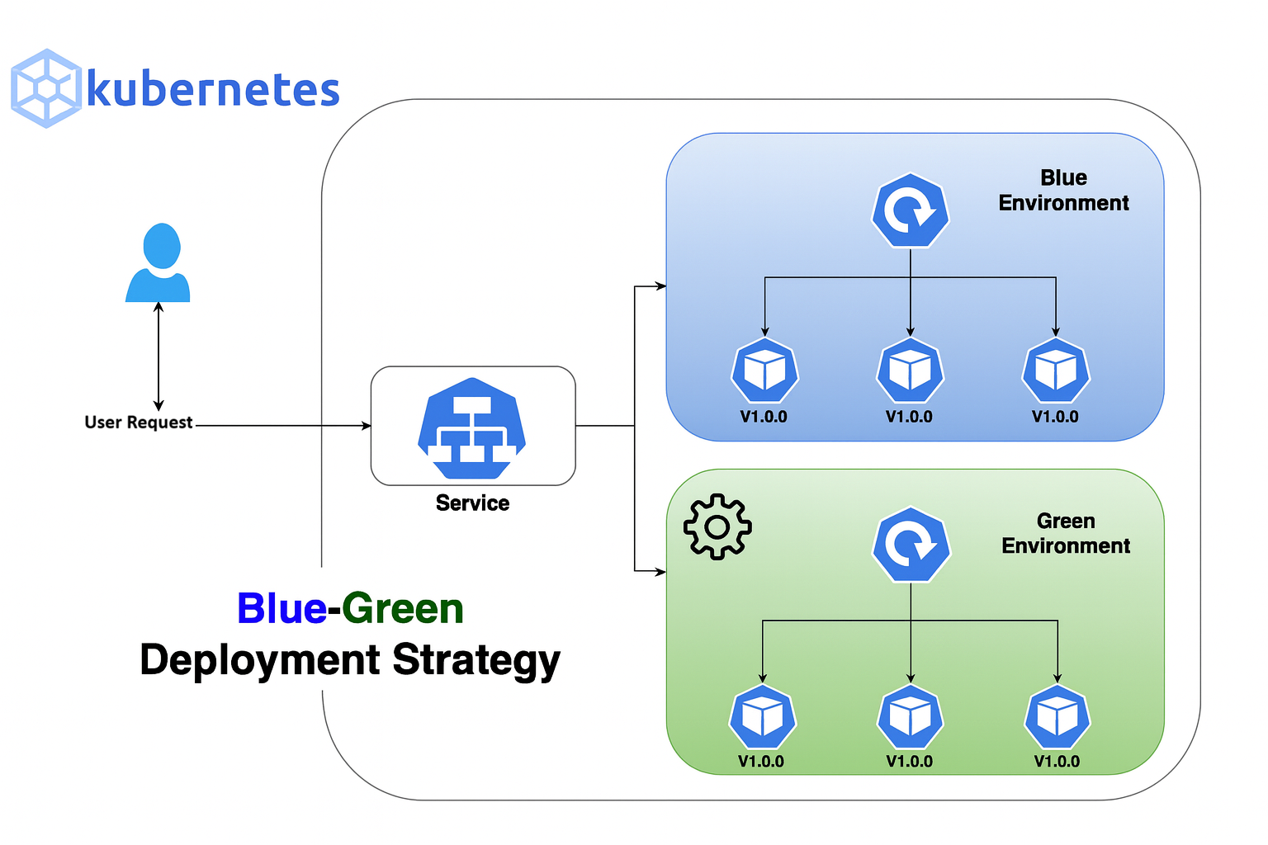
Blue Green with k8s
Deploy blue environment v1.0.0
Deploy green environment v2.0.0
Deploy Service with correct label Selector.
Label Selector switches or determines the traffic flow.
Monitor, validate Green environment with no hurry.
If ok – Switch the traffic to V2.0.0
Destroy v1.0.0

Slide 7

