Slide 1


SERVICENOW ITSM MODERNIZATION
Transforming Workflow Efficiency & Incident Response
A strategic blueprint to eliminate approval delays, automate queue routing, standardize templates, and accelerate major incident resolution.

Slide 2






STRATEGIC ROADMAP
Core Transformation Objectives
Fast-Track Approvals
Domain Queue Routing
Template Standardization
Bypass manual CAB queues for routine, low-risk requests.
Eliminate generic inbox traps with tech-specific queues.
Pre-fill complex form fields to eradicate typing errors.
Unified SR & CR Hub
Automated P1 Validation
Reduced Delay Times
Merge request and change steps to remove double work.
Auto-call on-call engineers and launch bridge in 2 mins.
Cut operational friction and speed up resolution cycles.

Slide 3
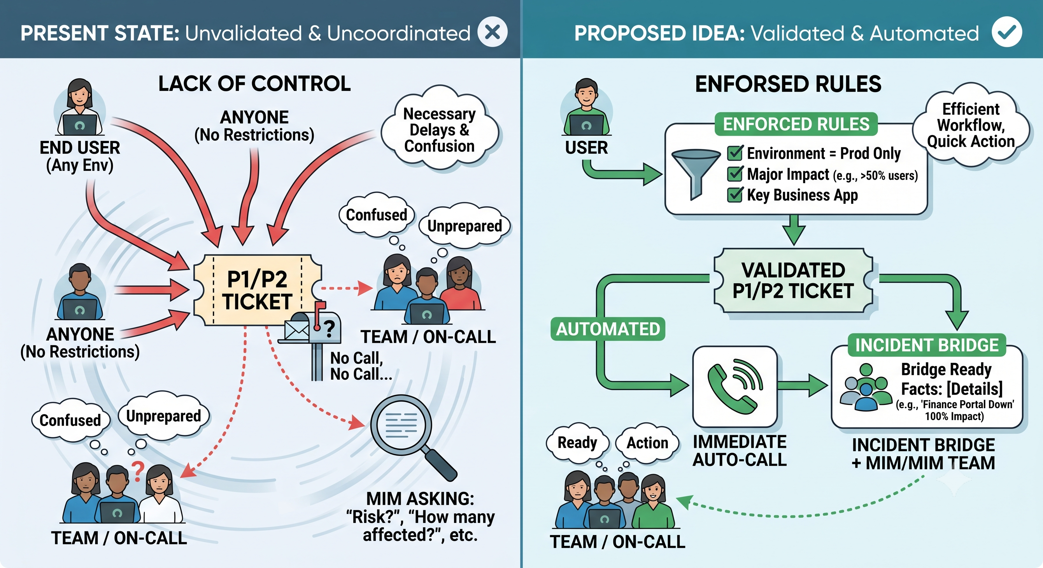
Optimizing Major Incident Management via Automated Validation
Enforced Criteria Validation
Automated On-Call Escalation
Instant Bridge Creation

Slide 4
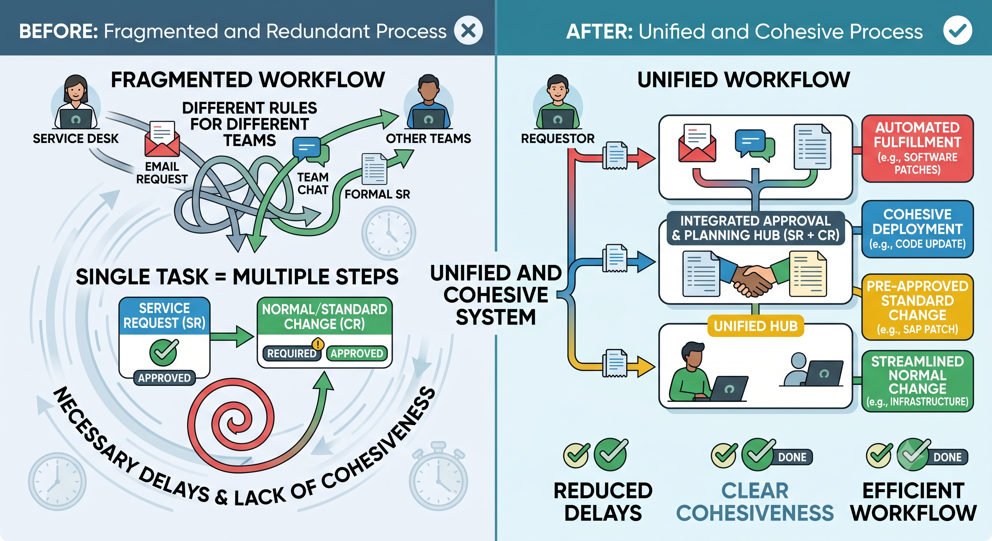
Unifying Workflows for Streamlined Process Execution
Single Centralized Entry
Merged SR & CR Approvals
Integrated Request-to-Change Workflow
Targeted Execution Pathways
Faster End-to-End Delivery (Measurable Impact)

Slide 5
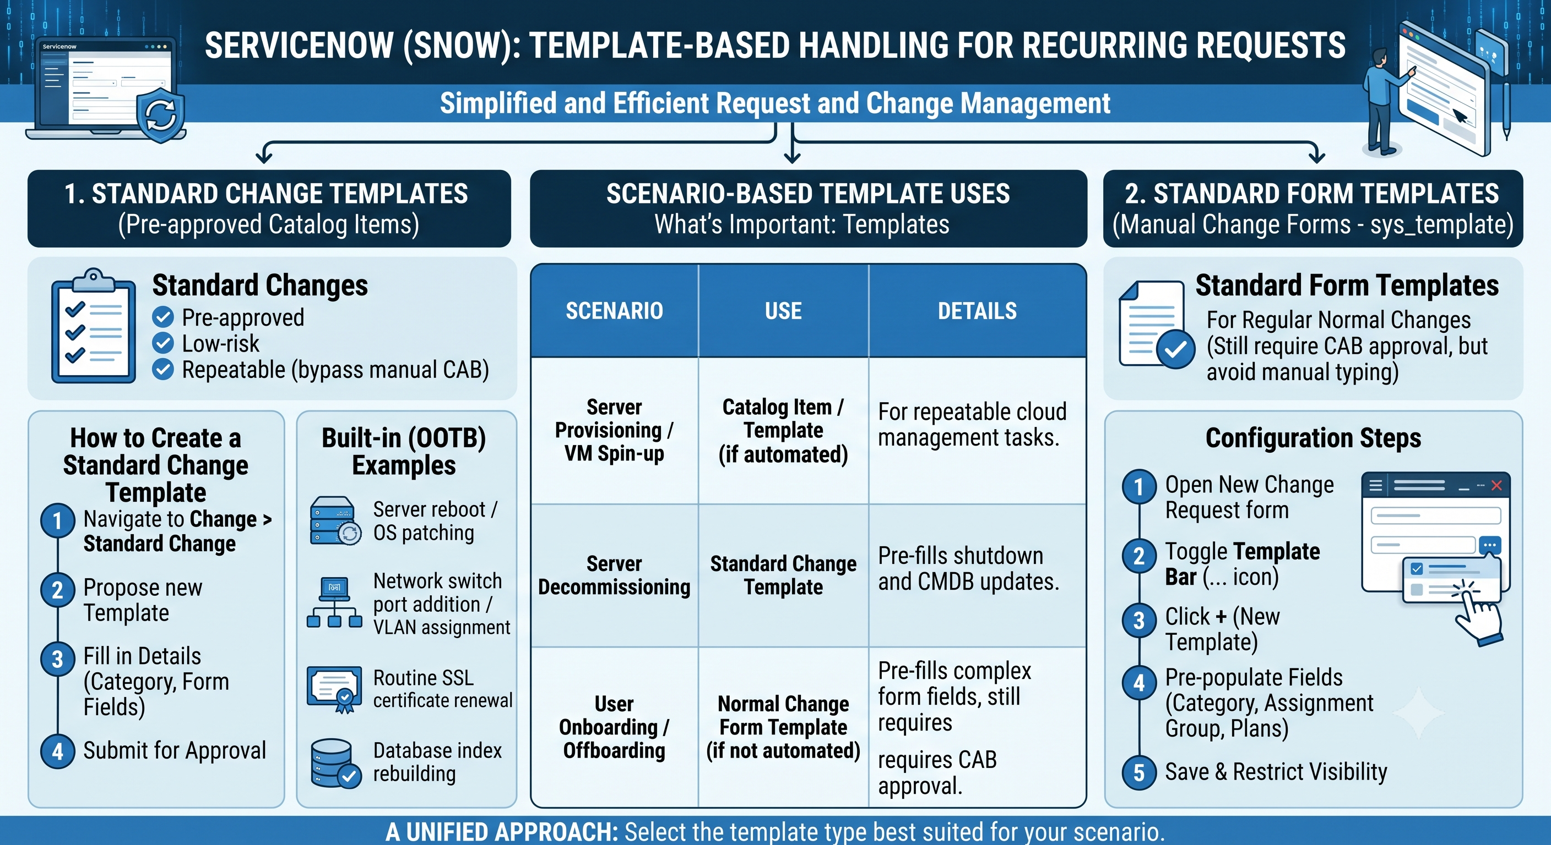
Accelerating Request Fulfilment via ServiceNow Templates
Pre-Approved Standard Changes
Auto-Filled Form Templates
Error-Free Data Entry like assignment Group

Slide 6
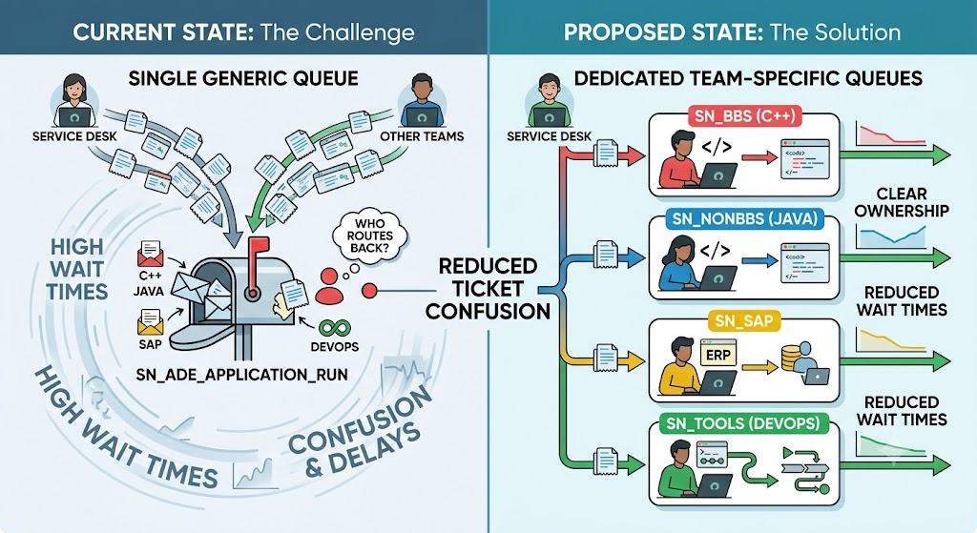
Defined SNOW Queue Management
Direct Tech-Stack Assignment:
Clear Accountable Ownership
Drastic Reduction in Wait Times
Resulting Faster resolution time

Slide 7
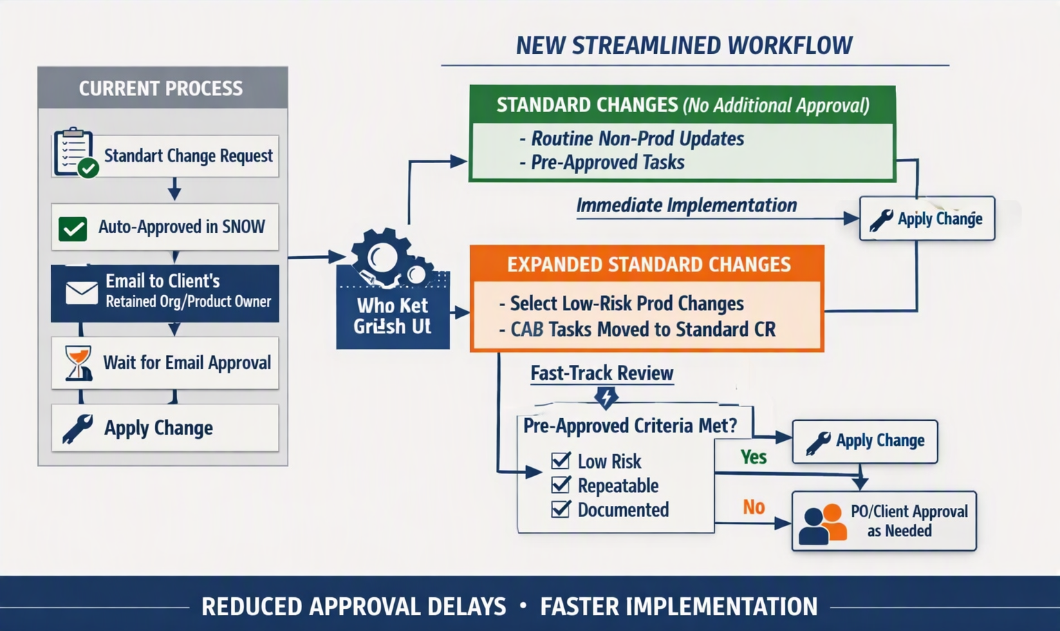
Streamlining Change Approvals for Faster Delivery
Eliminated Email Bottlenecks
Immediate Non-Prod Execution
Automated Fast-Tracking for Routine Production Tasks

Slide 8
EXPECTED BUSINESS OUTCOMES
Faster Delivery, Zero Email Bottlenecks, Enhanced Governance
Questions & Open Discussion

