Slide 1


MCA PROJECT · BRAINWARE UNIVERSITY
Library Management System
Problem Solving using Python · MCA17400(P)
PROJECT SUBMISSION
Santanu Ghosh
Student Code: BWU/MCA/26/022
Registration No.: 26102000140
Department of Computational Sciences · Brainware University

Slide 2


Why the library needed a new workflow
Problem
Introduction
Paper ledgers and fragmented tools create record discrepancies, inventory uncertainty, and delayed fine settlement.
The project responds with a modern, lightweight, web-based library automation platform.

Slide 3
What success means for this project
OBJECTIVES
SCOPE
Automate the record
Keep operations visible
Catalog, members, circulation, overdue fees, validation, and audit trails.
Staff operations, student/member borrowing, inventory state, and configurable lending rules.
Boundary: local/offline deployment.

Slide 4
What the system changes
From fragile tracking to validated transactions.
Existing approaches
Proposed system
Key rules
Manual ledgers and spreadsheet tracking are error-prone, fragile, and weak at duplicate-loan prevention and automatic fine handling.
Flask + Jinja2 web GUI with Book, Student, and Library domain classes, JSON persistence, validation, and transaction auditing.
14-day lending window · overdue charge ₹5/day · fine state: NONE, DUE, or PAID.

Slide 5

Inside the solution: four layers, one circulation loop
SOLUTION VIEW
Iterative incremental development: four sprints—architecture → OOP/storage → circulation/fines → web GUI/routing.
THREE-TIER ARCHITECTURE
Presentation
Application & routing
Persistence
HTML / CSS
library.py + JSON files
Flask app.py / main.py
CIRCULATION LOOP
Preview member/book → issue and decrement stock → return → calculate overdue → mark fine → restore stock and log transaction.

Slide 6


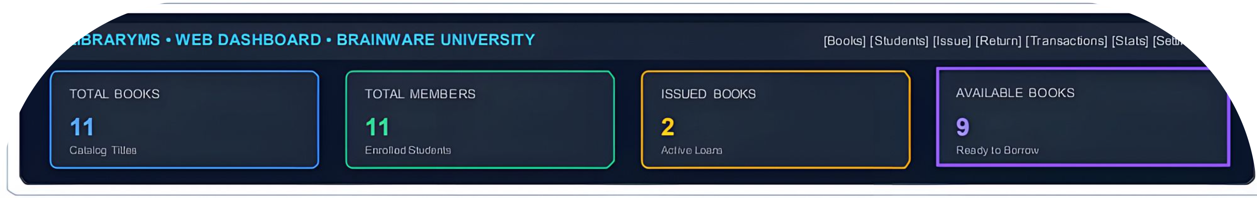
Implementation: the operator sees the whole system
One interface connects daily work to the underlying records.
Core modules
Interface evidence
Catalog CRUD, member registration, issue/return, overdue calculation, dues and income tracking, analytics, and settings.
Dashboard KPIs, live availability, circulation actions, return feedback, and configurable settings.
DASHBOARD EVIDENCE

Slide 7
Testing turns the workflow into evidence
The system is measured at the points where library work can fail.
54
PASS
0.154
<4 ms
UNITTEST CASES
REPORTED RESULT
SECONDS
QUERY/PAGE RESPONSE
Books, inputs, members, circulation, stock, duplicate loans, and fines were covered.
Observed evidence: 11 titles · 11 members · 2 active loans · 9 available books.

Slide 8





THE NEXT LIBRARY
FUTURE SCOPE
A practical foundation for the next library
Barcode/RFID
Automated email/SMS reminders
REST/mobile clients
Multi-campus synchronization
A portable offline-first system combining Flask routing, OOP domain modeling, responsive Jinja2 UI, JSON persistence, automated fines, and audit logging.
AI-driven recommendations
Key references: Flask Documentation; Python 3 Documentation; Jinja2 Documentation; Lutz, Learning Python; Pressman & Maxim, Software Engineering; Grinberg, Flask Web Development; Brainware University project guidelines.

Slide 9
Thank You

