Slide 1
ENUMGRID
An honesty-disciplined, unprivileged-first network enumeration platform with a grounded LLM triage copilot
Santhakumar Parivallal
Dissertation defense · 2026 · engineering + measurement contribution
Every number is produced by a reproducible harness — no fabricated data.
Notes:
ENUMGRID: a two-tier purple-team enumeration platform. The thesis is that a scanner can treat no-fabrication as a measurable property. This is an engineering + measurement contribution, not a new algorithm — I will be explicit about that.

Slide 2
The problem: tools launder uncertainty
A version-string guess and a confirmed exploit are shown as the same thing
VERSION GUESS
CONFIRMED EXPLOIT
"Apache 2.4.49 → CVE-2021-41773" — inferred from a banner. A back-ported distro build makes this a confident false positive.
A probe actually fired and the bug reproduced. Same visual weight in most tools — the reader cannot tell these apart.
And with an LLM in the loop, it gets worse
Asked "what is exploitable here?", a fluent model will invent a plausible CVE id that was never in the scan.
For a security tool, an invented finding is categorically worse than a missing one — a missed detail is recoverable; a fabricated CVE that sends an analyst down the wrong path is not.
Yet scanners report coverage ("N vulns found") and stay silent on their false-positive and hallucination behaviour.
Notes:
Two failure modes: (1) uncertainty laundering — inference and confirmation look identical; (2) LLM hallucination. The premise of the project is that an invented finding is worse than a missing one.

Slide 3
Thesis
Treat "no fabrication" as a first-class,
measurable property of a scanner.
Quantify and bound the tool's own over-claiming — for the deterministic CVE matcher AND the LLM copilot — instead of hiding it behind a single blended verdict.
Notes:
This is the one-sentence thesis. Everything after this is either how the system enforces it, or how the evaluation measures it.

Slide 4
Three defensible claims
Not algorithmic novelty — measured discipline
1
Honesty as a property
2
Unprivileged fidelity
3
Grounded LLM copilot
The matcher scores precision 1.00 / recall 1.00 (0 false positives) on a 33-case adversarial corpus; the copilot fabricates 0 CVEs across 5 runs.
A four-signal (TTL + OUI + hostname + mDNS) discovery/OS fusion recalls 0.99 ± 0.02 of hosts vs 0.53 ± 0.93 for unprivileged nmap -sn — without root.
Scan-grounded triage with a structural hallucination guard: real CVE ids into the context, a deterministic check on the way out. Grounding 1.000 ± 0.000.
Notes:
These three, in this order, are what I want to be examined on. Each is measured in the evaluation section.

Slide 5
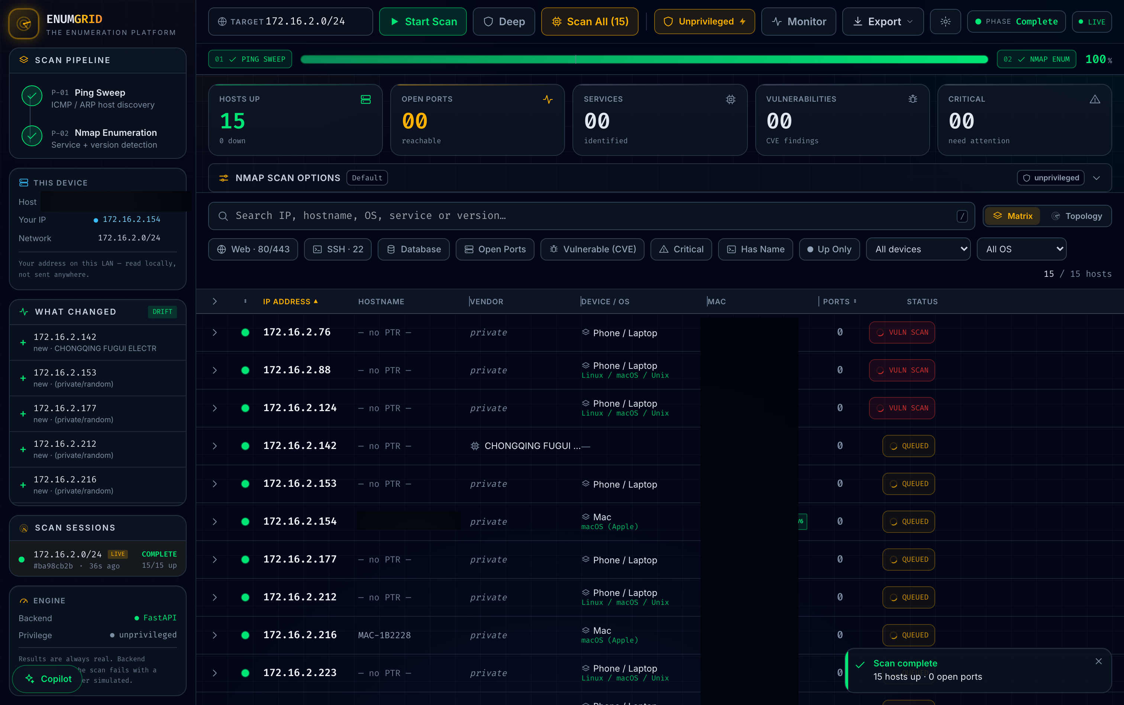
System design
Two-tier: single-file CLI + FastAPI/React, same engine, unprivileged-first
Two phases: multi-method host discovery (ICMP/ARP/TCP), then nmap service/version enumeration, streamed over SSE.
Four-signal unprivileged OS fusion — TTL + IEEE OUI + hostname + mDNS model — recovers fidelity without raw sockets.
Privilege auto-adaptation: root-only nmap flags rewritten to safe equivalents; elevation holds the sudo password in memory only.
Degrades to "Unknown" when signals disagree — never a guess.
Completed scan — 15/15 hosts, OS fusion, drift panel (hostname / MACs redacted for publication).
Notes:
The screenshot is a real unprivileged scan of my own authorised /24; open ports read 00 because the hosts are firewalled consumer devices — the true result, not simulated.

Slide 6
The honesty discipline — four mechanisms
What makes "no fabrication" measurable rather than a slogan
1
Confidence banding
2
Unknown over guessing
confirmed (probed, conf ≥ 7) vs version (inferred) — scored per band, so "high-confidence is more accurate" is measured.
unresolved OS / vendor / version is labelled Unknown; no CVE for a version-less banner or untabled product.
3
Never-simulated data
4
Provenance
no mock/demo mode in the evidence path; a failed scan says so instead of fabricating hosts.
every scan carries a manifest; golden-file tests fix the parser→model→report pipeline byte-for-byte.
Notes:
The same discipline extends to the copilot: real CVE ids into the context, a deterministic guard flags any id the model emits that is not in the scan.

Slide 7
Evaluation methodology
Sound method; the honest limits are scale, not design
Ground truth: exact on the pinned 9-host docker testbed; union-of-tools proxy (an upper bound) on real LANs.
Closed-world scoring on the CVE corpus: any extra id is a false positive, any missing id a false negative.
Uncertainty everywhere: Wilson 95% CIs; cross-environment macro-average (each network = one sample); multi-run CIs for the LLM.
Same code paths as the product — the harnesses call scanner._service_scan, vulndb.lookup_offline_cves, cve.parse_nvd.
Two layers: pure, unit-tested scoring (runs in CI, no Docker/network) + operator-run live runners.
2
environments (1 real LAN + 1 testbed)
178
CI-tested scoring tests, no Docker
Notes:
The methodology is defensible; I will not oversell scale. n is small and I say so.

Slide 8
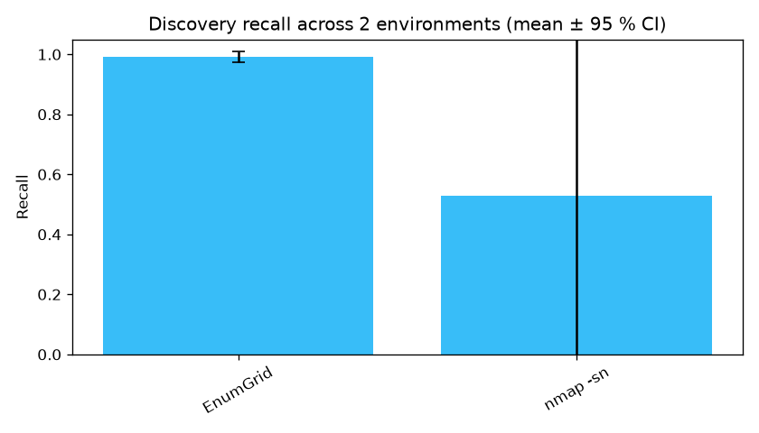
Result: unprivileged discovery
Four-signal fusion vs an unprivileged ping sweep, pooled across two environments
0.99
EnumGrid recall (±0.02)
0.53
nmap -sn recall (±0.93)
nmap -sn's huge CI is the honest headline: 0.06 on the ICMP-filtered LAN, 1.00 on the clean testbed — environment-dependent. EnumGrid is consistent. n = 2 is small and reported as such.
Cross-environment discovery recall (mean ± 95% CI, n = 2).
Notes:
On the clean testbed EnumGrid merely ties nmap -sn at 1.00 — it dominates only on real filtered LANs. I state that rather than claiming universal superiority.

Slide 9
Result: service / port / version detection
9-host pinned testbed, through the product's own scan path
1.00 / 1.00
0.89
0.83
3/3
ports P / R (0 FP)
service accuracy (8/9)
version accuracy (5/6)
planted-CVE recall
Confidence banding predicts its own error
High-confidence band (conf ≥ 7, n = 8): service accuracy 1.00. Low band (n = 1): service 0.00 — and that single low-confidence detection is the single miss.
56 unexpected CVEs on the rolling images are surfaced for review, never scored as false positives — a rolling image's full CVE set is unknowable a priori.
Notes:
The point of banding: the tool flags the exact detection it got wrong as low-confidence. That is honesty made actionable.

Slide 10
Result: CVE matching — precision corpus
Attach the right CVE to the right version, and never a wrong one
1.00
A real bug the corpus caught
precision (17/17)
The matcher's substring keyword match let "httpd" match inside "lighttpd" — so a patched lighttpd was flagged with Apache's path-traversal CVE. A genuine false positive.
1.00
recall — 0 false positives
Fixed with whole-token matching (vulndb._kw_hit) and locked by a regression test. This is the value of a precision corpus — it turns "we think it's accurate" into "here is the bug proving the test works."
33 adversarial cases: version boundaries (2.4.49 yes, 2.4.51 no), substring & magic-version collisions, a RHEL backport. Wilson 95% CI [0.816, 1.000]; CI-gated.
Notes:
Leading with a bug we found in our OWN matcher is deliberate — it demonstrates the corpus does real work.

Slide 11
Result: the primary live-NVD path — and its failure
Measured against the real NVD feed; the harness surfaced its own miss
8/8
Finding — surfaced, not hidden
documented-CVE recall
First run scored 7/8. The harness attributed the miss to absence (NVD returned 0 rows), not truncation.
Root cause: NVD indexes the vsftpd 2.3.4 backdoor under vendor vsftpd_project; nmap emits vsftpd — a CPE-dictionary drift.
Why it matters: the live-NVD layer alone has recall gaps where the two dictionaries disagree — which is exactly why ENUMGRID also runs the in-scan vulners NSE and an offline table, both of which recall it independently.
7/7
version-scoping precision
0 truncation losses from the CVSS top-N cap.
Notes:
This is the slide I most want to be asked about. A dishonest evaluation would have quietly fixed the corpus. We report the miss, attribute it, and show the mitigation.

Slide 12
Compared to what? Two schools of detection
Three detectors, same planted hosts — the tradeoff, on real hosts
Tool | School | Recall | Unexpected
nmap-vulners | version-match | 1.00 (3/3) | 133
EnumGrid | version-match (conservative) | 0.67 (2/3) | 13
Nuclei | active-PoC | 0.00 (0/3) | 0
Version-match maximises recall but is noisy — nmap-vulners gets 3/3 at 10× the false alarms (133 vs 13). EnumGrid trades a little recall for far less noise.
Active-PoC (Nuclei) fires nothing: the vanilla images expose the version but not the exploitable config — high precision, config-dependent recall.
EnumGrid's own recall varied 2/3 ↔ 3/3 across runs — real live-scan nondeterminism, which is why we measure run-to-run stability.
Notes:
The two schools trade recall for precision in opposite directions. Reporting both frames EnumGrid honestly instead of in a vacuum.

Slide 13
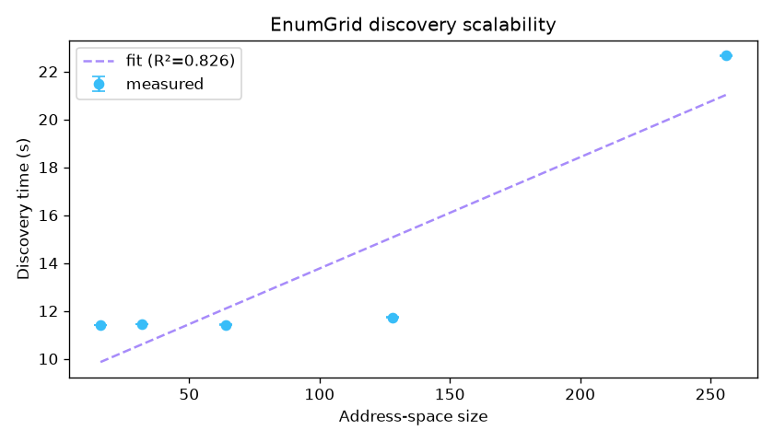
Scalability & the grounded copilot
Timing fit on the authorised /24, and a structural hallucination guard
Copilot grounding
1.000 ± 0.000
grounding across 5 runs — 0 fabricated CVEs
Structural, not sampled: real CVE ids into the context, a deterministic guard on the way out.
The only variance is coverage (recall) — the residual failure of a grounded model is silence, never invention.
A --self-test proves grounding collapses to 0 on a fabricated reply, so the metric can't be gamed.
Discovery time: 46.5 ms/address + 9.1 s overhead, R² = 0.83 (/28 → /24).
Notes:
Grounding is perfectly stable because it is enforced structurally. For a security tool, a missed detail beats an invented one every time.

Slide 14
Threats to validity & honest positioning
Named before a reviewer can
What the evidence supports
What it does NOT yet support
Discovery significantly out-recalls an unprivileged ping sweep.
Detection has no false positives on a known testbed.
The offline matcher is whole-token precise; copilot hallucination is bounded and measured.
A general "1.00 across arbitrary real networks" — n = 2, one synthetic.
Superiority over a mature vuln scanner (Nessus/OpenVAS).
Scalability beyond a /24; small, author-curated corpora.
This is an integration + measurement contribution, not a new algorithm — a strong dissertation / workshop paper.
Notes:
The document is deliberately self-critical: if an examiner raises a gap, it should already be on this slide.

Slide 15
Contributions & what's next
Scaffolded, honest — the rest needs real inputs, not fabrication
Contributions
Turnkey, awaiting real inputs
A two-tier, unprivileged-first enumeration platform.
An honesty discipline made measurable.
A reproducible measurement suite through the product's own code paths.
Two findings only an honest harness surfaces (CPE drift; the lighttpd FP).
Several distinct authorised networks → tighten the cross-env CI (runbook ready).
A held-out, independently-sampled CVE corpus (template + protocol ready).
OpenVAS/Nessus baselines (report-file adapters ready).
A pre-registered analyst user study (protocol ready — must be run, never simulated).
Notes:
Each future-work item is scaffolded so it is one command / one export / one study away — but none can be fabricated. That boundary is the point.

Slide 16
The contribution is the discipline —
and its measurement.
precision 1.00 / recall 1.00 on an adversarial CVE corpus — the one false positive it found is fixed and regression-locked
0 fabricated CVEs across five copilot runs
0.99 ± 0.02 unprivileged discovery recall vs a highly environment-dependent 0.53 ± 0.93 baseline
a primary live-NVD path at 1.00 recall — with its one real failure mode surfaced and attributed
Thank you.
Notes:
Close on the discipline. Every number here is reproducible and every limit is named.

