Slide 1
Mobile Communications
Chapter 2: Wireless Transmission
Frequencies
Signals
Antenna
Signal propagation
Multiplexing
Spread spectrum
Modulation
Cellular systems
Prof. Dr.-Ing. Jochen Schiller, http://www.jochenschiller.de/ MC SS05 2.<number>

Slide 2
Frequencies for communication
twisted pair
coax cable
optical transmission
1 Mm
300 Hz
10 km
30 kHz
100 m
3 MHz
1 m
300 MHz
10 mm
30 GHz
100 μm
3 THz
1 μm
300 THz
VLF
LF
MF
HF
VHF
UHF
SHF
EHF
infrared
visible light
UV
VLF = Very Low Frequency UHF = Ultra High Frequency
LF = Low Frequency SHF = Super High Frequency
MF = Medium Frequency EHF = Extra High Frequency
HF = High Frequency UV = Ultraviolet Light
VHF = Very High Frequency
Frequency and wave length:
λ = c/f
wave length λ, speed of light c ≅ 3x10⁸m/s, frequency f
Prof. Dr.-Ing. Jochen Schiller, http://www.jochenschiller.de/ MC SS05 2.<number>
Notes:
Universität Karlsruhe
Institut für Telematik
Mobilkommunikation
SS 1998
Prof. Dr. Dr. h.c. G. Krüger
E. Dorner / Dr. J. Schiller

Slide 3
Frequencies for mobile communication
VHF-/UHF-ranges for mobile radio
  simple, small antenna for cars
  deterministic propagation characteristics, reliable connections
SHF and higher for directed radio links, satellite communication
  small antenna, beam forming
  large bandwidth available
Wireless LANs use frequencies in UHF to SHF range
  some systems planned up to EHF
  limitations due to absorption by water and oxygen molecules (resonance frequencies)
    weather dependent fading, signal loss caused by heavy rainfall etc.
Prof. Dr.-Ing. Jochen Schiller, http://www.jochenschiller.de/ MC SS05 2.<number>

Slide 4
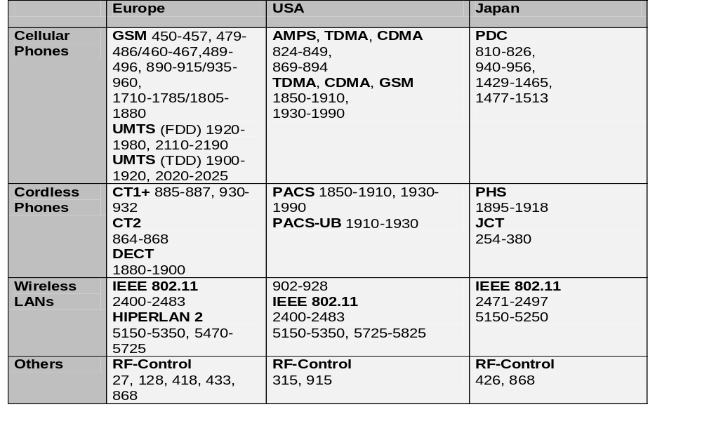
Frequencies and regulations
ITU-R holds auctions for new frequencies, manages frequency bands worldwide (WRC, World Radio Conferences)
Prof. Dr.-Ing. Jochen Schiller, http://www.jochenschiller.de/ MC SS05 2.<number>

Slide 5
Signals I
physical representation of data
function of time and location
signal parameters: parameters representing the value of data
classification
  continuous time/discrete time
  continuous values/discrete values
  analog signal = continuous time and continuous values
  digital signal = discrete time and discrete values
signal parameters of periodic signals:
period T, frequency f=1/T, amplitude A, phase shift ϕ
  sine wave as special periodic signal for a carrier:
  s(t) = A_{t} sin(2 π f_{t} t + ϕ_{t})
Prof. Dr.-Ing. Jochen Schiller, http://www.jochenschiller.de/ MC SS05 2.<number>

Slide 6
The amplitude of a periodic variable is a measure of its change over a single period
the frequency domain refers to the analysis of mathematical functions or signals with respect to frequency, rather than time. ... The inverse Fourier transform converts the frequency domainfunction back to a time function.
Phase shift is a term describing the displacement of two signals in time.
Radio propagation is the behavior of radio waves as they travel, or are propagated, from one point to another, or into various parts of the atmosphere.
Prof. Dr.-Ing. Jochen Schiller, http://www.jochenschiller.de/ MC SS05 2.<number>

Slide 7
Signal propagation ranges
Transmission range
  communication possible
  low error rate
Detection range
  detection of the signal
  possible
  no communication
  possible
Interference range
  signal may not be
  detected
  signal adds to the
  background noise
sender
transmission
distance
detection
interference
Prof. Dr.-Ing. Jochen Schiller, http://www.jochenschiller.de/ MC SS05 2.<number>

Slide 8




Signal propagation
Propagation in free space always like light (straight line)
Receiving power proportional to 1/d² in vacuum – much more in real environments
(d = distance between sender and receiver)
Receiving power additionally influenced by
fading (frequency dependent)
shadowing
reflection at large obstacles
refraction depending on the density of a medium
scattering at small obstacles
diffraction at edges
shadowing
reflection
refraction
scattering
diffraction
Prof. Dr.-Ing. Jochen Schiller, http://www.jochenschiller.de/ MC SS05 2.<number>

Slide 9
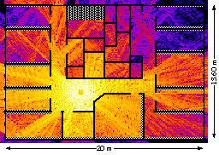
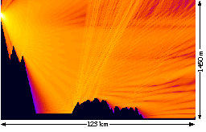
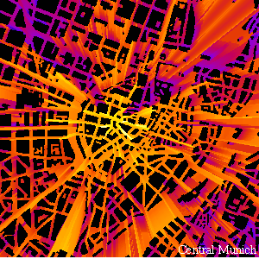
Real world example
Prof. Dr.-Ing. Jochen Schiller, http://www.jochenschiller.de/ MC SS05 2.<number>

Slide 10
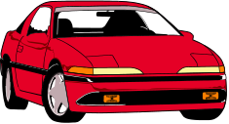
Multipath propagation
Signal can take many different paths between sender and receiver due to reflection, scattering, diffraction
Time dispersion: signal is dispersed over time
➔ interference with “neighbor” symbols, Inter Symbol Interference (ISI)
The signal reaches a receiver directly and phase shifted
➔ distorted signal depending on the phases of the different parts
multipath
pulses
LOS pulses
signal at sender
signal at receiver
Prof. Dr.-Ing. Jochen Schiller, http://www.jochenschiller.de/ MC SS05 2.<number>

Slide 11
Effects of mobility
Channel characteristics change over time and location
  signal paths change
  different delay variations of different signal parts
  different phases of signal parts
➔ quick changes in the power received (short term fading)
Additional changes in
  distance to sender
  obstacles further away
➔ slow changes in the average power
received (long term fading)
power
long term
fading
t
short term fading
Prof. Dr.-Ing. Jochen Schiller, http://www.jochenschiller.de/ MC SS05 2.<number>

Slide 12
Multiplexing
channels k_{i}
Multiplexing in 4 dimensions
  space (s_{i})
  time (t)
  frequency (f)
  code (c)
Goal: multiple use
of a shared medium
Important: guard spaces needed!
k₁
k₂
k₃
k₄
k₅
k₆
c
t
c
s₁
t
s₂
f
f
c
t
s₃
f
Prof. Dr.-Ing. Jochen Schiller, http://www.jochenschiller.de/ MC SS05 2.<number>

Slide 13
Frequency multiplex
Separation of the whole spectrum into smaller frequency bands
A channel gets a certain band of the spectrum for the whole time
Advantages:
no dynamic coordination
necessary
works also for analog signals
Disadvantages:
waste of bandwidth
if the traffic is
distributed unevenly
inflexible
guard spaces
k₁
k₂
k₃
k₄
k₅
k₆
c
f
t
Prof. Dr.-Ing. Jochen Schiller, http://www.jochenschiller.de/ MC SS05 2.<number>

Slide 14
Time multiplex
A channel gets the whole spectrum for a certain amount of time
Advantages:
only one carrier in the
medium at any time
throughput high even
for many users
Disadvantages:
precise
synchronization
necessary
k₁
k₂
k₃
k₄
k₅
k₆
c
f
t
Prof. Dr.-Ing. Jochen Schiller, http://www.jochenschiller.de/ MC SS05 2.<number>

Slide 15
Time and frequency multiplex
Combination of both methods
A channel gets a certain frequency band for a certain amount of time
Example: GSM
Advantages:
  better protection against
  tapping
  protection against frequency
  selective interference
  higher data rates compared to
  code multiplex
but: precise coordination
required
k₁
k₂
k₃
k₄
k₅
k₆
c
f
t
Prof. Dr.-Ing. Jochen Schiller, http://www.jochenschiller.de/ MC SS05 2.<number>

Slide 16
Code multiplex
Each channel has a unique code
All channels use the same spectrum
at the same time
Advantages:
  bandwidth efficient
  no coordination and synchronization necessary
  good protection against interference and tapping
Disadvantages:
  lower user data rates
  more complex signal regeneration
Implemented using spread spectrum technology
k₁
k₂
k₃
k₄
k₅
k₆
c
f
t
Prof. Dr.-Ing. Jochen Schiller, http://www.jochenschiller.de/ MC SS05 2.<number>

Slide 17
Modulation
Digital modulation
  digital data is translated into an analog signal (baseband)
  ASK, FSK, PSK - main focus in this chapter
  differences in spectral efficiency, power efficiency, robustness
Analog modulation
  shifts center frequency of baseband signal up to the radio carrier
Motivation
  smaller antennas (e.g., λ/4)
  Frequency Division Multiplexing
  medium characteristics
Basic schemes
  Amplitude Modulation (AM)
  Frequency Modulation (FM)
  Phase Modulation (PM)
Prof. Dr.-Ing. Jochen Schiller, http://www.jochenschiller.de/ MC SS05 2.<number>

Slide 18
Modulation and demodulation
analog
baseband
signal
digital
data
digital
modulation
analog
modulation
101101001
radio transmitter
radio
carrier
analog
baseband
signal
digital
data
analog
demodulation
synchronization
decision
101101001
radio receiver
radio
carrier
Prof. Dr.-Ing. Jochen Schiller, http://www.jochenschiller.de/ MC SS05 2.<number>

Slide 19
Digital modulation
Modulation of digital signals known as Shift Keying
Amplitude Shift Keying (ASK):
  very simple
  low bandwidth requirements
  very susceptible to interference
Frequency Shift Keying (FSK):
  needs larger bandwidth
Phase Shift Keying (PSK):
  more complex
  robust against interference
1
0
1
t
1
0
1
t
1
0
1
t
Prof. Dr.-Ing. Jochen Schiller, http://www.jochenschiller.de/ MC SS05 2.<number>

Slide 20
Spread spectrum technology
Problem of radio transmission: frequency dependent fading can wipe out narrow band signals for duration of the interference
Solution: spread the narrow band signal into a broad band signal using a special code
protection against narrow band interference
protection against narrowband interference
Side effects:
  coexistence of several signals without dynamic coordination
  tap-proof
Alternatives: Direct Sequence, Frequency Hopping
power
interference
spread signal
power
signal
spread
interference
detection at
receiver
f
f
Prof. Dr.-Ing. Jochen Schiller, http://www.jochenschiller.de/ MC SS05 2.<number>

Slide 21
Effects of spreading and interference
dP/df
dP/df
user signal
broadband interference
narrowband interference
i)
ii)
f
f
sender
dP/df
dP/df
dP/df
iii)
iv)
v)
f
f
f
receiver
Prof. Dr.-Ing. Jochen Schiller, http://www.jochenschiller.de/ MC SS05 2.<number>

Slide 22
Spreading and frequency selective fading
channel
quality
2
1
5
6
3
narrowband channels
4
frequency
narrow band
signal
guard space
channel
quality
2
2
spread spectrum channels
2
2
2
1
frequency
spread
spectrum
Prof. Dr.-Ing. Jochen Schiller, http://www.jochenschiller.de/ MC SS05 2.<number>

Slide 23
DSSS (Direct Sequence Spread Spectrum) I
XOR of the signal with pseudo-random number (chipping sequence)
  many chips per bit (e.g., 128) result in higher bandwidth of the signal
Advantages
  reduces frequency selective
  fading
  in cellular networks
    base stations can use the
    same frequency range
    several base stations can
    detect and recover the signal
    soft handover
Disadvantages
  precise power control necessary
t_{b}
user data
0
1
XOR
t_{c}
chipping
sequence
0
1
1
0
1
0
1
0
1
1
0
1
0
1
=
resulting
signal
0
1
1
0
1
0
1
1
0
0
1
0
1
0
t_{b}: bit period
t_{c}: chip period
Prof. Dr.-Ing. Jochen Schiller, http://www.jochenschiller.de/ MC SS05 2.<number>

Slide 24
DSSS (Direct Sequence Spread Spectrum) II
spread
spectrum
signal
transmit
signal
user data
X
modulator
chipping
sequence
radio
carrier
transmitter
correlator
lowpass
filtered
signal
sampled
sums
received
signal
products
data
demodulator
X
integrator
decision
radio
carrier
chipping
sequence
receiver
Prof. Dr.-Ing. Jochen Schiller, http://www.jochenschiller.de/ MC SS05 2.<number>

Slide 25
FHSS (Frequency Hopping Spread Spectrum) I
Discrete changes of carrier frequency
  sequence of frequency changes determined via pseudo random number sequence
Two versions
  Fast Hopping:
  several frequencies per user bit
  Slow Hopping:
  several user bits per frequency
Advantages
  frequency selective fading and interference limited to short period
  simple implementation
  uses only small portion of spectrum at any time
Disadvantages
  not as robust as DSSS
  simpler to detect
Prof. Dr.-Ing. Jochen Schiller, http://www.jochenschiller.de/ MC SS05 2.<number>

Slide 26
FHSS (Frequency Hopping Spread Spectrum) II
t_{b}
user data
0
1
0
1
1
t
f
t_{d}
f₃
slow
hopping
(3 bits/hop)
f₂
f₁
t_{d}
t
f
f₃
fast
hopping
(3 hops/bit)
f₂
f₁
t
t_{b}: bit period t_{d}: dwell time
Prof. Dr.-Ing. Jochen Schiller, http://www.jochenschiller.de/ MC SS05 2.<number>

Slide 27
FHSS (Frequency Hopping Spread Spectrum) III
narrowband
signal
spread
transmit
signal
user data
modulator
modulator
frequency
synthesizer
hopping
sequence
transmitter
narrowband
signal
received
signal
data
demodulator
demodulator
hopping
sequence
frequency
synthesizer
receiver
Prof. Dr.-Ing. Jochen Schiller, http://www.jochenschiller.de/ MC SS05 2.<number>

Slide 28
Cell structure
Implements space division multiplex: base station covers a certain transmission area (cell)
Mobile stations communicate only via the base station
Advantages of cell structures:
  higher capacity, higher number of users
  less transmission power needed
  more robust, decentralized
  base station deals with interference, transmission area etc. locally
Problems:
  fixed network needed for the base stations
  handover (changing from one cell to another) necessary
  interference with other cells
Cell sizes from some 100 m in cities to, e.g., 35 km on the country side (GSM) - even less for higher frequencies
Prof. Dr.-Ing. Jochen Schiller, http://www.jochenschiller.de/ MC SS05 2.<number>

Slide 29
Frequency planning I
Frequency reuse only with a certain distance between the base stations
Standard model using 7 frequencies:
Fixed frequency assignment:
  certain frequencies are assigned to a certain cell
  problem: different traffic load in different cells
Dynamic frequency assignment:
  base station chooses frequencies depending on the frequencies already used in neighbor cells
  more capacity in cells with more traffic
  assignment can also be based on interference measurements
f₃
f₅
f₂
f₄
f₆
f₅
f₁
f₄
f₃
f₇
f₁
f₂
Prof. Dr.-Ing. Jochen Schiller, http://www.jochenschiller.de/ MC SS05 2.<number>

Slide 30
Frequency planning II
f₃
f₃
f₃
f₂
f₂
f₁
f₁
f₁
f₂
f₃
f₇
f₃
f₃
3 cell cluster
f₅
f₂
f₂
f₂
f₂
f₄
f₆
f₅
f₁
f₁
f₁
f₄
f₃
f₃
f₃
f₃
f₇
f₁
f₂
f₃
f₆
f₅
f₂
7 cell cluster
f₁
f₂
f₁
f₂
f₁
f₂
f₃
h₁
h₂
f₃
h₁
h₂
f₃
3 cell cluster
with 3 sector antennas
g₁
g₂
h₃
g₁
g₂
h₃
g₁
g₂
g₃
g₃
g₃
Prof. Dr.-Ing. Jochen Schiller, http://www.jochenschiller.de/ MC SS05 2.<number>

Slide 31
Cell breathing
CDM systems: cell size depends on current load
Additional traffic appears as noise to other users
If the noise level is too high users drop out of cells
Prof. Dr.-Ing. Jochen Schiller, http://www.jochenschiller.de/ MC SS05 2.<number>

