Slide 1
MAE-CG: A MULTI-ATTENTION ENHANCED THIN CLOUD-REMOVAL GENERATIVE ADVERSARIAL NETWORK FOR AIRBORNE IMAGERY

Slide 2
AGENDA
ABSTRACT
INTRODUCTION
PROPOSED METHODOLOGY
RESULTS AND DISCUSSIONS
CONCLUSION

Slide 3
ABSTRACT
Optical satellite imagery is essential for resource surveys, vegetation management, and environmental monitoring.
Cloud cover often obstructs visibility and degrades image quality.
Develop a novel framework, MAE-CG to effectively remove thick clouds from satellite images using advanced deep learning techniques.
Combines CBAM and CAM attention mechanisms for enhanced cloud removal.
The MAE-CG model demonstrated superior performance in terms of Peak Signal-to-Noise Ratio (PSNR), Structural Similarity Index (SSIM),Mean Squared Error (MSE), and Root Mean Squared Error(RMSE) compared to existing methods.
The model effectively reconstructed cloud-free images by focusing on critical features and spatial details, showing resilience to thin clouds.

Slide 4
introduction
Remote sensing (RS) images play a crucial role in tracking land and sea conditions, managing disasters, and supporting agriculture. However, clouds frequently obstruct these images.
Clearing thin clouds can significantly improve the utility of data, particularly for Sentinel-2 satellites that face challenges with cloud coverage.
Various methods for removing clouds, such as multi-spectral imaging, image fusion, and statistical techniques, work to create clear, cloud-free images but often affect high-frequency details.
Recently, deep-learning methods like multiscale interactive fusion networks and spatial-logical aggregation networks have become popular due to their effectiveness in this task.
Recent progress in cloud detection and removal involves the application of CNNs and deep learning methods, which have enhanced the processing of both medium and high-resolution images.
Techniques like iterative haze optimization and sophisticated filtering, combined with improved CNN architectures such as multi-scale deep residual networks, have been effective in generating clear, cloud-free images.

Slide 5
Methods such as Conditional GANs (cGANs) and DCGANs address various cloud thicknesses, while attention mechanisms in models like SpA+Edges and SpA GAN enhance cloud removal.
HardGAN employs a multi-scale network and a normalization layer to achieve effective single-image dehazing.
The MAE-CG model uses parallel multi-attention operations, incorporating CBAM and CAM architectures, to reconstruct thin clouds as haze-free, maintaining local and global spatial contexts.
The parallel spatial attention frameworks utilize residual connections between short-skip and long-skip additions to preserve crucial features and minimize feature loss during training.
The MAE-CG model was trained and evaluated using the RICE-1 dataset, and its performance was compared to top single-image thin cloud removal methods.

Slide 6
Proposed Methodology 1. gan architecture
Research published Generative Adversarial Networks (GANs), a machine learning architecture for generative applications.
GANs revolutionize image synthesis, super-resolution, data augmentation, translation, and production.
GANs consist of two neural networks trained concurrently using adversarial procedures.
A GAN trains a generator to produce data samples, while a discriminator assesses the samples to determine authenticity and fraud, using minimax equation 1 to define its characteristics function.
The GAN characteristics equation consists of a generator, a discriminator.
GANs can create cloud-free images by training on paired datasets of cloudy and clear images with adversarial loss.

Slide 7
2. mae-cg architecture
The MAE-CG model uses CBAM and CAM architectures and residual multi-scale constitutional architecture for parallel multi-attention operations, preserving local and global spatial contexts for cloud-free reconstruction.
i) Generator Module
The MAE-CG generator module comprises Spatial Feature Extractors (SFEs) and a Parallel Attention Module (PAM), combining convolutional and residual convolutional blocks and spatial attention maps from the Convolutional Block Attention Module and Channel Attention Module.
The proposed method involves three 2D convolutional layers to extract basic feature maps, which are then passed to a generator network. The features are then sent to a residual network of multi-scale convolutional branches, each performing different convolutions at different scales.
The outputs are concatenated to form a consolidated multi-scale feature representation.
These features are processed by three Parallel Attention Modules (PAM) to refine the feature map and extract spatial context and importance. The architecture uses ReLU activation at each convolutional layer.

Slide 8
ii) Convolutional Block Attention Module (CBAM)
The CBAM improves feature mapping in traditional CNNs by focusing on important spatial and channel
areas.
The Channel Attention Module (CAM) and Spatial Attention Module (SAM) work sequentially, identifying crucial channels and pointing out relevant spatial locations.
The input feature map F undergoes average and max pooling, resulting in two independent features.
These are processed by a Multi-Layer Perceptron (MLP) with ReLU activation, producing a channel attention map (fc).
The SAM then focuses on F′, generating distinct feature representations.
The unified feature map is processed by a convolution kernel and sigmoid activation function,
resulting in a spatial attention map (fs).

Slide 9
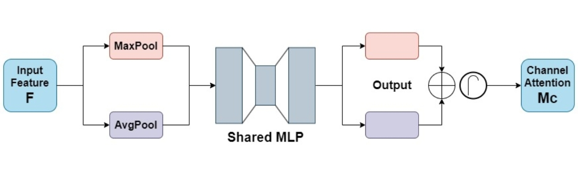
Convolutional Block Attention Module (CBAM) Architecture

Slide 10
iii) Coordinated Attention Module (CAM)
The Coordinated Attention Mechanism (CAM) is a network technique that uses positional information
to focus on large, important regions with minimal computational cost.
It captures cross-channel and direction-aware information, enabling models to accurately locate and
recognize objects of interest.
The mechanism involves embedding coordinate information and generating coordinate attention.
In the second step, a 1 × 1 convolutional transformation function is
applied to the outputs of two pooling layers, resulting in coordinate attention splitting the tensor into two
separate tensors, generating attentionvectors for horizontal and vertical coordinates of the input.

Slide 11
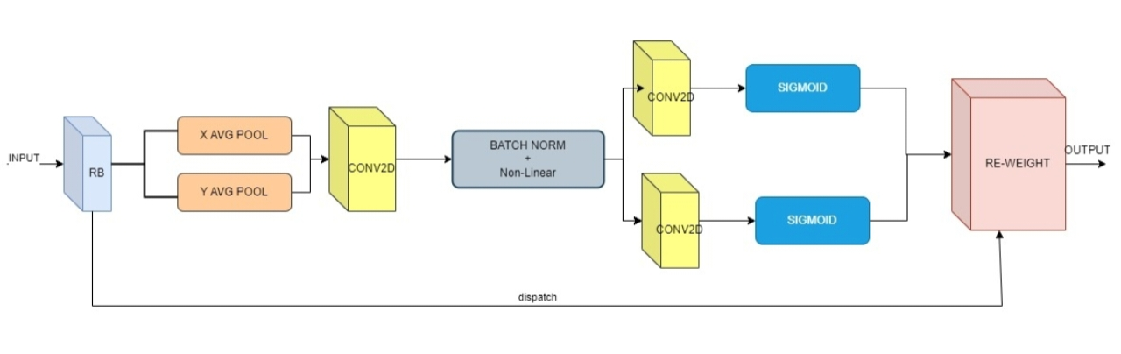
Coordinated Attention Module (CAM) Architecture

Slide 12
iv) Discriminator
The network's discriminator uses multiscale and standard convolutions to process cloud-free images.
The resulting image is processed in a multiscale convolutional structure with three 2D convolutional layers.
The outputs are concatenated and processed by a series of 2D convolutional layers.
A probability score is generated between 0 and 1, with a score closer to 1 indicating the input's authenticity and a score closer to 0 indicating fakeness.
The discriminator network maintains spatial resolution by using appropriate padding-stride settings and ReLU activation.
The score indicates the discriminator's confidence in the input.

Slide 13
RESULTS AND DISCUSSIONS 1. Experimental Setup
The RICE-1 dataset is a baseline cloud/mist dataset used to improve satellite imagery by removing clouds and mist.
The MAECG network is trained and tested using this dataset, which contains 500 pairs of images with 512 × 512 pixels spatial resolution.
The model's performance is evaluated using quantitative metrics like PSNR, SSIM, MSE, and RMSE.

Slide 14
2. Result Analysis
The MAE-CG architecture is compared to four GAN-based haze removal techniques: DHI, AOD-Net, DehazeNet, and Cycle-Dehaze.
The model's reliability and generalizability are enhanced through training and validation phases. As training progresses, validation loss decreases and aligns with increased training accuracy.
The model with the smallest difference between these losses is selected as the best model.
Performance comparisons are presented in Table 1 and Figure 6, with MAE-CG performance compared to SOTA techniques.

Slide 15
CONCLUSIONS
The research aims to develop a robust cloud removal model, specifically the Multi Attention Enhanced Thin Cloud-Removal Generative Adversarial Network (MAE-CG), which has shown superior performance in tests against the RICE-1 dataset. The model incorporates two spatial-attention mechanisms: Convolutional Block Attention Module (CBAM) and Coordinative Attention Module (CAM), which enhance its ability to extract superior spatial context, leading to high-quality, cloud-free image reconstruction. The MAE-CG model achieved the highest Peak Signal-to-Noise Ratio (PSNR) value of 24.80 and the highest Structural Similarity Index (SSIM) score of 0.862, indicating its ability to produce high-quality images with the best structural similarity to reference images. The results underscore the importance of retaining image integrity and quality while efficiently removing thin clouds. Future studies should focus on enhancing current methods, such as cloud detection technologies, machine learning algorithms, and computational capabilities, to increase the overall usefulness and effectiveness of cloud removal models.

