Slide 1
DUAL ATTENTION HYBRID CNN FRAMEWORK FOR CLOUD REMOVAL FROM REMOTE SENSING DATA

Slide 2
AGENDA
Abstract
Introduction
Proposed Model
Methodology
Description of Dataset
Conclusion

Slide 3
ABSTRACT
Optical satellite imagery is essential for resource surveys, vegetation management, and environmental monitoring.
Cloud cover often obstructs visibility and degrades image quality.
Develop a novel framework, MAGAN, to effectively remove thick clouds from satellite images using advanced deep learning techniques.
Combines CBAM and CAM attention mechanisms for enhanced cloud removal.
Peak Signal to Noise Ratio (PSNR)
Structural Similarity Index (SSIM)
Mean Squared Error (MSE)

Slide 4
INTRODUCTION
Remote sensing is crucial for monitoring and acquiring ground information, but the presence of clouds can significantly degrade image quality. Thick clouds completely obscure ground details, necessitating the use of multi-temporal data to reconstruct occluded information. Thin clouds, however, only partially obscure ground features, making it possible to remove them using advanced image processing techniques.

Slide 5
Proposed Model
The Multi-Attention Generative Advanced Network (MAGAN) is a novel model that uses multiple attention mechanisms and advanced neural network architectures to improve cloud removal from remote sensing images. It combines spatial, coordinate, and transformer-based feature enhancement to enhance image clarity and detail preservation. MAGAN outperforms existing methods in terms of PSNR and SSIM, as demonstrated on the RICE dataset.

Slide 6
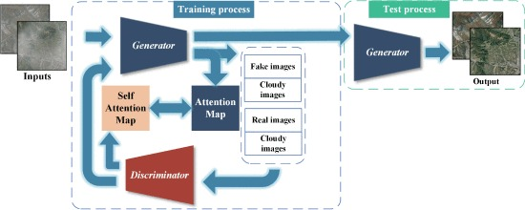
ARCHITECHTURE

Slide 7
Methodology
1. Generator
The proposed approach for this project is using AttentionGAN, The novelty in this project is by using GANs while preserving cycle consistency, computing loss for clouds to clear, computing loss for clear to clouds and also preserving attention which leads to preserving background pixels through computing pixel loss and shifting attention towards the changes in images clouds, shadows, etc.

Slide 8
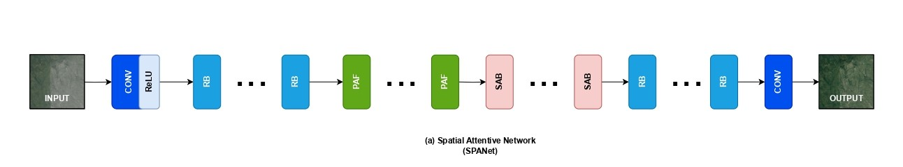
SPATIAL ATTENTION NETWORK (SPANet)

Slide 9
A. CONVOLUTIONAL BLOCK ATTENTION MODULE (CBAM)
The Convolutional Block Attention Module (CBAM) is a tool that improves the performance of convolutional neural networks (CNNs) by focusing on key features and areas in an image. It uses channel and spatial attention to identify specific features, such as colors or textures, and creates a feature map. CBAM is lightweight, easy to add, and consistently improves performance in tasks like object recognition and image classification. The code and models are available for anyone to use.

Slide 10
B. The Coordinate Attention Module (CAM)
The Coordinate Attention Module (CAM) enhances the attention mechanism by preserving positional information along both horizontal and vertical spatial dimensions. It divides the attention process into two 1D feature encoding steps for each spatial direction and generates attention maps sensitive to spatial direction. These maps help the model focus on specific areas while maintaining positional context, enhancing the representation of important objects and areas.

Slide 11
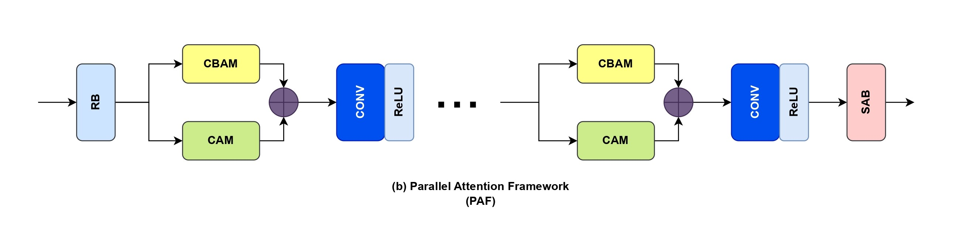
PARALLEL ATTENTION FRAMEWORK (PAF)

Slide 12
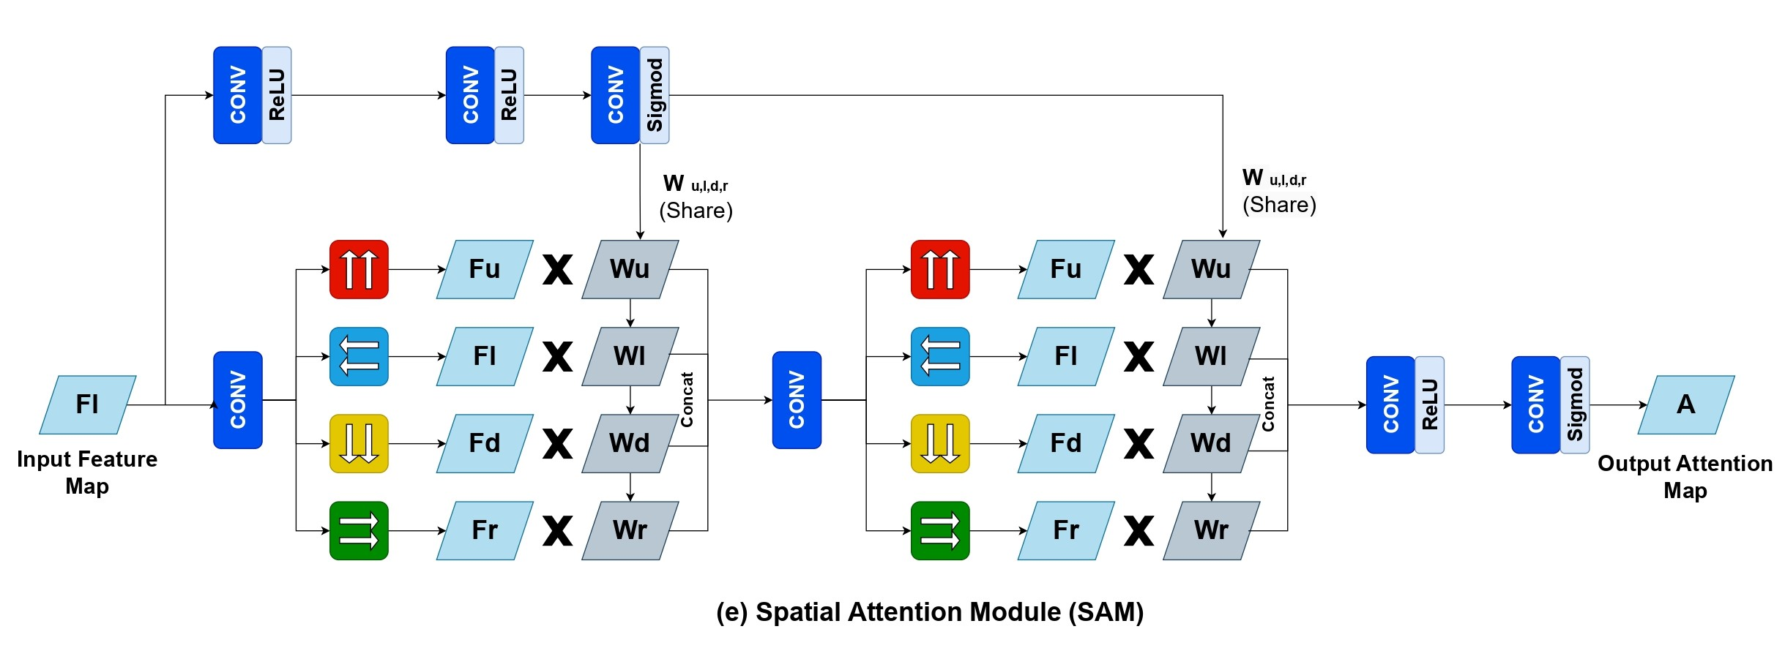
SPATIAL ATTENTION MODULE (SAM)

Slide 13
2.Discriminator
The generators act on attended regions, unlike basic discriminators which consider the entire image. The attention-guided discriminator uses the attention mask as input, aiming to distinguish fake image pairs (My and Gy) and real image pairs (My and y), while Dxa focuses on real image pairs (Mx and Gx). This approach is similar to the basic discriminator but takes the attention mask as input.

Slide 14
DATASET
The Remote sensing Image Cloud Removing (RICE) dataset is a valuable open-source resource designed to facilitate research in cloud removal from high-resolution remote sensing imagery. Addressing the scarcity of training data for deep learning models, the RICE dataset is divided into two subsets: RICE1 and RICE2. RICE1 contains 500 data samples, each with a pair of 512×512 cloudy and cloudless images collected from Google Earth by toggling the cloud layer visibility. RICE2 comprises 736 groups of 512×512 images, each group containing a cloudy image, a cloudless reference image, and a cloud mask image. These images are derived from Landsat 8 OLI/TIRS data, specifically LandsatLook Natural Color and Quality Images, with cloudless references selected within 15 days of the cloudy images for minimal temporal variation. The RICE dataset provides high-resolution, well-aligned image pairs for training and testing deep learning methods in cloud removal and is accessible at RICE Dataset GitHub Repository.

Slide 15
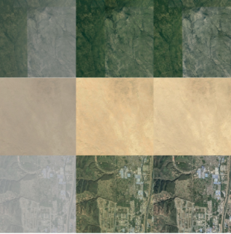
OUTPUT

Slide 16
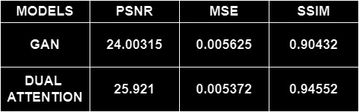
Result Analysis: Metrics

Slide 17
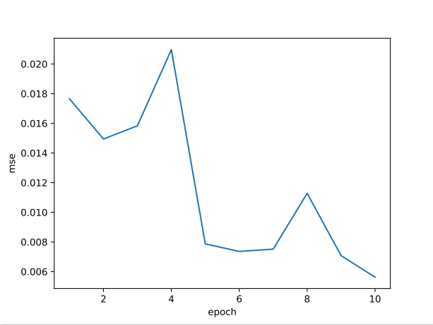
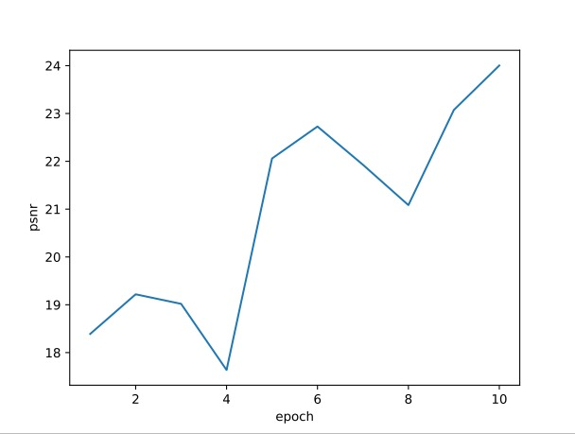
GAN - MODEL

Slide 18
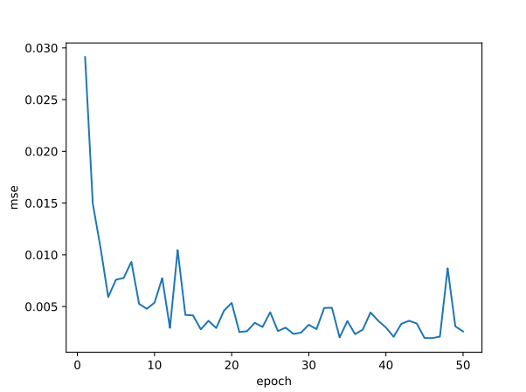
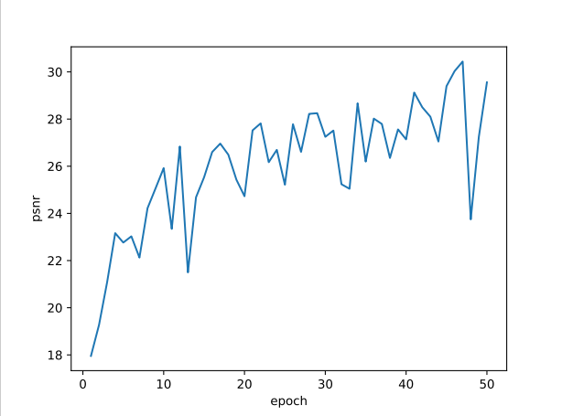
DUAL ATTENTION

Slide 19
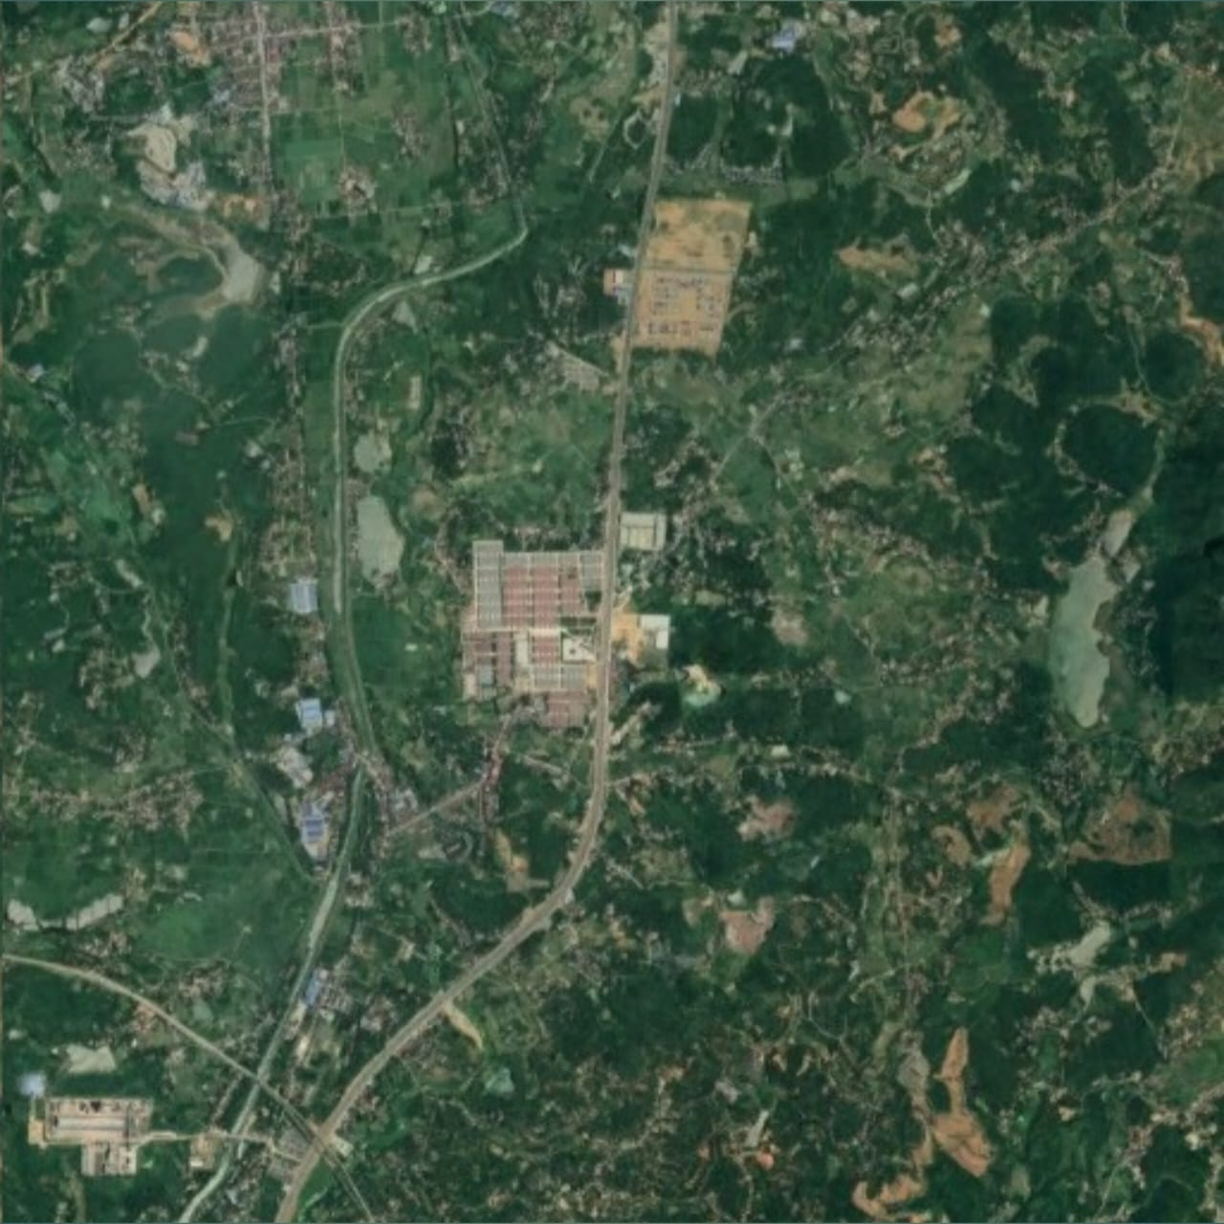
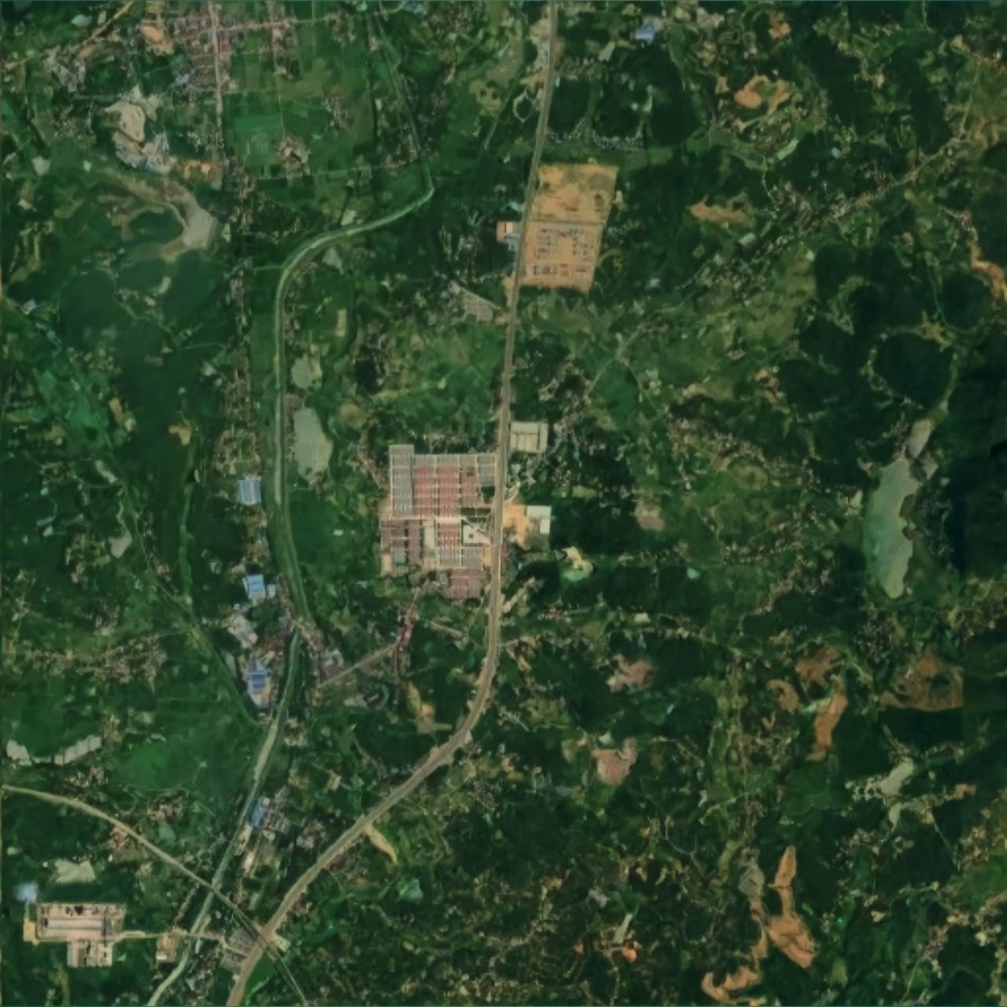
Comparison
GAN
Dual Attention

Slide 20
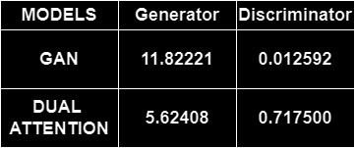
Loss Function:

Slide 21
CONCLUSION
Demonstrates superior performance compared to existing methods.
Effectively reconstructs cloud-free images by focusing on crucial features and spatial details.
Robust in removing thick clouds.
MAGAN significantly improves the quality of cloud-free satellite images.Potential to enhance the utility of satellite imagery for environmental and resource management applications.

