Slide 1
Detecting Heart Disease: A Comprehensive Guide
By Santhana lakshmi

Slide 2
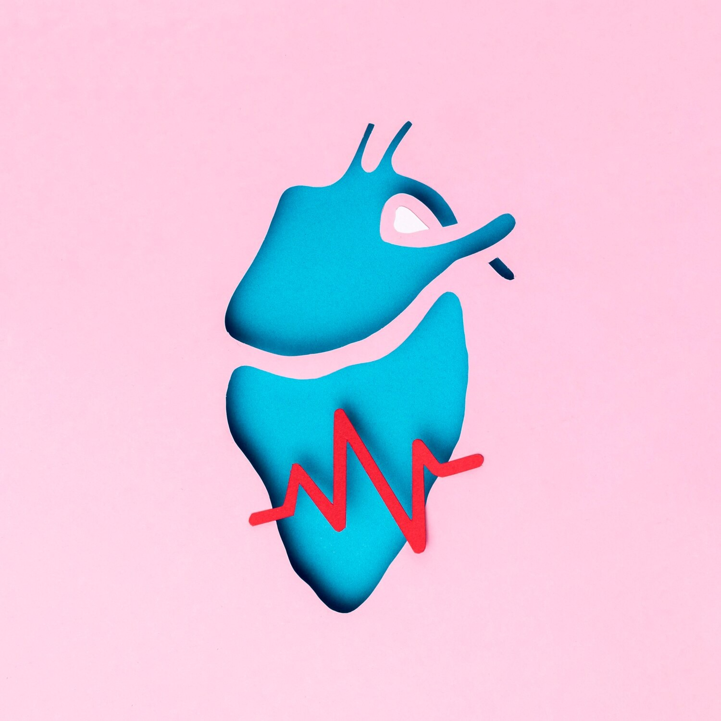


Introduction
This presentation provides a comprehensive guide to detecting and managing heart disease. We will explore the risk factors, symptoms, diagnostic tests, and treatment options.
Understanding these key aspects is crucial for early detection and prevention of heart disease.

Slide 3


Risk Factors
Several risk factors contribute to the development of heart disease, including high blood pressure, high cholesterol, smoking, obesity, and diabetes.
Understanding and addressing these risk factors is essential for preventing heart disease.

Slide 4


Recognizing the symptoms of heart disease is vital for early intervention. Common symptoms include chest pain, shortness of breath, fatigue, and irregular heartbeat. It's important to seek medical attention if any of these symptoms are experienced.

Slide 5


Diagnostic Tests
Several diagnostic tests are used to detect heart disease, such as electrocardiogram (ECG), stress test, echocardiogram, and cardiac catheterization. These tests help in evaluating the heart's function and identifying any potential issues.

Slide 6


Treatment for heart disease may include lifestyle changes, medications, and in some cases, surgical procedures such as angioplasty or bypass surgery. It's important to work closely with healthcare professionals to determine the most effective treatment plan.

Slide 7


Adopting a healthy lifestyle is crucial for preventing heart disease. This includes maintaining a balanced diet, engaging in regular physical activity, managing stress, and avoiding tobacco use. Implementing these strategies can signiﬁcantly reduce the risk of heart disease.

Slide 8


Patient Education
Educating patients about the importance of heart health and the warning signs of heart disease is essential. Empowering individuals with knowledge can lead to early detection, timely intervention, and improved outcomes.

Slide 9

Conclusion
In conclusion, early detection and management of heart disease are critical for improving outcomes and reducing the risk of complications. By understanding the risk factors, symptoms, diagnostic tests, and treatment options, individuals can take proactive steps to protect their heart health.

Slide 10
Thanks!
Do you have any questions? youremail@email.com
+91 620 421 838
www.yourwebsite.com @yourusername

