Slide 1
S&P GLOBAL & CRISIL CAMPUS HACKATHON 2026 · CASE STUDY
TRIDENT.
LIVE SIGNAL · SVB REPLAY, 8 MAR 2023
“SVB Financial announces emergency capital raise after $1.8 billion loss on bond portfolio sale”
A real-time AI/NLP risk engine with a tactical index rebalancer and a wholesale-banking stress tester
Entity
SIVB · SVB Financial · alias 0.94
Event
Credit Event · liquidity
One engine · two strategies · three signals
Sentiment
−0.62
Impact
9 / 10
[Your Full Name]
Gate
TRIGGERED · 2 sources
Indian Institute of Technology Madras
github.com/<your-username>/iitm-<your-name>-hackathon
Engine
1.43 ms p50
Notes:
Open with the story: in March 2023 a bank failed in under 48 hours, and the run spread through text first.
TRIDENT reads that text and turns it into a structured, audited risk signal in about 1.43 milliseconds.
One engine, two strategies, three signals: sentiment, event class and impact. The card on the right is a real signal from our SVB replay.

Slide 2



PROBLEM & APPROACH
Risk arrives as text hours before it arrives as data
The problem
Our approach
Market-moving news, filings and posts are unstructured; risk systems read structured feeds.
Free sources lag (GDELT 15 min, NewsAPI free 24 h) and are full of duplicates, rumors and ambiguous names.
A useful signal must be fast, calibrated, explainable and tied to a decision.
Resolve
Map every item to a company, a sector or the market; reject ambiguous names with a logged reason.
Score
Target-aware sentiment, event class with abstain, impact calibrated to realized moves; confidence and evidence on each.
SVB, March 2023 (UTC)
Act
8 Mar 21:15
9 Mar
10 Mar 16:20
Module A tilts a 15-stock index (minutes to days). Module B stress-tests a wholesale book and reports CET1 (capital).
Capital raise after $1.8bn bond loss
$42bn withdrawal requests in one day
Regulators close the bank
Both modules built: A consumes sentiment, B consumes event + impact, so all three fields are exercised.
Notes:
Two decision horizons from the same signals: tactical position sizing and strategic capital adequacy. We built both modules because they consume different fields of the signal.

Slide 3
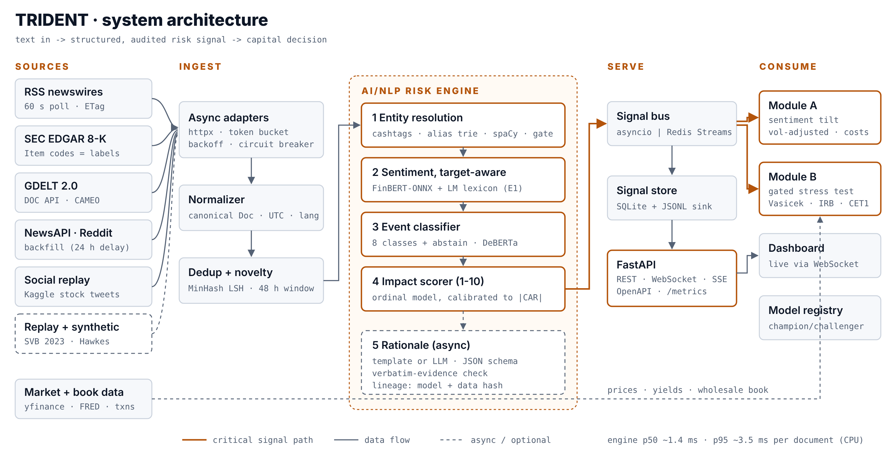



SYSTEM DESIGN
Simple to run on a laptop, with a clear path to bank scale
Replay or live
Deterministic replay of SVB-2023 and COVID-2020 means the demo needs no keys and no network; live mode polls RSS, SEC EDGAR, GDELT, NewsAPI and Reddit.
Pluggable bus
In-process asyncio queue by default; Redis Streams with one setting; Kafka partitioned by ticker behind the same interface.
Lineage on every signal
Model versions, data hash and replay id travel with each signal; a champion/challenger registry logs every model change.
Measured: engine 1.43 ms p50 / 3.29 ms p95 per document · Module A rebalance 0.34 ms · Module B full revaluation 2.75 ms · 855 docs/s on one CPU process
Notes:
Walk the critical path in amber: sources, adapters with circuit breakers, dedup, the five engine stages, the bus, FastAPI, the two modules. Kafka is the right answer at bank scale and the wrong one for a judge's laptop, so the bus is an interface.

Slide 4




IMPLEMENTATION HIGHLIGHTS
Four design choices that separate signal from noise
Target-aware sentiment
Events with an abstain class
Finance lexicon with Loughran-McDonald words, negation and delta phrases, blended with FinBERT exported to ONNX INT8. Scored per entity: “Microsoft beats Google” is + for MSFT, − for GOOGL.
8 classes plus Other, weak labels from keywords, 8-K Item codes and GDELT CAMEO, distilled into DeBERTa. A champion/challenger registry only promotes a model that beats the incumbent.
VADER scores “Profit plunges after default” as +0.44. TRIDENT: −0.91.
Synthetic-only challengers were rejected (F1 0.48 vs 0.65).
Impact calibrated to realized moves
Module B, the way a bank measures it
An ordinal model maps severity, |sentiment|, novelty, burst velocity, source reliability and magnitude cues to deciles of |CAR[0,+1]| from a market-model event study.
Vasicek PD migration, duration-convexity, Greeks and Black-Scholes, Basel IRB RWA and CET1, stressed-correlation VaR, reverse stress test. A two-source gate stops single headlines.
Out-of-sample Spearman 0.20 (5-seed mean 0.23).
Credit I=9: CET1 13.0% → 8.4%.
Python 3.11 · FastAPI · Pydantic · scikit-learn · SciPy · cvxpy · transformers + onnxruntime · spaCy · ECharts · 55 tests incl. Hypothesis property tests
Notes:
Each tile is a tech choice and the reason for it. Emphasize the abstain class and the gate: an honest Other beats a confident wrong label that fires a capital alert.

Slide 5
KEY RESULTS
Measured against baselines, with the data source named
1.43 ms
0.65 vs 0.47
8.4%
58/58
Engine latency p50
Sentiment F1 vs VADER
CET1 after Credit I=9
Behavioral tests passed
p95 3.29 ms · 855 docs/s
authored 180-headline set (optimistic)
from 13.0% · P&L -80m
entity precision 1.00 · recall 0.98
Module A, out of sample
0.95
net information ratio (gross 1.23), 2024-2025, parameters chosen on earlier years
Across 5 seeds: net IR 0.29 ± 0.62, IC 0.064. The signal is real; costs decide whether it pays.
Data: sentiment and entities on authored 180-headline set (optimistic); impact and Module A on synthetic known-answer market; Module B on the synthetic wholesale book. Regenerate on real data with scripts/run_all_results.py. *approximate historical moves.
Notes:
Name one limitation honestly: the sentiment set is authored and optimistic, and the impact and Module A numbers come from a known-answer synthetic market that validates the pipeline. Real-data reruns are one command. Credibility is the asset.

Slide 6
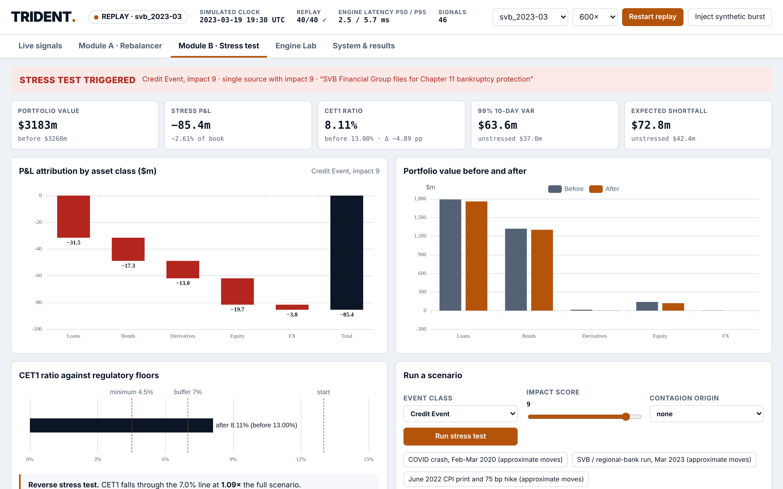

DOMAIN IMPACT
From headline to capital decision in one replay
SVB replay, 8 March 2023 (UTC)
21:15
First headline, impact 8, one source
HELD
21:40
Second wire confirms the story
TRIGGERED
→
P&L -90m · CET1 13.0% → 7.9%
CAPITAL VIEW
Credit surveillance
Obligors flagged within minutes, ranked by calibrated impact, evidence attached.
Portfolio managers
A cost-aware tilt with caps and bands, not headline chasing.
Risk & treasury
Event-triggered CET1, VaR and reverse stress for the risk committee.
Notes:
This is the screen to pause on in the demo: the status flips from monitoring to triggered. The first headline was held because only one source reported it; the trigger came on independent confirmation. Then the capital number a risk committee actually reads.

Slide 7
LIMITATIONS & NEXT STEPS
What we know is weak, and what we would build next
Limitations
Next steps
Free sources lag by minutes to a day; engine speed is not end-to-end speed.
Sentiment and entity scores use an authored set; real PhraseBank and labeled headlines are the numbers to report.
Template synthetic text is easy to detect (AUC 0.95); it is capped at 30% of training and never used for evaluation.
Impact and Module A were validated on a known-answer market; real-price results depend on data we fetch locally.
IRB without maturity adjustment; Greeks are linear except the options book.
Fine-tune FinBERT and DeBERTa on real labels; serve ONNX INT8.
Indian market: NSE universe, Indian regulatory disclosures, Hindi and regional-language news via GDELT.
LLM-generated synthetic data that passes adversarial validation.
Sector contagion through a learned correlation network; online recalibration of impact.
Rating-surveillance view: map signals to obligors in a credit portfolio.
TRIDENT: text in, capital decision out, every step auditable.
Notes:
State the limitations before the jury asks. Close with the one-line summary and invite questions.

