Slide 1
Credit Card Fraud detection
PRESENTED BY
S. Santhana Malini
Year : III
Dept: Electricals and Electronics Engineering
Holycross Engineering College

Slide 2
Content
1. Introduction
2. Problem definition
3. Proposed solution
4. Implementation
5. Input
6. Result

Slide 3
Introduction
1. ONLINE SHOPPING : One of the largest and fast going trend.
2. MODE OF PAYMENT: Credit card, Debit card, Net banking.
3. MAJOR MISTAKE : Credit/Debit card details is known to others.
4. Online payment does not required physical card.

Slide 4
Problem Definition
Online payment does not requires physical card.
Anyone who know the details of card can make fraud transaction.
Currently card holder come to know the fraud detection is carried out.
To mechanism to track the fraud transaction.

Slide 5
Proposed solution
A mechanism is developed to determine whether the given transaction is fraud or not.
The mechanism uses hidden markov model to detect fraud transaction.
Hidden Markov model is work on the basis of spending habit of users.
Classifies user into low, Medium or High category.

Slide 6
Implementation
Project is implemented using following technologies; HTML, CSS, Javascript, PHP and MySQL.
HTML and CSS is used for interface designing.
Javascript is used for client side validation.
PHP is used for server side scripting
MySQL is used for database.

Slide 7
Input
# imports import pandas as pd import seaborn as sns import matplotlib. pyplot as plt pd.set_option(‘display.float_format’, lambda x: ‘%.2f’ % x) sns.set_theme( df = pd.read_csv(‘/kaggle/input/creditcardfraud/creditcard.csv’) # turn off warnings import warnings warnings. filterwarnings(‘ignore’) Data Set 0 => Transação legítima 1 => Fraude

Slide 8
• df.sample(5)

Slide 9
Df.loc[:, [‘Time’, ‘Amount’]].describe()

Slide 10
Plt.figure(figsize=(10,8)) sns.barplot(x=df[‘Class’].value_counts().index, y=df[‘Class’].value_counts(), color=‘blue’) plt.title(‘Fraudulent vs. Non-Fraudulent Transactions’) plt.ylabel(‘Count’) plt.xlabel(‘0:Non-Fraudulent, 1:Fraudulent’)

Slide 11
Sns.displot(df[‘Time’], kde=True)

Slide 12
Result/output
Time V1 V2 V3 V4 V5 V6 V7 V8 V9 ... V21 V22 V23 V24 V25 V26 V27 V28 Amount Class 49166 43942.00 1.22 0.66 -0.45 0.80 0.13 -1.23 0.36 -0.22 -0.54 ... -0.08 -0.18 -0.08 0.44 0.54 0.34 -0.03 0.04 0.76 0 283877 171944.00 2.06 0.02 -1.04 0.41 -0.06 -1.20 0.25 -0.39 0.40 ... -0.28 -0.62 0.33 0.07 -0.27 0.19 -0.06 -0.06 0.89 0 222314 142926.00 -0.74 1.19 0.84 -0.39 0.87 -0.12 0.93 -0.02 -0.82 ... 0.28 0.92 -0.60 0.77 0.95 0.15 0.15 0.12 2.70 0 272641 165194.00 1.86 -1.13 -1.50 -0.33 -0.53 -0.60 -0.18 -0.24 -0.53 ... 0.07 0.50 -0.17 -0.39 0.18 -0.03 -0.02 -0.04 158.00 0 90270 62947.00 -2.05 -0.18 -0.15 1.19 0.76 0.02 -0.63 0.95 -0.63 ... 0.16 -0.00 -0.60 -1.29 0.14 -0.17 -0.13 -0.46 60.00 0 5 rows × 31 columns

Slide 13
 | Time | V1 | V2 | V3 | V4
49166 | 43942.00 | 1.22 | 0.66 | -0.45 | 0.80
283877 | 171987.00 | 2.06 | 0.02 | 1.56 | 0.34
222317 | 142976.00 | -0.87 | 1.89 | 2.76 | 2.65
279430 | 165243.00 | 1.98 | 1.76 | 1.09 | 1.00
97052 | 62927.00 | -2.75 | 0.18 | 0.47 | -1.05

Slide 14
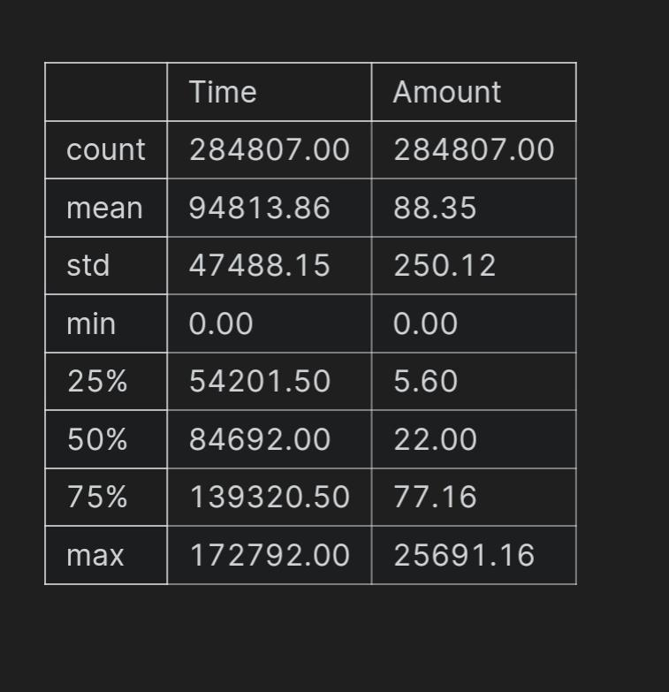

Slide 15
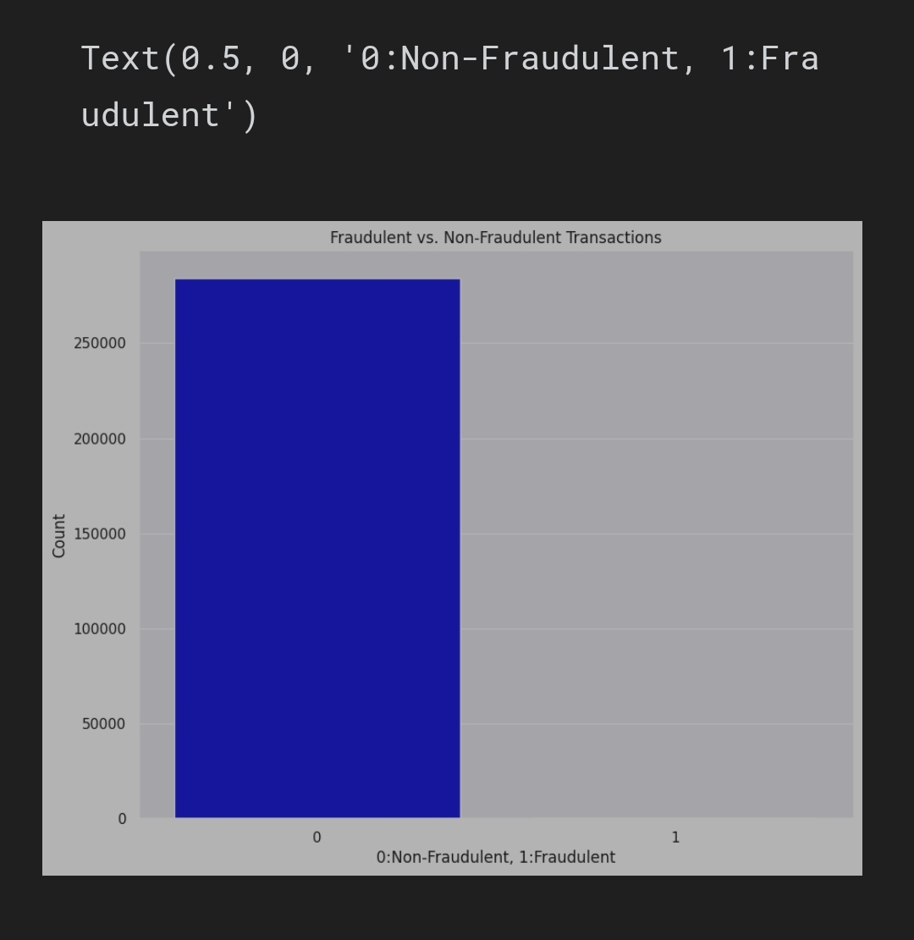

Slide 16
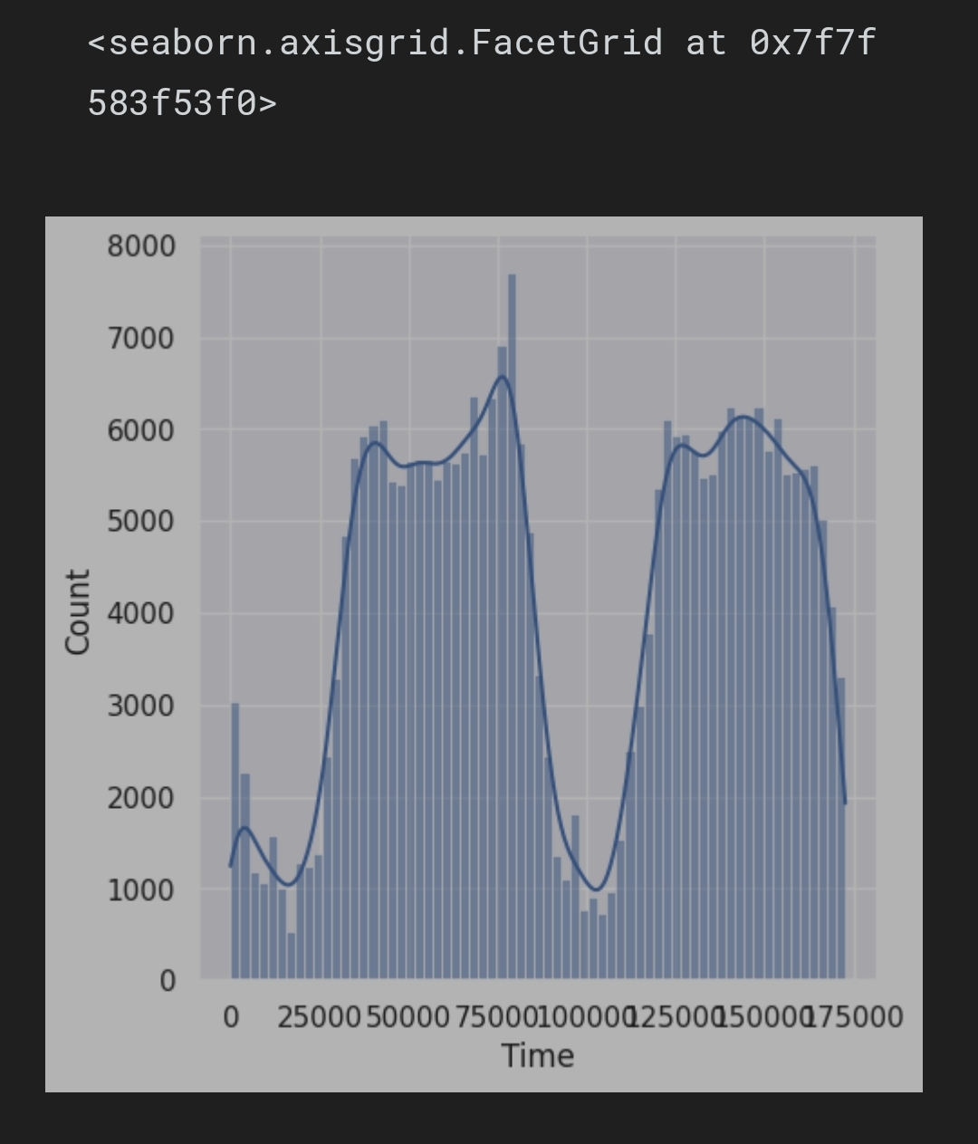

Slide 17
Thank You

