Slide 1
SELF WATERING SMART POT
PRESENTED By:
Sabarrish A G(22AI044)
Sanjay S S(22AI045)
Santhiya S(22AI046)
Guided By : Dr. K. Lalitha
TEAM NO:20
22AIC14 : Internet of Things & It’s Application

Slide 2
Abstract
This paper presents the design and development of a self-watering smart pot integrated with an IoT device to automate plant irrigation.
The IoT device allows users to remotely monitor and control the pot through a mobile or web application, providing notifications and insights about the plant’s health.
The smart pot enhances water efficiency by adjusting irrigation based on environmental condition.
This low-cost, easy-to-use system is suitable for both home gardeners and agricultural applications.

Slide 3
Objectives:
The objective of this project is to create a self-watering smart pot that automatically waters plants based on soil moisture levels.
It will use sensors and an IoT device to monitor plant health and allow users to control and track watering remotely through a mobile or web app.
This project aims to simplify plant care for users while promoting sustainability and reducing the need for manual watering.
The goal is to make plant care easier, save water, and ensure plants stay healthy without constant manual watering.

Slide 4
Components Required:
ESP8266 NodeMCU
Capacitive soil moisture sensor
DHT11 sensor module
L293d motor driver/ relay
5v mini water pump
Hose
7.4 volt battery
Female header pins
1N4007 diodes
Common PCB

Slide 5
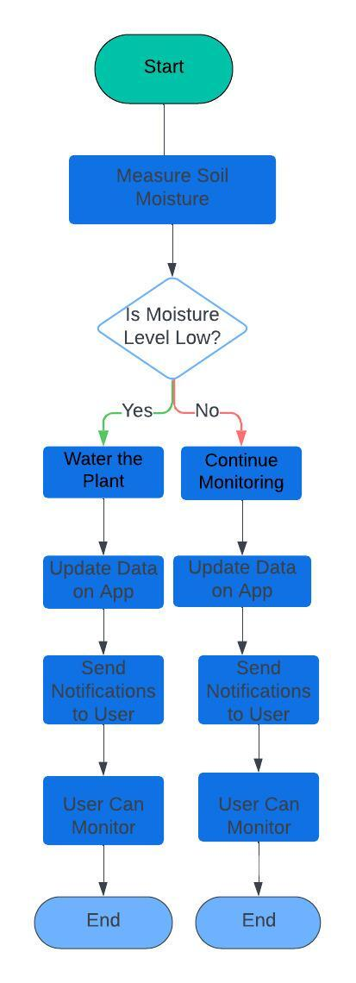
Flow Diagram:

Slide 6
Implementation:
Hardware
For a self-watering smart pot, you would have physical sensors installed to monitor soil moisture levels and water availability.
Hardware components then transmit this data to a central control system or app, allowing for automatic watering adjustments based on the plant's needs.
Software
The software for a self-watering smart pot would include a app that displays real-time data from the sensors, such as soil moisture levels and water reservoir status
It would also feature controls for adjusting watering schedules and settings, notifications for when the water level is low or if maintenance is needed

Slide 7
THANK YOU

