Slide 1

ME PROJECT PRESENTATION
Nellai Green & Civic
Civic complaint management
with authority email alerts
N
Report. Notify. Respond. Verify.
OUR NELLAI
OUR RESPONSIBILITY
PRESENTED BY
Santhiya M
Register No.: 952825405014
M.E. CSE — Final Year
SCAD College of Engineering & Technology
SANTHIYA M / M.E. CSE, FINAL YEAR / SCAD COLLEGE OF ENGINEERING & TECHNOLOGY
01
Notes:
Good morning. I am Santhiya M, register number 952825405014, a final-year M.E. Computer Science and Engineering student at SCAD College of Engineering & Technology. My project is Nellai Green & Civic. This localhost prototype manages complaints and sends authority alerts. Gmail accepted test NGC-063524AD on 7 October 2026; inbox arrival is checked separately. The ZIP supports a Python 3.12 setup on Windows, Linux and macOS. AI classification is a future extension.

Slide 2
01 / PROBLEM DEFINITION
A report should start a response.
Design problem: civic reports and environmental participation need one traceable workflow.
01
02
03
Scattered reporting
Unclear responsibility
Missing closure
A concern needs a location, evidence, category and a clear record.
Routing should follow configured teams and jurisdictions.
A status change should be supported by evidence and citizen feedback.
Project response: a shared, auditable platform that connects reporting with action and community care.
SANTHIYA M / M.E. CSE, FINAL YEAR / SCAD COLLEGE OF ENGINEERING & TECHNOLOGY
02
Notes:
Describe the problem as the motivation for this design. Do not claim measured failure rates or comparisons with government systems; no such study was conducted.

Slide 3
02 / AIM & OBJECTIVES
One core platform. Several community outcomes.
Capture civic and environmental issues with photographs and location.
Assign responsibility using configurable rules and working-day deadlines.
Track evidence, escalation and citizen verification.
Support volunteers, tree records and water observations.
Automatically queue authority email alerts for every new complaint.
SANTHIYA M / M.E. CSE, FINAL YEAR / SCAD COLLEGE OF ENGINEERING & TECHNOLOGY
03
Notes:
Emphasize accountable workflow and extensibility. Environmental modules demonstrate how the same core can support additional use cases.

Slide 4
03 / IMPLEMENTED SCOPE
A focused, working localhost demonstration.
A complete complaint workflow with an administrator email outbox; no sensor hardware is required.
Citizen portal
Authority workspace
Administrator controls
Register, report, track, verify and manage the account.
Assigned issues, progress updates and resolution evidence.
Teams, calendars, rules, modules and complaint review.
GIS & environment
Community participation
Authority email outbox
Clusters, heatmap, trees and water-resource layers.
Volunteer profiles, activities and capacity-aware joining.
Automatic alerts, message previews and delivery status.
SANTHIYA M / M.E. CSE, FINAL YEAR / SCAD COLLEGE OF ENGINEERING & TECHNOLOGY
04
Notes:
Explain that records are actually persisted and roles are enforced through the API. Seeded records are synthetic and labelled. AI and sensors are not simulated as real predictions.

Slide 5
04 / TECHNOLOGY SELECTION
Open technologies, clear responsibilities.
Layer | Technology | Responsibility
Web interface | React + TypeScript | Role-based views, forms and reusable components
API and services | Python + FastAPI | Validation, authentication and complaint workflow
Persistence / GIS | PostgreSQL + PostGIS | Records, distance lookup and geographic boundaries
Maps | Leaflet + OpenStreetMap | Interactive layers, clustering and heatmaps
Development / tests | VS Code, pytest, Playwright | Local run tasks, API and browser verification
SQLite is available as an easier local adapter; PostGIS is used for the prepared demo.
SANTHIYA M / M.E. CSE, FINAL YEAR / SCAD COLLEGE OF ENGINEERING & TECHNOLOGY
05
Notes:
These are implementation choices, not claims of novel algorithms. Official technology references are listed at the end of this presentation.

Slide 6
05 / SYSTEM ARCHITECTURE
A modular monolith with API boundaries.
Citizen
Authority
Administrator
REACT WEB APPLICATION → REST API /api/v1
CORE PLATFORM
MODULE REGISTRY
Auth · RBAC · Workflow · GIS · Notifications · Audit
Green · Volunteer · Water · Flood
POSTGRESQL + POSTGIS
Email + escalation worker
SANTHIYA M / M.E. CSE, FINAL YEAR / SCAD COLLEGE OF ENGINEERING & TECHNOLOGY
06
Notes:
Every diagram element is editable. Explain that one API owns transactions, while a separate worker checks deadlines. The modules share core services and the database through documented interfaces.

Slide 7
06 / ROLES & PERMISSIONS
Access follows responsibility.
Action | Citizen | Authority | Administrator
Submit a report | Yes | Yes | Yes
View private complaint details | Own reports | Assigned team | Managed reports
Assign team / correct category | No | No | Yes
Update and resolve | No | Assigned team | Yes
Verify resolution | Reporting citizen | Only own reports | Only own reports
Configure modules / calendars | No | No | Yes
Staff role grants require a super administrator. Public maps omit contact details and private photos.
SANTHIYA M / M.E. CSE, FINAL YEAR / SCAD COLLEGE OF ENGINEERING & TECHNOLOGY
07
Notes:
This matrix is enforced at API level, not just by hiding browser buttons. Resolution verification is restricted to the original reporting citizen, even when the caller is an administrator.

Slide 8
07 / DATA MODEL
A traceable record behind every action.
USERS
COMPLAINTS
AUTHORITIES
UPLOADS
EVENTS + ESCALATIONS
RULES + CALENDARS
Email outbox + audit trail | Optional records: trees · volunteers · water · gauge readings
SANTHIYA M / M.E. CSE, FINAL YEAR / SCAD COLLEGE OF ENGINEERING & TECHNOLOGY
08
Notes:
Foreign keys preserve references. A dedicated complaint_emails table holds pending, sent or failed authority alerts with attempts and timestamps. Schema changes use Alembic migrations.

Slide 9
08 / COMPLAINT LIFECYCLE
A complaint ends with citizen verification.
01
02
03
04
05
06
07
Reported
Assigned
Acknowledged
In progress
Resolved
Verification
Closed
Not resolved? Citizen reopens → In progress
Resolution requires a description, photograph, timestamp, location and responsible user.
SANTHIYA M / M.E. CSE, FINAL YEAR / SCAD COLLEGE OF ENGINEERING & TECHNOLOGY
09
Notes:
The resolve endpoint records RESOLVED and VERIFICATION events in the same transaction. Rejection is a separate administrator decision with a recorded reason. This demo does not insert a fake AI-analysis stage.

Slide 10
09 / AUTHORITY ASSIGNMENT & ESCALATION
Deadlines follow a configured working calendar.
Category + GPS + jurisdiction + responsibility rule → responsible team
Example: 3 working days
Escalation policy
Reported: Friday, 18 September 2026
Weekend: Saturday and Sunday
Configured example holiday: Monday, 21 September
Deadline: Thursday, 24 September
1. Reminder at the due check
2. Configured higher team
3. Additional configured levels
The holiday is a test-calendar input, not an assertion about official holidays.
SANTHIYA M / M.E. CSE, FINAL YEAR / SCAD COLLEGE OF ENGINEERING & TECHNOLOGY
10
Notes:
This exact working-day calculation is covered by a test. The worker does not hard-code a government officer. Existing complaints keep a policy snapshot; reopening begins a new escalation cycle.

Slide 11
10 / GIS & DUPLICATE REVIEW
Location informs the response.
01
02
03
Nearby search
Jurisdiction matching
Possible duplicates
PostGIS distance queries use metres and spatial indexes.
A point is matched to configured geographic boundaries.
Same category, within 100 m and seven days; text similarity supports review.
Reports are linked after administrator review. Original reports and evidence are retained.
Public map positions are rounded. Official boundaries and ownership need verified records.
SANTHIYA M / M.E. CSE, FINAL YEAR / SCAD COLLEGE OF ENGINEERING & TECHNOLOGY
11
Notes:
Map layers include clusters and a heatmap. The duplicate score is text similarity, not a trained image model. No report is automatically deleted as a duplicate.

Slide 12
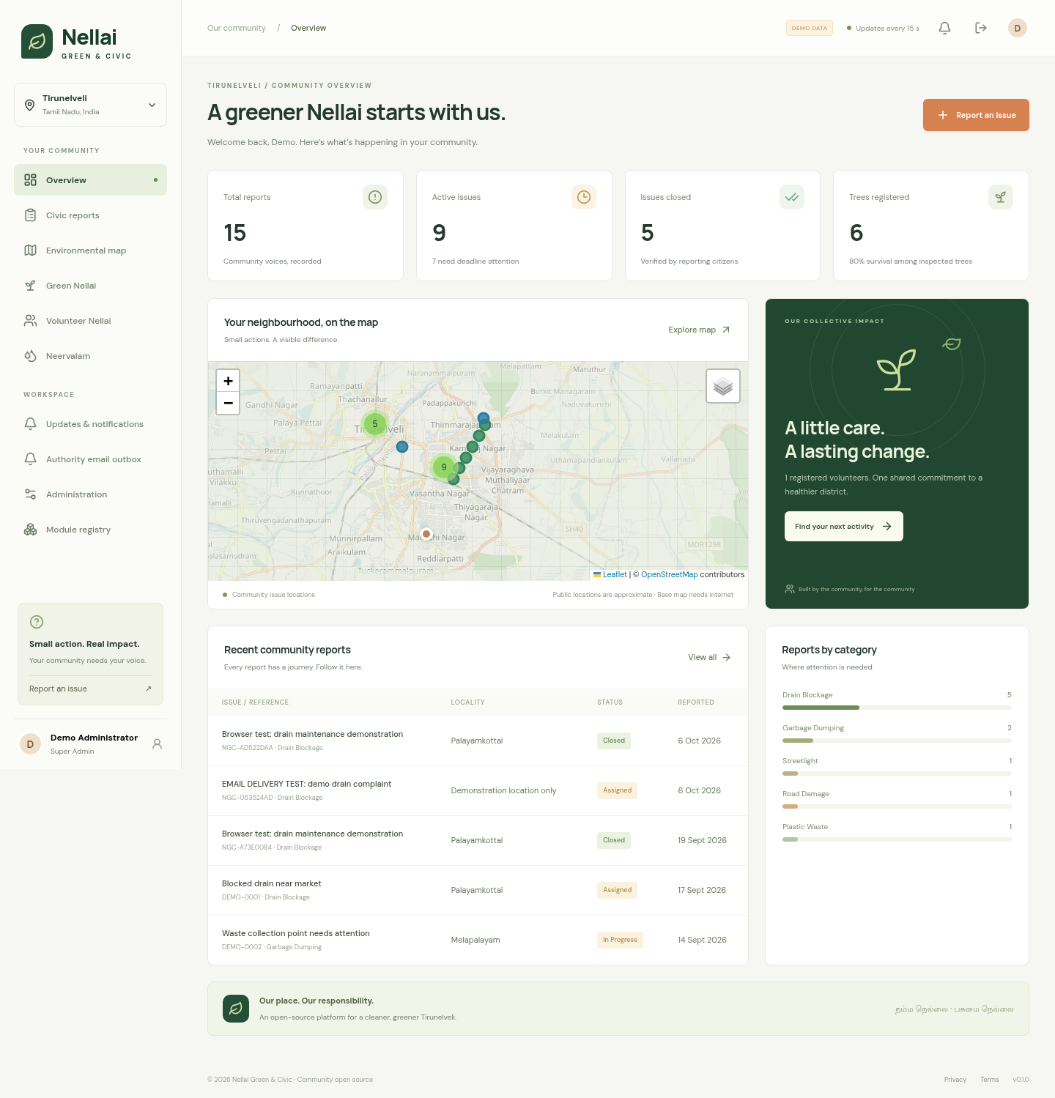
11 / LIVE APPLICATION SCREENSHOT
The working dashboard.
Actual screenshot from the running local demo; all shown records are demonstration data.
A shared overview
Report counts
Open and closed issues
Registered trees
Neighbourhood map
Category distribution
SANTHIYA M / M.E. CSE, FINAL YEAR / SCAD COLLEGE OF ENGINEERING & TECHNOLOGY
12
Notes:
Use this screenshot if the live environment is unavailable. The figures are synthetic demo record counts, not research findings or real district statistics.

Slide 13
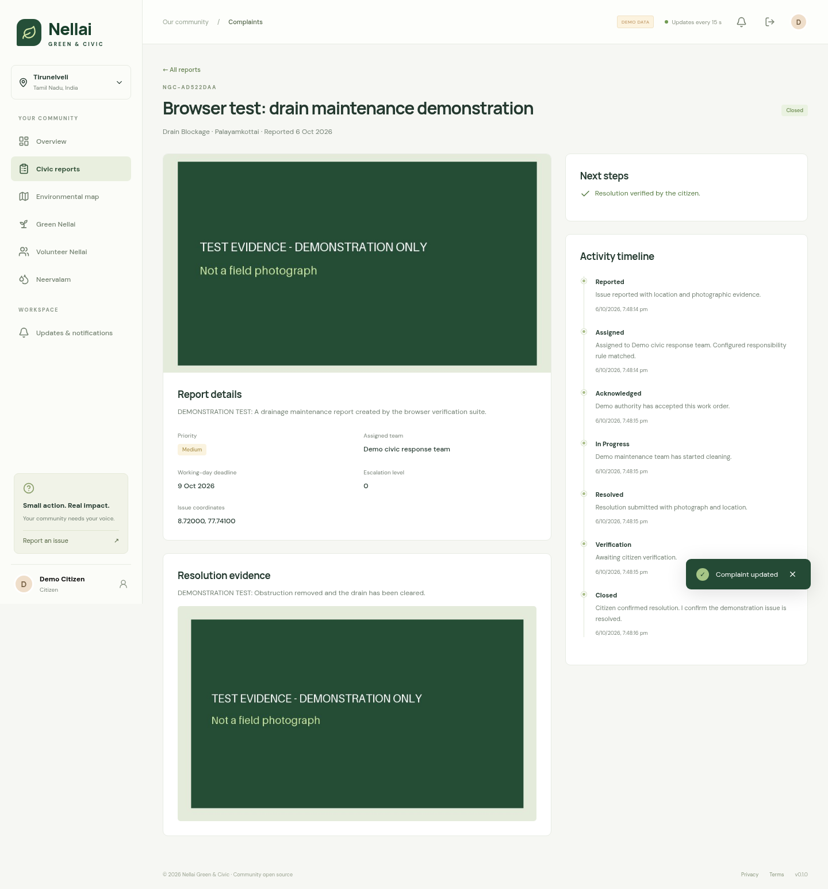
12 / VERIFIED END-TO-END WORKFLOW
Evidence and history stay with the report.
Browser-tested sequence
Citizen uploads a photo
Authority acknowledges
Work is completed
Resolution photo is added
Citizen confirms closure
SANTHIYA M / M.E. CSE, FINAL YEAR / SCAD COLLEGE OF ENGINEERING & TECHNOLOGY
13
Notes:
This is the record created by the Playwright browser test. Explain that the backend separately tests reopening, authorization failures and escalation behavior.

Slide 14
AUTHORITY EMAIL / DESIGN
Every new complaint creates an authority alert.
Complaint submission stays fast because the email is delivered by a separate worker.
1. Save complaint
2. Preview alert
3. Deliver or retry
Report, evidence and an email queue entry are saved together.
The administrator sees the recipient, complaint details and status.
With outgoing mail configured, the worker sends and retries failures.
Recipient for this demo: sandymuthukutti@gmail.com
Verified 7 October 2026: Gmail accepted test NGC-063524AD. Outbox status: SENT.
SANTHIYA M / M.E. CSE, FINAL YEAR / SCAD COLLEGE OF ENGINEERING & TECHNOLOGY
14
Notes:
A complaint creates an outbox entry even without a matched authority. Gmail accepted the labelled test email for sandymuthukutti@gmail.com and the restarted worker also delivered the other queued demo alert. SENT means SMTP acceptance, not proof of inbox arrival. Delivery needs internet and a running worker. Retries stop after five failures. The ZIP excludes the App Password, so a new PC requires private mail setup.

Slide 15
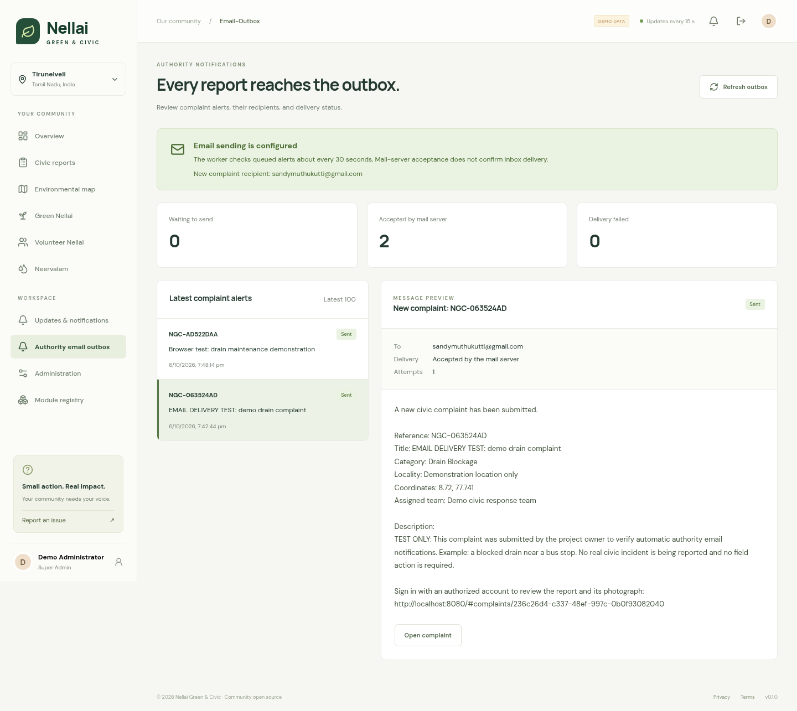
AUTHORITY EMAIL / LIVE SCREENSHOT
The authority email, ready to review.
Actual administrator outbox: recipient, message contents and truthful delivery status.
What to demonstrate
Select the test report
Show the recipient
Read the email details
Explain the SENT state
Open its complaint
SANTHIYA M / M.E. CSE, FINAL YEAR / SCAD COLLEGE OF ENGINEERING & TECHNOLOGY
15
Notes:
Sign in as administrator and open Authority email outbox. The screenshot records the real original-PC SENT state after Gmail accepted the message. Ask the recipient to check Inbox/Spam; do not treat SMTP acceptance as inbox confirmation. On another PC create a new report, because the original database is not included in the ZIP. The preview uses the actual outgoing email formatter.

Slide 16
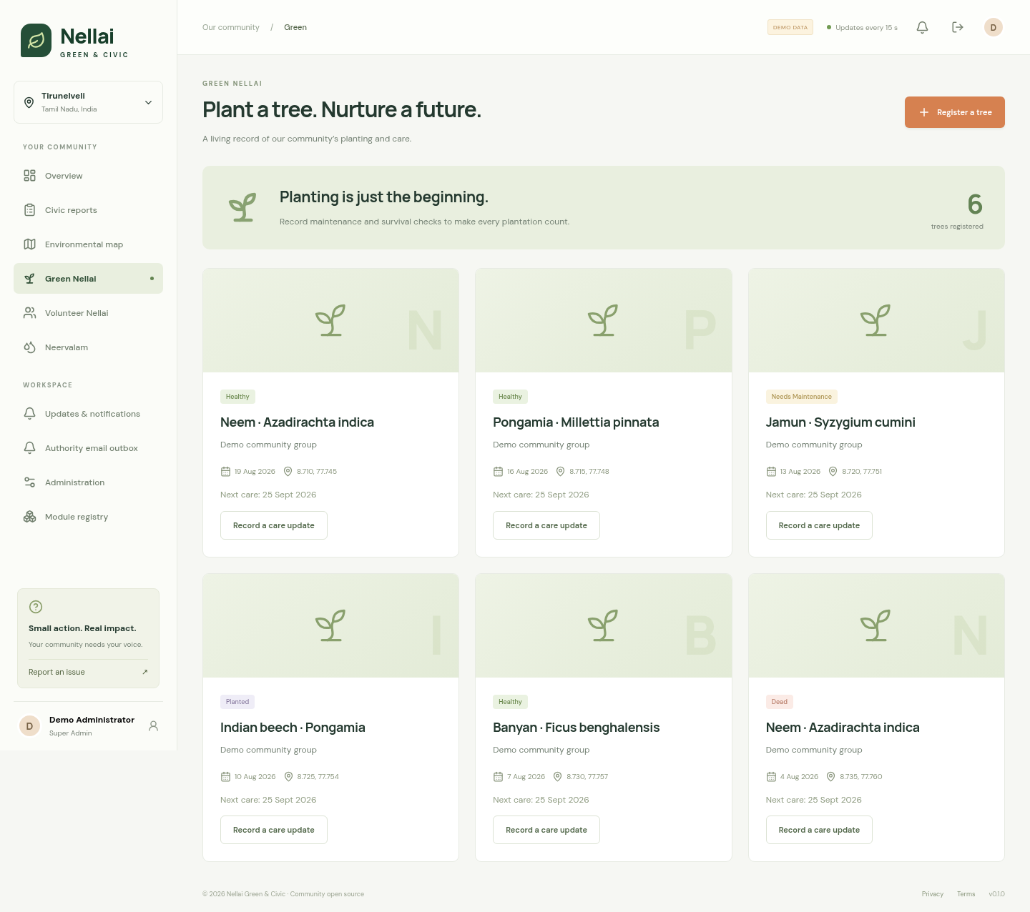
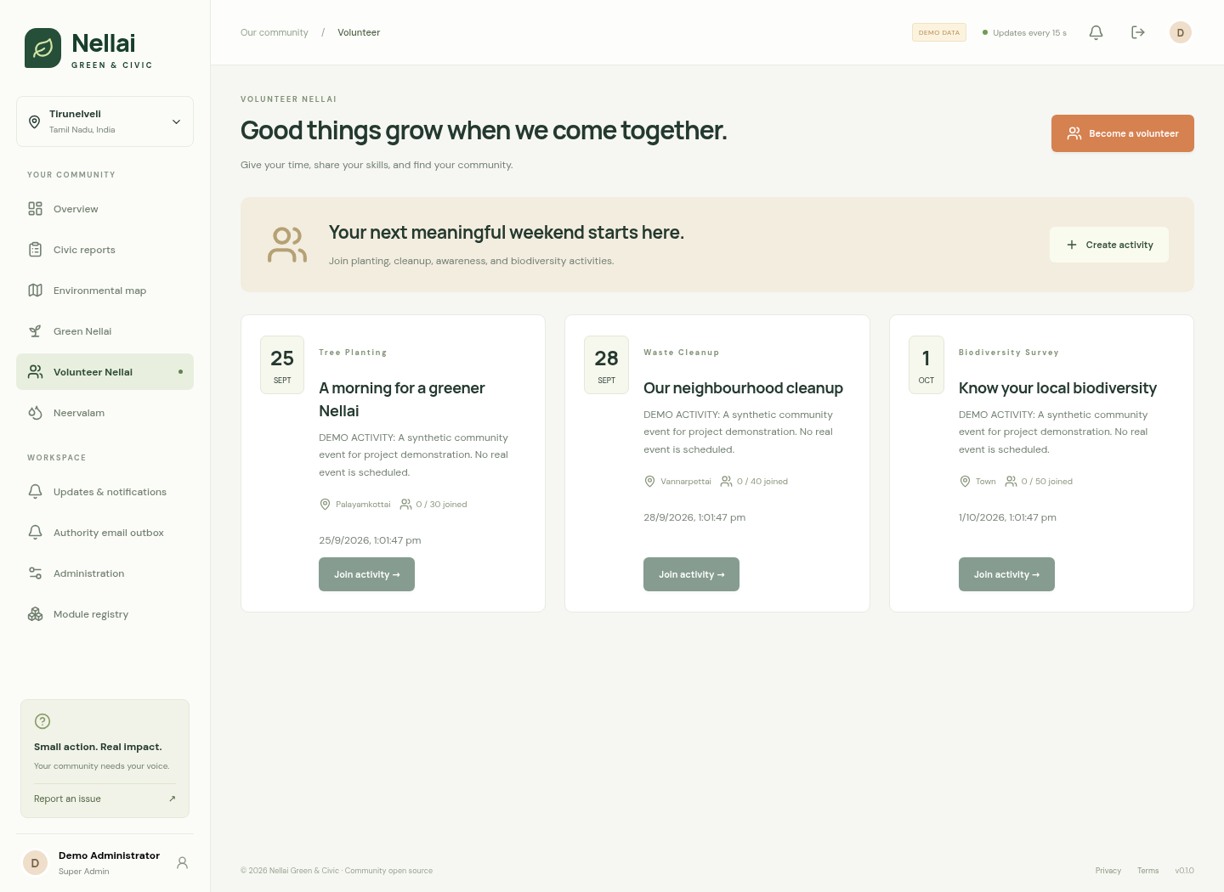
13 / GREEN NELLAI & VOLUNTEERS
From a planting day to a living record.
Trees: species, planting date, coordinates and care status.
Volunteers: profiles, activities and available places.
SANTHIYA M / M.E. CSE, FINAL YEAR / SCAD COLLEGE OF ENGINEERING & TECHNOLOGY
16
Notes:
Survival rates use inspected trees only; newly planted trees are not counted as known survivors. No automatic species recommendation or land ownership claim is made.

Slide 17
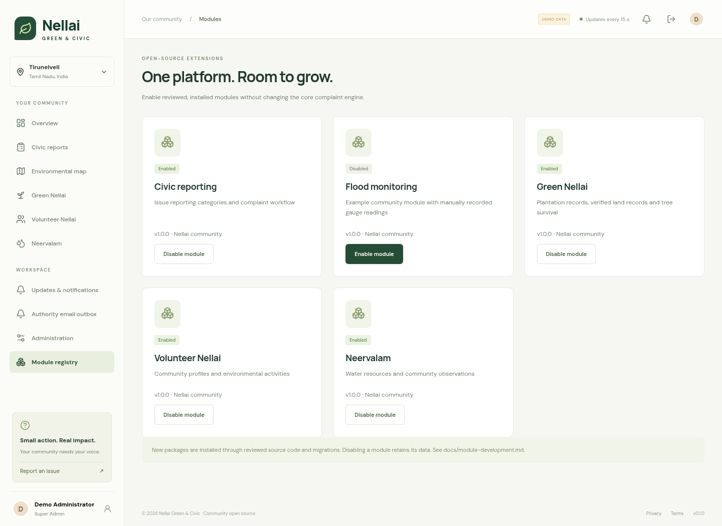
14 / OPEN MODULE ARCHITECTURE
A module can add a new community capability.
MODULE PACKAGE
module.json
backend / API / models
frontend component
database migration
tests + README
SANTHIYA M / M.E. CSE, FINAL YEAR / SCAD COLLEGE OF ENGINEERING & TECHNOLOGY
17
Notes:
Demonstrate enabling the example flood module. It adds a page and APIs for manual gauge readings. It is a reviewed installed source package, not executable code uploaded by anonymous users.

Slide 18
15 / ENGINEERING CONTROLS
Security and privacy are part of the workflow.
Authentication
Authorization
Private evidence
Argon2 passwords; JWT sessions; refresh rotation.
Role and ownership checks on API operations.
Validated images; EXIF removal; authenticated access.
Public-data minimization
Traceability
User choice
No public contact details or private photographs.
Workflow history, audit records and session revocation.
Password-confirmed citizen account deletion.
SANTHIYA M / M.E. CSE, FINAL YEAR / SCAD COLLEGE OF ENGINEERING & TECHNOLOGY
18
Notes:
These are implemented controls, not an independent security certification. Account deletion has documented demo limits for retained operational history. A public rollout needs further review.

Slide 19
16 / VALIDATION RESULTS
Verification with reproducible tests.
Results below are functional checks from this implementation, not field-performance research.
25
3
PASS
API / module tests passed
on PostgreSQL + PostGIS
Browser scenarios passed
workflow + outbox + layout
TypeScript + web build
Python lint + migrations
API checks cover access controls, email retries, pending alerts and private previews.
Workflow tests cover reopening, duplicate linking and escalation idempotence.
SANTHIYA M / M.E. CSE, FINAL YEAR / SCAD COLLEGE OF ENGINEERING & TECHNOLOGY
19
Notes:
Show docs/verification.md if asked. Twenty-five backend/module tests passed on PostGIS. Three browser scenarios cover the full workflow, administration/modules/responsiveness and email outbox; the outbox scenario was repeated after real Gmail acceptance. Do not claim AI accuracy, scalability numbers or government adoption.

Slide 20
17 / PORTABLE DEMONSTRATION
One demo package. Three operating systems.
Extract the ZIP, install Python 3.12, then run the launcher for your PC.
Windows
Linux
macOS
START_WINDOWS.bat
Double-click to set up
and start the demo.
bash START_LINUX.sh
Run from the extracted
project folder.
bash START_MAC.command
Run in Terminal from
the extracted folder.
http://localhost:8080
Built website + SQLite demo data. First setup needs internet; configure Gmail privately on each PC.
SANTHIYA M / M.E. CSE, FINAL YEAR / SCAD COLLEGE OF ENGINEERING & TECHNOLOGY
20
Notes:
Follow RUN_ON_ANOTHER_PC.md. Python 3.12 is required and packages download during first setup. No Node.js or Docker is required for the packaged demo. Fresh demo logins are generated in runtime/DEMO_CREDENTIALS.md. The ZIP excludes original passwords, database and uploaded files. SQLite supports the portable workflow; the original PC uses PostGIS. Gmail and external map tiles require internet. Windows and macOS launchers are supplied but native execution was not available on the Linux build host.

Slide 21
18 / LIMITATIONS & NEXT STEPS
A clear boundary between demo and future work.
Working in this demonstration | Further setup or future work
Human-selected complaint categories | Trained image and text classification models
Configured illustrative teams and boundaries | Verified official datasets and government APIs
Manual water observations and gauge records | IoT sensor feeds and validated flood predictions
Responsive React web interface | Completed Flutter app and store publishing
In-app updates and Gmail SMTP alerts | New-PC mail setup; public deployment; mobile push
Functional local tests | Independent security, privacy and performance reviews
SANTHIYA M / M.E. CSE, FINAL YEAR / SCAD COLLEGE OF ENGINEERING & TECHNOLOGY
21
Notes:
This slide is essential: explain honestly what is implemented. The user chose a simple local demo rather than a Play Store project. No fake external system or AI output has been added.

Slide 22
19 / REFERENCES
Technology references & reproducibility.
FastAPI security and API documentation
https://fastapi.tiangolo.com/tutorial/security/oauth2-jwt/
PostGIS spatial distance queries
https://postgis.net/docs/ST_DWithin.html
React documentation
https://react.dev/learn
Leaflet documentation / OpenStreetMap attribution
https://leafletjs.com/reference.html | https://www.openstreetmap.org/copyright
Source, verification, and demo steps
README.md · docs/verification.md · docs/demo-guide.md
SANTHIYA M / M.E. CSE, FINAL YEAR / SCAD COLLEGE OF ENGINEERING & TECHNOLOGY
22
Notes:
These are technology documentation references. A separate academic literature survey can be added by the student if required by the college; no papers or research results are fabricated in this deck.

Slide 23
THANK YOU
Our Nellai. Our responsibility.
One report. A clear owner.
A verifiable resolution.
Nellai Green & Civic
Questions & live demonstration
SANTHIYA M / M.E. CSE, FINAL YEAR / SCAD COLLEGE OF ENGINEERING & TECHNOLOGY
23
Notes:
Invite questions. Be ready to show the live workflow, module manifest, API docs, tests, or the working-day calculation.

