Slide 1
KEC_AI_BRIGHTRED@DRAVIDIANLANGTECH 2025: MULTIMODAL HATE SPEECH DETECTION IN DRAVIDIAN LANGUAGES
AUTHORS
Kogilavani Shanmugavadivel
Malliga Subramanian
Nishdharani P
Santhiya E
Yaswanth Raj E

Slide 2
GOALS
To detect hate speech across Tamil, Telugu, and Malayalam languages using both text and audio data.
To enhance classification accuracy through feature fusion and optimized model selection.
To participate in the DravidianLangTech@NAACL 2025 shared task on multimodal social media analysis.

Slide 3
DATASET DESCRIPTION
Source: Social media platforms.
Languages: Tamil, Telugu, Malayalam.
Modalities: Text and Audio
Two main classes: Hate and Non-Hate.
Hate subclasses: C (Personal defamation), G (Gender), P (Political),
R (Religious).

Slide 4
METHODOLOGY
Cleaned and normalized both text and audio data.
Trained multiple models for each modality.
Random Forest achieved the best performance for text, and CNN outperformed others for audio data.
Combined predictions from Random Forest (text) and CNN (audio) for final classification, evaluated using accuracy, precision, recall, and F1 score.

Slide 5
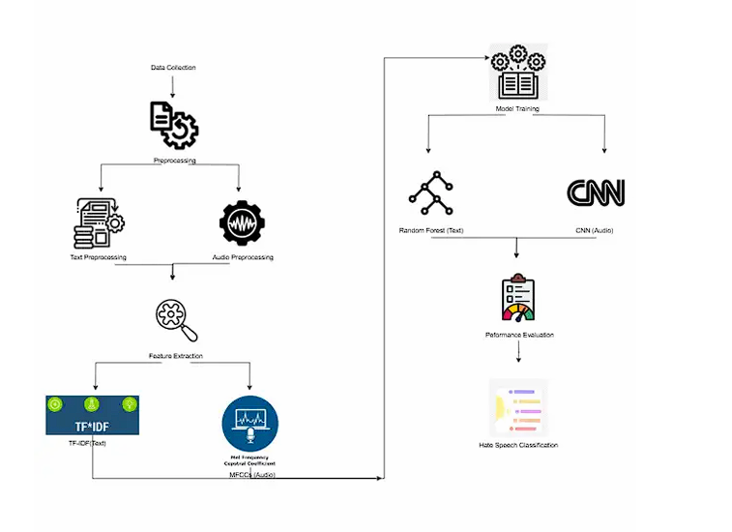
FLOW DIAGRAM

Slide 6
RESULTS
The Random Forest model effectively captured semantic features for text, achieving high accuracy, while the CNN model extracted key features from audio signals, also yielding high accuracy.
Complex models (Capsule, BiLSTM, ConvLSTM) showed overfitting and lower generalization.
Fusion strategy can be enhanced using transformer-based approaches.
Low F1-scores in final evaluations highlight need for better optimization and feature alignment.

Slide 7
CONCLUSION
The paper successfully demonstrates that model fusion using Random Forest (text) and CNN (audio) improves hate speech detection in Dravidian languages.
Simpler models (like RF and CNN) outperformed more complex deep learning models in this multilingual, multimodal setup.
Future work can focus on transformer-based fusion, larger datasets, and end-to-end multimodal architectures.

